Slide 1
Arizona Project WET
Water Festival Unit
2024-2025

Slide 2
WATER FESTIVAL
UNIT
GUIDING QUESTIONS:
Where is Arizona’s water?
What are the connections between people, water, and heat in the environment?

Slide 3
WATERSHEDS & SUSTAINABILITY: Lesson 4
We all have a role:
The quality of water in a river or lake is influenced by both natural factors and how people use the land around it.
Everyone is responsible for the health of the watershed and the water systems within it.
Our actions, good or bad, have an impact on our water supply.

Slide 4
WATERSHEDS & SUSTAINABILITY: Lesson 4
It All Adds Up
Investigative Questions
How do contaminants/pollutants travel downstream?
What are the ways that pollution in a watershed is reduced or prevented?

Slide 5
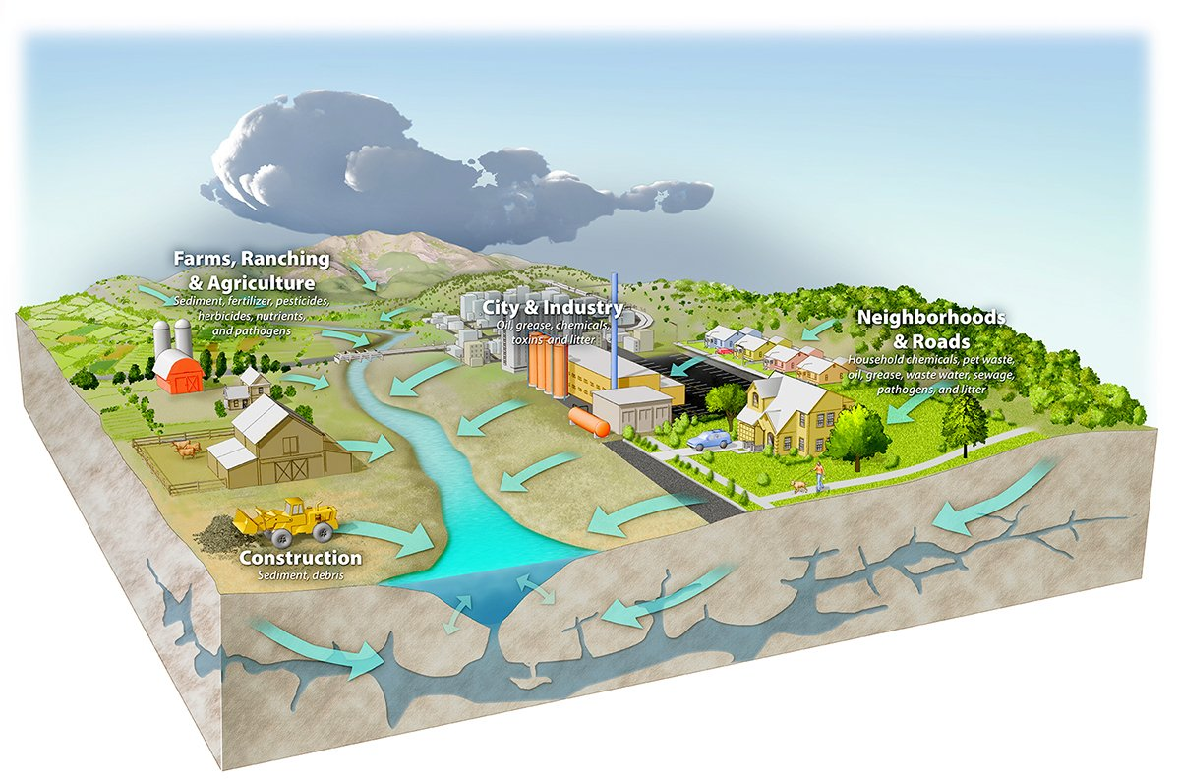
WATERSHEDS & SUSTAINABILITY: Impacting Water
Someone is always downstream
The choices people make and the pollution they create upstream can affect communities and ecosystems downstream.
When tracking water quality we focus on two main categories of pollution.
Notes:
Now that we understand how watershed work, we know that water connects us all.
Do you know what those two types of pollution are?
Do you think the most influential neighborhoods are upstream or downstream.

Slide 6
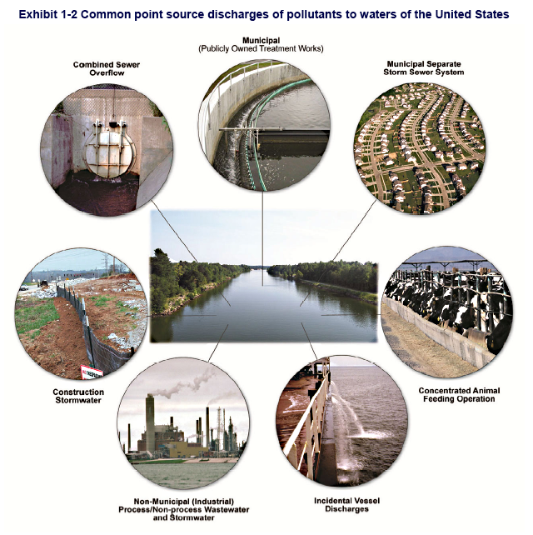
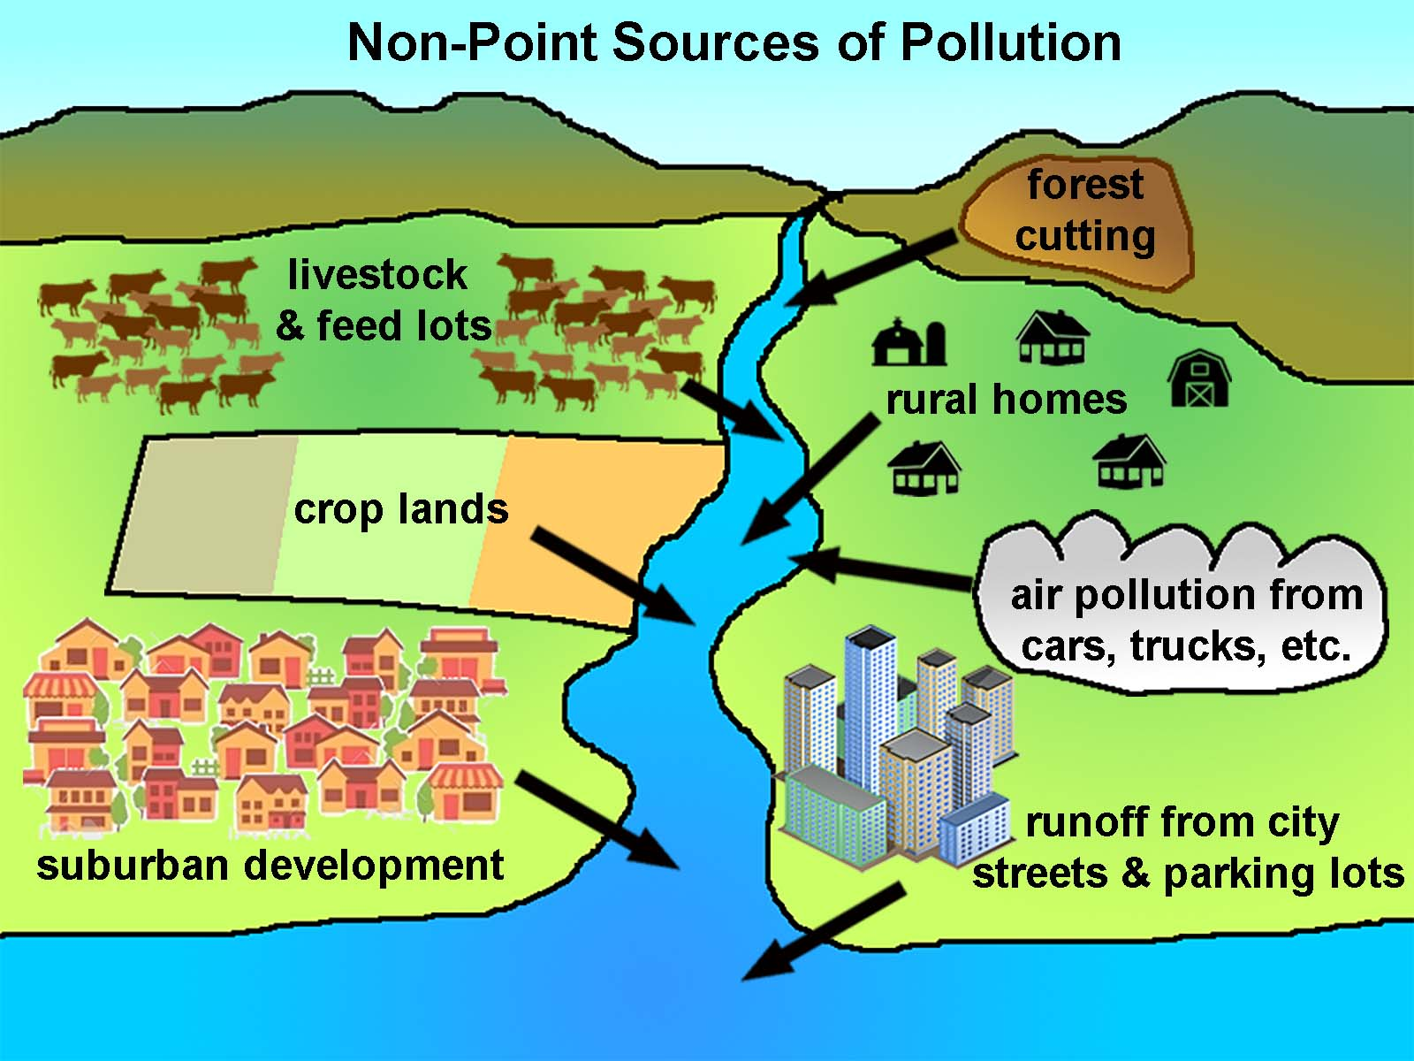
Point Source
Nonpoint Source
Nonpoint pollution is harder to track as it can come from different places. These pollutants could result from agriculture, transportation, industry, or runoff.
Point pollution comes from a specific place, like a factory’s pipe or a sewage drain. It is easier to monitor and we have laws to protect against it.
Notes:
Both types of pollution can be carried by surface runoff and groundwater, which makes it harder to know the source. It is also harder to protect water from nonpoint source pollution because it comes from many different places, and is often hard to hold one person/party responsible.

Slide 7
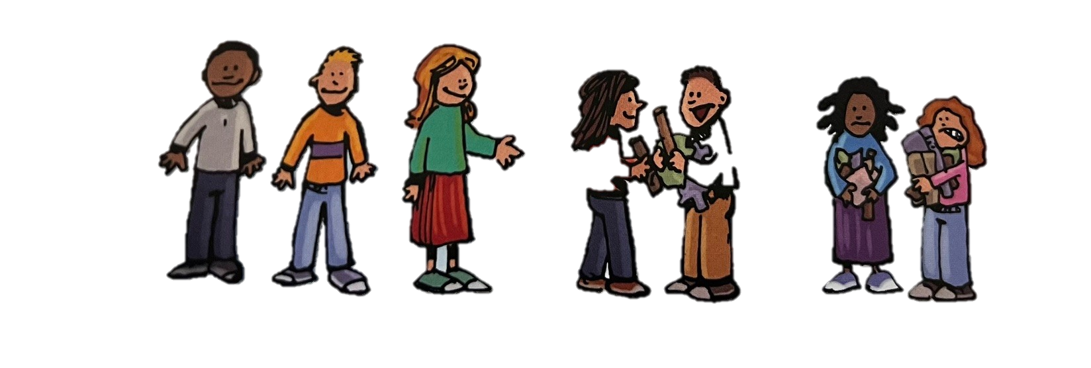
WATERSHEDS & SUSTAINABILITY: Impacting Water
The Activity:
Students develop a plot of waterfront property then learn how everyone can prevent pollution entering a river by identifying the pollution emitted from their property.
Then students get Best Management Practices and discuss how to reduce and prevent pollution from entering waterways.
Notes:
Explain activity from book
Best Management Practices are techniques that everyone can use to help keep as much storm water as possible out of our storm drains and sewers. Some of these Practices can be implemented by City Water Managers, and many of these are “low-impact” and can be done by everyday people living on the land.

Slide 8
Check out Green Stormwater Infrastructure
Notes:
Click on link - https://storymaps.arcgis.com/stories/b9c35f205ea14015a23b446ff75eeeb4
And at bottom of the page you can click through green stormwater infrastructure examples with your class for solutions we can implement in our community to reduce pollution runoff and mitigate urban heat.
What messages do you think are being sent to the people living in each community…? Which one would you rather live in and why?

Slide 9
Lesson 4
Wrap-Up
Systems and System Models
&
Cause and Effect
Understanding the different sources of pollution allows us to make better choices and choose better practices that can help reduce and prevent pollution.
Can everyone contribute to and be responsible for good water quality?
Notes:
Have class discussion or small group chats about BMP and how people impact the land and the flow of water.
Human water use affects where water is stored and how water moves. We redirect rivers, sometimes build dams, we drain water from wetlands for development. We cover the surface of the land with impermeable materials which changes the flow and speed of water. It also changes where the water ends up in the water cycle. Within an urban environment we often in crease the runoff within a watershed which often also increases the pollutants in the water, which decreases our water quality. We will focus on how to become better watershed managers in future lessons.

