Slide 1

Build Your Own Groundwater Model
Notes:
TEACHER NOTE: This presentation was originally designed to be presented virtually. If you are in the classroom, feel free to modify delivery to suit your needs. Or consider having APW Educators deliver this presentation to your class in person with student models.
Using University of Arizona, Arizona Project WET materials, we’re going to learn about the groundwater system.
If virtual, let’s start off by making sure our computers are set up for the best participation.

Slide 2

Ground Rules
Only unmute when called on
Use the chat respectfully
Cameras on for more fun!
Participate
Notes:
Slide is for a virtual presentation
And, some ground rules for our presentation today:
Only unmute when called on.
Use the chat respectfully
Cameras on for more fun!
Participate.

Slide 3


Does water move through earth materials?
Let’s do an experiment…
Notes:
We’re going to start off today by doing an experiment. Let’s go see our friend Liam and see if he can help us figure out if water moves through earth materials.

Slide 4
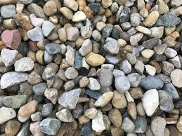
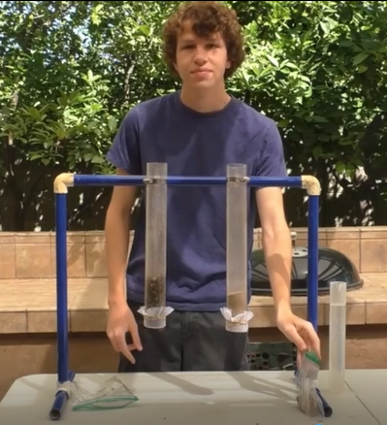
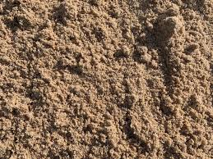

Ask yourself:
Will water move through the gravel?
Liam will be comparing
gravel and sand
in earth material tubes. What will the water do?
Notes:
Liam will be working with gravel and sand in earth material tubes. He wants to know if water will move through gravel. What do you think?

Slide 5

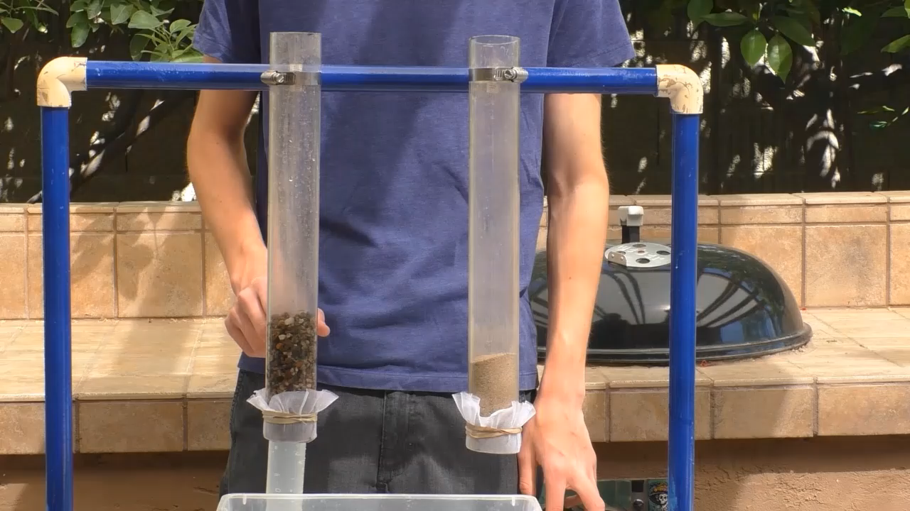
Will the water move through the gravel?
Just say it!
Notes:
((REFERENCE-Script from video …”If you answered Yes, how long will it take for all the water to come out the bottom”))
RUN VIDEO
Let’s make a prediction. How long do you think it will take for water to move through gravel...or won’t it go through?

Slide 6

If so, how long will it take for the water to get out?
Just say it!
Notes:
((REFERENCE-Script from video …”If you answered Yes, how long will it take for all the water to come out the bottom”))
RUN VIDEO
Let’s make a prediction. How long do you think it will take for water to move through gravel...or won’t it go through?

Slide 7
Let’s test this…
Notes:
Wow! It only took about 3 seconds for the water to flow through the gravel.

Slide 8
Will the water move through the sand?
If so, how long will it take?
Just say it!
Notes:
How long will it take for water to move through sand?

Slide 9
Let’s test it out!
Notes:
((REFERENCE video script: “We will time how long it takes to come out of the bottom…..This is so interesting. What do you observe? Is the water ever going to pass through the sand? Yea! It did!”))
Let’s see what Liam found out….
Well it seems Liam discovered it took about 15 seconds for the water to flow through the sand.
Let’s see how everyone did on their guesses!

Slide 10
Does water move through earth materials?
What did our experiment show?
YES!!
Does water move through earth materials at the same rate?
No!!
Notes:
So what did we learn from Liam?
Does water move through earth materials? YES!!
Does water move through earth materials at the same rate? NO!!
WHY ??

Slide 11

Why do you think water moves faster through gravel than through sand?
Raise your hand!
Notes:
If virtual, type in the chat why you think that water moved faster through the gravel than the sand? Or maybe some brave person can raise their hand and explain why water moves faster through gravel than sand.
NOTE: Make sure the students understand the water is moving through the SPACES between the earth materials.
Great job everyone. So by watching Liam’s experiments, we know that water moves through the spaces in the earth materials.

Slide 12
How Does the Groundwater System Work?
Let’s use our models...
Notes:
Now we’re going to work with our GW models. A model is usually a smaller version or representation of something larger. In our case, our model represents the groundwater system which covers a distance of 50 miles across and is hundreds of feet deep.
Does everyone have their materials for a model? Great. Let’s get started.

Slide 13
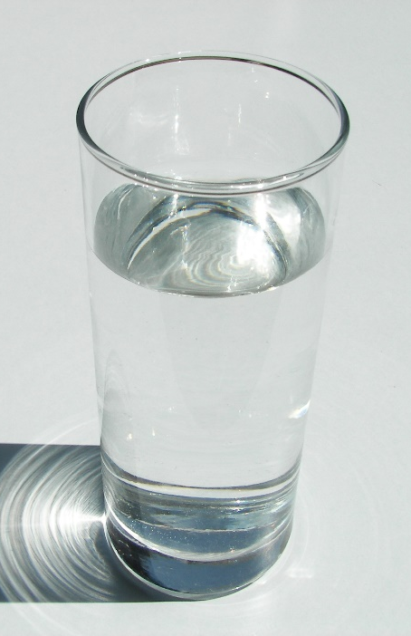
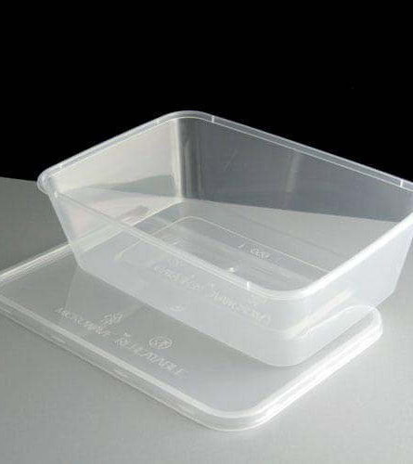
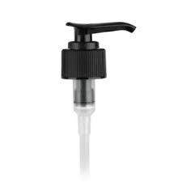
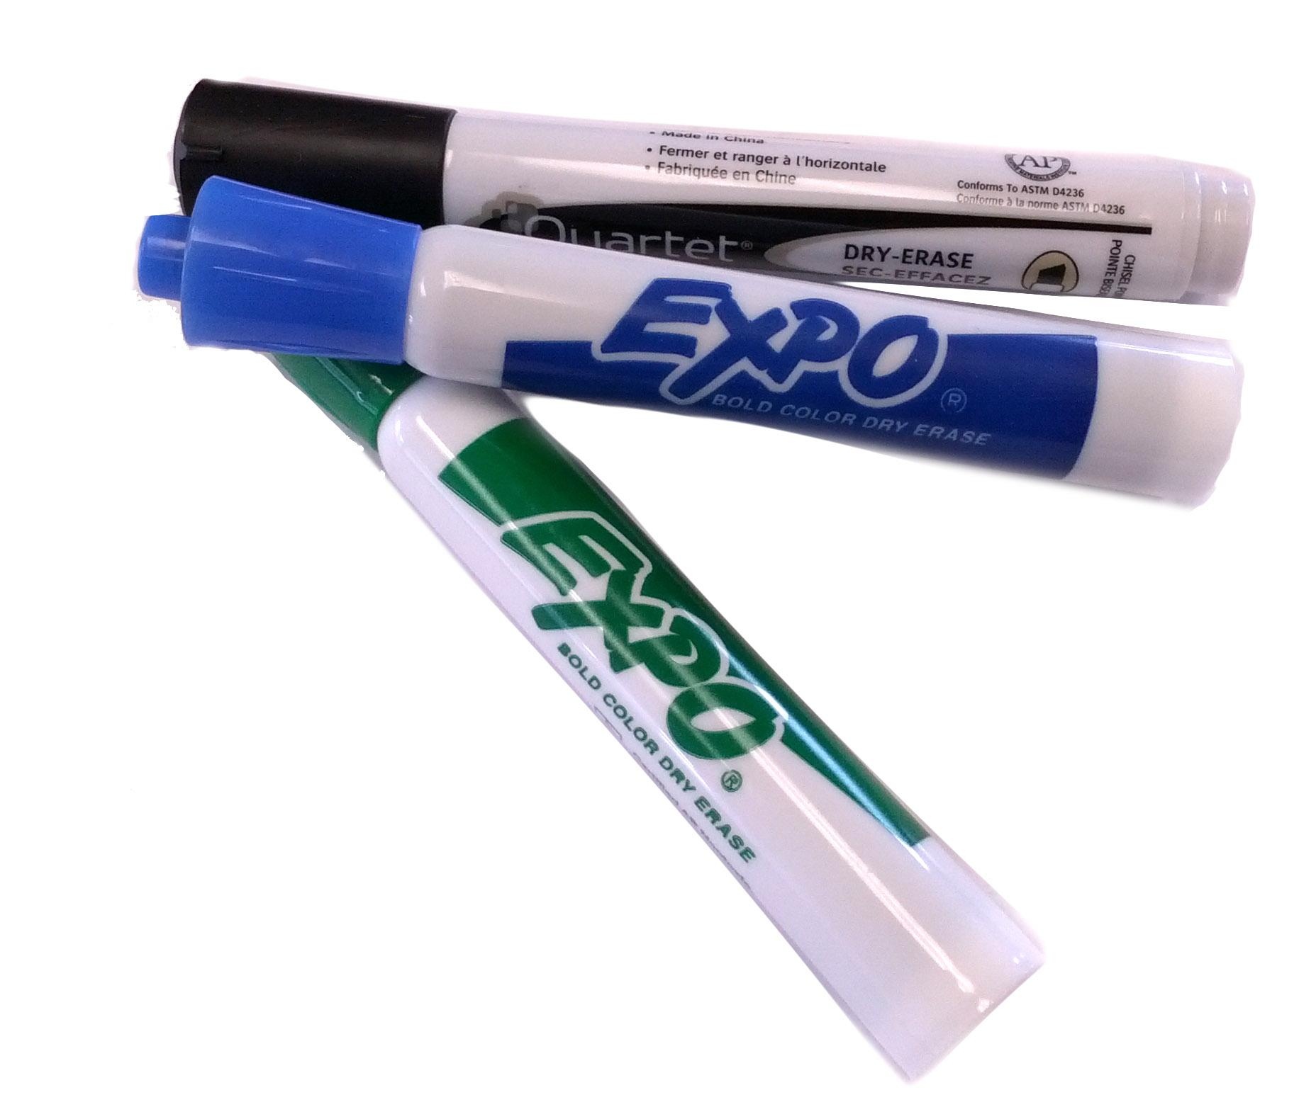
You will need…
This Photo by Unknown Author is licensed under CC BY-SA-NC
See-through container
Gravel or sand
Pump from soap bottle
Water
Dry erase marker
Notes:
As a refresher, you should have gotten these supplies ready… If you have a dry erase marker, that may be helpful but not necessary.
NOTE: Move forward even if some students aren’t ready.

Slide 14
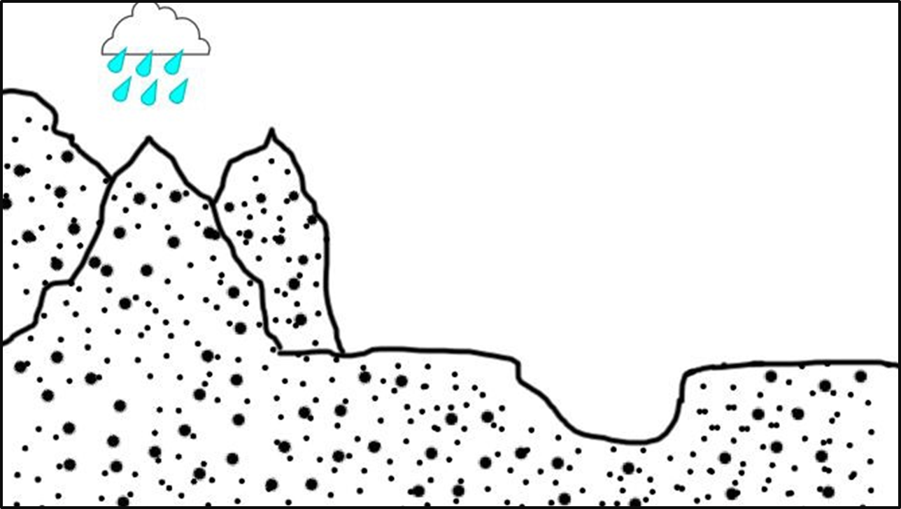
2-D Picture Model
Notes:
We’re also going to work with this 2D picture model of the GW system. This picture should look very familiar from your Pre-assessment. Pay close attention to these images as you’ll see them again on your Post Assessment after class.
Let’s set up our model. Go ahead and pour your gravel into your container.
Do we have anything in our 3D model that represents mountains at this time? (No). Ok. Let’s create a mountain by using our hand to slope the dirt up to one side of the container.
If virtual: I’m going to switch to my web camera so you can see my model and follow along.
(Switch to your web cam and stop sharing presentation to view both camera and students. If in Zoom, spotlight your video)
Ok, first thing we’re going to do is simply move our earth materials up to one side of our container. By doing this we create a high point, our mountain, and a low point. Has everyone got their mountain created? Ok. Let’s have everyone turn on their cameras and show us their mountains. Ooo..those mountains look great!
Ok. Great. I’m switching back to the presentation and picture model to make a couple of points. (Share screen - presentation mode)
Let’s relate this 2D picture model to our 3D model. What do the black dots represent in the picture model? (dirt or earth materials)
Great job.
Remember, our model represents an area 50 miles across and several hundred feet deep.

Slide 15
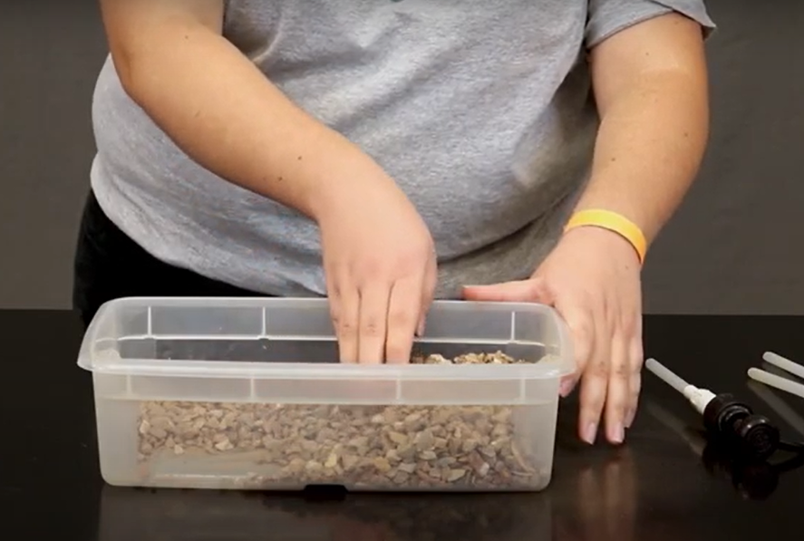
Create a mountain in your model
High point
Low point
Notes:
For those of you without models, this is what yours might look like at this point. We have a high point - our mountain. And our low point down here.
Does everyone’s model look like this now? Great.
(Stay on Presentation mode)

Slide 16
How does water get into the ground?
Raise your hand!
Notes:
So looking at this picture, how do you think water gets into the groundwater system? Type your answers into the chat box. (from rain)
(If they don’t get the answer ask…)
Excellent, yes. From the rain.
And where does it rain first around here? (pause) Where is it raining in our picture model? Yes. It rains first up in the mountains. Great.
Now we’re all going to make it rain on our mountains and watch what happens in our model.

Slide 17
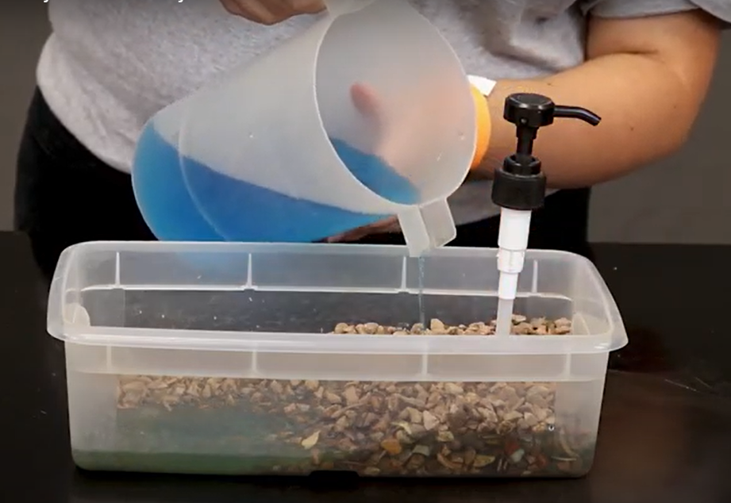
Make it rain on your model….
Notes:
NOTE: Do this together with students using your webcam and model.
So I’m going to switch back to my webcam so we can work together again.
For our friends who don’t have models, watch what is happening when it rains on my model and type what you see in the chat box.
Everyone else with models, watch what happens when you make it rain on your mountains. Watch the model from the top and from the side too!
Now we’re all going to make it rain on our mountains and watch what happens in our model. Take your container of water and pour it slowly ONLY OVER THE MOUNTAINS. Pour enough water into your model so there is water in the low spot. Be sure to watch what happens to your model as the rain is falling.
Our friends who don’t have models,what are you seeing happen in my model? Please type your observations in the chat box.
(Read chat box responses)
What did you notice when it rained on the mountains? (Read chat entries first)
What DIRECTION did the rain flow first? (it flowed down.) Perfect, yes the rain flowed down.
What caused the water to flow down? (gravity) Or what force acted on the water to make it flow down? (gravity)
Yes! And then where did it flow? (across the model)
Great job everyone.
I’m going to switch back to the presentation for a moment. Let’s see this in action on our 2D model.

Slide 18


How Does Water Get Into the Groundwater System?
Raise your hand!
Notes:
((This slide is animated - 5 clicks)
So here we see water raining on the mountain. Water is flowing down by gravity and moving between the spaces in the earth materials, soaking into the ground and filling up the low spots.

Slide 19

Groundwater moves through spaces between the earth materials.
Notes:
If we magnified those spaces, it might look like this. This picture best shows that water is found in the space between the earth materials. This is what we observed during our earth materials experiment with Liam earlier. Water flows through all those spaces in the earth materials.
NOTE: This is called out on the assessment so important to mention.

Slide 20
Low points in the ground become filled with water. In nature, what do we call these low points now filled with water?
Raise your hand!
Notes:
((This slide is animated - click twice to get to red circle))
Low points in the ground become filled with water. In nature, what are these filled in low points called?
What does this area in red represent in your physical model?? (the low point)
In nature, what might this low point be if it was filled with water? (a lake or pond) Great.
Lakes, ponds, rivers and streams are all types of SURFACE WATER.
If water is in the ground it’s called groundwater. If water is found on the surface or top of the earth, its called surface water. (Emphasize -repeat twice)
NOTE: It might take them a while to get this.

Slide 21
So why do we care about groundwater??
Raise your hand!
Notes:
If virtual, type in your chat box why you think groundwater is important….
Because we use it! Except for the large urban areas like Phoenix and Tucson, almost the entire state of Arizona solely relies on groundwater to meet our needs for drinking, bathing, – almost everything we do involves using water… from the food we eat to the devices we use everyday like computers and cell phones. Everything uses water.
The problem here in Arizona is we take water out of the ground much faster than mother nature can put it back into the ground. According the the AZ Dept of Water Resources, it’s taken over a million years for water to get into our GW system, but we’ve been using it up in a matter of decades.

Slide 22


We use groundwater!
Notes:
Now we’re going to pump water out of our groundwater system and see what happens.
Before we do, just notice that this picture best shows that we use groundwater because we’re pumping it out.

Slide 23
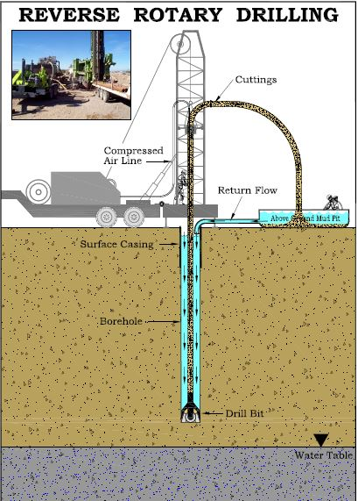
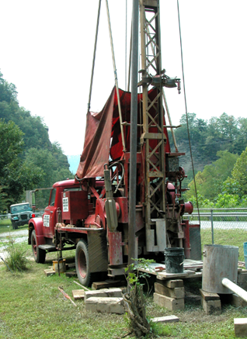
How do we get water out of the ground to use it?
Notes:
((This slide is animated. 2nd click, reverse rotary drill image comes up; 3rd click- drill rig)
How do we get water out of the ground? (We dig).
Yes, we dig using very specialized machines. Here’s a couple pictures of them.
These machines install wells into the ground which are really big metal tubes with screened openings to keep the dirt out. Let’s look at a picture of a well (next slide)

Slide 24
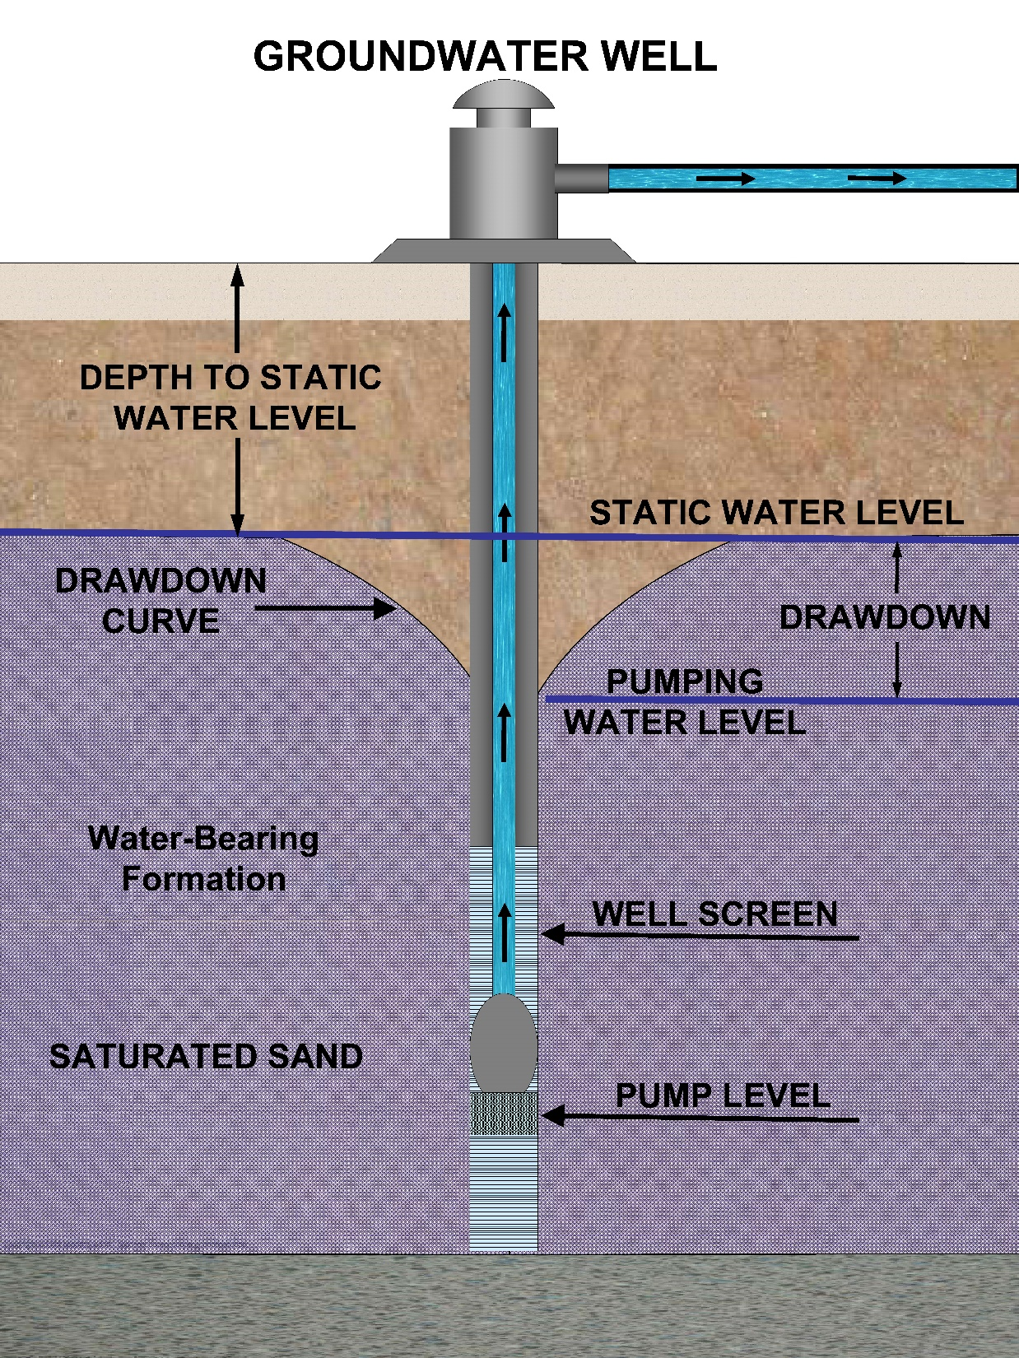
Notes:
((This slide is animate. 1st click goes to well screen; 2nd click goes to pump))
Here’s a picture of a well that’s been installed. Notice the long metal tube. The well screen is what keeps dirt out of the water. And notice where the pump is - deep in the well.
We get water out of the ground by pumping it out.

Slide 25
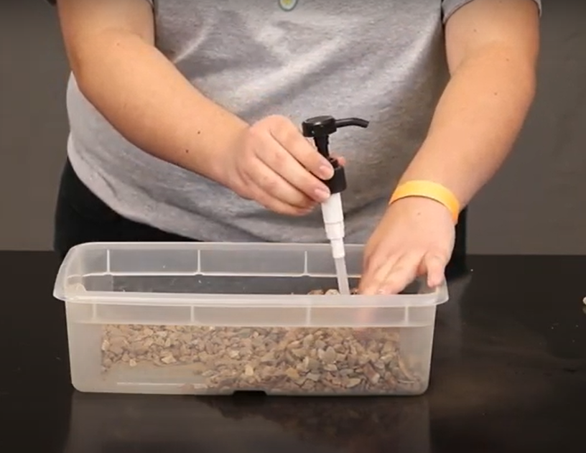
Dig in to your mountain with your pump.
We will use the pump to get water out of the ground.
Notes:
Let’s go back to your models. Let’s have our friends who don’t have models type what they notice into the chat box again.
People with models, make sure you have a container ready to pump the water into.
Be sure to watch what happens to the water in your model. Watch your model from the top and from the side –(repeat) watch from the top and from the side.

Slide 26
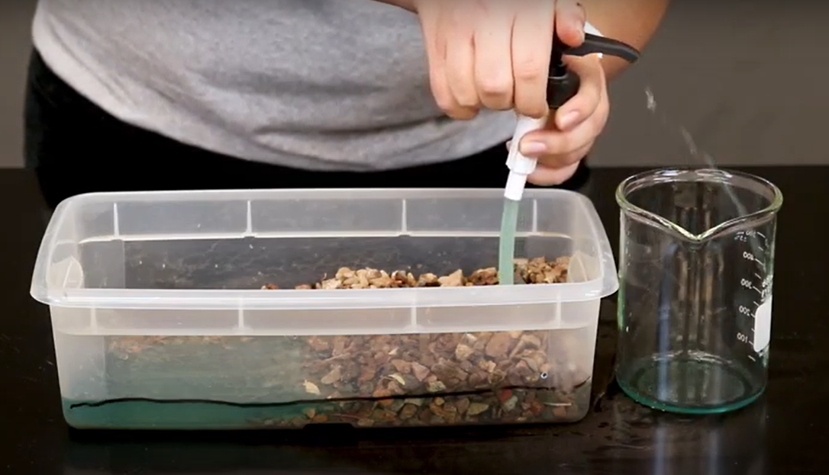
Notes:
Switch back to webcam
I’m going to do this with you.
If you have a dry erase marker, you can mark the water level on the side of your container and observe what happens. Ok. Everyone start pumping! Be sure to watch what’s happening in your model.
What are you noticing?? Let’s see what happened. Can everyone show their model to their camera?? Oo those all look great!!
Let’s talk about what happened.
What did you notice as you pump water out of the groundwater system? (water is going down) (Be sure to check the chat answers)
Where is it going down? (lake ) Where else? (ground)
Let’s switch back to the presentation for a moment. (stay on this slide for them to see water level) We started here with our water level but now… (next slide)

Slide 27
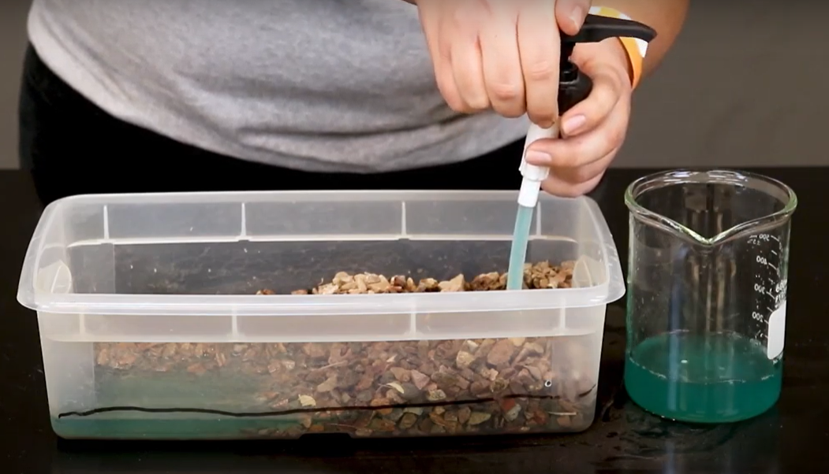
What did you observe?
Raise your hand!
Notes:
Our water level is lower.
Let’s take a closer look at what happened. (next slide)

Slide 28
Water level is at top of the line before pumping
Water level dropped below the line after pumping
Notes:
If you marked your container with a dry erase marker, you should have seen something like this…
Did everyone notice the drop in water levels in the lake and the groundwater after pumping the groundwater?
Excellent! What you observed is happening throughout Arizona. The effects from overpumping groundwater can be serious.

Slide 29



Why did the surface water level go down when we pumped water out of the ground?
Raise your hand!
Notes:
Why did the surface water level go down when we pumped water out of the ground? Any brave person want to raise their hand and share why this happened? You can also type your answers into the chat.
Excellent. Yes. Surface water and groundwater are connected. One influences the other. This picture best shows that groundwater and surface water are connected.
((Slide is animated. Describe what’s happening on the slide as you click- click 1- curved arrow shows water moves into well and gets pumped out; click 2 straight arrow shows water level going down; click 3 water level seen moving down; click 4 curved arrow shows groundwater moving into surface water; click 5 groundwater level goes up and fills up SW; straight arrow shows surface water level is filled)
What will happen when it rains on the mountains again? Yes, more water enters the groundwater system and more water will fill the lake. The problem here in Arizona is it doesn’t rain very much, does it. So because it doesn’t rain much here, our groundwater supplies are not filling back up.

Slide 30






Is groundwater part of the water cycle?
Just say it!
Notes:
NOTE: this slide is animated. Solicit answers before showing image.
Ok. We have just one more thing to cover and then we’re going to do a quick review. (Do NOT click animation yet)
Is GW part of the water cycle? What do you think? Raise your hands or type your answer in the chat box.
Can anyone explain how GW is part of the WC? Raise your hand if you think you can explain how GW might be part of water cycle.
Let’s take a look on our picture:
((Start Animation Here))
Yes, GW is part of the water cycle. As surface water evaporates, GW will move into the SW area. Water always seeks its own level. If we look at our models we can see that water in the ground is the same level as water in our lake.
Great job everyone!! Now we’re going to go through a quick round of review questions. Are we ready?

Slide 31
Let’s Review What We Have Learned!
Notes:
Ok now we’re going to go over everything we have learned today really quickly. So let’s see how many of these questions we can get right!

Slide 32

Did the water move faster through the gravel or sand?
Put it in the chat!

Slide 33
Did the water move faster through the gravel or sand?
Put it in the chat!
GRAVEL
SAND
Notes:
CORRECT ANSWER: gravel
Water moved faster through the gravel because there are larger spaces between the individual pieces of gravel

Slide 34
When it rained, which direction did the water flow FIRST?
Put it in the chat!

Slide 35
When it rained, which direction did the water flow FIRST?
Put it in the chat!
DOWN
ACROSS
Notes:
CORRECT ANSWER: down
Water moves down first via gravity, then moves across as water seeks its own level

Slide 36
What does this picture show about groundwater?
Put it in the chat!

Slide 37
What does this picture show about groundwater?
Put it in the chat!
Groundwater has earth materials like gravel and sand floating in it.
Groundwater is found in the spaces between earth materials.
Notes:
CORRECT ANSWER: Groundwater is found in the spaces between earth materials.

Slide 38
Why did the surface water level go down when we pumped water out of the ground?
Put it in the chat!

Slide 39
Why did the surface water level go down when we pumped water out of the ground?
Put it in the chat!
Groundwater and surface water are connected.
The surface water evaporated into the clouds.
Notes:
CORRECT ANSWER: Groundwater and surface water are connected
Surface water does evaporate into the clouds, but that takes a long time. In our model, the surface water went down because we pumped out groundwater, representing that groundwater and surface water are connected

Slide 40
Is groundwater part of the water cycle?
Put it in the chat!

Slide 41
Is groundwater part of the water cycle?
Put it in the chat!
YES
NO
Notes:
CORRECT ANSWER: Yes
Groundwater is part of the water cycle because water enters the water cycle through rain, groundwater is connected to surface water, and surface water evaporates (leading to more rain leading to more groundwater…)

Slide 42
Why do we care about groundwater?
Put it in the chat!

Slide 43

Is groundwater part of the water cycle?
Put it in the chat!
Because we can swim in it!
Because we use it!
Notes:
CORRECT ANSWER: Because we use it
We can’t fit between tiny earth material particles, so there is no way we can swim in groundwater. It is NOT an underground lake. Only microbes can swim in groundwater!

Slide 44

Great Job!
Thanks Everyone!
Notes:
Does anyone have any questions?
COPY THIS LINK into the chat to take students to the post-assessment: 4GW-Post-Assmt https://uarizona.co1.qualtrics.com/jfe/form/SV_25pkOrfIYMfTle5

