Slide 1
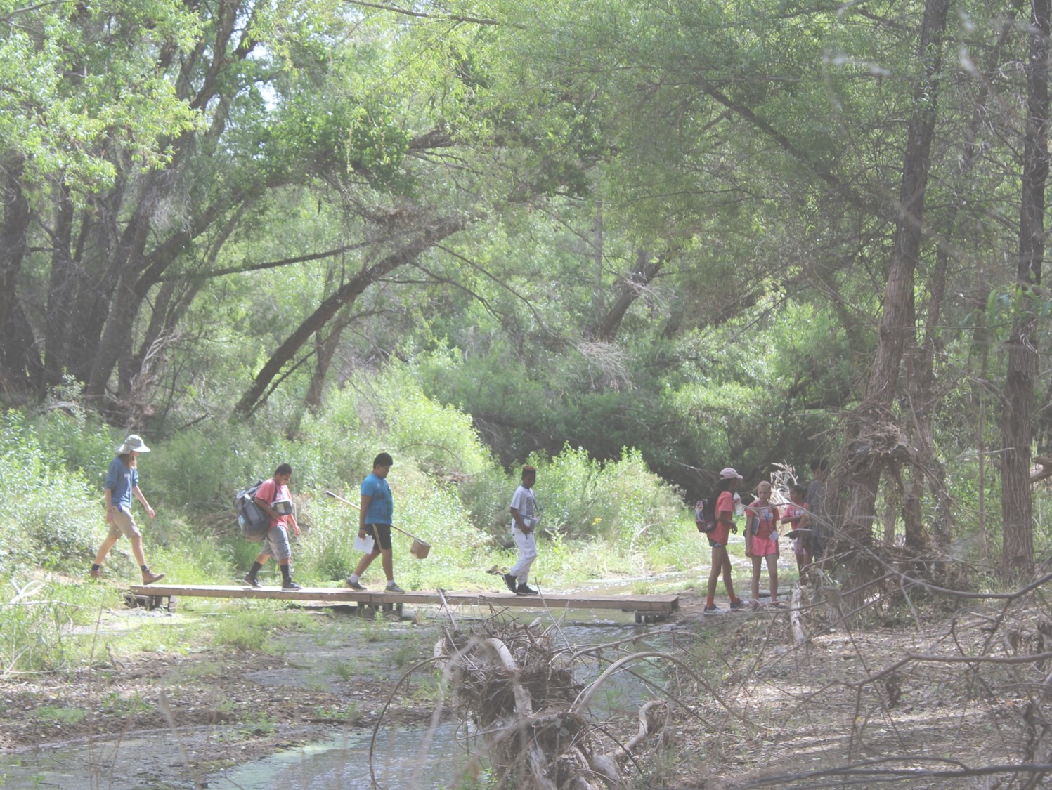




Field Investigation
Planning and Carrying Out an Investigation
How will you collect data in the field?
Notes:
Launch the Lesson
Earlier in the unit, students selected a scientist and formed science teams. In this lesson, students prepare for their field day by asking questions and defining problems to be investigated. Students will also develop a plan for collecting data and carrying out their investigation in the field. Make sure students are sitting in their groups and remember their chosen science fields.
What science are you studying? Aquatic Biology, Botany, Entomology, Soils, Water Chemistry
Note: When putting students into science groups, please remember there are TWO water chemistry groups. Water chemistry #1 determines the dissolved oxygen level of the water using a titration procedure which takes about 20-30 minutes per test. Water chemistry #2 determines pH, total dissolved solids, and turbidity. These 3 measurements are performed quickly, and students can record multiple measurements at the same location and then move to other locations to collect data.

Slide 2
Notetaking from a Science Investigation Video
Already Know …
Facts I’ve Learned …
Questions I still have …
Before
During
After
Notes:
Assign videos to groups of students or students who will work together on this science investigation. Have them list their prior knowledge about this science. Then have them view the video and take notes on facts that were learned. Immediately following have them write the questions that they still have.
Students should then discuss their notes on the video with their collaborative learning group. Then they should take what they saw and learned and see if they can come up with ways to conduct an investigation on this topic in their backyard, schoolyard, neighborhood or nearby water place.

Slide 3
What can I, as a <scientist>, investigate in order to tell whether the ecosystem is healthy or not?
From my perspective as a botanist, a healthy riparian area is like this:
  Has lots of plants
  Has lots of different kinds of plants
  The plants are lush, dense
  The plants are not dried out
To test for health, I can
  Count the number of plants
  Count the number of kinds of plants
  Grade or rate the lushness of the plants
  Rate the dryness of the plants
To count the number of kinds of plants I can
  Pick a place to look at
  Pick a plant and identify its species
  Search the whole place for more samples of that species and count them
  Record the species and the number of them
  Pick a different plant, identify, count, record
  Do that over and over again until I’ve counted all of the plants in the place
What might be hard about this and what can I do about it?
  I don’t know plant names – get a field guide to plants
  I don’t have time to count every single plant in the whole riparian area – get a map and pick sampling spots that are good examples of the rest of the place; count just those spots
  My spots need to all be the same size – take a yard stick and measure out a square in each spot.
Notes:
Hidden slide illustrating the thinking process for making distinctions about a healthy riparian area through identifying ways to refine the research question or procedure in order to make the investigation reasonable and doable.

Slide 4
Complete Questions in your science notebook:
TOPIC OF STUDY
FOCUS QUESTION (Big Idea)
  Write your main, testable question.
  What data will you collect? What will you measure?
Notes:
Students can design investigations that they can conduct in their own backyard, schoolyard, neighborhood or nearby water place.
Once students have developed a general vision for their field investigation, they are ready to dive into designing it. Pass out the Guide to Science Investigation Design. This sheet is designed to be pasted into a science notebook for reference for multiple investigations, but students will need to write each question and its answer on the pages following the Guide.
Have students answer questions 1 and 2.

Slide 5
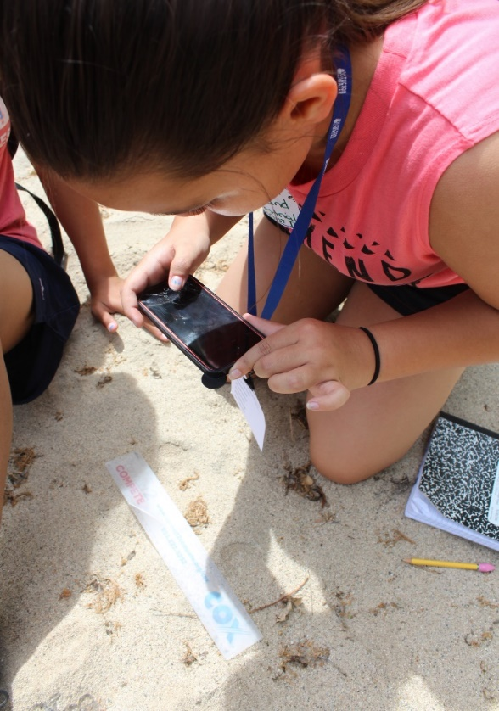
Can you improve your question?
Ask yourself…… | Refine your question...
What is your question? | Are there bugs there?
What is the physical range of your investigation? (The world? All of Arizona? The whole riparian area? One part of the riparian area?) | Are there bugs at the Hassayampa River Preserve?
What will you measure? | How many species of bug, and how many bugs in each species are counted at the Hassayampa River Preserve?
Will your measured value be the same all-the-time and everywhere within your scope? Or do you need to include time or location in your question? | How many species of bug, and how many bugs in each species are counted in one meter square next to the pond, 30 feet from the pond, and 0.25 mi from any open water source at the HRP?
Notes:
Ask students to share their questions with the class. As they share, if applicable, prompt students to improve their question in one of the ways illustrated here.
Once each group has had a chance to share and possibly improve their question, have them complete questions 3 and 4.

Slide 6
Complete Questions in your science notebook:
PLANNING (Materials & Methods)
  List all materials you need for the investigation.
  Write a plan for collecting the data that you need to answer your question. Leave space to write notes about what you did in detail when in the field.
  In each step of your plan, tell what materials you will need to use and for what purpose.
Notes:
Question 3: Students are asked to create a “plan” for collecting data. This is similar to a procedure but may not be as specific and detailed as a typical procedure. This provides them with an opportunity to think through what they are going to do in the field to collect data. Students won’t yet know the specific data collection protocol that they will be using until they are in the field. For example, any group doing chemical testing will follow the detailed instructions that come with the test kits, so the details of that testing protocol would not need to be included in their plan.

Slide 7
Complete Questions in your science notebook:
DATA COLLECTION/OBSERVATIONS
  Create a Data Table, include space for written observations and drawings.
A table is a grid with rows and columns.
Data Tables make it easy to collect lots of data in the field.
Data Tables organize the procedure and the data:
  Independent variables in columns on the left
  Dependent variable in columns in the middle
  Each row holds a different value of the independent variable
  Trials may be in separate dependent variable sub-columns or separate sub-rows.
Notes:
Question 4: note that a data table is especially important. When students arrive in the field, their mentor scientists will expect the students to have a table and to be able to explain their plan of action.
The following two slides show examples of different table configurations.

Slide 8
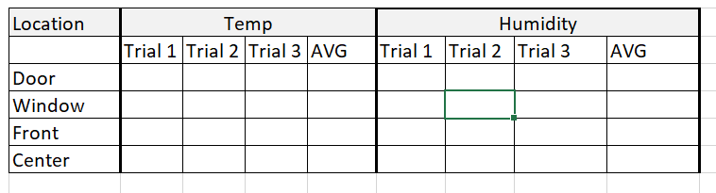
Complete Questions in your science notebook:
DATA COLLECTION/OBSERVATIONS
  Create a Data Table, may include space for written observations and drawings.
What you are changing
What you are measuring
Notes:
This slide should help students to understand variables. They will be changing one variable and keeping the variable that they’re measuring constant. For example, they could use the exact same procedure to measure temperature but vary the location or the depth of the reading.
NOTE: An independent variable is what you are changing. (In this case, location.) A dependent variable is what you are measuring. (In this case, temperature and humidity.)

Slide 9
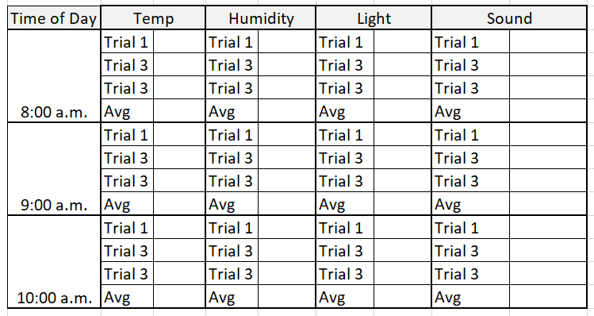
Complete Questions in your science notebook:
DATA COLLECTION/OBSERVATIONS
  Create a Data Table, include space for written observations and drawings.
Notes:
This is a different data table. Check for understanding about what is changed to make measurements using the same procedure.
You can use this opportunity to discuss with students what else they might want to record when they are collecting data. These might be things outside of the specific measurements that are still important such as date, location, weather, or any other qualitative observations. Making observations is a big part of being a scientist!
Once students understand what they should do, walk around the room to check their data tables as they work. Your goal for this class period is for each group to produce a usable data table.

Slide 10
Does your plan answer these questions?
Where will you conduct the investigation?
(Be specific; pinpoint locations on the map.)
What variable will you change between measurements?
What is the constant variable, i.e., what will you take measurements of?
Notes:
CONCLUSION
As students complete their investigation plans, have them check their work by making sure that these questions are answered in their plan. If there is time, have teams swap their procedures and do a peer review, using these questions to guide their feedback.
Where will you conduct the investigation?
What variable will you change between measurements?
What is the constant variable, i.e., what will you take measurements of?

