Slide 1
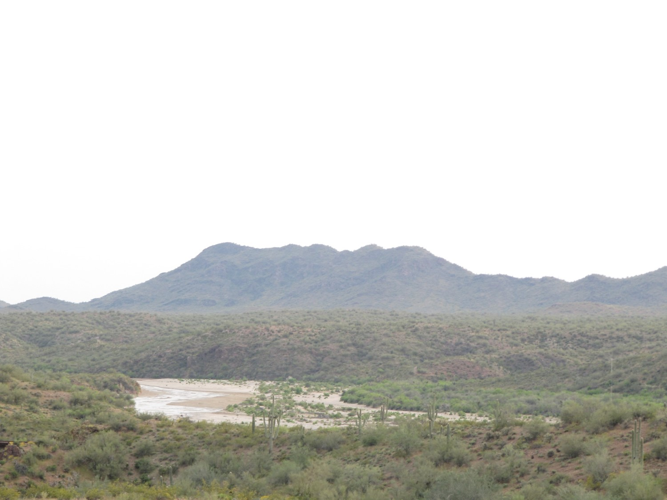





Core Idea for Knowing Science
Applying a Net Force
Building your water supply system.
Pump It Up Activity
Notes:
Today we’re going to learn about how the Central Arizona Project (CAP) delivers water across the state of Arizona. We’re going to learn about applying a net force to object to make it move and build a scale model of the CAP. To do this, we’re going to learn about the Engineering Design Process which will help guide our decision-making efforts when planning our scale model construction project.

Slide 2
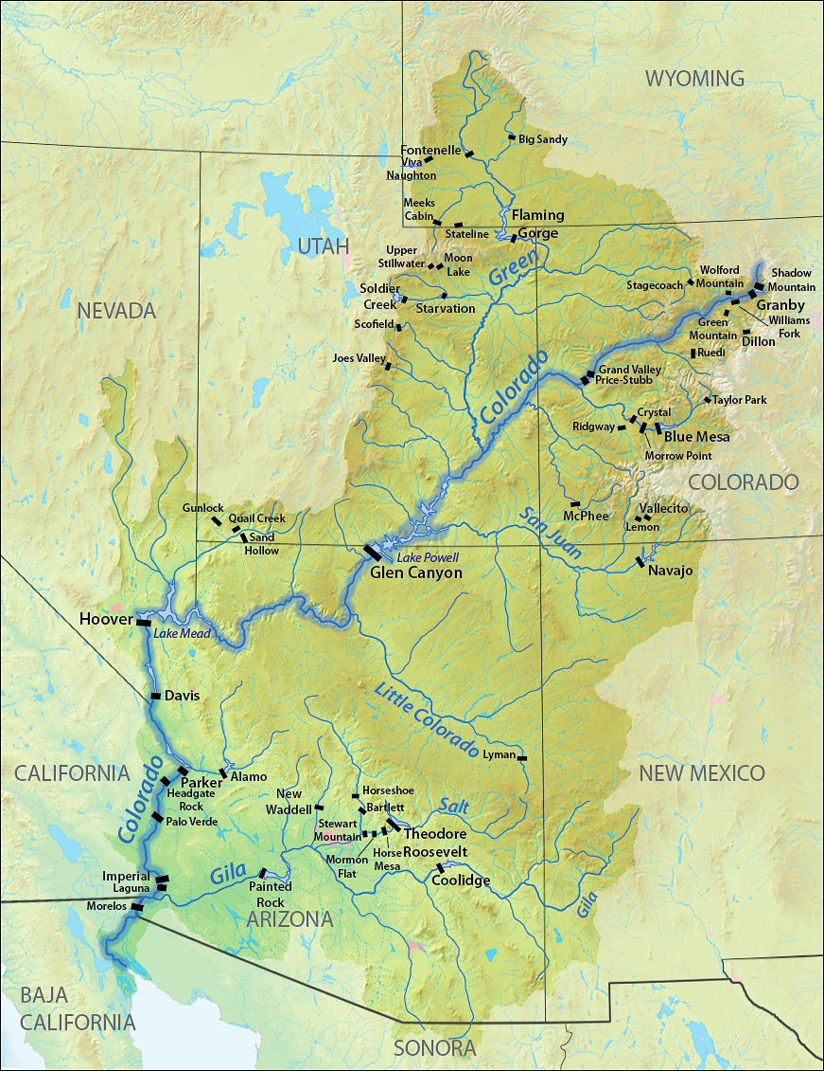
Colorado River Watershed
What is the major force acting upon this watershed?
Notes:
A watershed is the land area where water flows to low points. The boundaries are high points which often correspond to mountains. In this case many of the Rocky Mountains in Colorado.
Watersheds come in all different sizes. The Colorado River Watershed includes several states. Almost all of the state of Arizona is part of this watershed. How does water get all the way from Wyoming and Colorado down to Yuma Arizona? What force is acting upon it? (gravity)

Slide 3
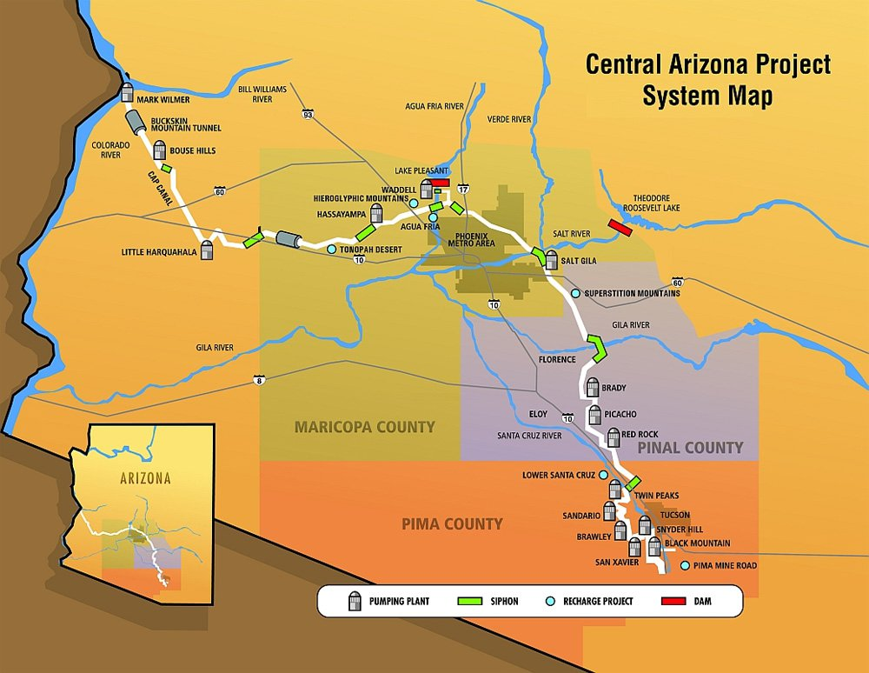
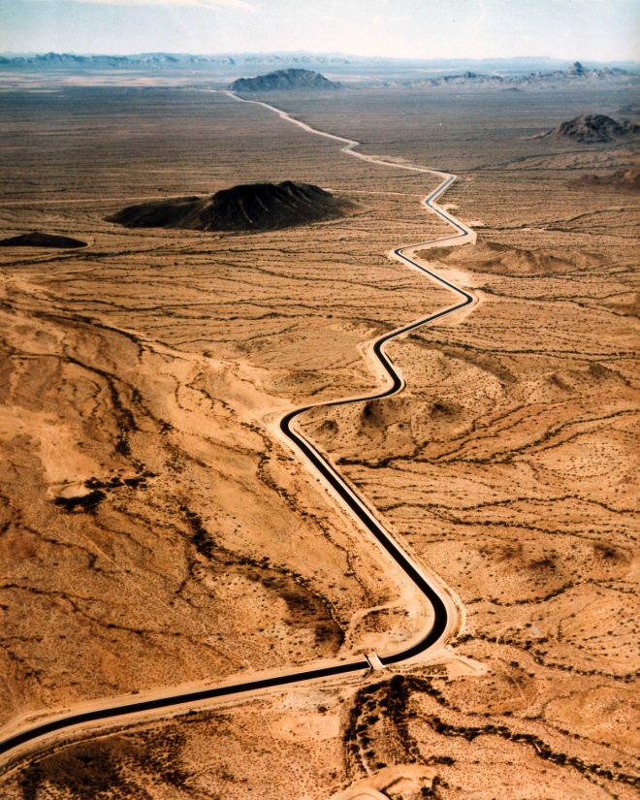
How does the CAP get water to us?
Notes:
The Colorado River water enters Arizona at Lake Havasu, at the western border of our state. Looking at this map, how does the CAP get water to where we need it? (there are pumping stations and siphons shown on the map.)
How might these pieces of water infrastructure equipment supply a net force? How do they work to move water? (pumping stations pump water uphill and siphons drain water downhill)

Slide 4
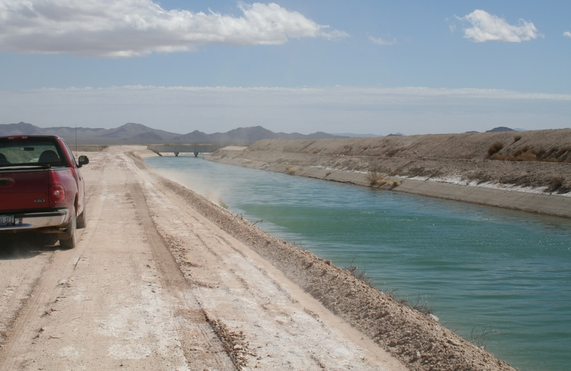

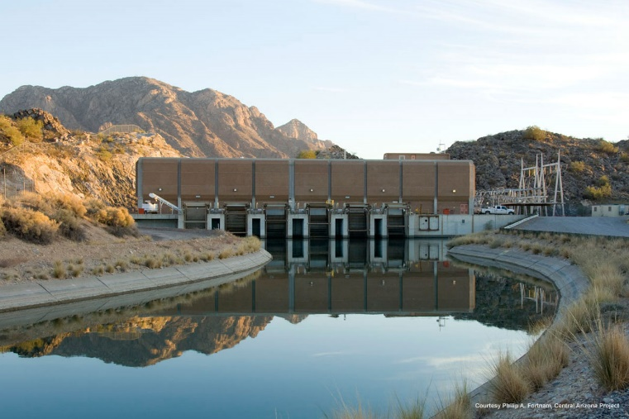
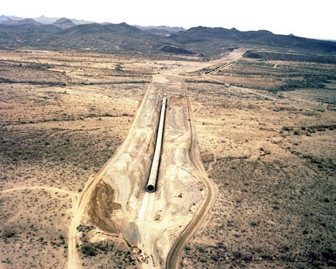
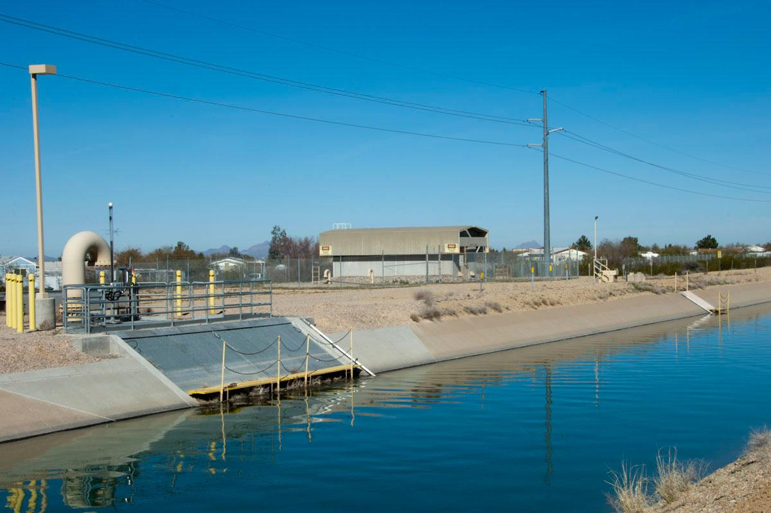
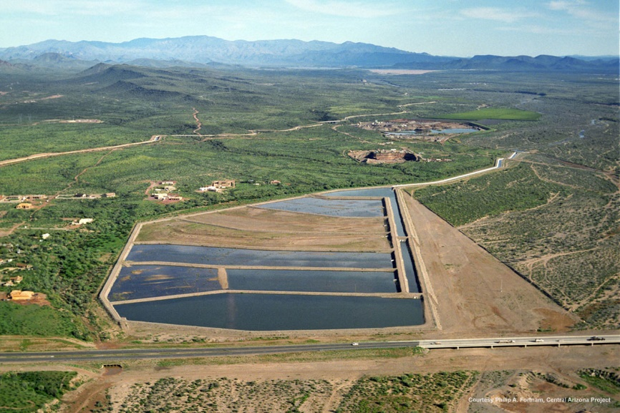
Central Arizona Project Map
Notes:
This gives you an overview of the Central Arizona Project. You will see that it contains pumping station, and tunnels and storage in Lake Pleasant near Phoenix and underground in Tucson.
14 pumping plants
5 recharge projects
12 tunnels and siphons
42 turn-outs
water is lifted 3000 feet along 336 miles of canal

Slide 5
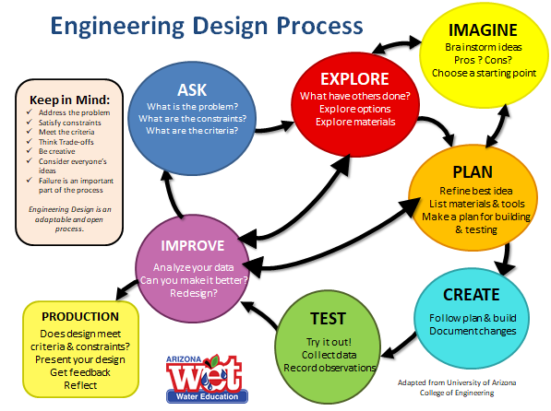
How can the engineering design process help us?
Notes:
Take a look at the Engineering Design Process. What do you notice? ( it’s a sort of cycle; it’s a cycle with multidirectional arrows)
How do you think the multidirectional arrows can help us with our project? What do they suggest can be done? (after you test, you can explore and imagine better ways of creating your project; after testing, you can improve and update your plans and re-test your project. )

Slide 6


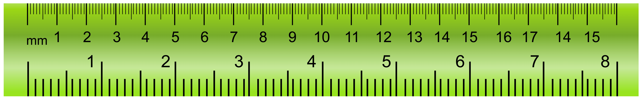
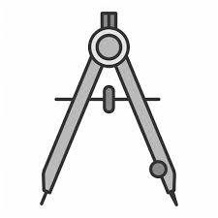
The Challenge
Imagine that you are part of a team of engineers designing the Central Arizona Project (CAP). Your challenge is to design and test a system to deliver water uphill and a distance away using a model.
The scale model distance between the water source and canal end is 4 feet (each inch represents 7 miles, so it represents 336 miles).
The scale model elevation gain is 1 foot (each inch represents 241.7 feet in elevation which represents the 2900 feet of elevation
Notes:
Here’s what we are going to do today. To begin, you’re going to be given “to-scale diagrams” of all the pieces of equipment you’ll have to work with. You’re going to use those diagram to help you plan your scale model. Remember, you must meet ALL of the criteria and constraints for your project.

Slide 7
Criteria and Constraints
Criteria
Design must be 4 feet in length (Scale: 1” = 7 miles)
Final Reservoir must be 12” high (Scale 1” = 241.7 feet in elevation)
4 reservoirs
2 canals
Constraints
Canals must flow by gravity between 2 different reservoirs.
Limit of 3 pumps
No additional materials allowed.
Not all materials have to be used.
Notes:
Here are the criteria and constraints. All need to be met to have a successful design.
If you were a contractor hired to do a job and you didn’t follow the criteria and constraints, what might happen? (you could be hired, your project might be unsafe, etc.)

Slide 8
Explore
EXPLORE
In our engineering design challenge, the exploration phase involves getting to know the equipment that is provided. Use the dimensions on the “to scale” reference photos to help you plan your design.
Materials per Group
3 – pumping devices of different sizes
2 – 1-foot sections of Styrofoam “canals”
10 – plastic containers to build 4 reservoirs (lids are optional)
20 – Styrofoam cups for canal supports
1 – yardstick or ruler
Notes:
Explore your equipment .. Do research … what have others done?

Slide 9
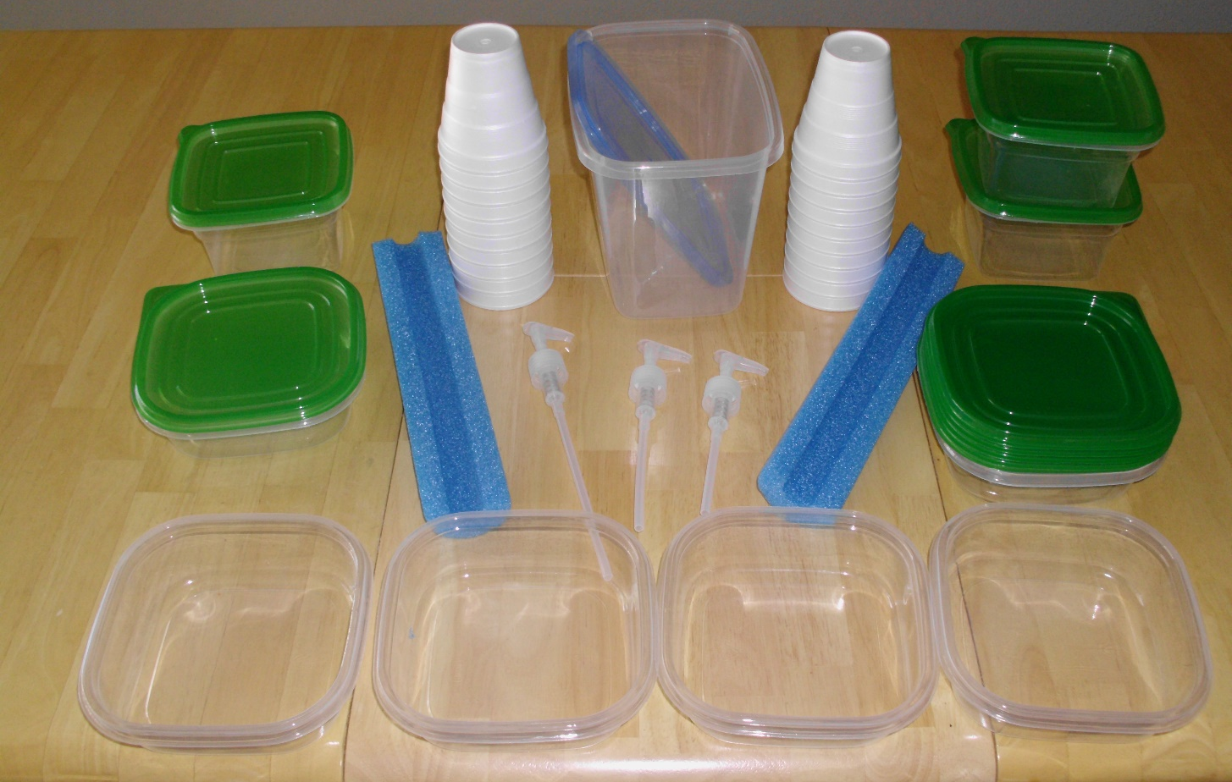
Pump it Up!
What does your equipment look like?
Notes:
What did you decide to use?

Slide 10
Imagine
IMAGINE
IMAGINE: First, brainstorm multiple ways to arrange and configure your parts to design your water supply system and make rough sketches on your own. Your team will need to discuss and agree on the best idea to move forward to the PLANNING stage.
Design 1: Design 2: Design 3:
Notes:
Direct each student to take time to imagine how the equipment might be put together to meet the challenge as well as the criteria and constraints.

Slide 11
Small Group Engineering Design Plan
PLAN
PLAN: Use the graph paper provided to draw your chosen system.
Include an aerial perspective (top view) as well as a cross sectional view (side view).
Include arrows and draw as to-scale as possible.
Notes:
Divide students into groups. Provide link to graph paper in the chat box if you’re doing this virtually.
Everyone should have their equipment list and their imagined designs. They will discuss their ideas with their group and choose the best equipment and design ideas.
Then the group will use the Zoom annotation tools in their small groups to draw each view as much to scale as possible. You can all draw at the same time!
After they draw the aerial view make sure they will save to the file before going on to the cross sectional view.
Open a new graph paper file and repeat the process with their their cross-sectional view. Make sure they save both of their design files.

Slide 12
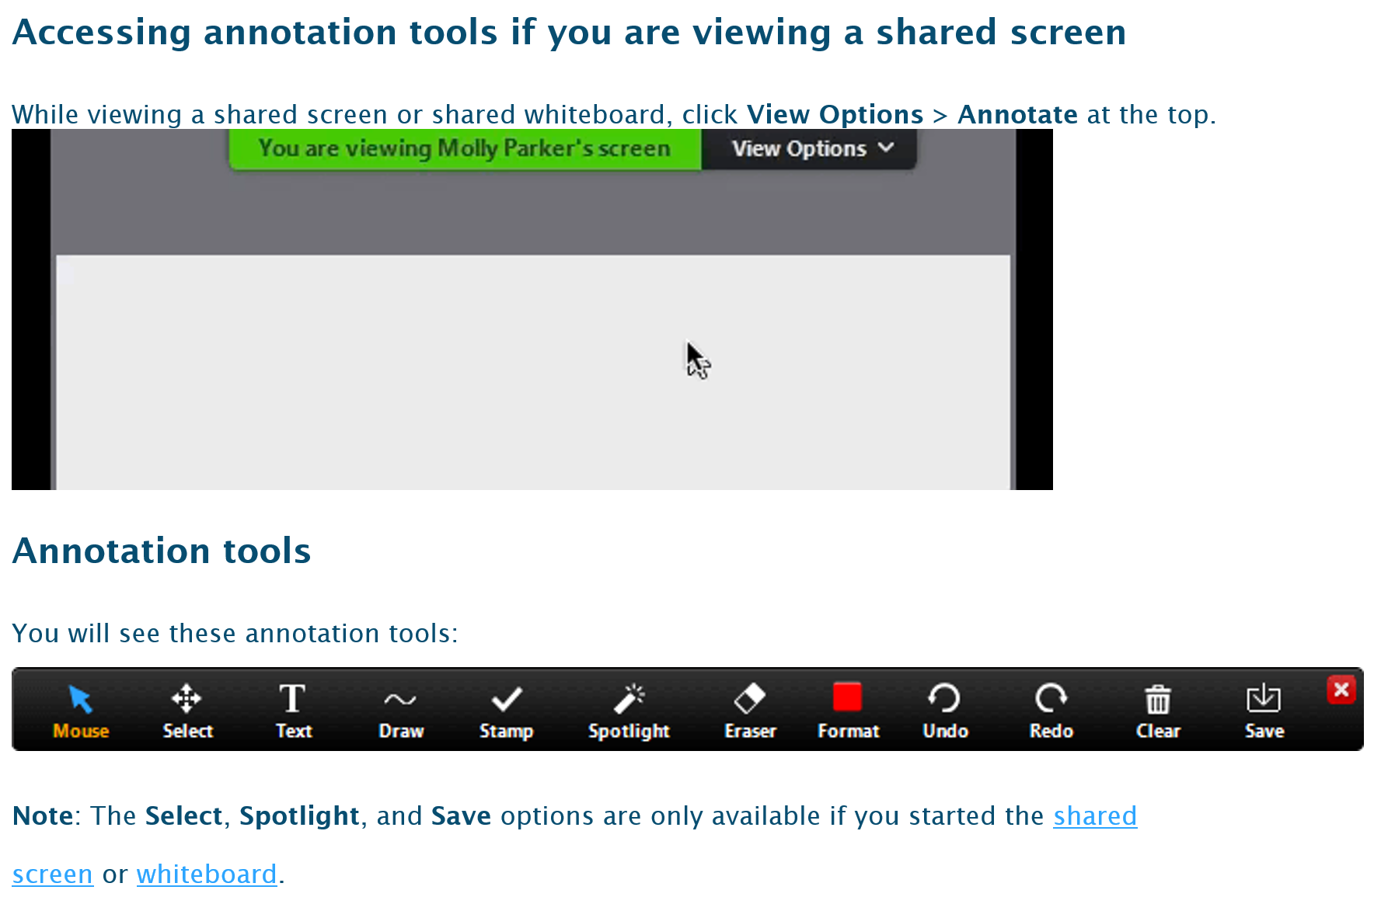
Annotation Tool
Notes:
If you’re in Zoom, this is how you can do group annotations. You all know how to use this!

Slide 13

Notes:
This is what the graph paper looks like. Think about what scale you want to use, i.e. how many inches will each block represent?

Slide 14
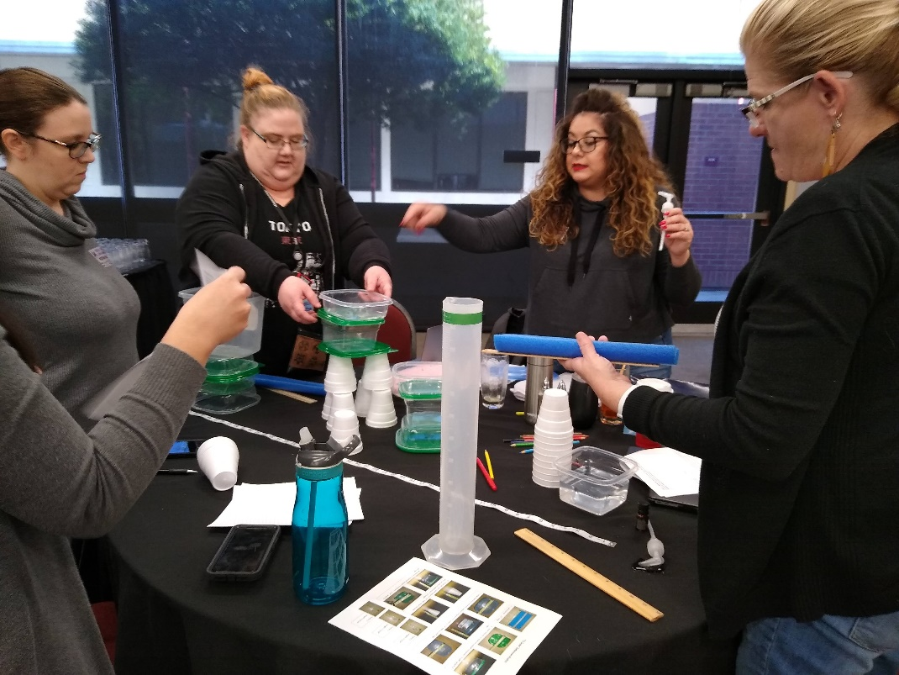
Larger Group
Report out
IMPROVE
The initial IMPROVE step will be accomplished through group sharing and hearing about other groups plans.

Slide 15
Homework: Pump it Up!
Build Your Design and Test It
Notes:
Homework

Slide 16
EDP Process Reflection
  What could you have done better and where in the EDP process would that happen? There may be several areas. List all you think of.
  How did the criteria and constraints impact your thinking?
  What do you wish you could have done differently before beginning your model?
  What other materials would you have liked to have had available to work with?

Slide 17
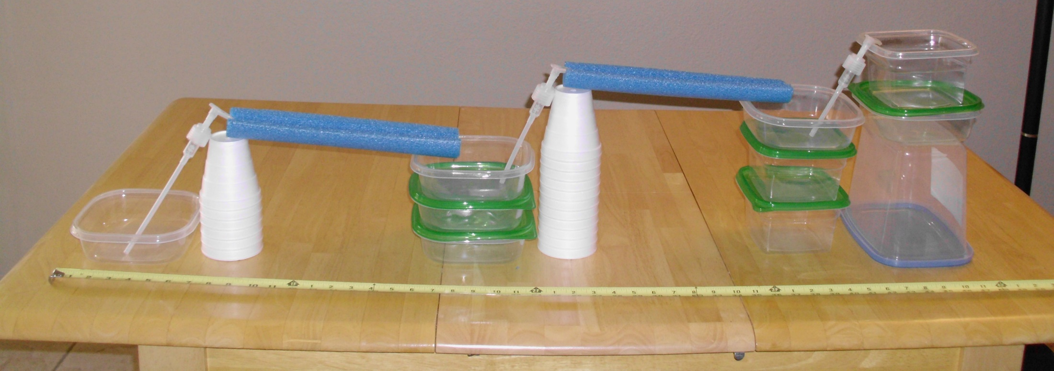
Pump it Up!
What Does Your System Look Like?

Slide 18
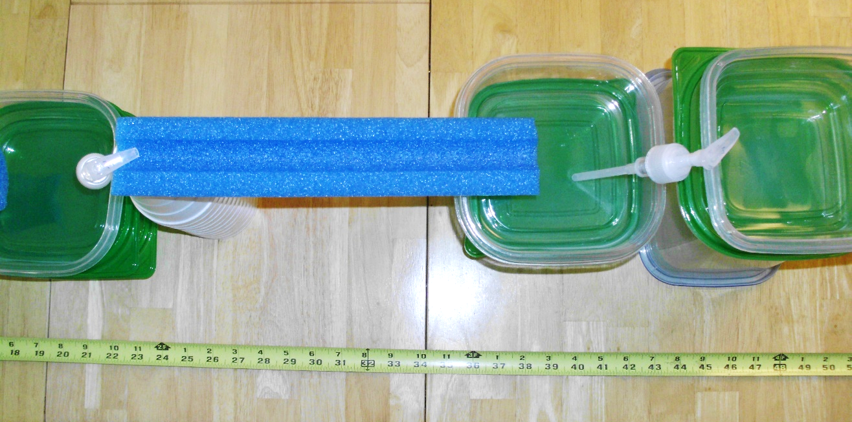
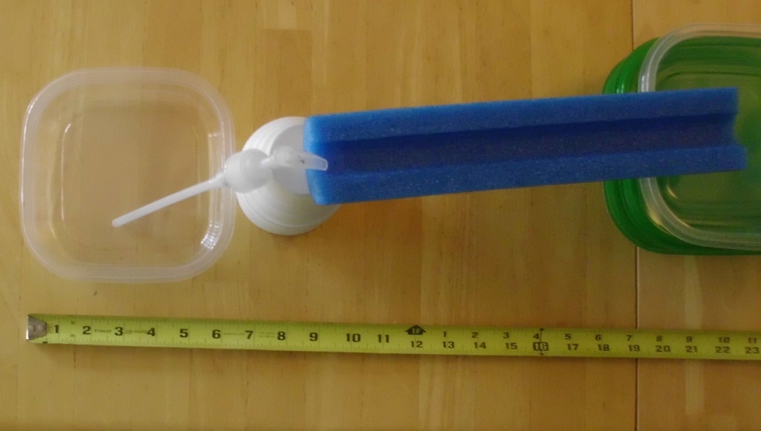
Pump it Up!
What Does Your System Look Like?

Slide 19
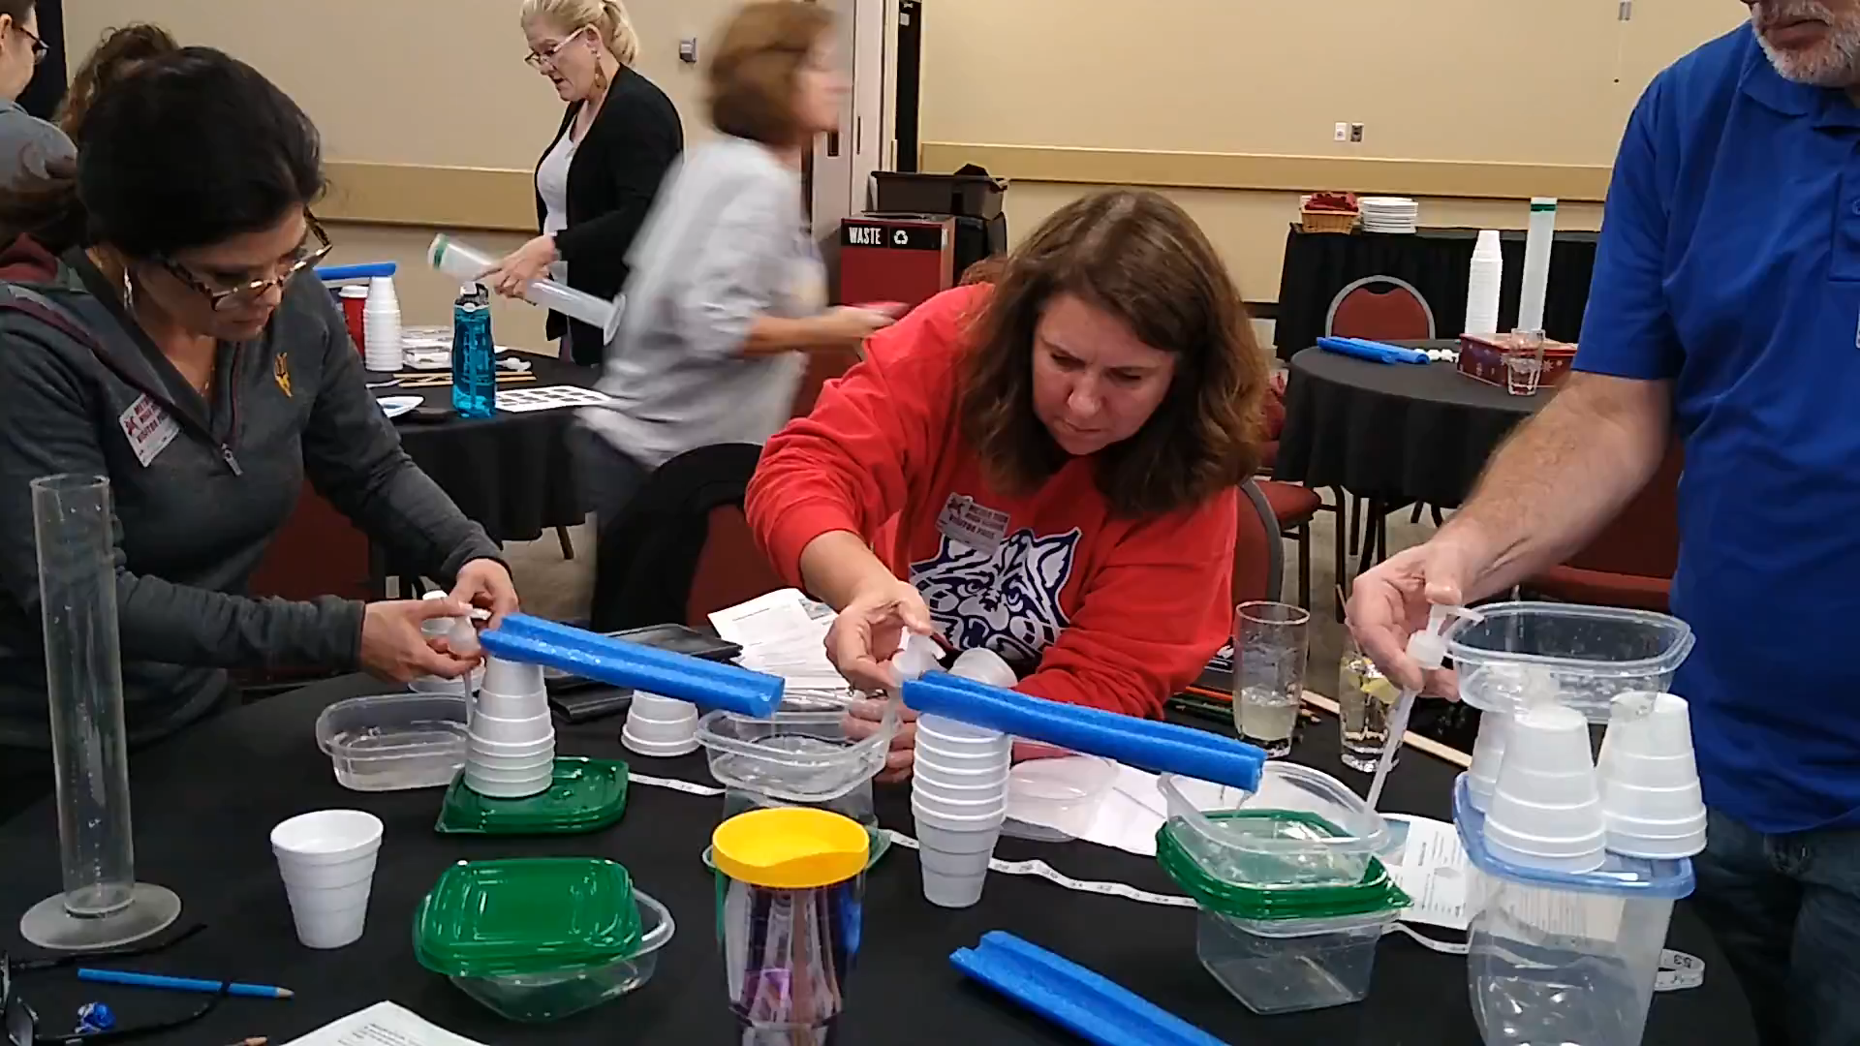
Creighton Superintendent
Notes:
Short video of PD in action.

Slide 20
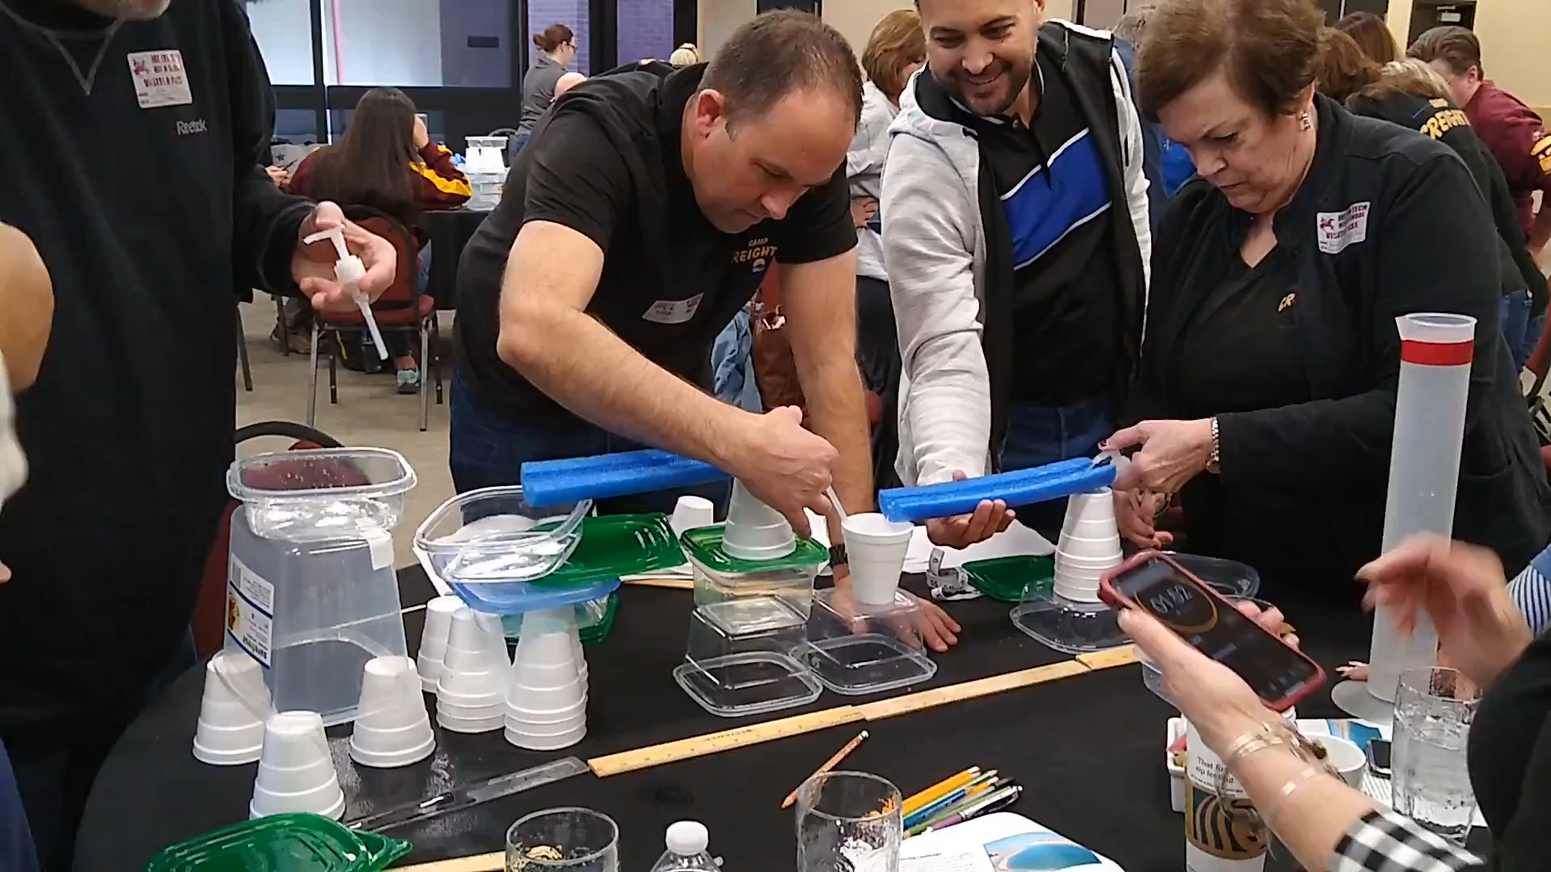
Creighton
Notes:
Short video of PD in action.

Slide 21
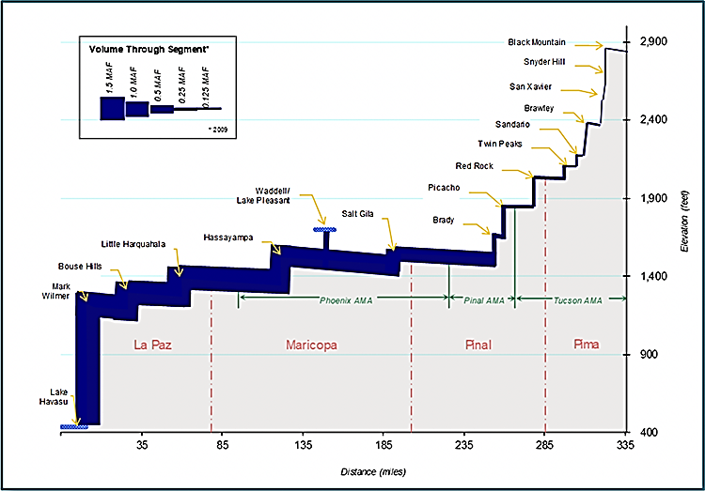
HINT
What happens in between pumping stations?
https://www.cap-az.com/public/blog/993-water-brought-to-you-by-central-arizona-project
Notes:
This is an elevation profile of the CAP. What do observe happening in between pumping stations (water is flowing down by gravity)

Slide 22
What Did You Learn?
Explain the difficulties you encountered with moving water uphill and how you solved them.
Reflect on the usefulness of the engineering design process in solving this problem. Be specific.
Relate your experience in designing this system to the problem(s) that engineers might have encountered in designing the CAP system.

