Slide 1
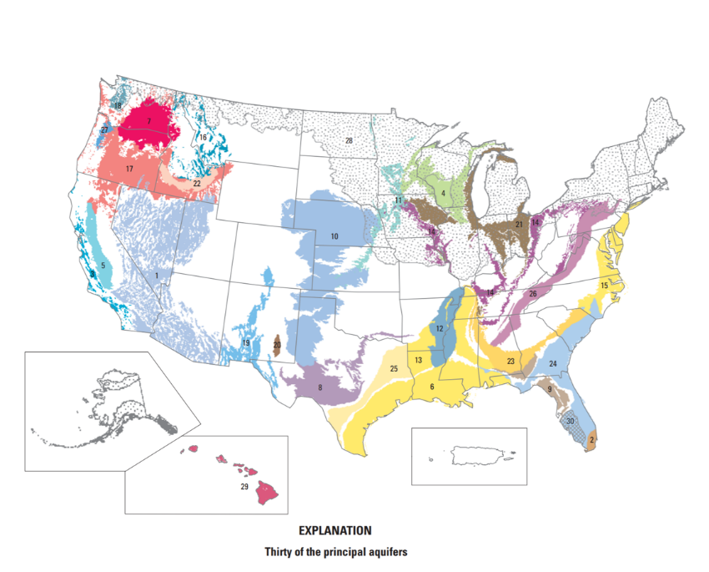
GROUNDWATER & ARIZONA: Pre Lesson 1
Unearthing Groundwater:
Groundwater Use in the U.S.
The National Ground Water Association has determined that 38% of the U.S. population, depends on groundwater for its drinking water supply.
Notes:
So our first lesson has to do with groundwater… so we wanted to provide you with some background
Groundwater is the largest source of fresh water on Earth - it's kind of a big deal! In fact, there is way more water in the ground than there is in all the world's rivers and lakes.
https://www.usgs.gov/special-topics/water-science-school/science/groundwater-information-topic

Slide 2
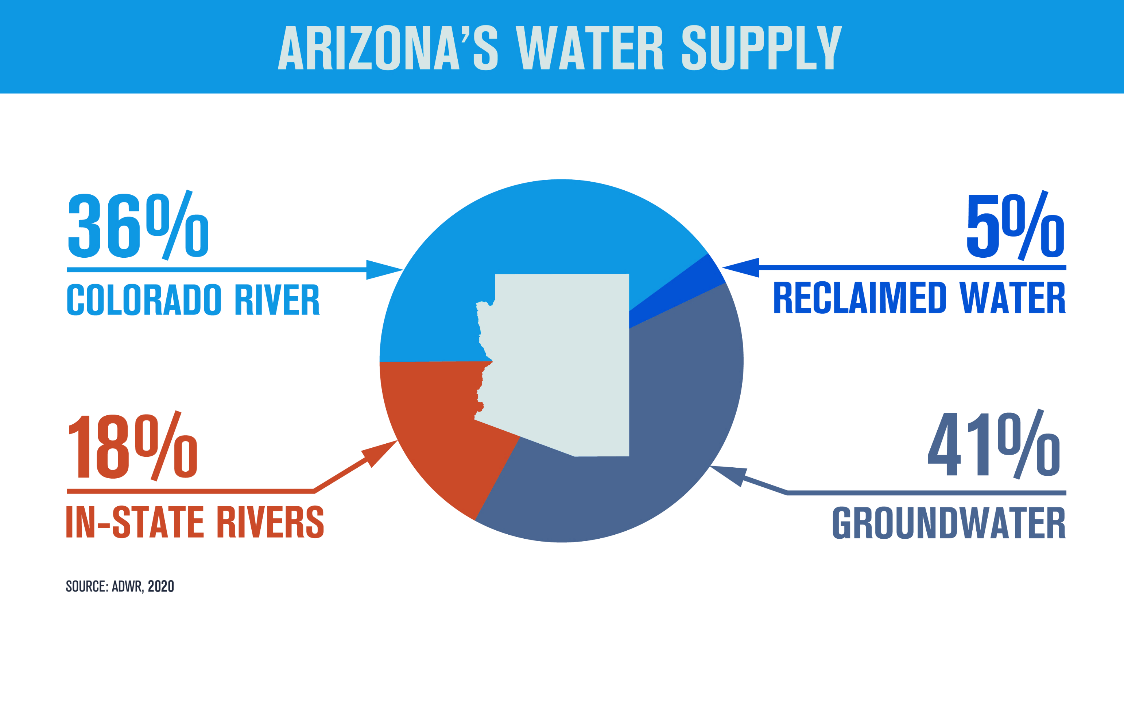
GROUNDWATER & ARIZONA: Pre Lesson 1
How important is groundwater to Arizona?
Notes:
Arizona uses water from several sources. Some of it comes from rivers, and a small amount which we are trying increase is coming from reclaimed water, but currently most of our water comes from groundwater!
We will help students better understand this topic when we come to your school with our groundwater flow model.

Slide 3
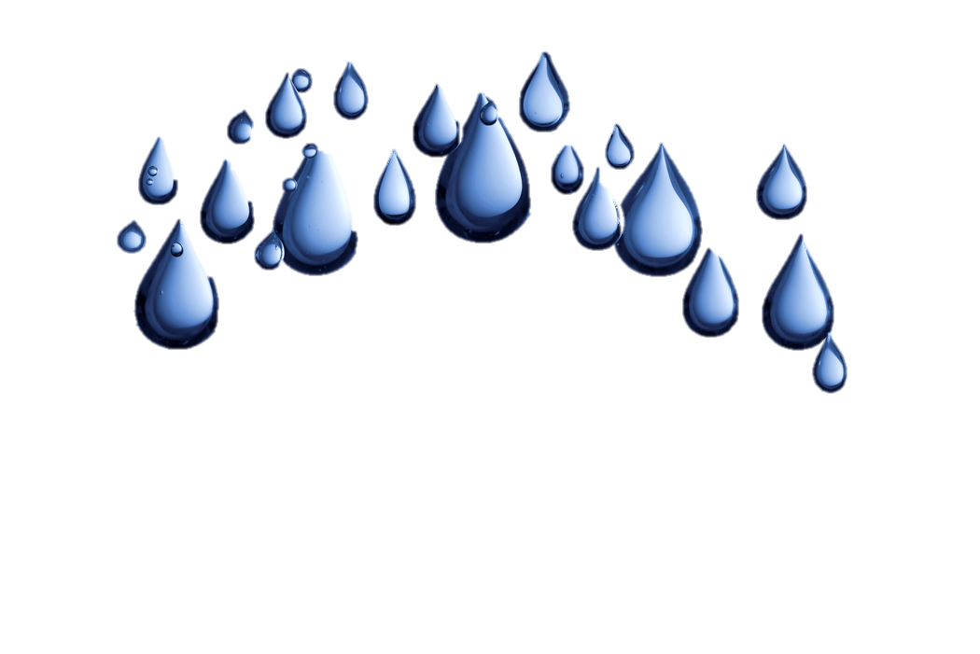
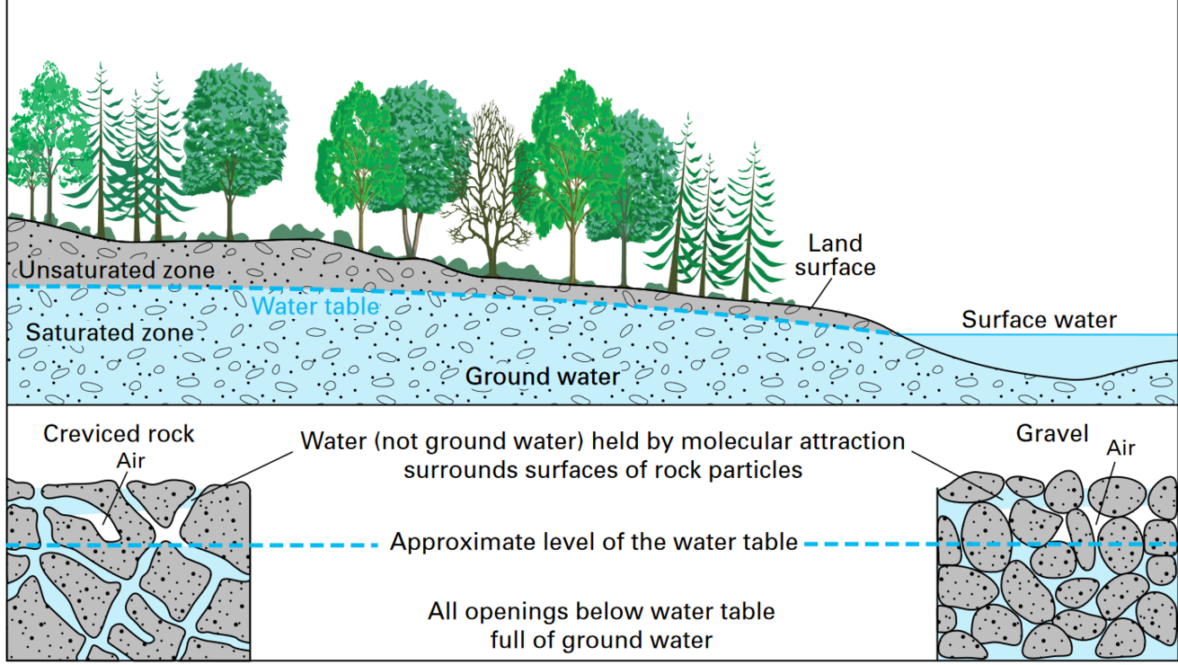
Let’s
Review!
Pore Spaces
Groundwater moves between the spaces and pores and is pulled down due to gravity. The bigger the spaces between the materials, the faster or easier the water can move around it.
Aquifer:
An area where significant groundwater is present. Groundwater flows between layers of earth materials.
Notes:
Groundwater begins as what? Where does it come from? Precipitation Then what happens? It runs off the land until it can find places to soak down through materials or it fills up surface water.
Groundwater is what it sounds like - water in the ground that fully saturates (or fills up) the pores or cracks in soils, sand and rocks. Then what is an aquifer?
An aquifer is an underground bed of saturated soil or rock that yields significant quantities of water. Aquifers come in all sizes and their origin and composition are varied. They may be small or very large and can run for thousands of square miles underground all while remaining out of sight.

Slide 4
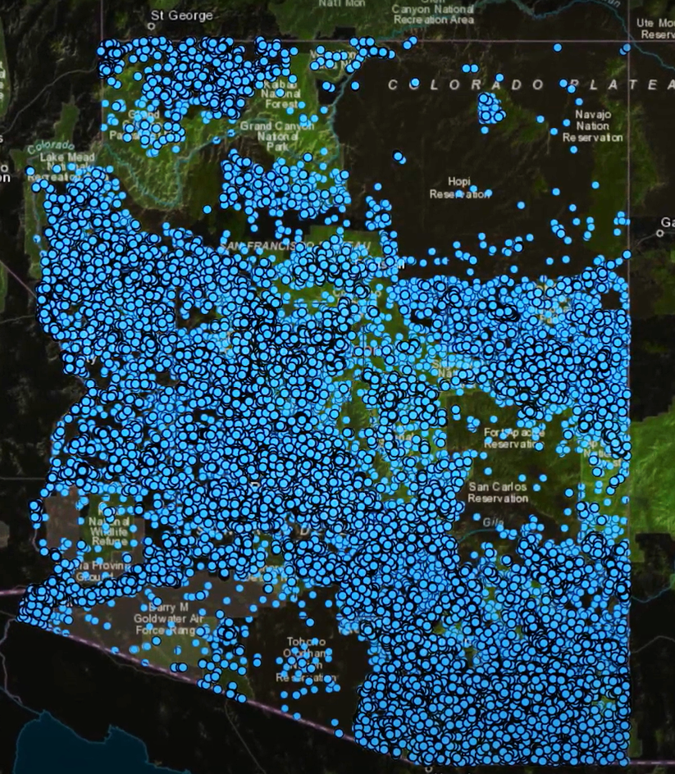

GROUNDWATER & ARIZONA: Pre Lesson 1
Well, well, well, what do we have here?
How do we access and use groundwater?
Both individual landowners and city municipalities drill wells to access groundwater.
Notes:
So how do we get groundwater ? Remember we pump it up through wells! The only we can use it is by pumping it up.
Can you believe there are so many wells all over Arizona?

Slide 5
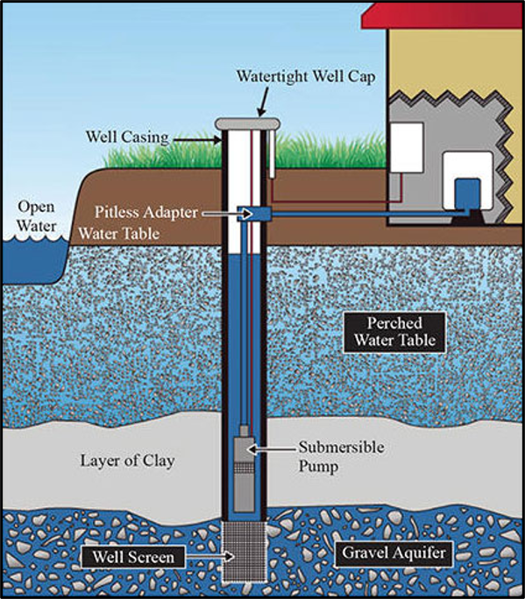
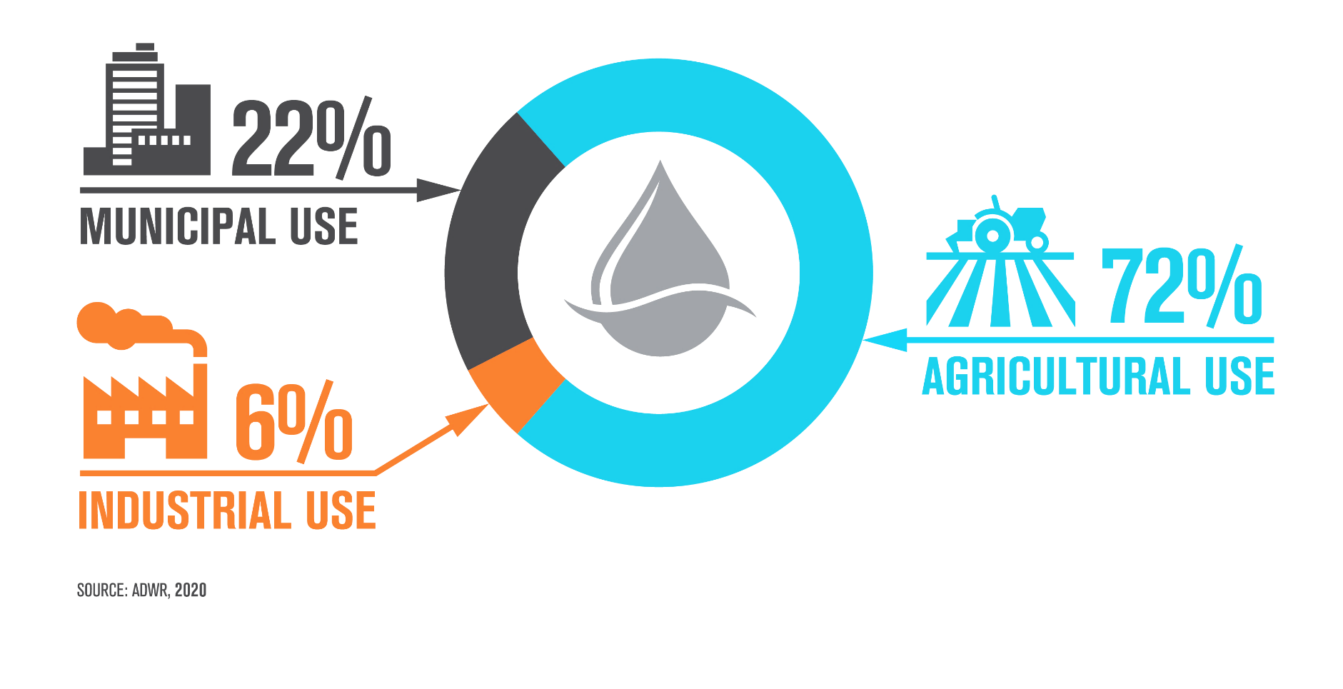
GROUNDWATER & ARIZONA: Pre Lesson 1
How do we pump it up
and why?
We use it for drinking water, agriculture, and for pretty much everything else.
Do different places have different amounts of groundwater? Do you think it is evenly distributed under Arizona?
Notes:
Just like surface water (lakes and rivers), our groundwater is not evenly distributed across the state…
There are many types of wells (some are observation wells so that we can see what is under our feet and some are pumping wells). Some are only 100s of feet deep while others can be 1,000s feet deep. But they all are expensive
A drilled well is constructed by a rotary drilling machine that literally “drills” a hole into the ground until it reaches the underground water source. These types of wells require a casing on the outside of the drilled hole as well as screening to prevent the driving water from being contaminated. The screen also reduces the amount of sediment flowing into the water storage tanks and can also improve the integrity of the well. These types of wells can reach depths up to 1,000 feet. Once the drilled well has been opened, a submersible water pump and piping system are installed and a casing cap is installed on top of the water wells, which also is designed to protect the integrity of the below-ground water source and reduce exposure to chemicals and other contaminants.

Slide 6
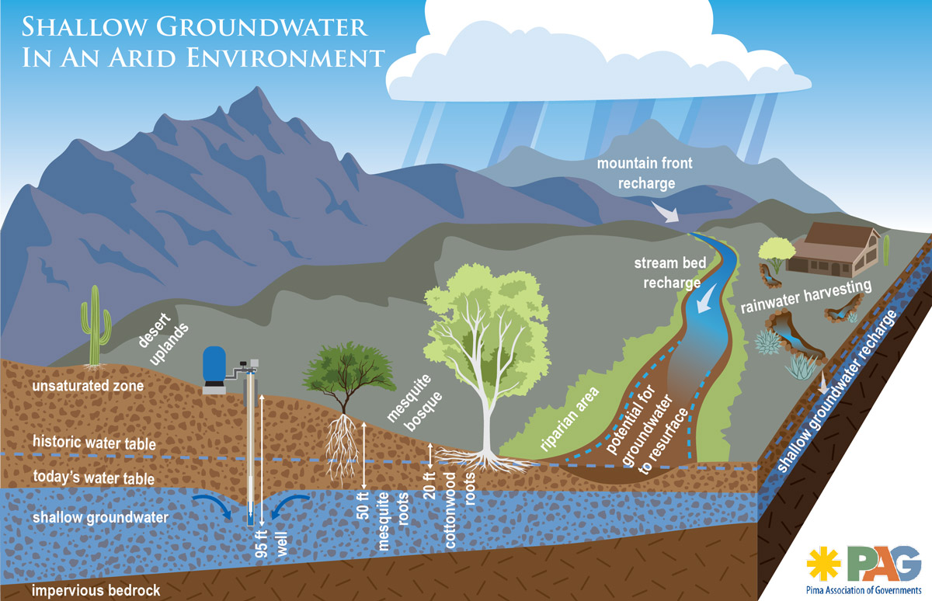
Going, Going, Gone?
Decline & Depletion
Notes:
What if we just keep pumping? Students will get to explore this when we come visit your school.
The water stored in the ground can be compared to money kept in a bank account. If you withdraw money at a faster rate than you deposit new money you will eventually start having account-supply problems. Pumping water out of the ground faster than it is replenished over the long-term causes similar problems. We call this overdraft
Pumping groundwater at a faster rate than it can be recharged can have some negative effects on the environment and the people who use that water:
LOWERING OF THE WATER TABLE – a severe consequence of excessive groundwater pumping is that the water table, below which the ground is saturated with water, can be lowered.
If groundwater levels decline too far, then shallow wells may dry up causing well owners to drill deeper (this is very expensive and not always possible.
We also know if we take too much groundwater it can reduce the amount of water in our streams, rivers and lakes.
We also call the area that lowers around the well that is pumping water, a cone of depression…

Slide 7
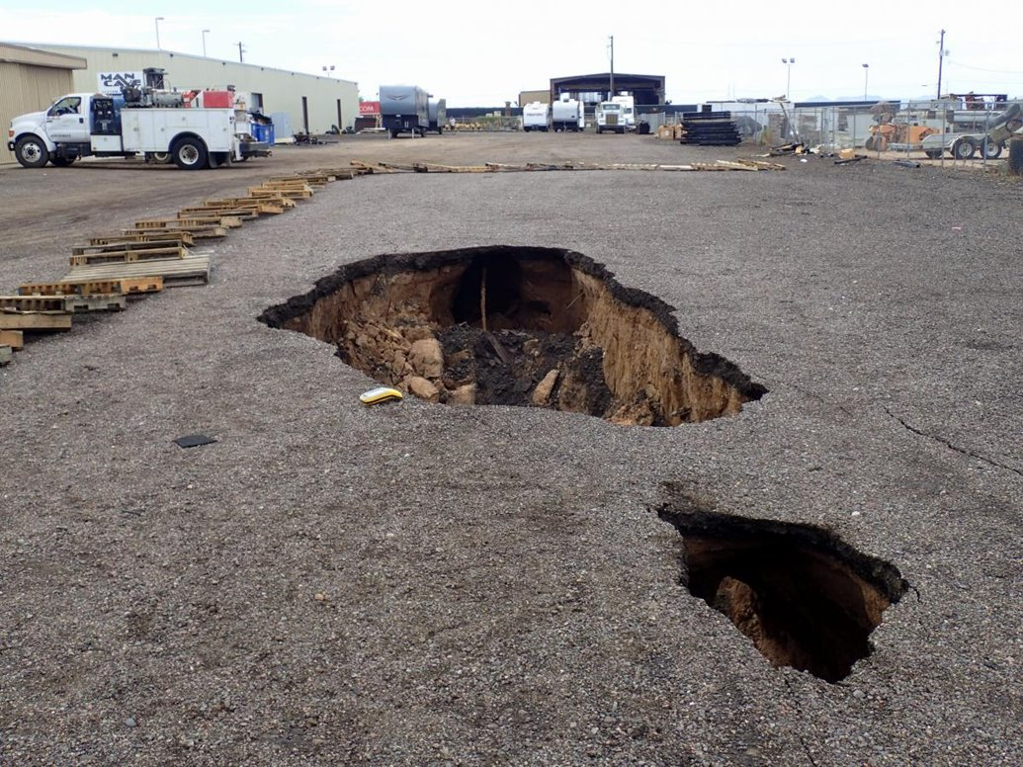
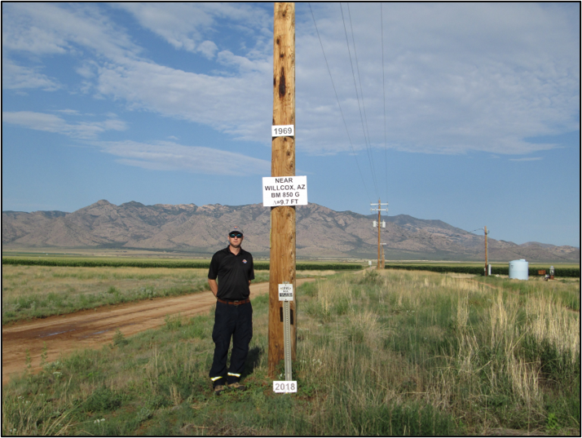
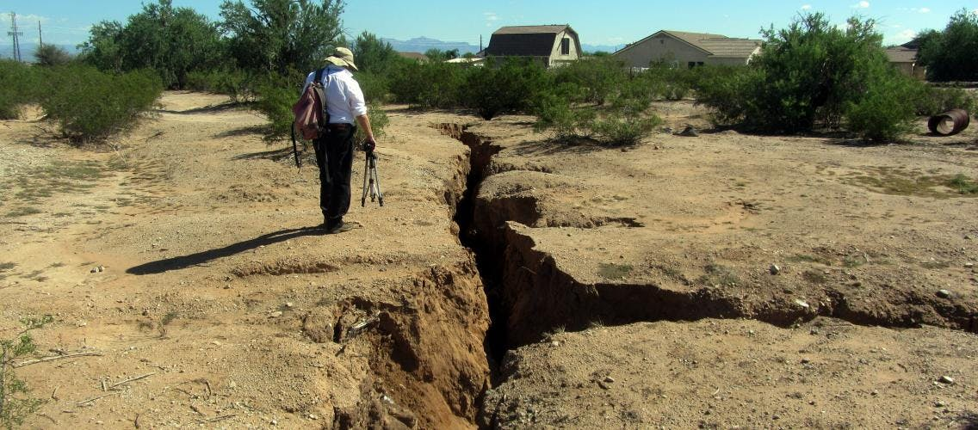
Sink Holes, Fissures & Land Subsidence, Oh My!
Notes:
So when we take too much groundwater besides drying up lakes and rivers, we can also cause damage to the land! This is a 2-mile-long crack that opened in the AZ desert in Pinal County between Casa Grande and Tucson because of groundwater pumping! The land subsided more in one area than in another, so it caused the earth to crack open. We call this a land fissure, and we have no idea if they can be repaired or how to repair them. ​
​
The bottom right picture is near Wilcox, AZ where the land has actually started to subside due to over pumping of groundwater. When land subsides, it loses its capacity to hold groundwater, as the spaces between the materials collapse and get smaller and smaller, so we can’t just pump water back into the ground to fix subsidence issues.​
​

Slide 8
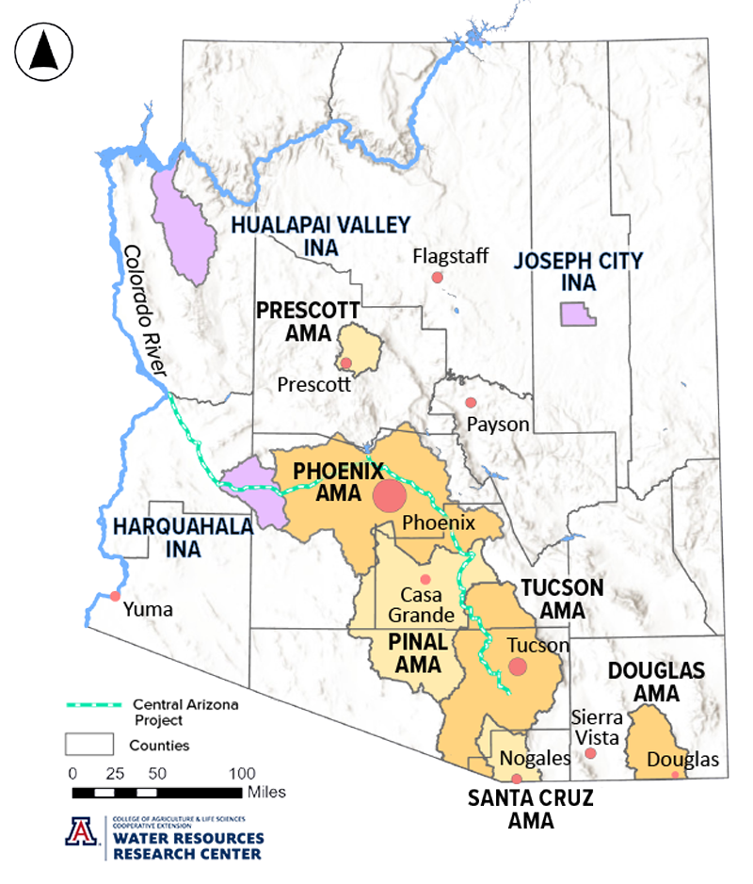

GROUNDWATER & ARIZONA: Pre Lesson 1
1980 Arizona Groundwater
Management Act
Active Management Area and Irrigation Non-Expansion Area designations​
Groundwater pumping limitations​
Recharge​
Notes:
Because of over pumping and the issues we just discussed finally in 1980 The 1980 Arizona Groundwater Management Act (GMA) was passed.
The passing of the 1980 Groundwater Management Act (GMA) was monumental for many reasons. First and foremost, it established laws that enabled the State to manage and protect groundwater for the benefit of all residents across Arizona. It also created provisions to ensure this finite water source was preserved for the future.
It created Active Management Areas (AMAs), which introduced regulation and conservation measures in parts of the state with a history of heavy reliance on groundwater.
There are six AMAs in the state, Prescott, Phoenix, Pinal, Tucson, Santa Cruz and Douglas. Each has its own long-term goal in accordance with the Groundwater code
INAs – are Irrigation Non-expansion areas which prohibit the expansion of new irrigated acreage within established boundaries and require irrigators to report their water use if they pump more than 35 gallons per minute. There are 3 INAs.

Slide 9
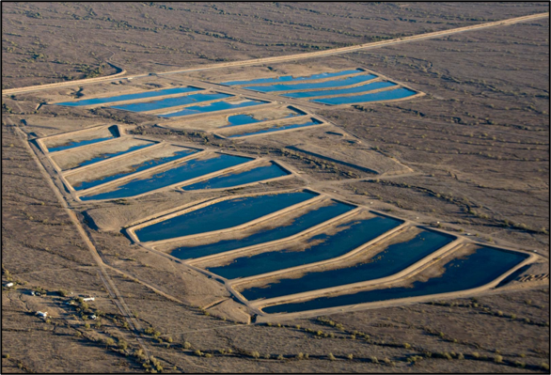
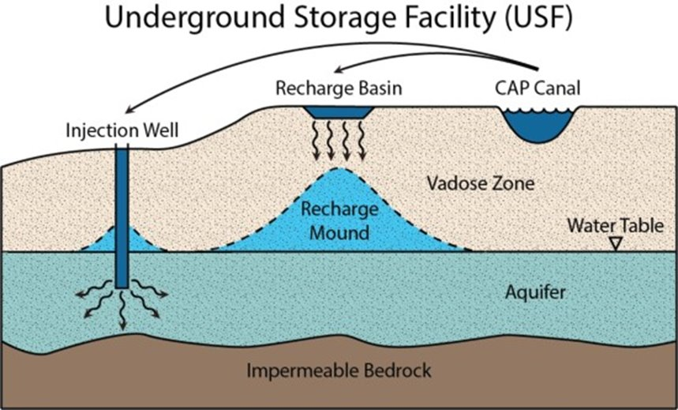
GROUNDWATER & ARIZONA: Pre Lesson 1
Recharging the Aquifer
Notes:
. Phoenix and Tucson are both trying to achieve safe-yield –which means the amount being drawn or taken is the same amount being replaced annually.
Where do you think we might get water to recharge into the ground? We often get this water from the Colorado River. We build basins in the ground and put water from the CAP and reclaimed water (treated wastewater) into them to recharge the aquifer. ​
What are the benefits of storing water underground rather than above ground? It stops evaporation. ​​

Slide 10
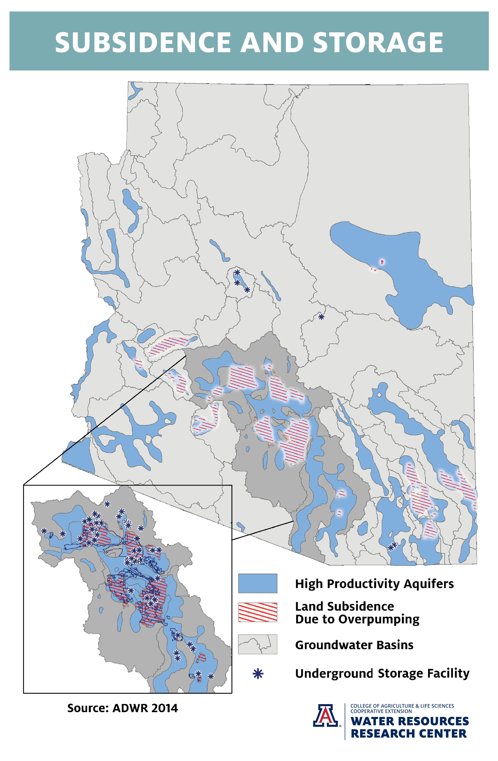
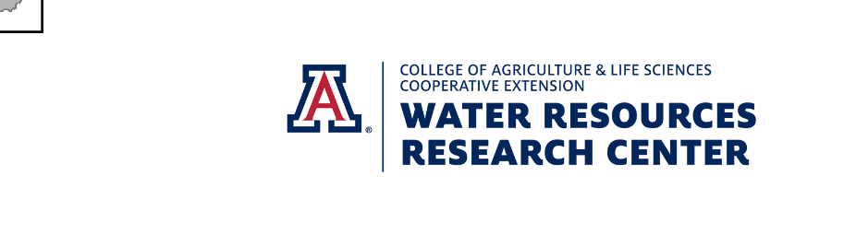
Notes:
Back in the 1950s, approximately 70 percent of the water used in Arizona was groundwater.
Even though the overall usage of groundwater in Arizona has been reduced to 40 percent, groundwater is still a fundamental water source and in some areas of Arizona, it remains the only water source, highlighting the importance of managing this resource not just for today but for future generations.

Slide 11
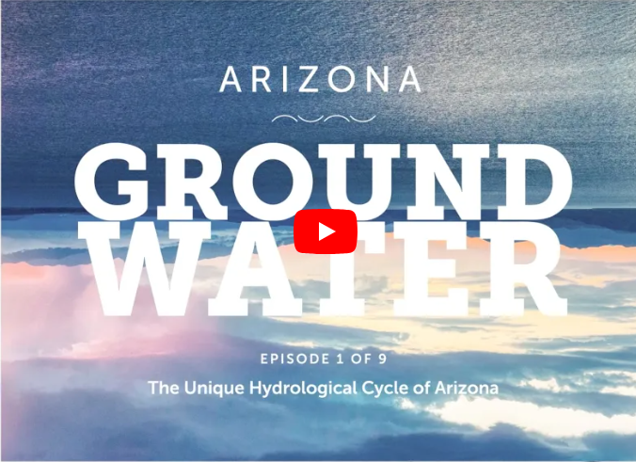

GROUNDWATER & ARIZONA: Pre Lesson 1
Watch Series of Arizona Groundwater Videos – an APW & ADWR joint project.
This Photo by Unknown Author is licensed under CC BY-NC

Slide 12

Groundwater & Sustainability : Lesson 1
A PLUME PROBLEM
Investigative Questions
How does water move underground?
If groundwater is contaminated, will pollutants move to other nearby locations?
Notes:
Now that we know a little more about groundwater we also want to think about what happens if it gets contaminated or polluted.

Slide 13
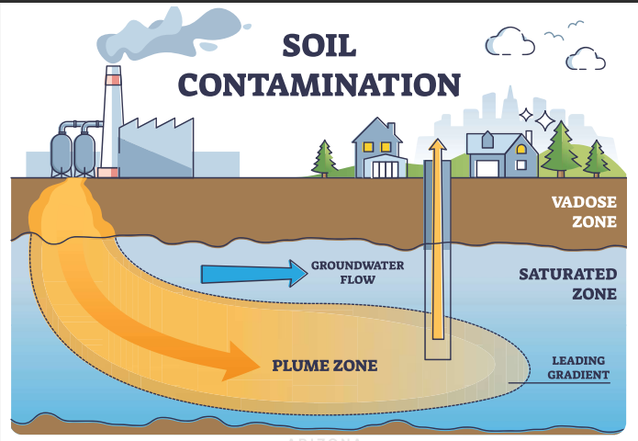
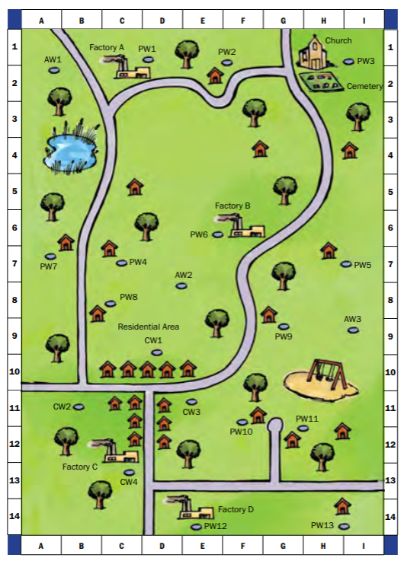
GROUNDWATER: A Plume Problem
The Activity:
Students read through a scenario and plot data on a map to discover groundwater contamination levels.
They soon learn that with new evidence their data may not lead to only one answer.
Sometimes past solutions become current problems.
Notes:
You can do this activity as a class demonstration or in groups and let the students actually measure out the water. The picture will also take you to a great graphic and more information.
Helping students make that connection as to just how precious a resource our fresh clean water is, helps make water conservation relevant.

Slide 14

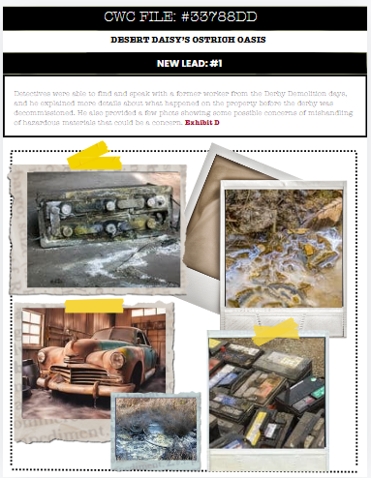
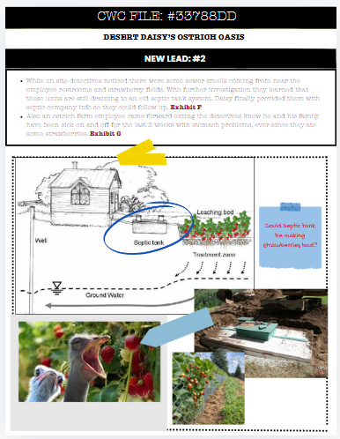
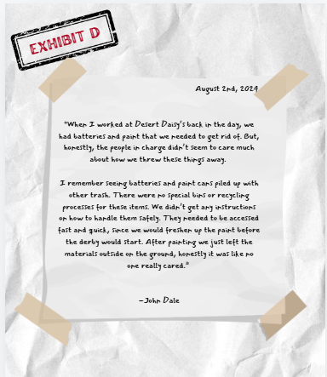
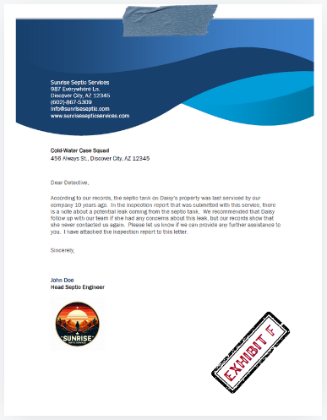
Now think about how this activity might play into the case file?
Provide Lead #1 & #2 after lesson:
Notes:
Pass out the additional case file leads that go with each lesson. We anticipate that students are then continuously adding to their MAP worksheet page and their initial argument page as they continue to make new discoveries.

Slide 15
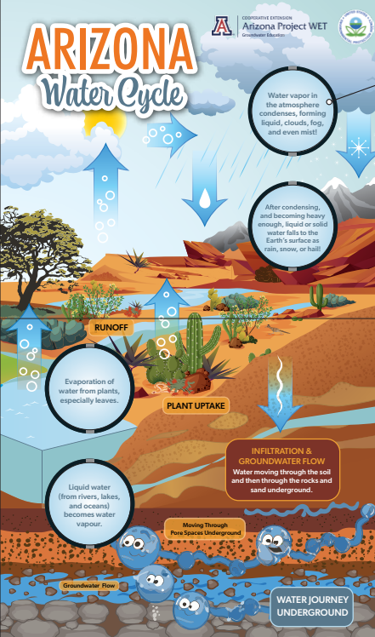
Wrap-Up
Stability &
Change
Lesson 1
What have you learned about how groundwater moves?
If it is contaminated, can pollutants move to other locations?
How does groundwater fit within the Arizona Water Cycle?
How can you protect and conserve groundwater?
Notes:
100% you can be a groundwater guardian, have students share in groups things they can do to protect and conserve groundwater. In the next lesson you will discover how you can make individual actions that help us conserve water and help keep it clean and plentiful.

