Slide 1

WATERSHEDS & CLIMATE: Lesson 3
We all have a role:
The quality of water in a river or lake is influenced by both natural factors and how people use the land around it.
Everyone is responsible for the health of the watershed and the water systems within it.
Our actions, good or bad, have an impact on our water supply.

Slide 2

WATERSHEDS & CLIMATE: Lesson 3
CSI: Water & Diseases
Investigative Questions
What is the role of water in transmitting diseases and in human/animal wellness?
How do the characteristics of environments that promote the transmission of diseases change with a changing climate?
Notes:
This is all about helping students appreciate clean drinking water.

Slide 3
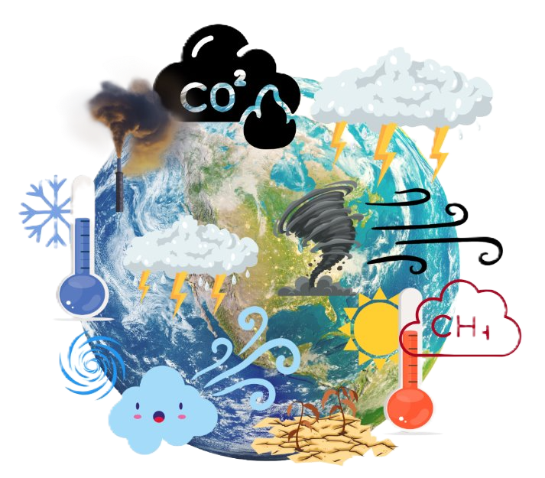
WATERSHEDS & CLIMATE: Lesson 3
Climate Change
Climate change is a long-term shift in global and regional weather patterns and temperatures. While these shifts can be natural, the current rapid change is driven by human activity, primarily the burning of fossil fuels like coal, oil, and gas.

Slide 4
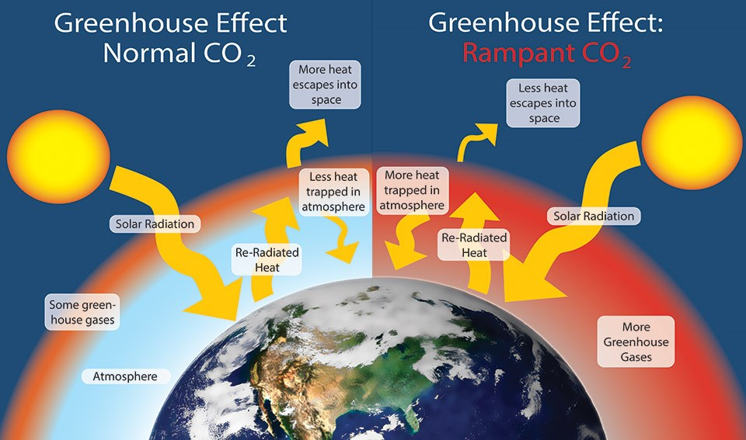
WATERSHEDS & CLIMATE: Lesson 3
Global Warming & Green House Effect
Global warming is the long-term heating of Earth’s surface observed since the pre-industrial period (between 1850 and 1900) due to human activities, primarily fossil fuel burning, which increases heat-trapping greenhouse gas levels in Earth’s atmosphere.
Notes:
The Sun ultimately drives Earth's climate by emitting energy in the form of sunlight. Sunlight is solar radiation mostly in the form of visible and a smaller portion as ultraviolet (UV) energy. This is also called shortwave radiation. The solar energy that has been absorbed by Earth's surface is then emitted in a different form. Since Earth is much cooler than the Sun, it emits weaker radiation with longer wavelengths, in the infrared range. Some of this infrared radiation passes through the atmosphere unimpeded, but the majority is absorbed by GHGs. As the concentrations of GHGs increase within the atmosphere, more infrared radiation is absorbed and less escapes directly to space, resulting in amplified warming. This is called the Enhanced Greenhouse Effect.

Slide 5
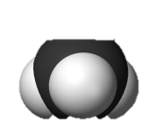
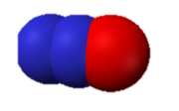
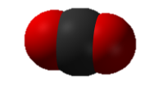
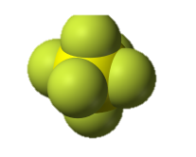
WATERSHEDS & CLIMATE: Lesson 3
Key Human Activities
Burning Fossil Fuels
Deforestation
The combustion of coal, oil, and natural gas for electricity, transport, and industry is the largest source of greenhouse gas emissions.
Forests absorb CO2 from the atmosphere. Deforestation not only releases stored carbon but also eliminates a vital tool for regulating the climate.
Methane (CH4)
Agriculture & Livestock
Nitrous Oxide (N₂O)
Agricultural practices, particularly livestock farming, produce large amounts of methane, a powerful greenhouse gas. Fertilizers also release nitrous oxide.
Sulfur Hexafluoride (SF₆)
Carbon Dioxide (CO₂)
Notes:
Carbon Dioxide (CO₂) is a colorless, odorless gas consisting of molecules made up of two oxygen atoms and one carbon atom. Carbon dioxide is produced when an organic carbon compound (such as wood) or fossilized organic matter, (such as coal, oil, or natural gas) is burned in the presence of oxygen.
Methane (CH₄) is a colorless, odorless non-toxic gas consisting of molecules made up of four hydrogen atoms and one carbon atom. Methane is combustible, and it is the main constituent of natural gas-a fossil fuel. Human sources include the mining of fossil fuels and transportation of natural gas, digestive processes in ruminant animals such as cattle, rice paddies and the buried waste in landfills.
Nitrous oxide (N₂O) is a colorless, non-flammable gas with a sweetish odor, commonly known as "laughing gas", and sometimes used as an anesthetic. Nitrous oxide is naturally produced in the oceans and in rainforests. Man-made sources of nitrous oxide include the use of fertilizers in agriculture, nylon and nitric acid production, cars with catalytic converters and the burning of organic matter.
Sulfur hexafluoride (SF₆) is an extremely potent greenhouse gas. SF₆ is very persistent, with an atmospheric lifetime of more than a thousand years. SF₆ is human-made, and the primary user of SF₆ is the electric power industry. SF₆ is used extensively in high voltage circuit breakers and switchgear, and in the magnesium metal casting industry.

Slide 6
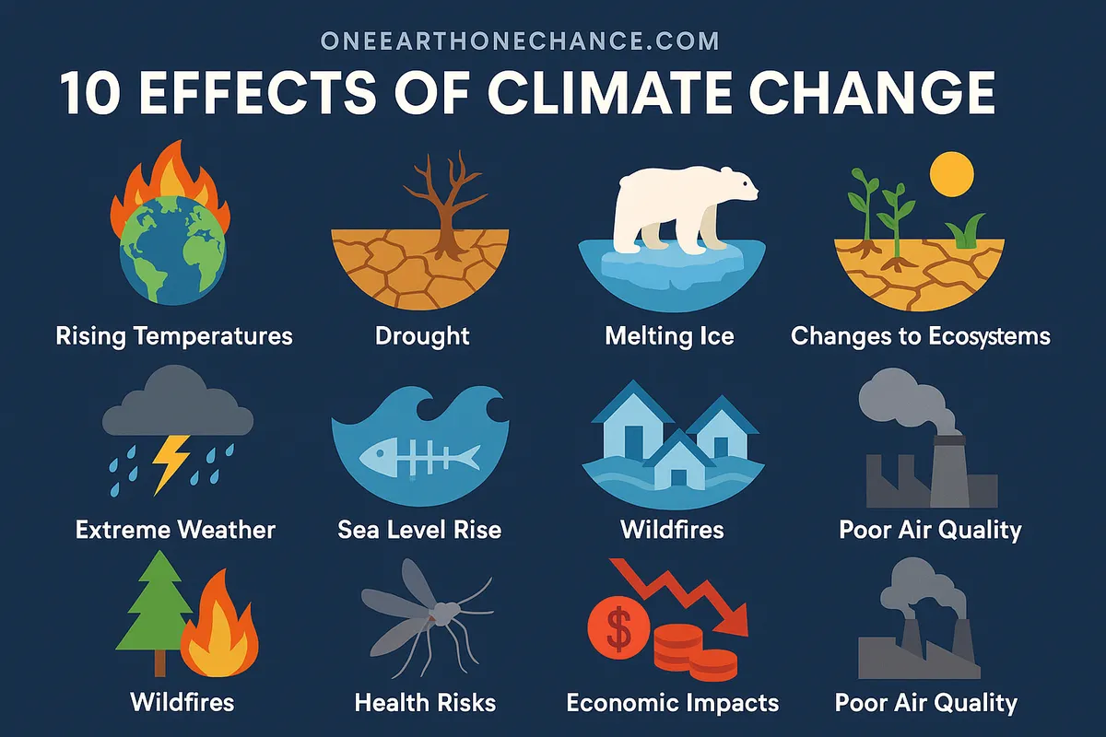
WATERSHEDS & CLIMATE: Lesson 3
Because the Earth is a system where everything is connected, changes in one area causes changes in other systems (precipitation, sea levels, catastrophic storms, water scarcity and declining biodiversity).

Slide 7
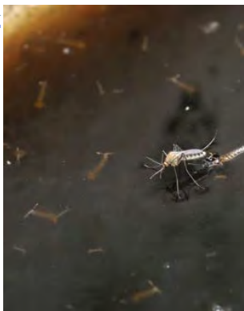
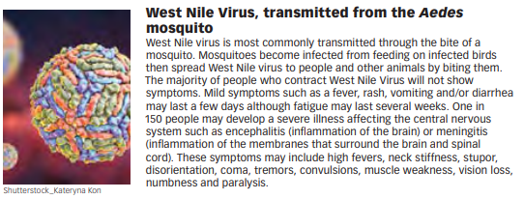
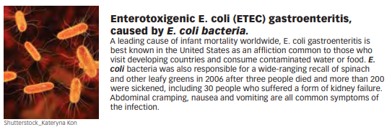
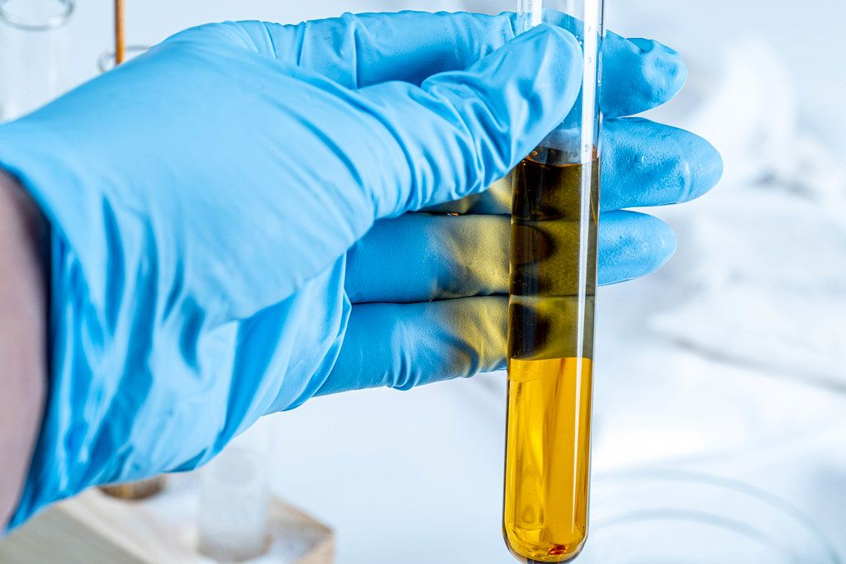
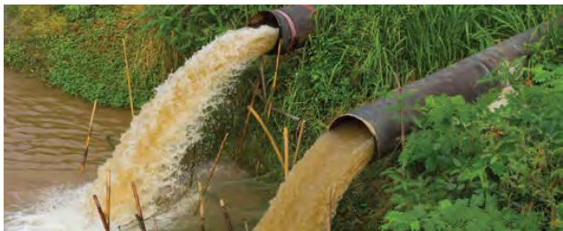
WATERSHEDS & CLIMATE: Lesson 3
Waterborne Diseases
Activity:
Students learn about how a changing climate may affect waterborne and vector diseases.
They search for others who have been “infected” with the same disease as they have, learning and sharing about each disease.
Notes:
With climate change and extreme weather (drought and more precipitation or flooding in areas along with different temperatures introduced in regions) how might this affect waterborne diseases?

Slide 8
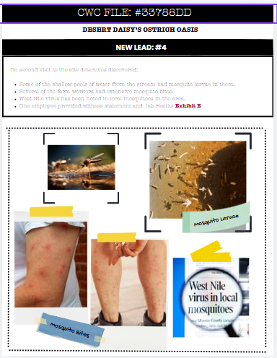

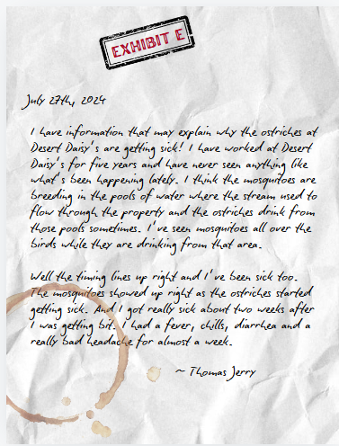
Now think about how this activity might play into the case file?
Provide Lead #4 after lesson
This Photo by Unknown Author is licensed under CC BY-NC
Notes:
Pass out the additional case file leads that go with each lesson. We anticipate that students are then continuously adding to their MAP worksheet page and their initial argument page as they continue to make new discoveries.

Slide 9
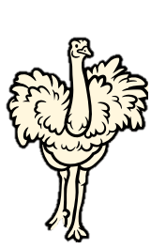
Lesson 3
Wrap-Up
Systems and System Models
&
Cause and Effect
Better understanding the role of water in transmitting diseases helps us be more aware of human/animal wellness.
So how do you think climate change and new extremes will affect disease and water quality?
Notes:
Also, you can think about how climate change and extremes mixed with human impacts within a watershed might compound these issues and create even more water quality and health problems. It is up to all of us to be problem solvers and to take care of our water.

Slide 10

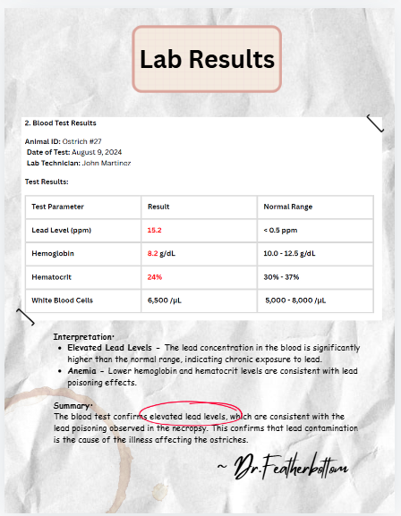
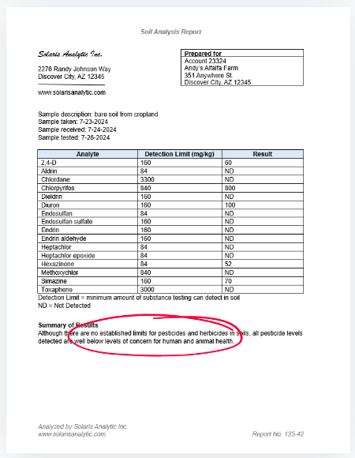


Close the Case
Final Test Results
Final Case Synopsis
Notes:
You will then have another envelope (from the superintendent of the Cold-Water Case Squad) that holds the evidence and test results that will close the case. You can decide whether to wait a day or several days before providing the students with the actual answer. There are test results and findings that you can give first that will lead them to an answer, but if you don’t read out the final case file page, you can still have your students try to figure out where the culprit came from. Then eventually share the synopsis from the Superintendent closing the case.

Slide 11
SUSTAINABILITY & STEWARDSHIP:
My Water Footprint
Investigative Questions
How much water do I use daily?
Why is water use called a water footprint?
How can I be a better water steward?

Slide 12
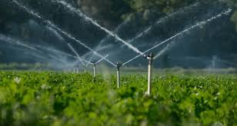

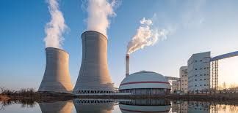
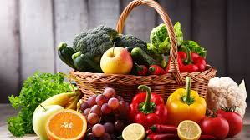
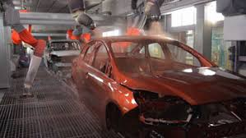
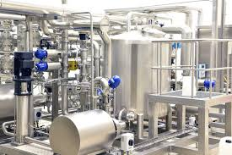
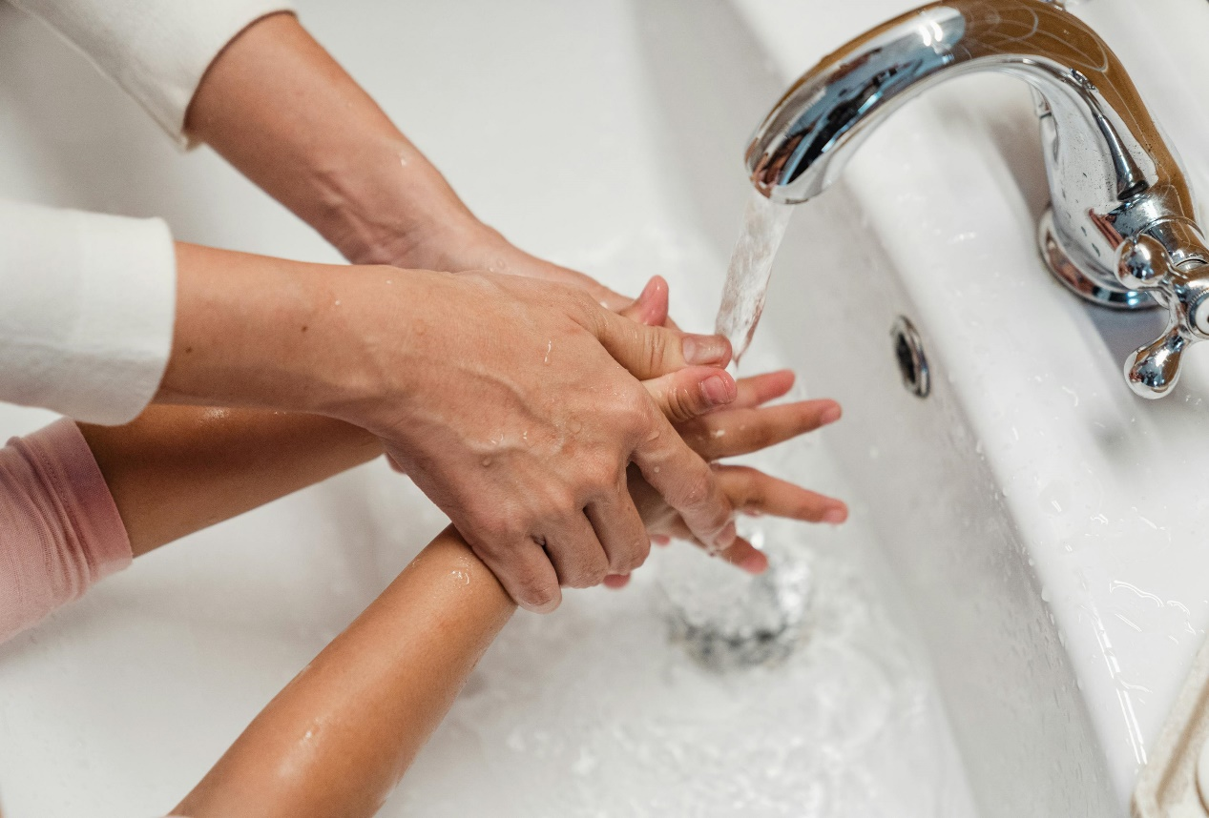
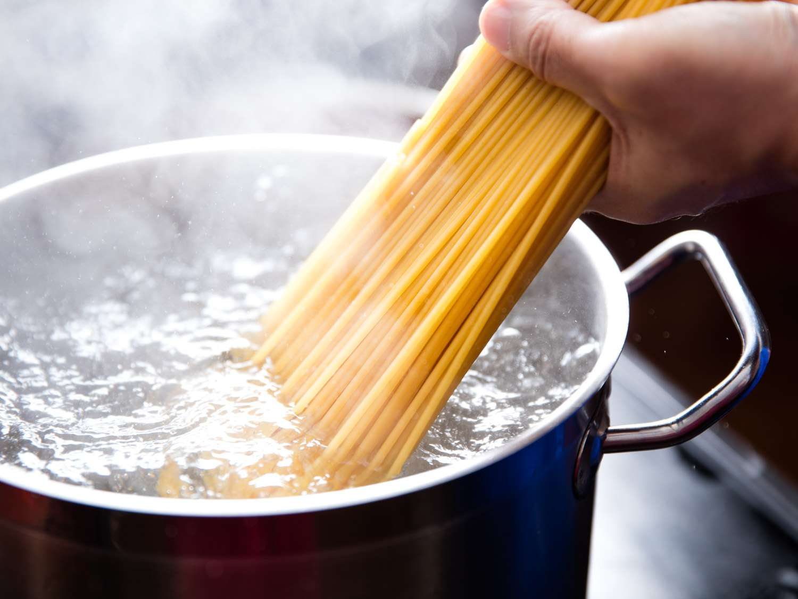
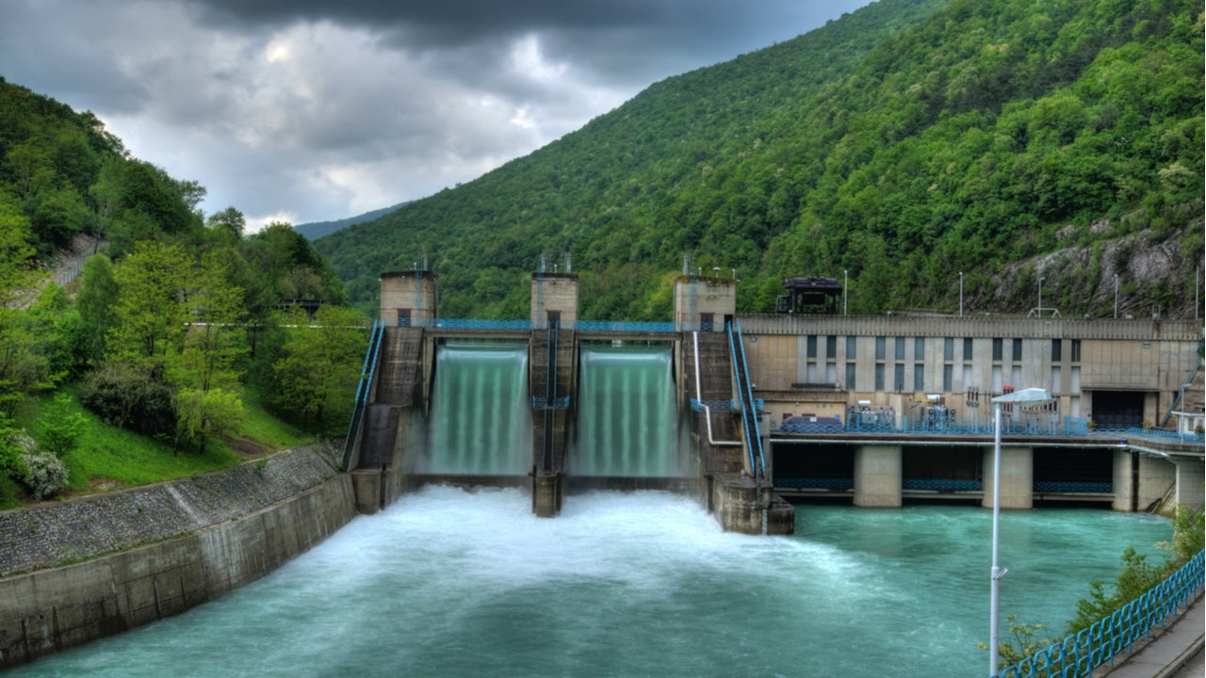
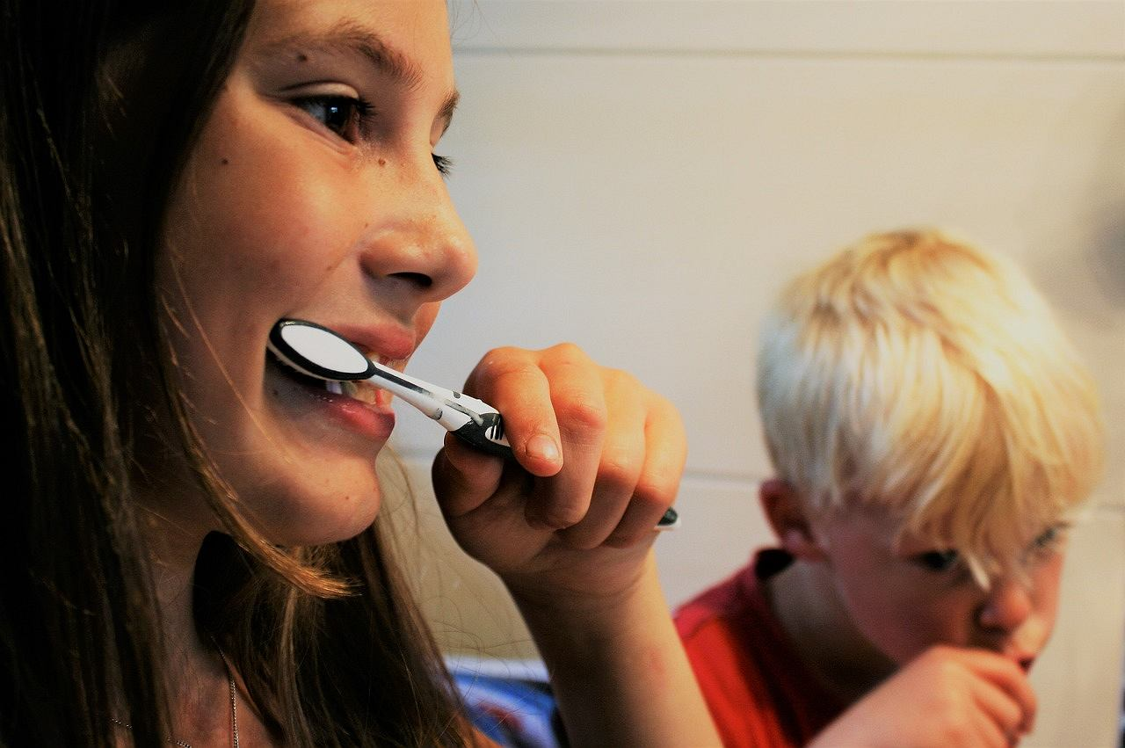
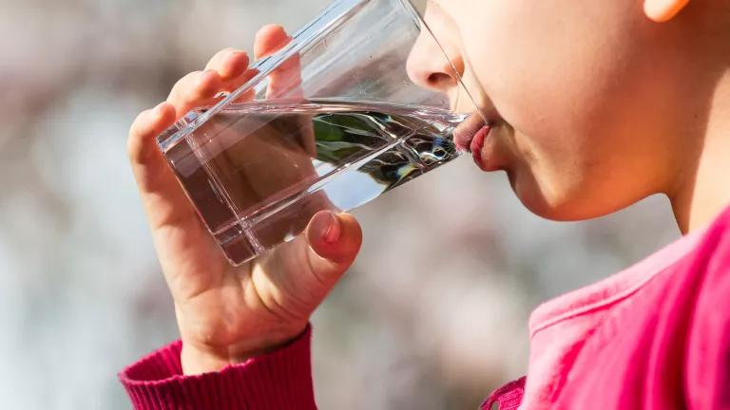
Indirect Water Use
The water used to produce the goods and services we all enjoy. It is the water hidden or not seen by the end-user during the process or manufacturing of a good or service.
Direct Water Use
Water you use directly to do something immediately. Water that is seen, felt and used at that given time. When you turn on your faucet or hose for water.
Notes:
What is Direct Water Use – that will show first, then indirect
Direct Water use: Drinking water, bathing, flushing a toilet, brushing your teeth. To make a bowl of pasta, water is required to boil the dry pasta in the pot – this is direct water use for the person eating that pasta at home.
Indirect Water use: also called hidden or virtual water – because the water use is often unseen by the end-user of a product or service, but the water has been used or consumed throughout the process chain. In order to produce the pasta, water is required at many steps along the way - water to grow the wheat; water to produce the fuel for machines to harvest the wheat and transport the pasta to the store; and water to create the electricity for processing the wheat into flour and pasta.

Slide 13
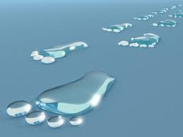
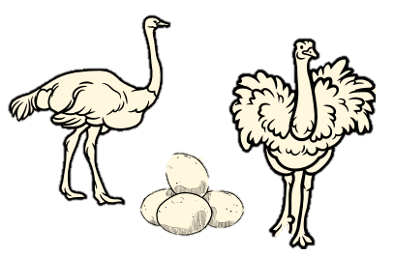
SUSTAINABILITY & STEWARDSHIP:
What is a Water Footprint?
It reveals water use patterns, from the individual level all the way to the national level.
It shines a light on the water used in all the processes involved in manufacturing and producing our goods. It also accounts for water contaminated during manufacturing and production.
A water footprint is measured in terms of the volume of water consumed, evaporated and polluted.
Notes:
It is like an invisible mark that shows how much water you use for all the things you do and things you use (direct water use and what you eat and wear).
Blue Water Footprint: The amount of surface water and groundwater required (evaporated or used directly) to produce an item.
Green Water Footprint: The amount of rainwater required (evaporated or used directly) to make an item.
Grey Water Footprint: The amount of freshwater required to dilute the wastewater generated in manufacturing, in order to maintain water quality , as determined by state and local standards.
https://watercalculator.org/footprint/what-is-a-water-footprint/
There is also a lesson in the book you can do

Slide 14
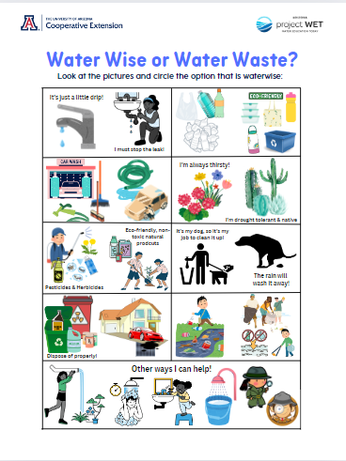
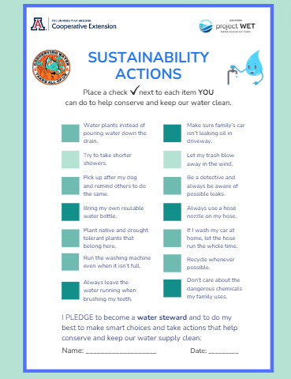
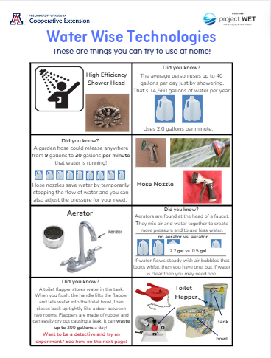

SUSTAINABILITY & STEWARDSHIP:
BE THE TIDAL WAVE OF CHANGE!
Your daily choices and actions can add up to make a positive difference.
Notes:
Water Worksheets for your students to check their understanding of sustainability actions. And resources they can share with family and friends

Slide 15
Splashing into Solutions
You Have the Power!
What is Water Conservation?
What is Water Efficiency?
Beneficial reduction in water loss, waste or use by changing behavior to use less water.
Minimize the amount of water used to accomplish a function or task. Doing more with less water. Normally relies on well-engineered products and fixtures or technology
Notes:
Being a water steward is really about both… making good choices to practice water wise behaviors while also utilizing new technologies to make water use more efficient. This is how we can all help make a positive impact!

Slide 16
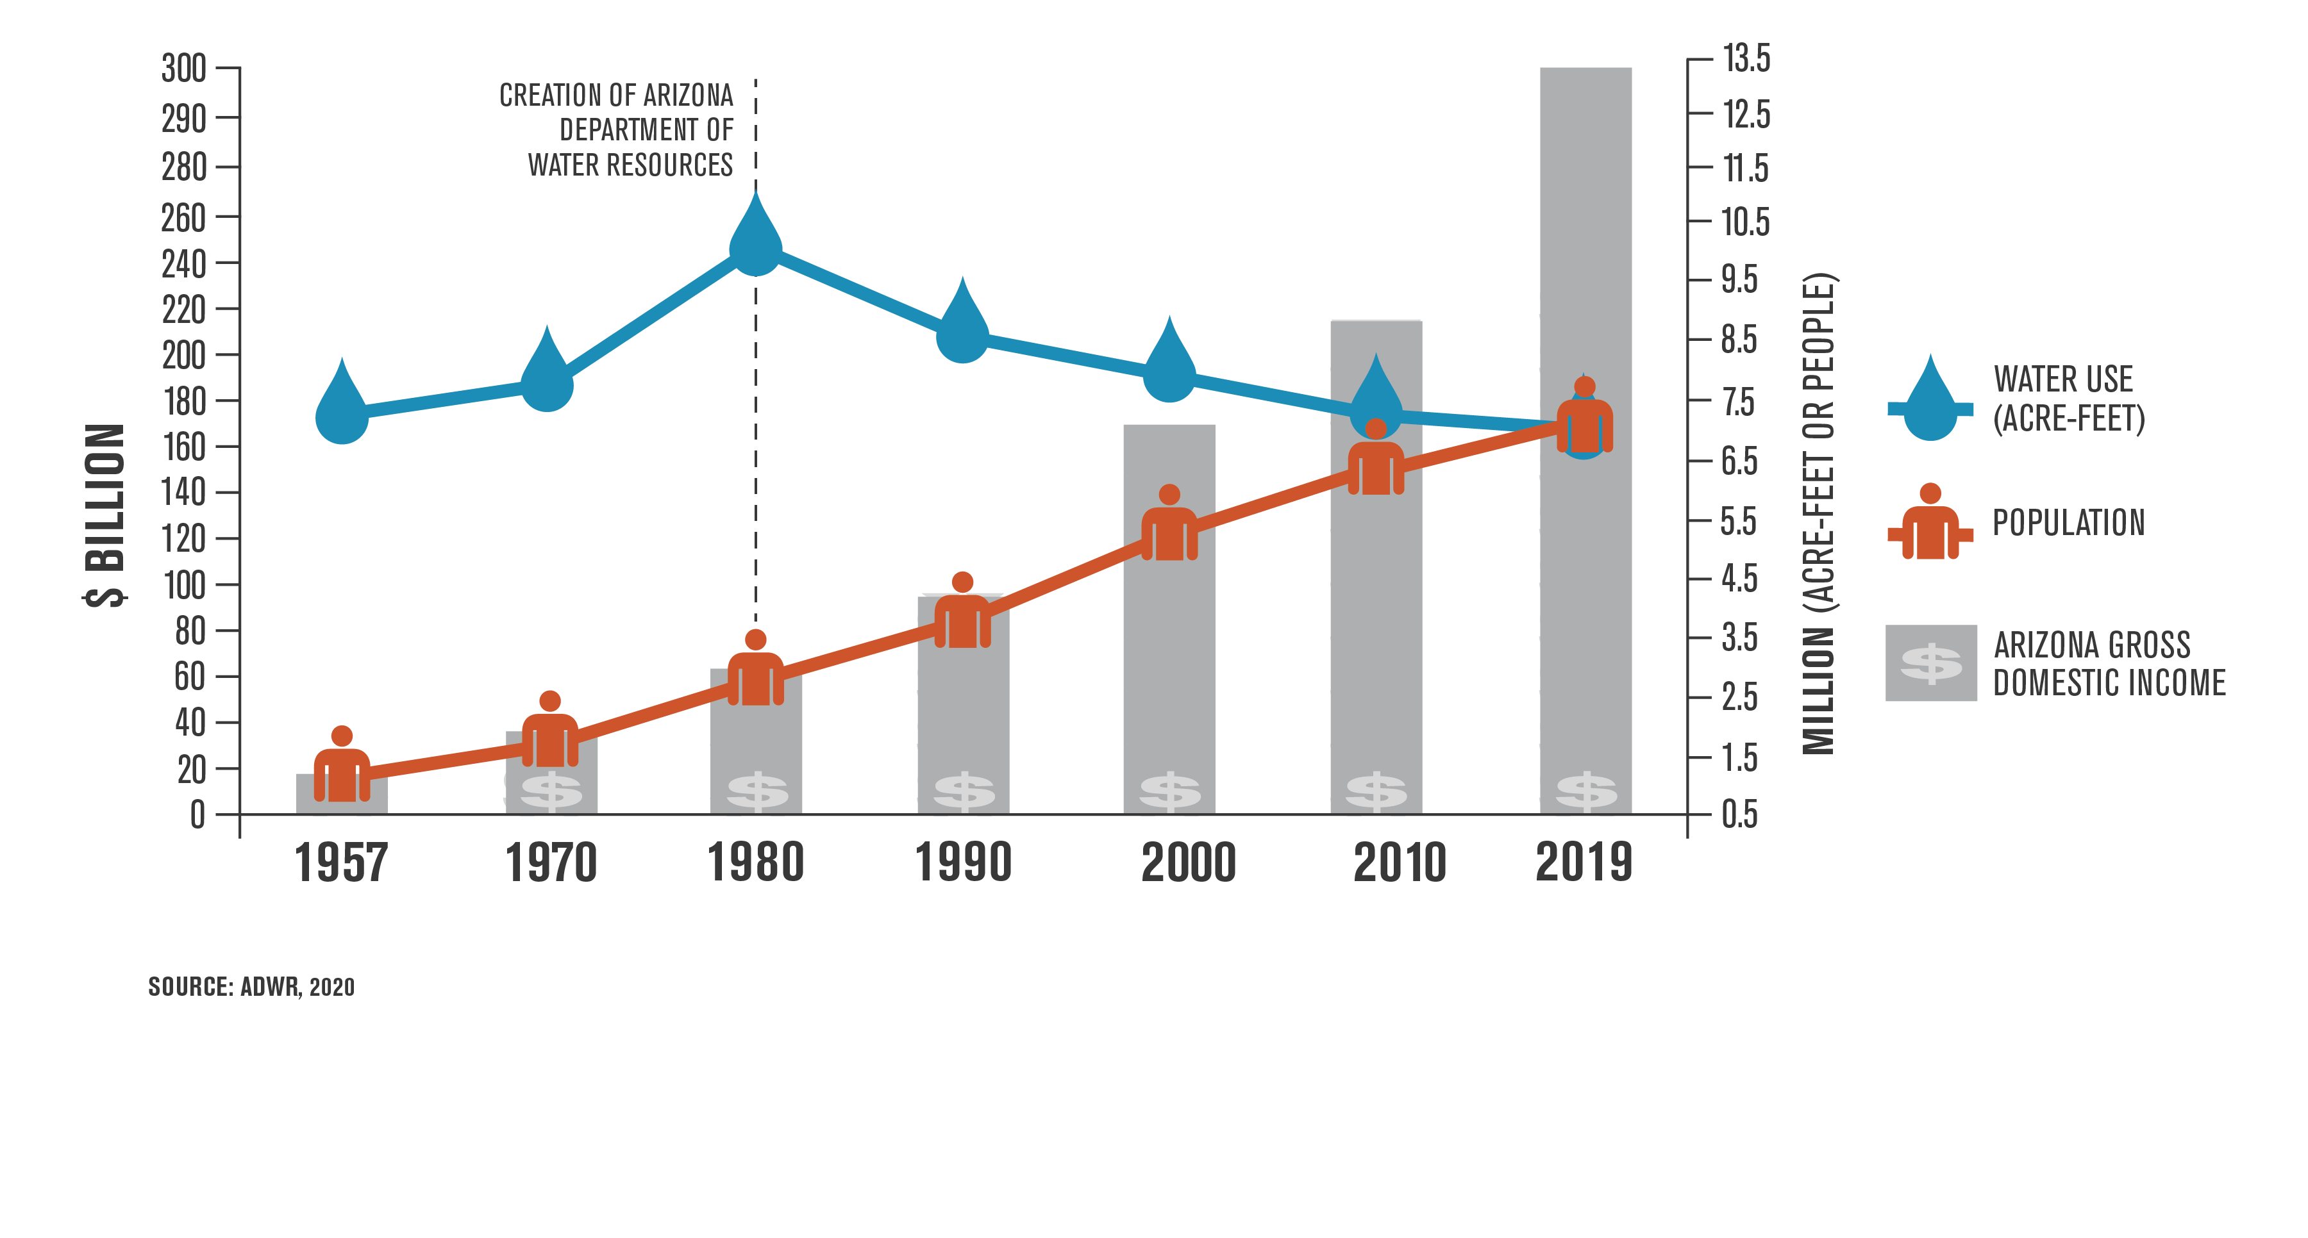
Notes:
There is hope! What do we notice in 1980? Passes the 1980 Groundwater Management Act…
1980 we had 2.7 million people but we were using over 9 million acre-feet of water
2019 we have over 7 million people and we are using under 7 million acre-feet of water – that is pretty incredible
through significant investments in water conservation and infrastructure and the reuse of water, our water use is essentially the same as it was more than half a century ago.
What is an acre foot of water? = enough water to cover an acre of land a foot deep = 326,000 gallons (about the size of a football field a foot deep).
According to the ADWR – The average number of homes served annually by an acre-foot of water actually increases to 3.5 when all of Arizona’s five “Active Management Areas” are taken into account. There are many variables but this is how cities look at development of new homes.

Slide 17

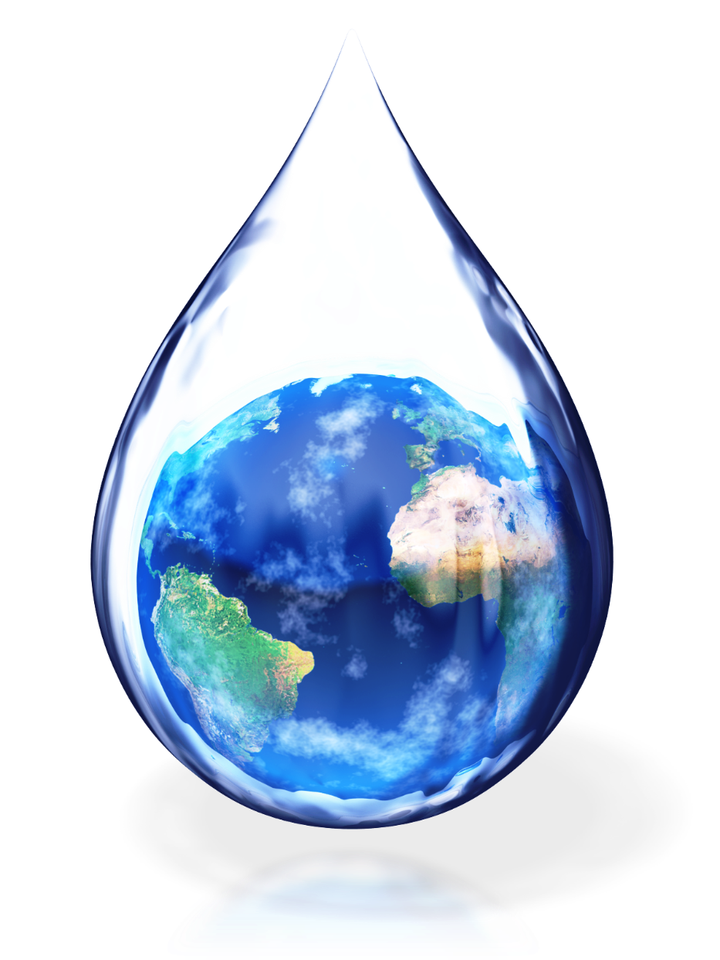
Take the PLEDGE:
I PLEDGE to be a water steward, to do my best to make smart choices and take actions that help conserve and keep our water supply clean.

