Slide 1
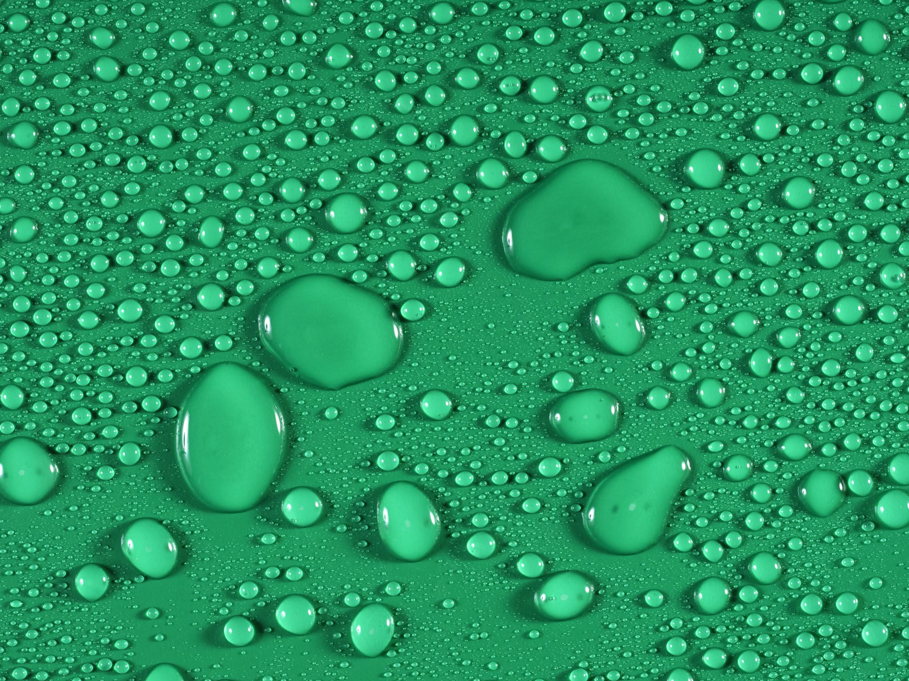


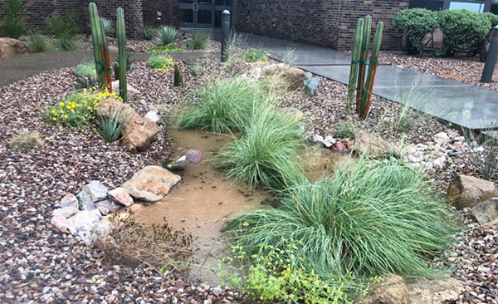


Planting for a Rainy Day
2025-2026

Slide 2

Lesson 1: Estivation, Xerophytes, and Ephemerals
Investigative Questions
How have the animals and plants living in Arizona adapted so that they can survive here?
How does transpiration and evaporation relate to plants’ and animals’ adaptations for water conservation and temperature management when living in Arizona?
What is a watershed and which watershed do you live in within Arizona?
Notes:
Might want to start this class discussion with a driving questions board and have students read the background info provided in Student Handbook after you set-up the next experiment

Slide 3
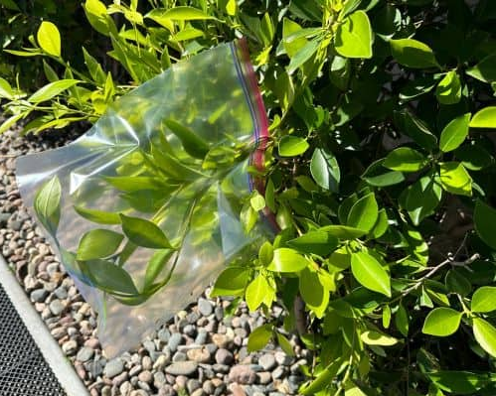
Thirsty Plants – Set-up: Lesson 1
Experiment Time:
Take students outside to an area with several plants (a variety is best).
Have students carefully place the bag over several leaves of their plant, and zip the bag closed.
Record their data on the worksheet.
Make predictions and while you wait to check on your bags (approx. 60 minutes) proceed with rest of lesson.
Tip – sunny days and spots will work best for this experiment!
Notes:
We have provided you with additional resources too. Full-body activity and a fun experiment. Set up this activity while you do the rest of the lesson, and so it can sit in the sun for at least an hour.

Slide 4
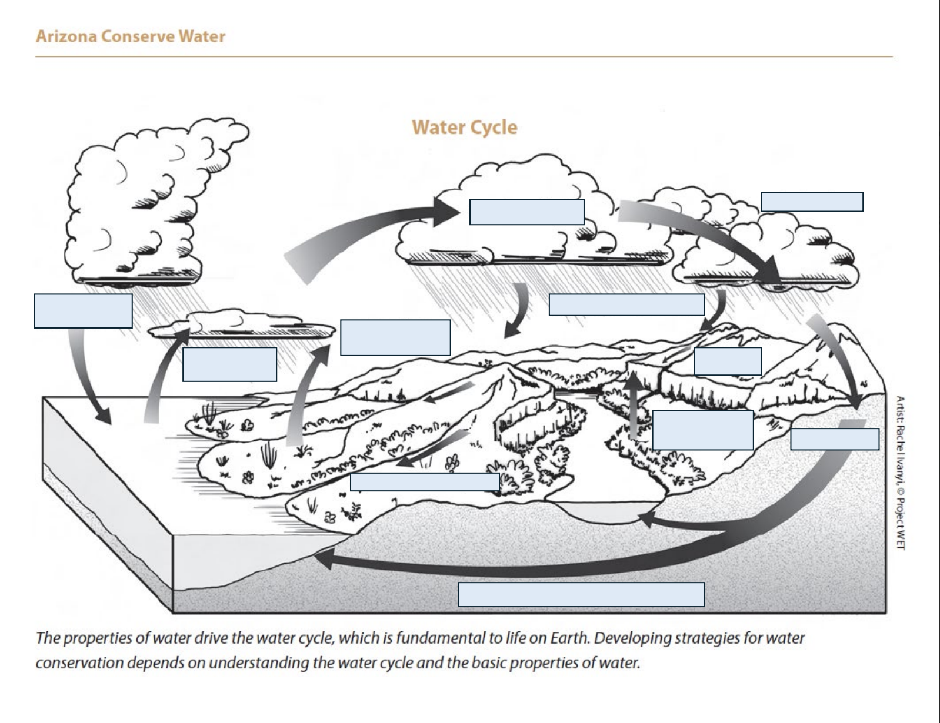
Water Movement In the Water Cycle
Notes:
Give the students a chance to think about how water moves and changes form. Ask them to write down three questions that they have about the phenomena. If you are able to give the students sticky notes - create a public board of questions to refer back to during the unit.
What are the forces that drive these changes in the water cycle?
Give them the diagram and have them label all of the water cycle parts and processes. (draw arrows, different colors, etc.)
These are the Cross Cutting Concepts demonstrated in this lesson

Slide 5
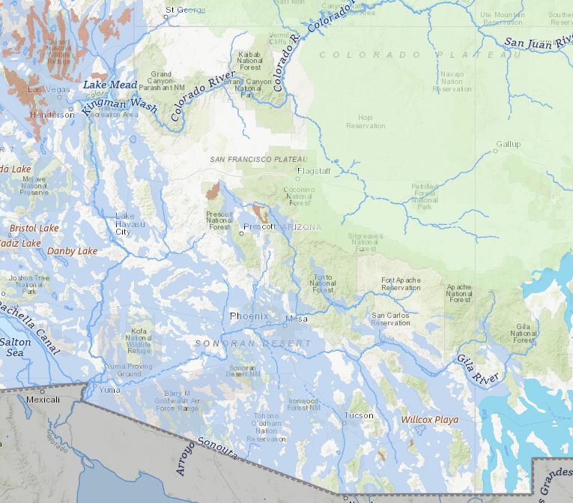




How much water do we have in Arizona? Why?
Total land area of Arizona:
113,990 square miles
Total water area of Arizona:
0.3%
Aquifers =
Notes:
https://www.usgs.gov/special-topics/water-science-school/science/how-wet-your-state-water-area-each-state
We don’t have much water compared the size of our state… so what does this mean?
Water is not distributed equally across the Earth-there are arid regions and wet regions.
Start Poll Lesson 1 Intro

Slide 6
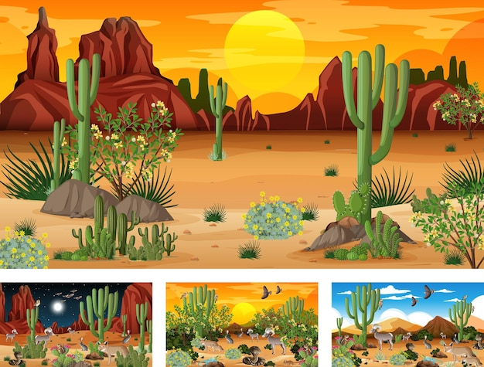
Investigative Questions:
How does water move through our local water cycle?
Are you a part of our water cycle ?
Does water move in and out of your body?
We live in a desert!
Notes:
Have your students brainstorm and think about what their local water cycle looks like. What processes are happening? Is it dry or wet most of the time? Are there trees and plants? Animals? People? What are ways you are part of the water cycle or that water moves in and out of your body? People drink, perspire (sweat), breathe –respiration, and urinate – so yes water does move through our body, and we are part of the water cycle
So why is Arizona a Desert? What makes a desert a desert? Region of land that has an arid/dry climate receiving less than 25 centimeters (10 inches) of sporadic rainfall annually

Slide 7

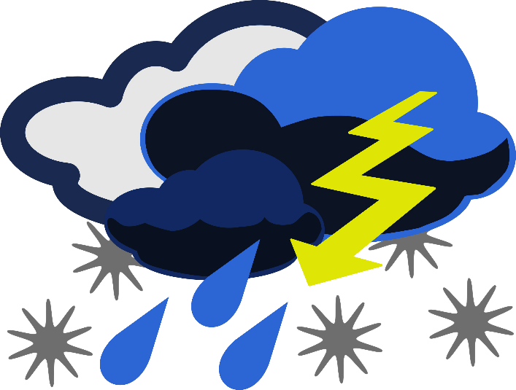
What is climate?
Is climate the same as weather?
Weather: what happens day to day (temp, clouds, precipitation)
Climate: is average measurements over several years
Climate is what you expect, and weather is what you get
Notes:
Because when we live in a desert the climate and weather is a specific way. And this has an effect on the water that we have.
Who can unmute or put in chat what is Weather?
Our climate and weather play an important role in regards to what does happen to the moisture we have here in Arizona…

Slide 8
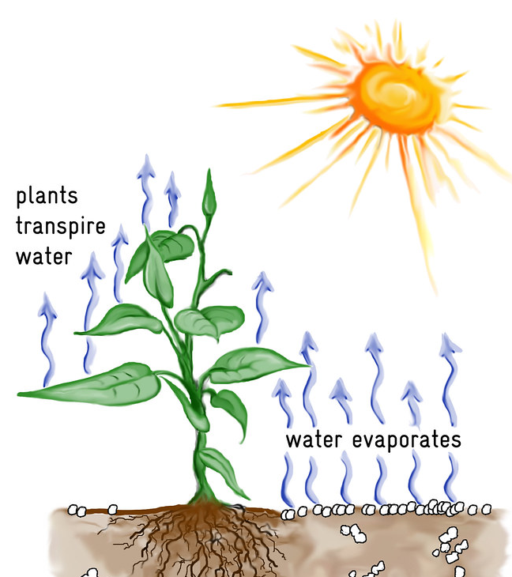
What is
evapotranspiration?
What is evaporation?
What is transpiration?
What form is water changing from and into during each process?
This Photo by Unknown Author is licensed under CC BY
Notes:
Start Evapotranspiration Poll:
Read slide first – water goes from a liquid into a gas – water vapor. then say what do we get when we combine these two processes?
Evapotranspiration – combining evaporation and transpiration together, which means it is all the water that’s coming off the soil. Overall Evapotranspiration is an important process in the water cycle because it is responsible for a substantial amount of the atmosphere's water vapor. Without that input of water vapor, clouds couldn't form and precipitation wouldn’t fall.
So we are going to look at some climate tables.
More info if needed: They measure evapotranspiration in different ways, but one scientific instrument mainly used by farmers is called an atmometer and is usually used with alfalfa crops or grasses, to get the data for different areas. Another measuring device is called a lysimeter.

Slide 9
Notes:
Notice inches of rainfall, what is our max?
Note this is over the year

Slide 10
Notes:
Notice max especially when compared to our rainfall max (only 12 inches in Tucson)

Slide 11
Notes:
We get a lot more evapotranspiration then we get precipitation… so what does this say about our climate? If you were an alien and looked at this data, what would you expect the climate to be like in Arizona? What kind of plants would you expect to find? this is going to be a very dry place – a desert, it isn’t that we don’t get rain or precipitation, but that our Evapotranspiration is much higher than our precipitation. About 7 x more …What does this mean for your local water cycle and climate? It means we need to be smart about the water we have

Slide 12
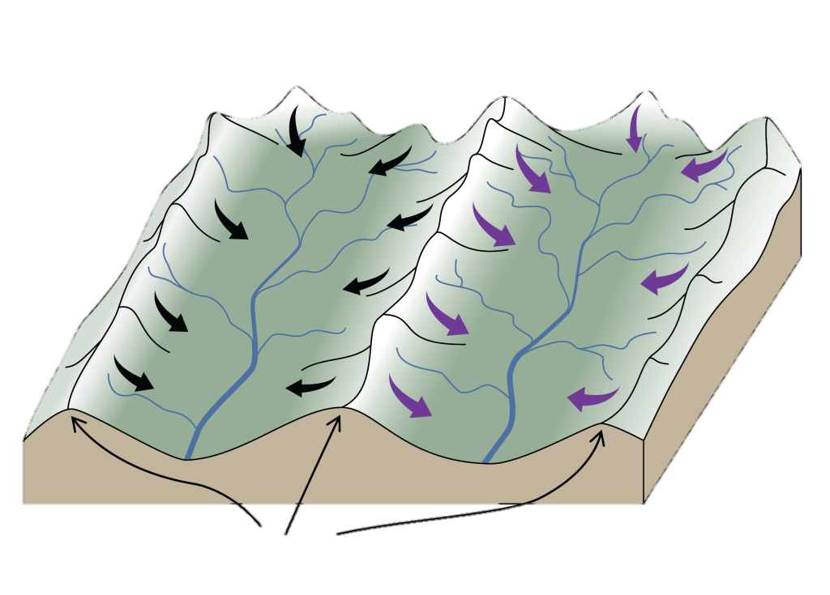
Watersheds & Maps: Lesson 1
What is a Watershed?
A watershed is: a land area that DRAINS to the low points.
Notes:
So at this point in the lesson you will have students look at the maps in the Student Handbook but before they break to do this we want them to know what a Watershed is…
You probably know what state and city you live in, but do you know which watershed you live in?
Did you know that with every step that you take, you are always in a watershed?
What exactly is a watershed, and why should you care about it?
What is a watershed? Break the word down:
Water
Shed – both a noun (building that stores something) and verb (to cast off or let fall, like a dog sheds)
Do the definition and motion “A watershed is….a land area…that DRAINS to the low points.”
Ask: “If the definition is true, then what are the edges or boundaries of a watershed?”
Mountains
High points

Slide 13
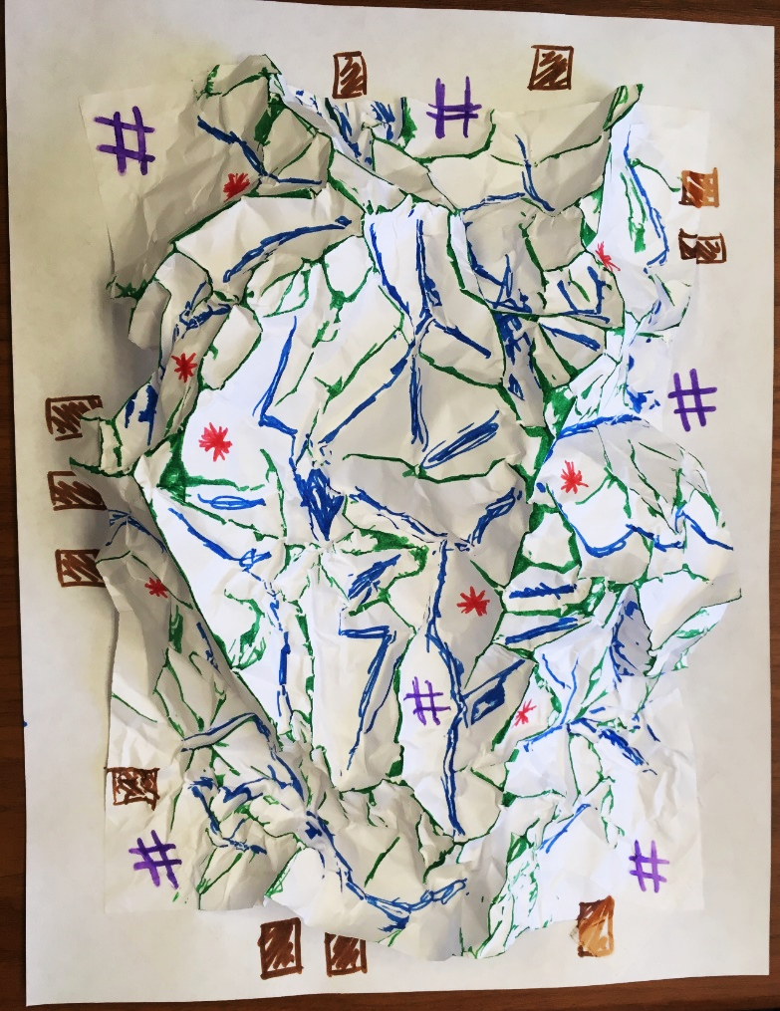
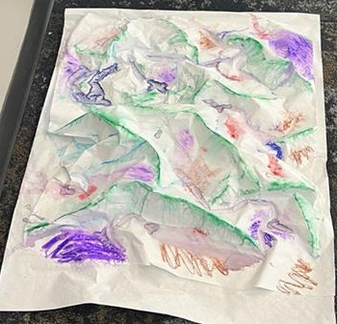
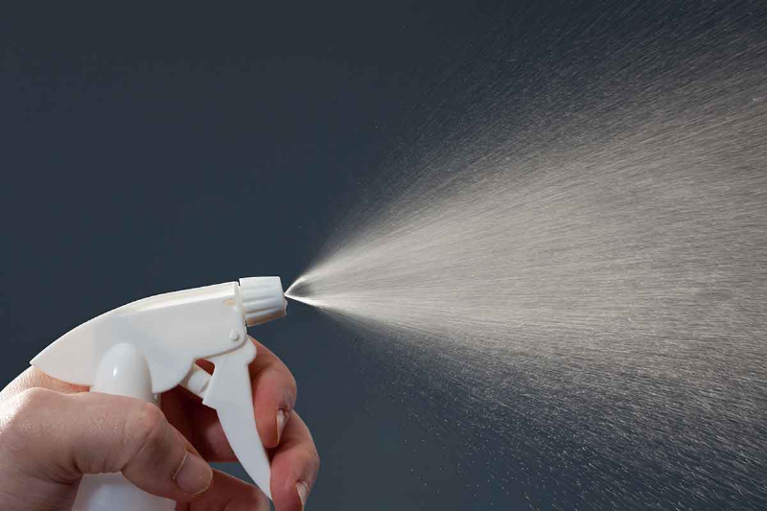
Optional Activity: Watersheds Work
Key/Legend:
Ridges (along upfold) = Green
Valleys (along downfold) = Blue
Optional Colors:
Farms (colored area) = Brown
Old Mines (*) = Red
Cities (#) = Purple
Additional topics can be other colors
Notes:
Have your students create a watershed model with paper and markers.
This is seriously one of my favorite activities and we do this at all of our workshops as it is such a great visual of how a watershed works.
Tip, use waterbased markers to get a better effect and don’t let students flatten out the paper too much!
What are the boundaries of a watershed? High points and low points are what? Helping them to understand what is a Watershed – a land area that drains to the low points and that they are in a watershed. If you can’t do the watershed in class, there is a nice video.

Slide 14
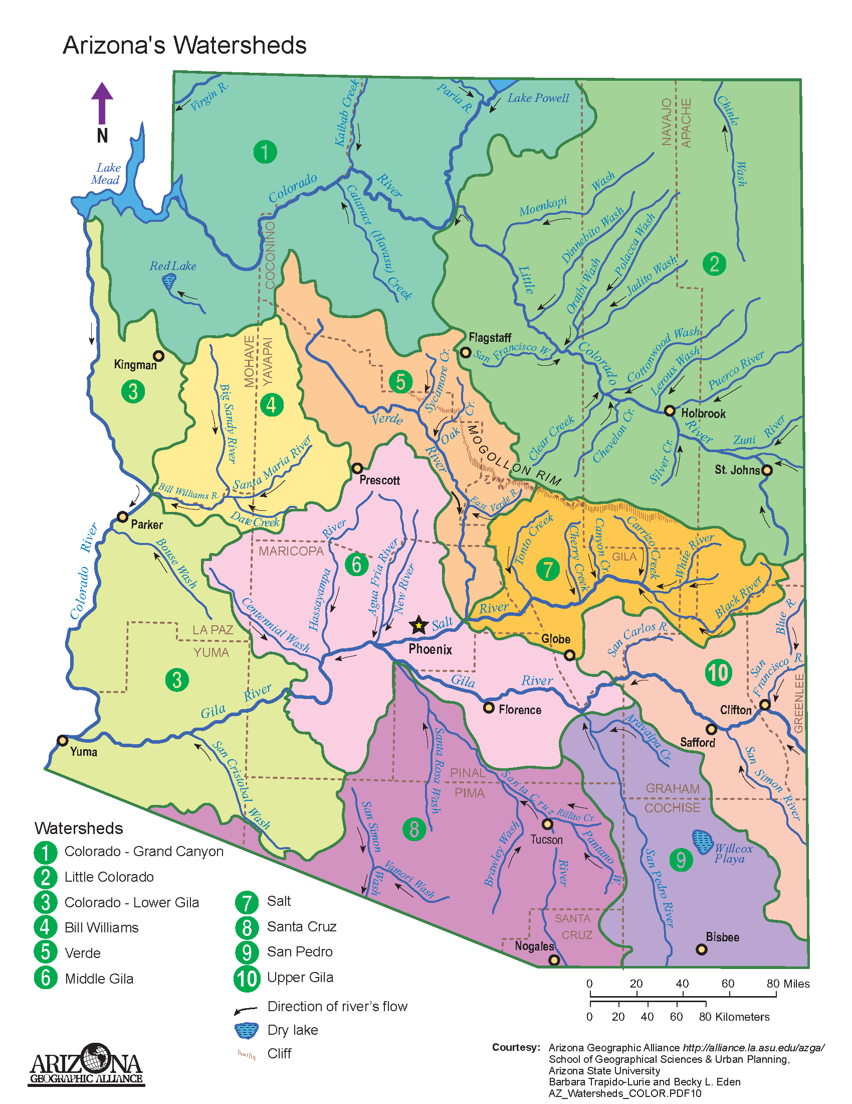
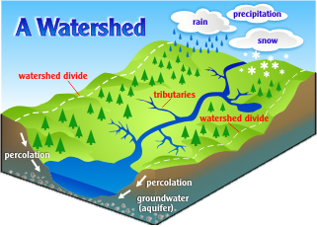
Watersheds & Maps: Lesson 1
What are we managing when we talk about watershed management?
The land and water in that area.
Notes:
We don’t only have to think of and protect the water that is in a watershed, but we also have to manage all of the land in that area… all the way from the high points or mountains, down to the low points of the rivers and valleys.
Because what happens to the land affects the water and what happens to the water affects the land.
Now students look at different maps to compare water availability, temp and rainfall in areas and discuss how different types of habitats are found there. What kind of animals and plants live in these different habitats/ecosystems? Then students play adaptation matching game.

Slide 15
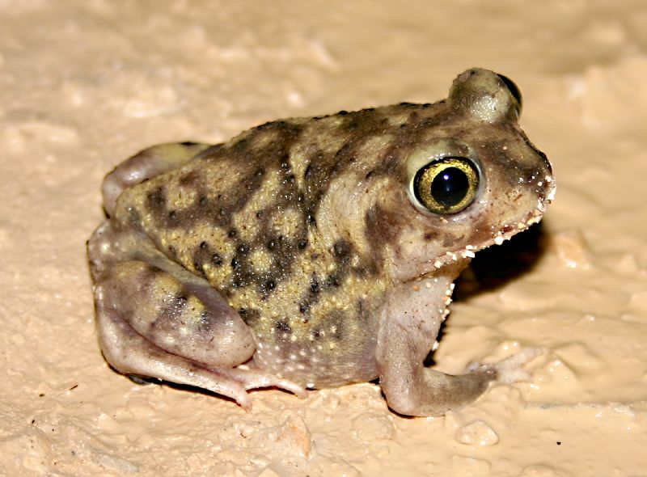
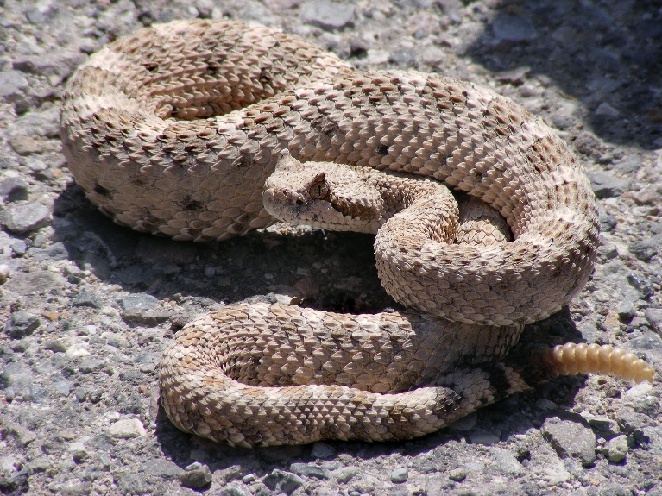
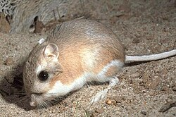
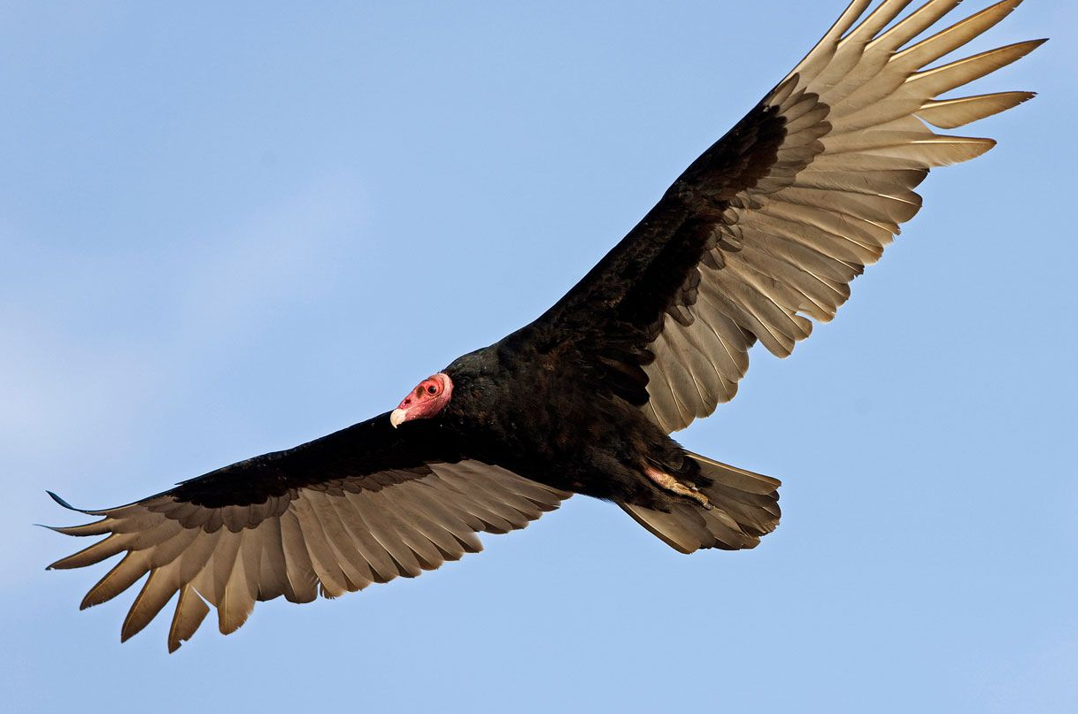
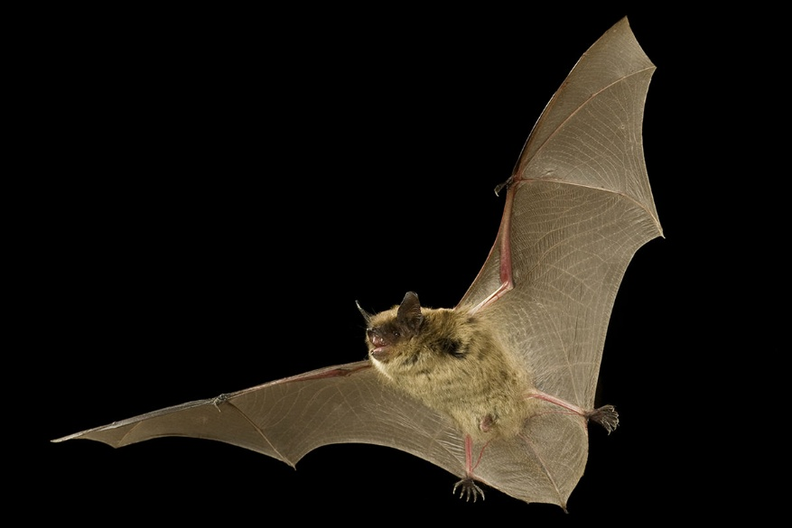
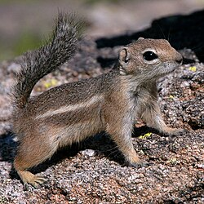
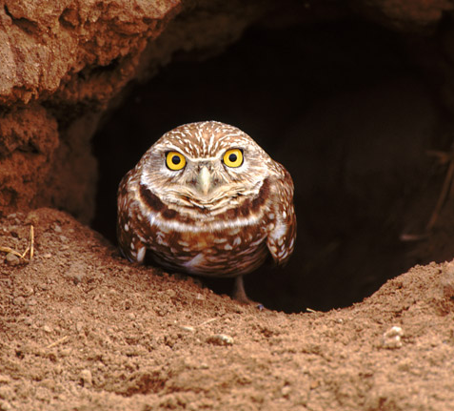
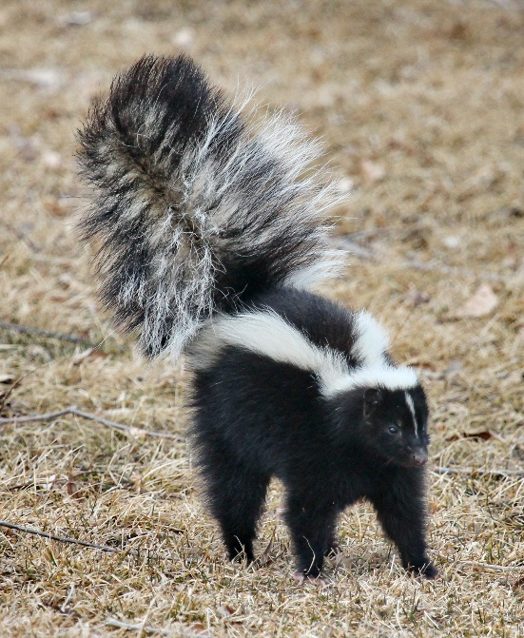
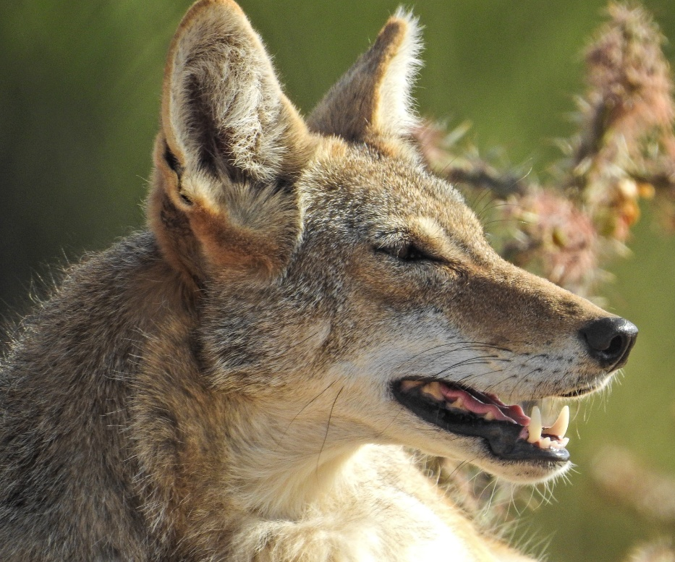
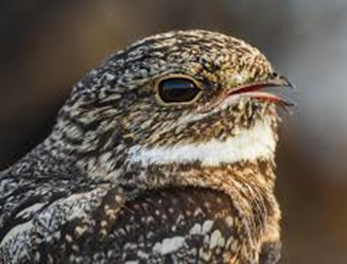
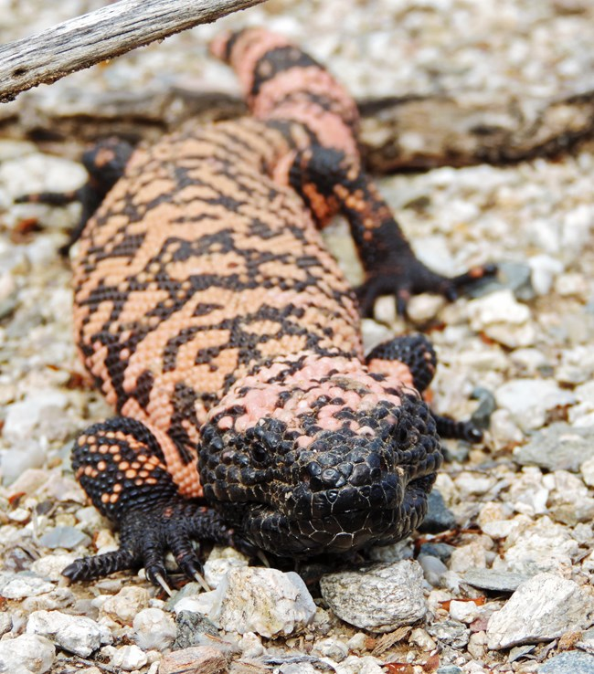
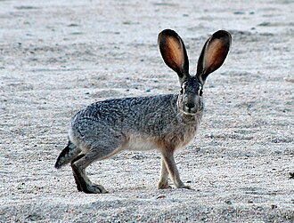
Amazing Adaptations: Lesson 1
Evaporation to cool & get water from food source
Estivation & Crepuscular
Nocturnal
Notes:
So, now that we understand that we are in Arizona and it is a desert, have students review background info in Student Handbooks and then brainstorm about different desert plants and animals with special adaptations for the Arizona environment. You can use this slide to summarize what they read.
Many animals have specialized adaptations that help them survive in our Arizona climate…
Estivation – is like hibernation, except it occurs in the hot dry summer instead of the cold wet winter. Desert toads estivate and burrow underground during the dry part of the year and then awaken and come out during the first summer monsoons.
Crepuscular – means animals that come out to be active at dawn and dusk to avoid the hottest parts of the day
Nocturnal animals come out at night when it is cooler and have adaptations so they can hunt at night.
Some animals use evaporation techniques to cool – coyotes can pant to cool down, and jack rabbits have long appendages, and their ears help them cool. Owls and hawks open their mouth and use their throats to do something similar to panting to stay cool.
Then there are animals like vultures and kangaroo rats that get all the water they need through their food sources.

Slide 16
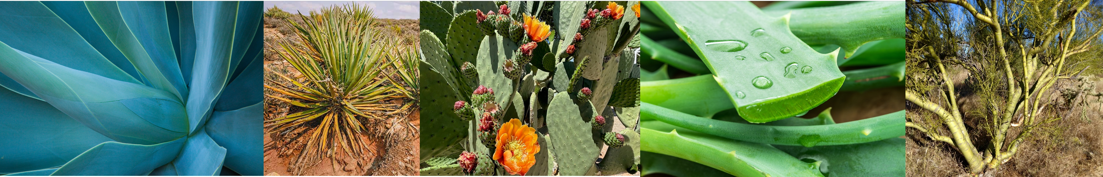
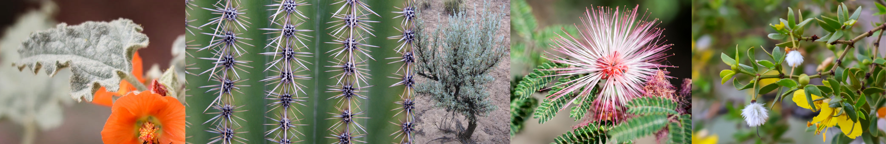
Amazing Adaptations: Lesson 1
Plants Must Conserve Water & Stay Cool
Thick, fleshy, and waxy leaves or stems can help plants store more water.
Xerophytes
Small, waxy, hairy leaves, or having spines help reduce water loss through evaporation.
Notes:
Now that we understand what evaporation and transpiration are, have students think about some different characteristics that enable plants to conserve water and stay cool.
Many native plants are xerophytes: plants that have adapted to arid environments by developing physical structures that help them to survive extreme heat and water deprivation. Palo Verde, Sagebrush, Creosote, Agave, and Cacti!
Cacti are some of the best adapted plants for drought tolerant conditions on earth. They often have shallow roots to soak up lots of water quickly as soon as it rains, and they can store enough water in their stems or bodies to often meet their needs for a year. They also have spines instead of leaves to reduce transpiration and loss of water and even have a specialized metabolic system, that allows them to keep their stomata closed during the day and to open at night for photosynthesis.
Others reduce the number and size of leaves to reduce water loss and these plants often have green bark (Palo Verde) to enhance photosynthesis. Some have silvery hair on the leaves to reflect the sunlight and keep the surface of the leaf cooler.

Slide 17
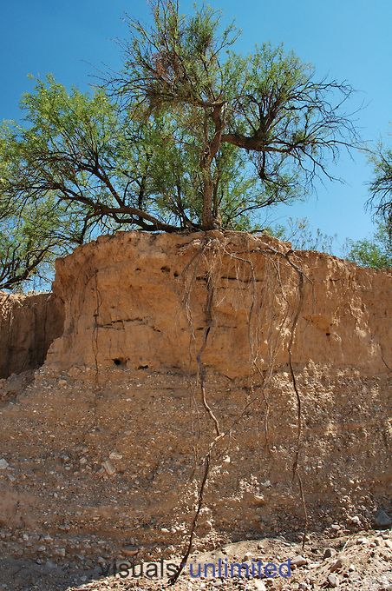
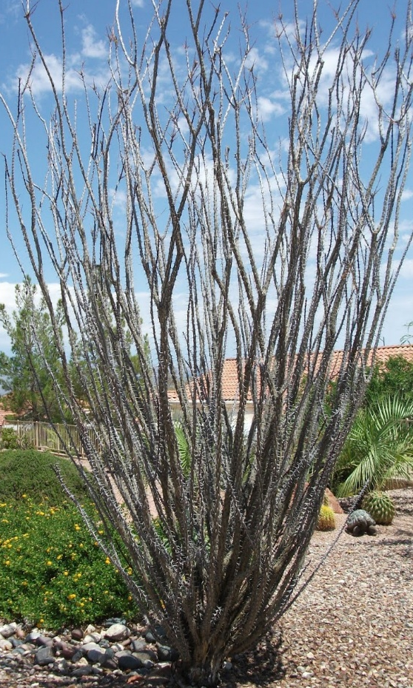
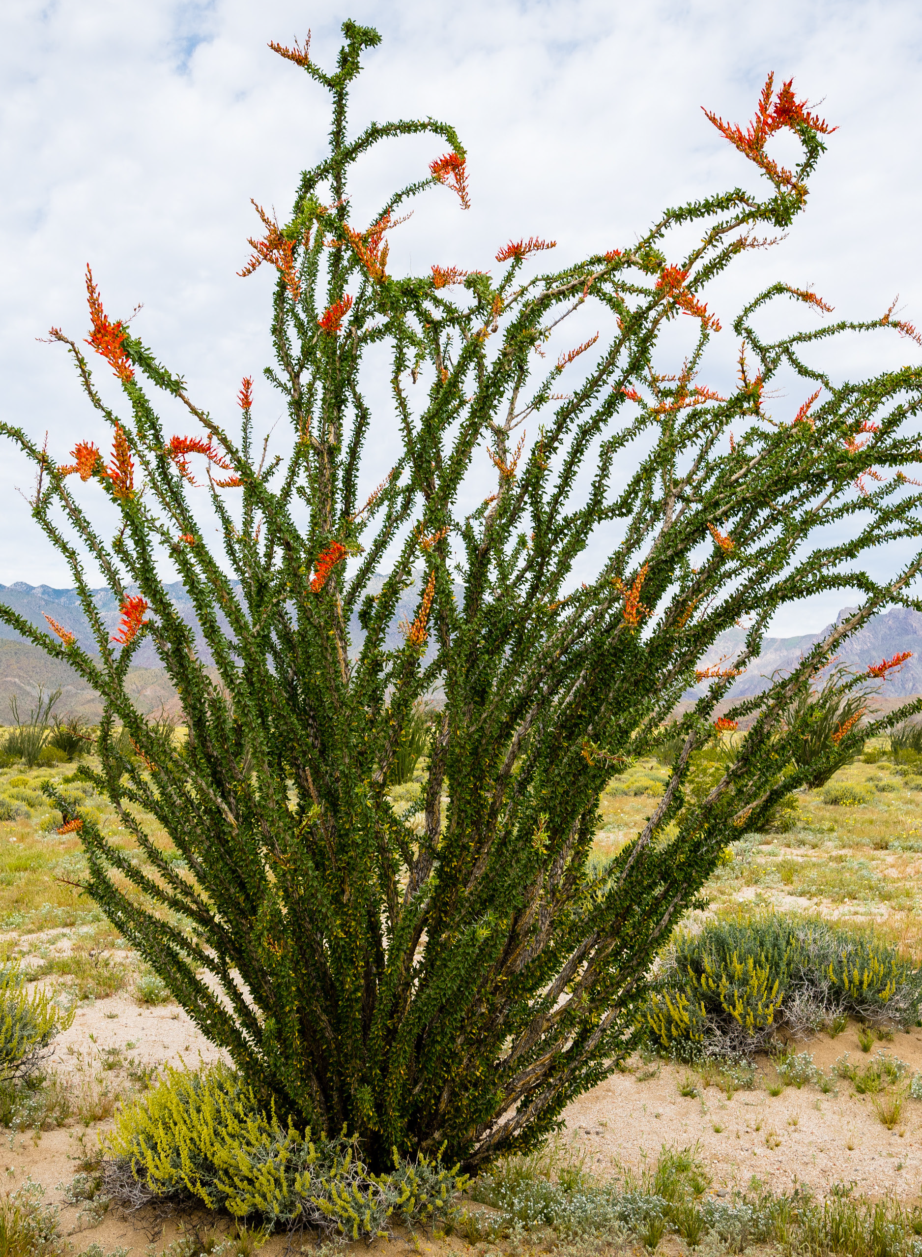
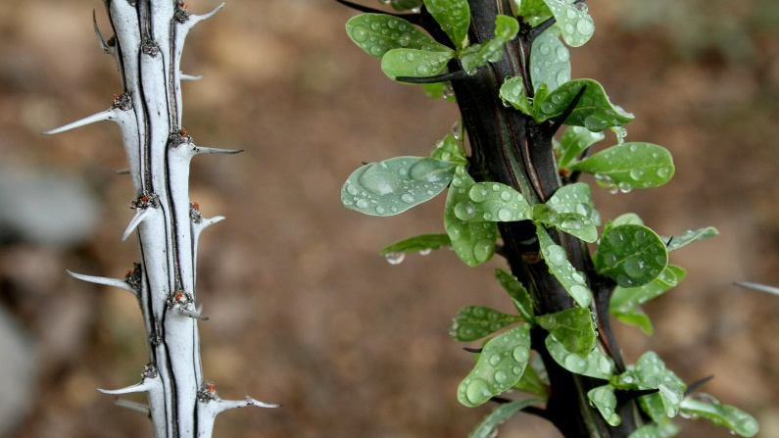
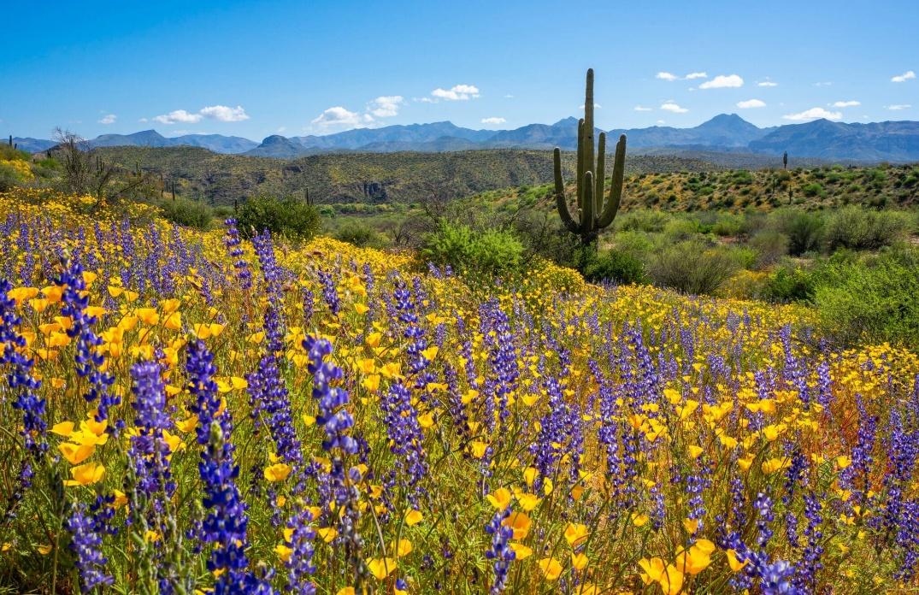
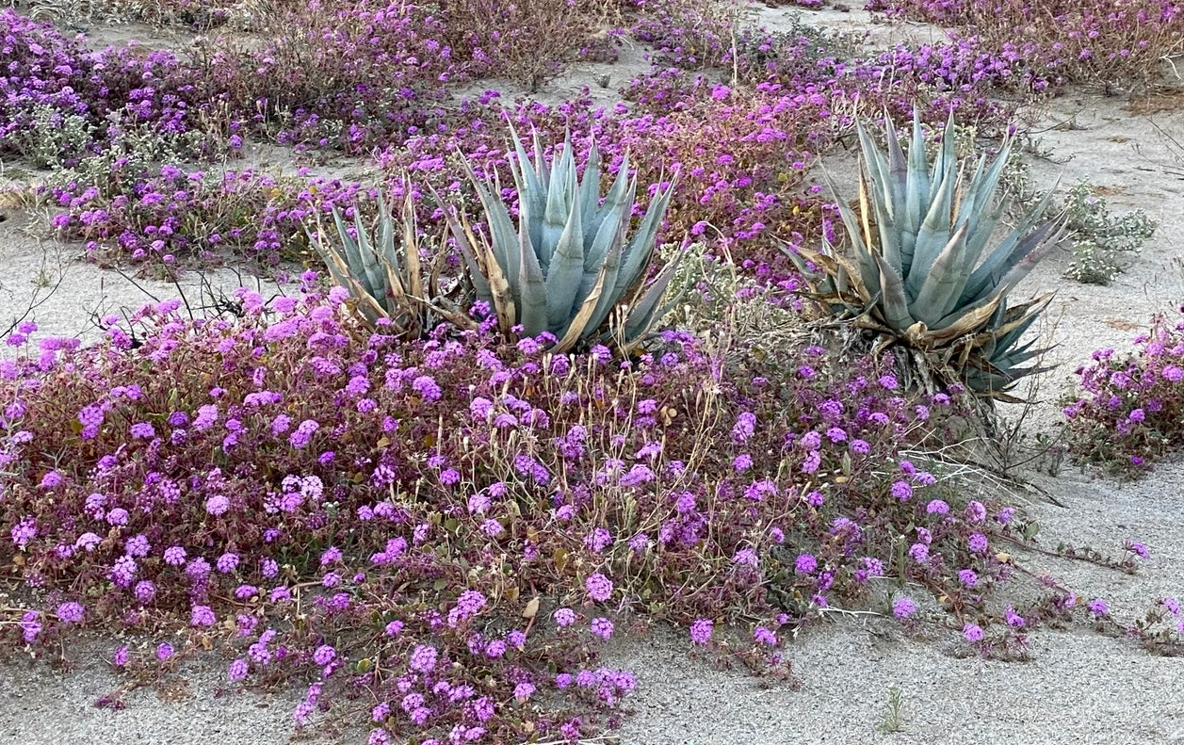
Amazing Adaptations: Lesson 1
Phreatophytes
Perennials
Some survive by becoming dormant when hot and dry and then rejuvenating when it rains.
Some plants have extremely long roots that travel deep (tap root) to tap into deeper groundwater.
Ephemeral
Some plants can germinate when it rains and complete their entire life cycle in a few weeks or months.
Notes:
Phreatophytes – are plants that grow extremely long roots (have a tap root) that reaches into deeper groundwater. The Mesquite Tree have the deepest roots of any native plant and can reach 80 feet! The Creosote and Mesquite have deep tap roots but also shallow radial roots so they can get as much water as possible.
Perennials – survive by becoming dormant when it is hot and dry and then rejuvenating when it rains. Ocotillos can do this up to 5 times within a year and is a great example of this.
Ephemeral plants – germinate when it rains and can complete their entire life cycle in a few weeks or months to make sure they have enough water. Lupine, Desert Verbena Mojave Aster… they grow, flower and produce seeds in weeks and then the seeds remain viable in the soil for years waiting for the right wet conditions to germinate again.

Slide 18
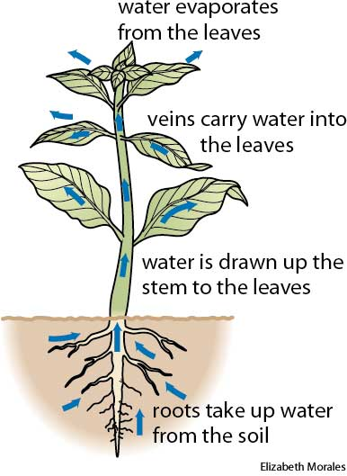
Water cycle: Thirsty Plants - Discovery
Plant Perspirations!
Take students outside to go collect their bag.
Carefully remove one leaf from the plant and put in your bag.
Make observations about how much water is in the bag and share with class.
How did the water in the bag get there?
Notes:
After matching game go grab Thirsty Plant Activity and have some discussions.
How does water get into the plant? What form of water goes into the roots? Liquid.
What causes the heat energy? The sun – it is the driver of water moving through the plant.
And then how does it get out? Evaporates out through the leaves…
Do you think that water is potable?
Move to next slide after “Do you know what this process is called?”

Slide 19
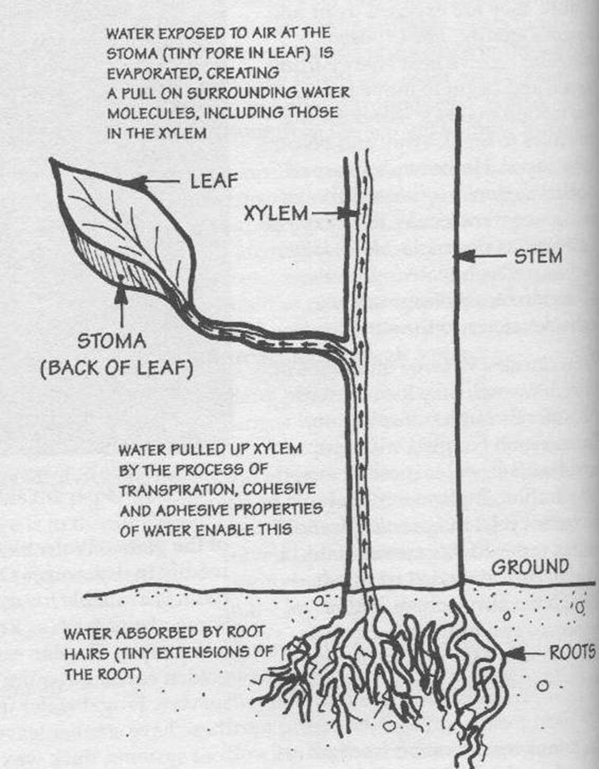
Water cycle: Thirsty Plants - Discovery
Transpiration
Water molecules change form from a liquid to a gas when the molecules heat up and leave a plant.
Notes:
What form is the water when it leaves the plant? We don’t usually see it because it is a gas. But by collecting it in the bag, we can see the moisture back in the form of a liquid.
Capillary action happens when the sun heats up the water molecules on the plant’s surface and changes it to a gas, it also pulls the next molecules up through the plant due to water sticking to itself and to other things (very important property of water). Water sticks to itself (cohesion) and other things (adhesion – clouds)

Slide 20
Transpiring Thoughts!
Do you think transpiration plays an important role in the water cycle & our local environment?:
How many leaves were in your bag?
How many leaves did you estimate were on your tree?
How much water do you think would come from the entire tree in that same time?
How about all the trees in your neighborhood?
Notes:
This is where you can do some fun math! And this is where you can tie in so many other topics too, like adaptations of plants, and really have the students explore and think about why different types of plants would release more water than others. Why we would want to plant certain plants that can survive in the desert (native and drought tolerant).
Transpiration is invisible, but a very important part of the water cycle.

Slide 21
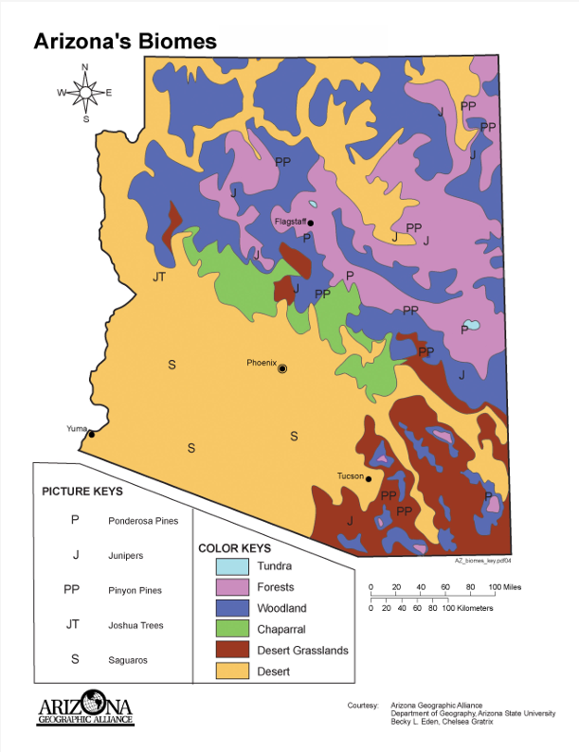
Wrap-Up
Now we understand what a watershed is and which one we live in here in Arizona.
Discuss how adaptations enable species (plants & animals) to live in this environment and your local area.
Summarize water and heat related adaptations into categories (avoiding heat, storing water, dissipating heat, accessing water, etc.)
Systems and System Models
& Cause and Effect
Notes:
Add transpiration, evaporation, precipitation and percolation to your water cycle diagram.

