Slide 1

Lesson 2: Part A Smart Landscapes
Investigative Questions
What does water-efficient landscapes or xeriscaping mean?
How can you harvest rainwater to transform an impermeable plot of land on your school grounds into a water-efficient oasis?
Notes:
Xeriscape: Derived from xeros, Greek for “dry” plus scape, a scene (Prounced Zeer-a-scape) = Dry Landscapes

Slide 2
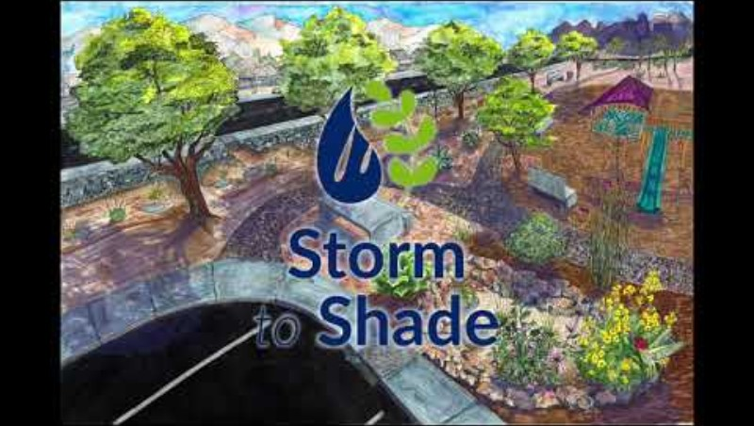
Smart Landscapes: Lesson 2 Part A

Slide 3
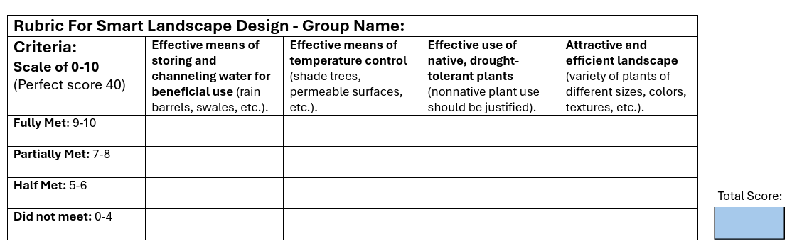
Smart Landscapes: Lesson 2 Part A
Water-Efficient Landscapes & Gardens
Xeriscape (zeer-i-scape) = “Dry Garden”
Notes:
Xeriscape: Derived from xeros, Greek for “dry” plus scape, a scene (Prounced Zeer-a-scape) = Dry Landscapes
Next go over what makes a Water-Efficient Landscape and what your students will need to focus on as they design their system/garden.

Slide 4
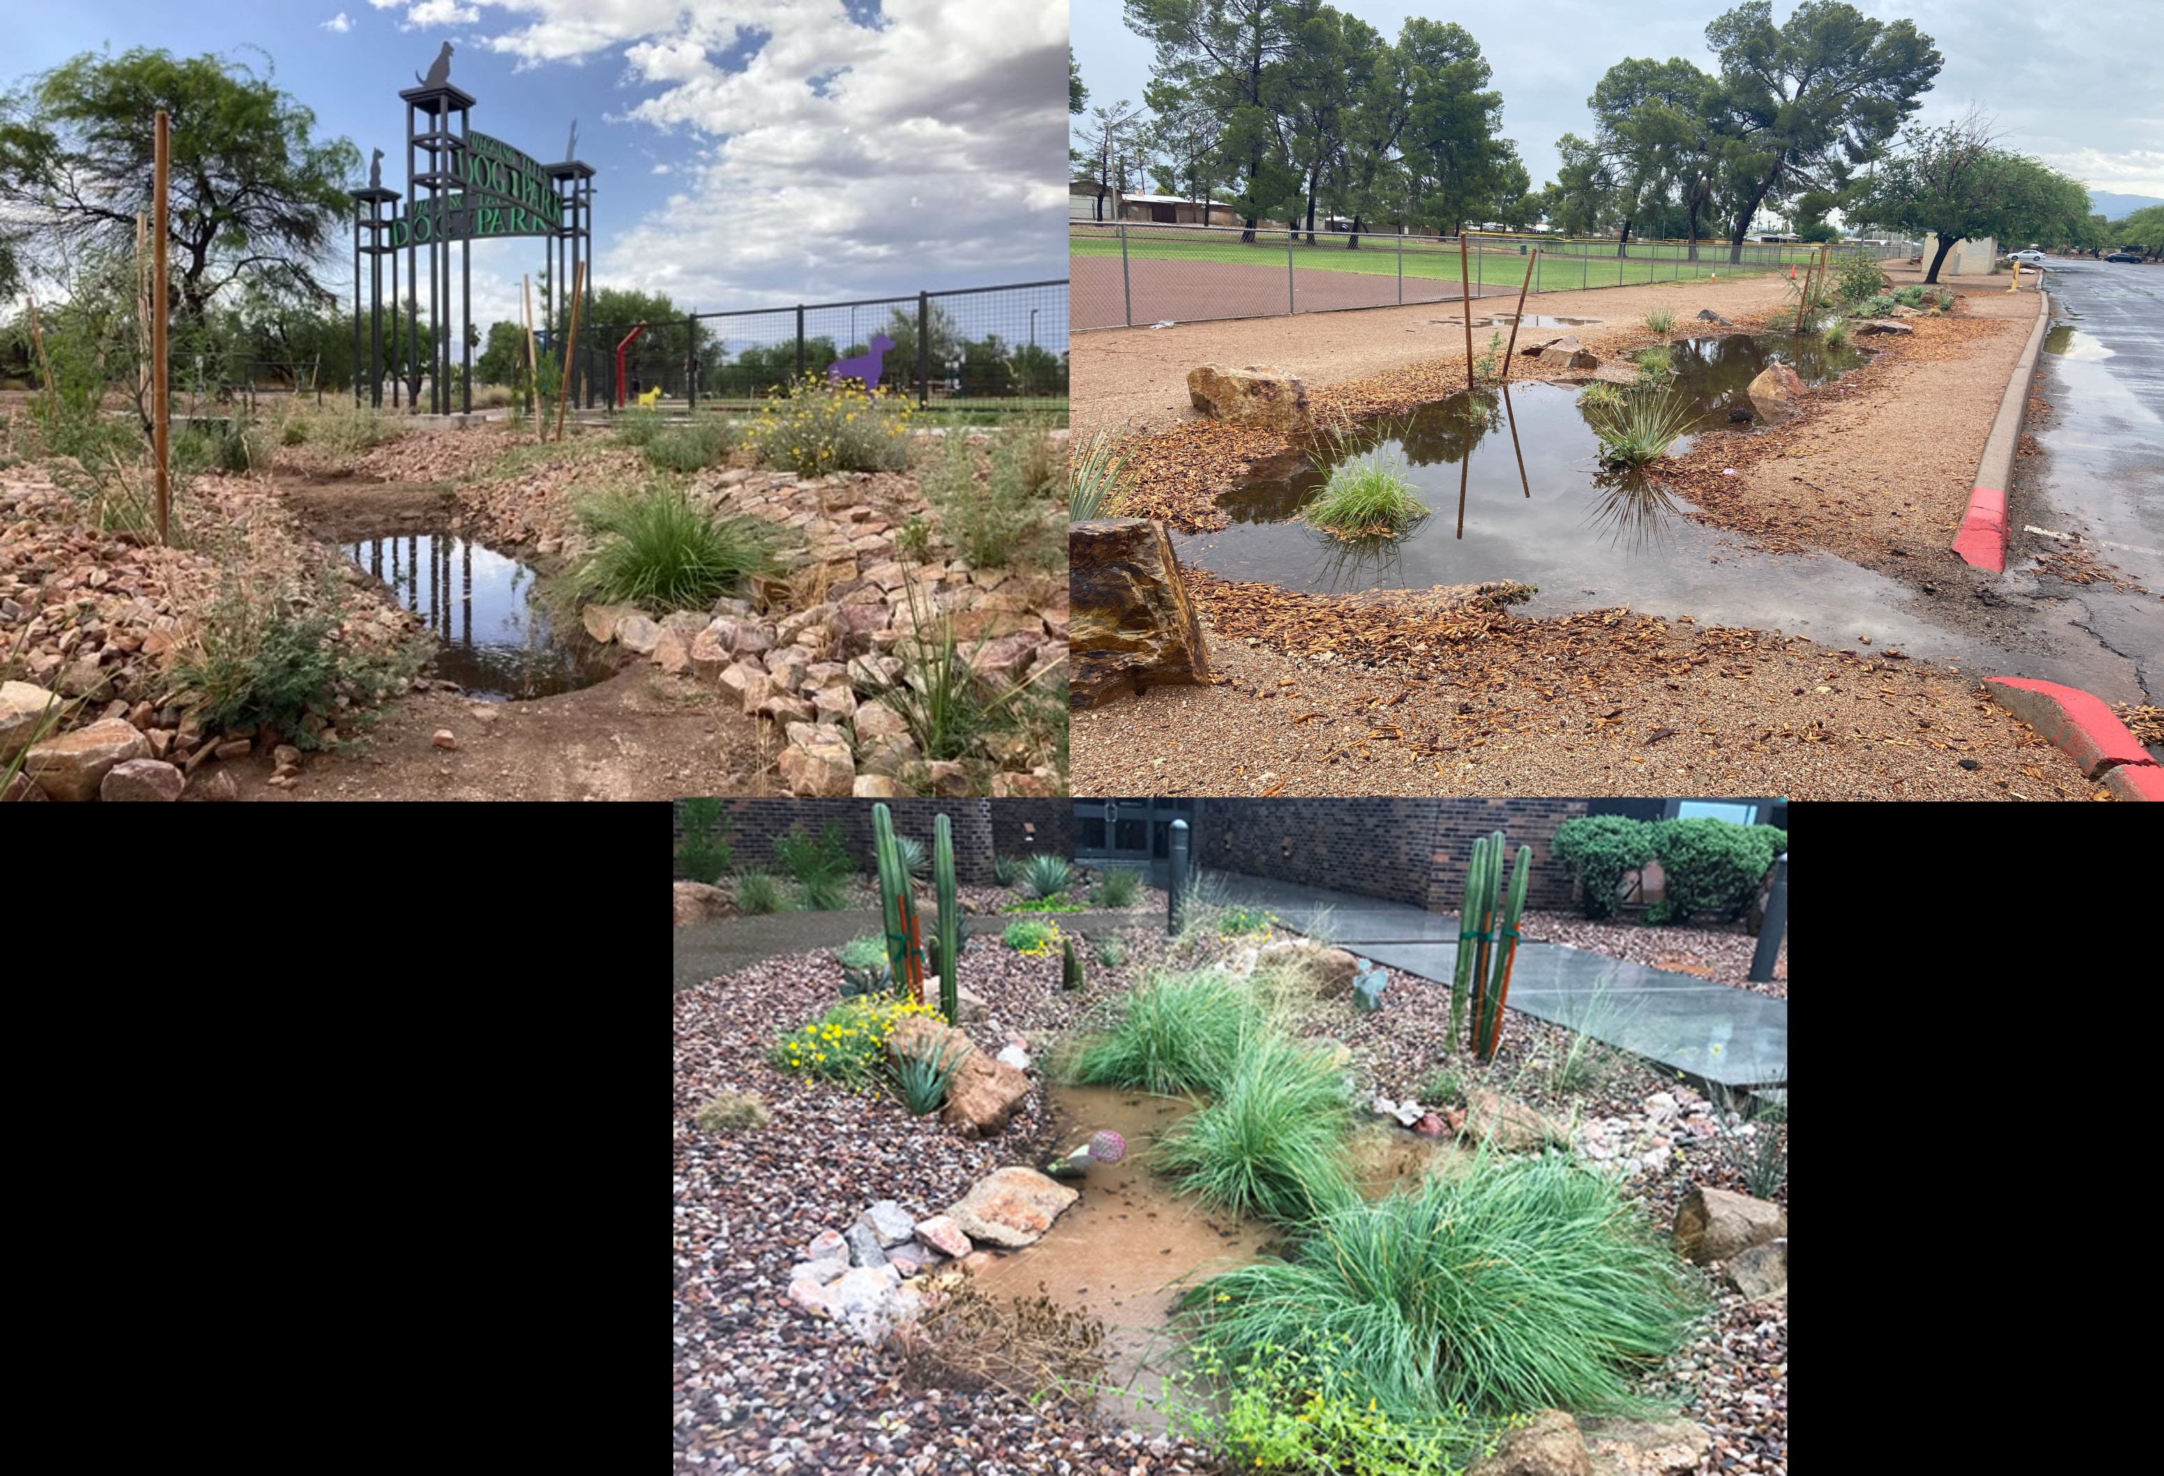
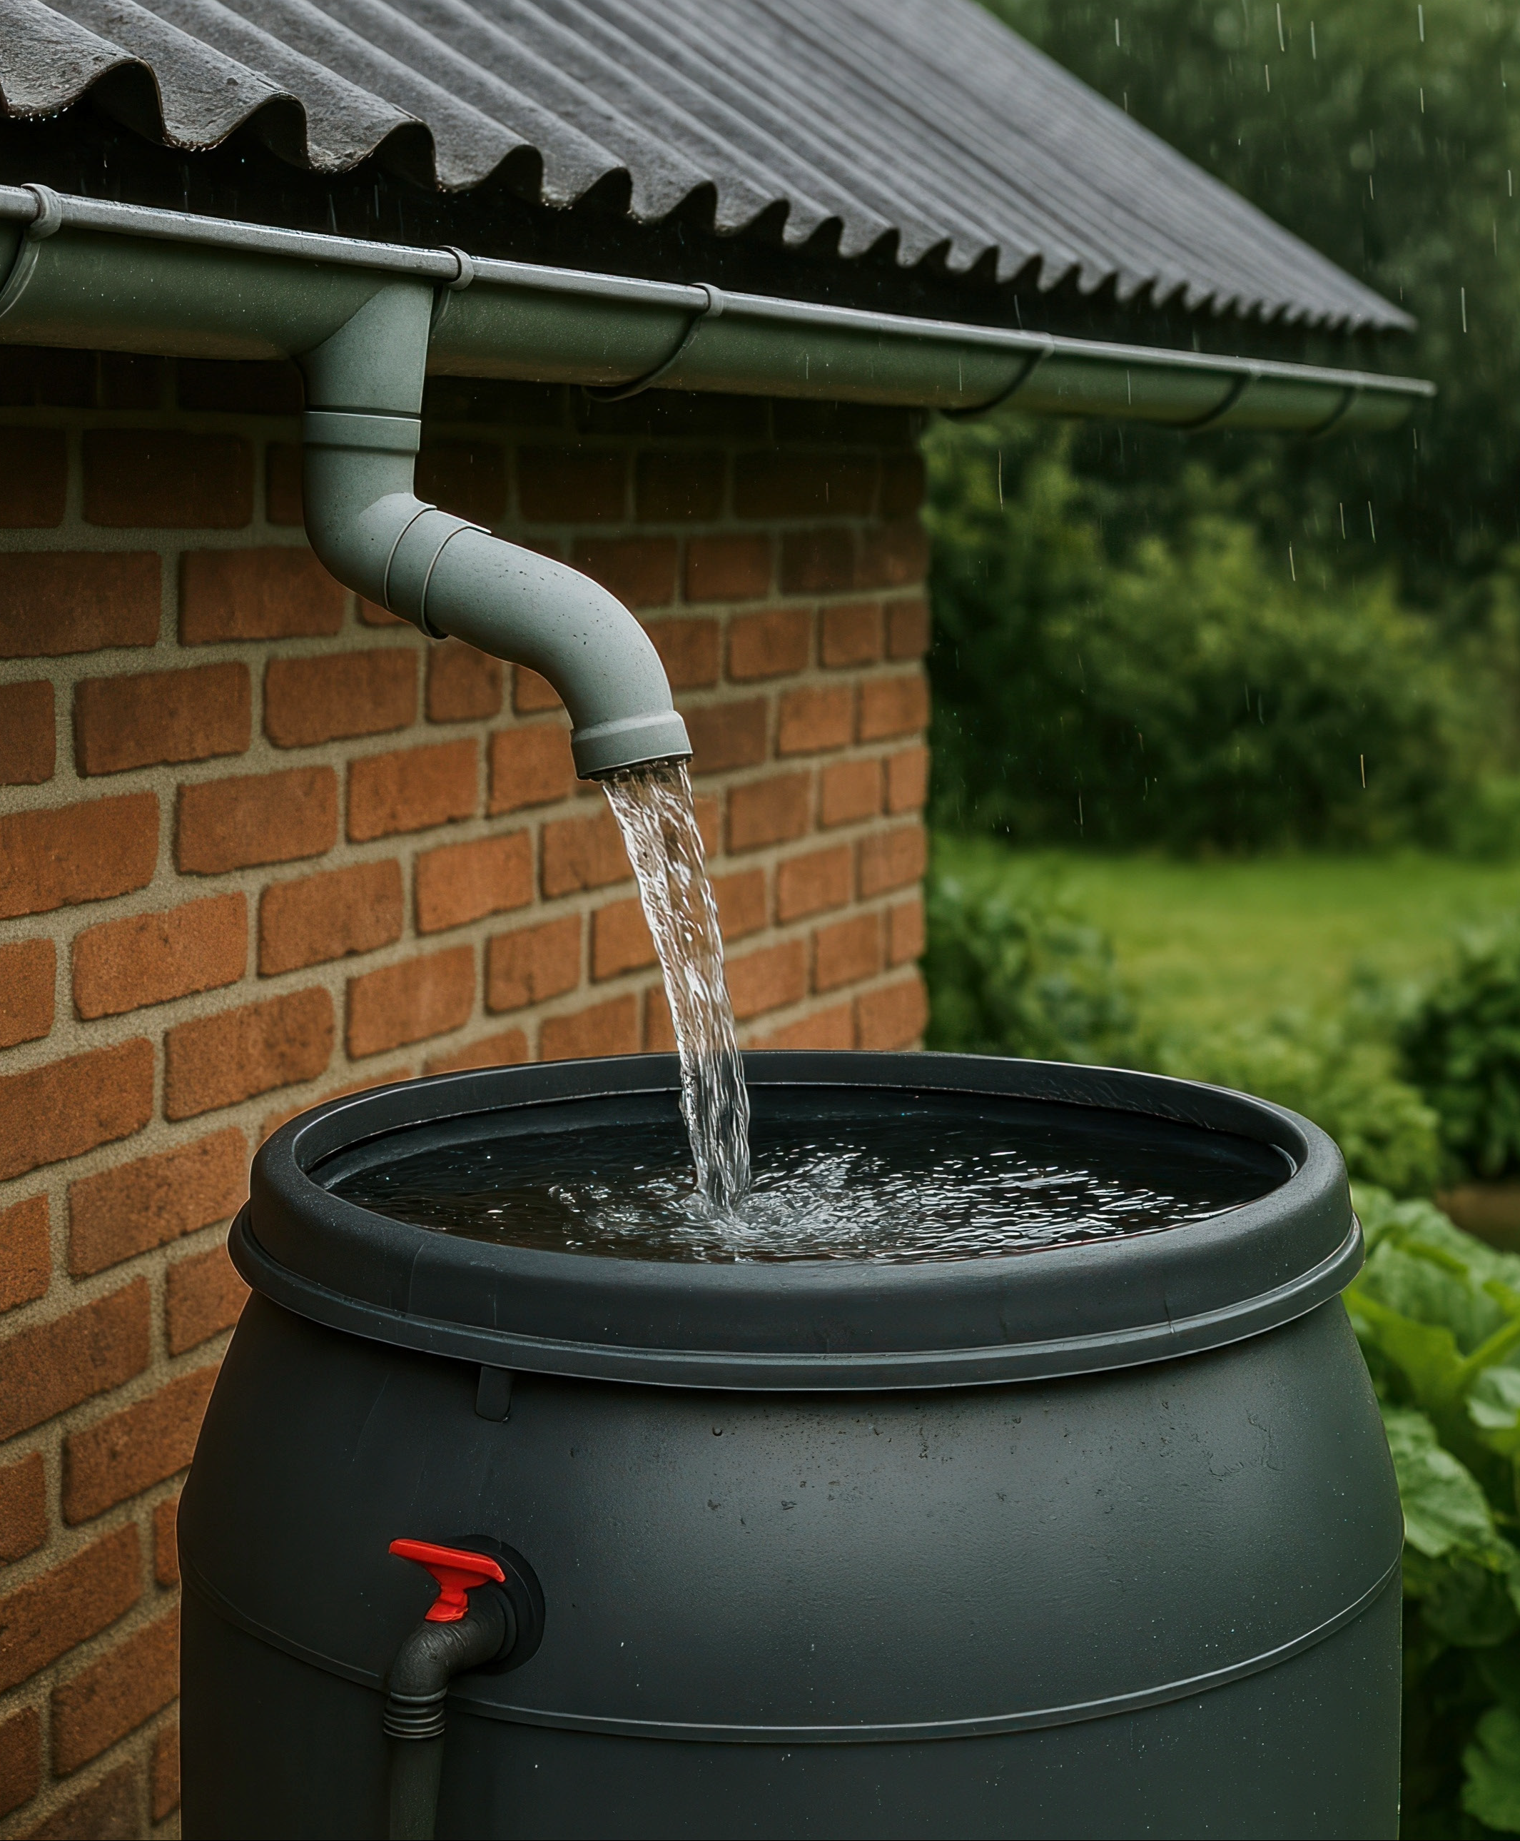
Effective Water Usage
Store and Channel Water for Beneficial Use
Create berms and swales to slow, spread out and sink water, to keep it where we need it (as groundwater).
Use rain gutters & rain barrels to capture water for later use.

Slide 5
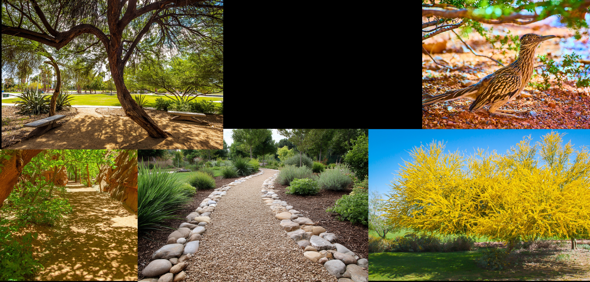
Cool it Down
Create Shade
Plant trees and use permeable surfaces.
Cool neighborhoods to promote more recreational use.
Help mitigate the urban heat island effect.

Slide 6
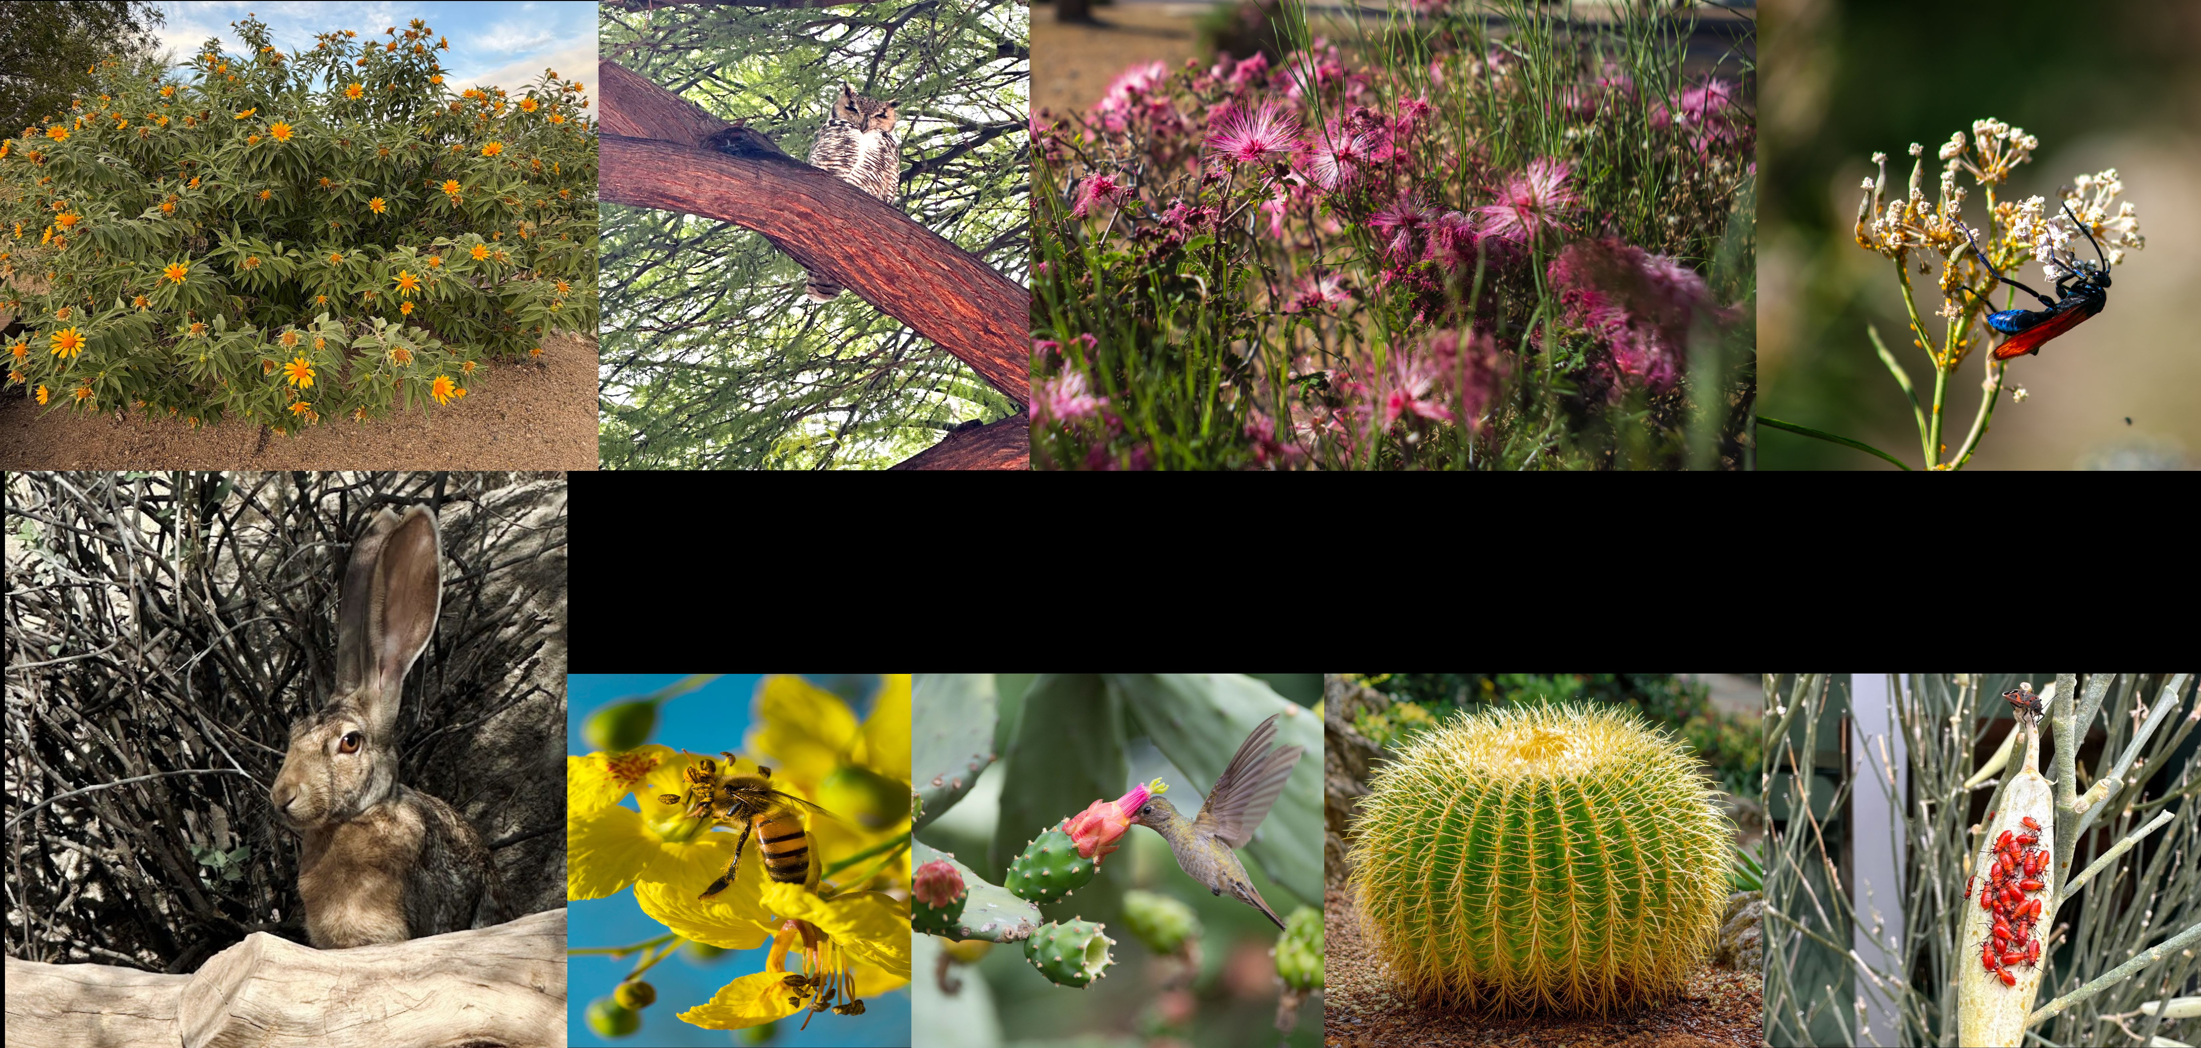
Effective Use of Native & Drought-tolerant Plants
Saves water and provides
habitat and food for animals.

Slide 7
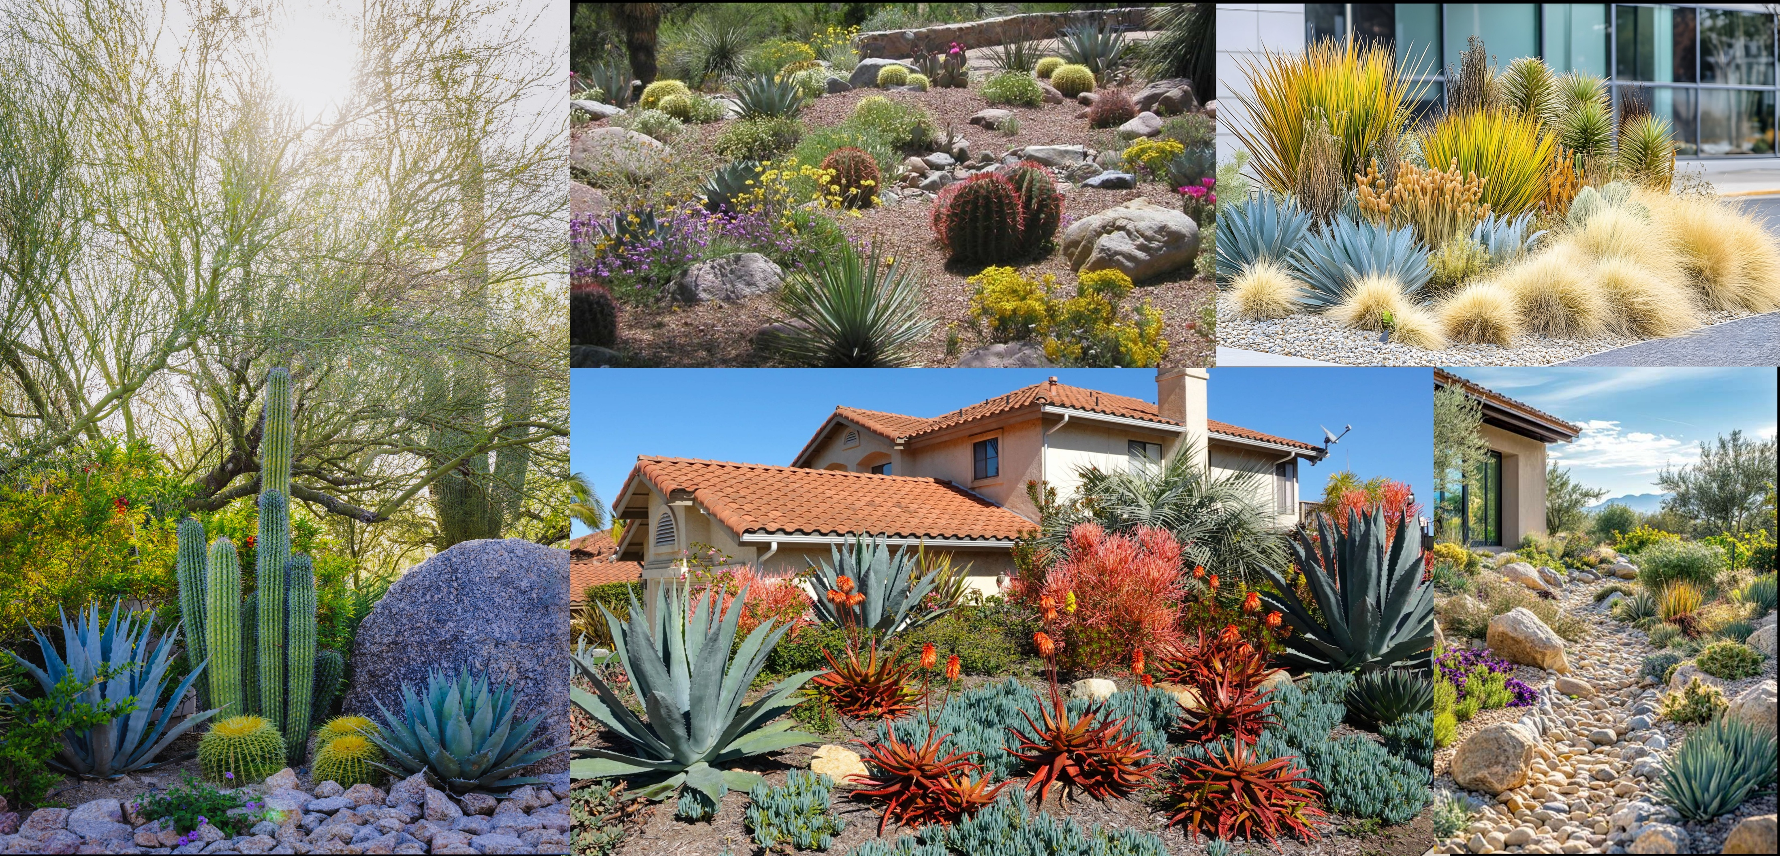
Attractive & Efficient Landscape
Notes:
It is important to use a variety of plants, different colors different textures. Also important to group plants by both their water needs and sun and shade needs.

Slide 8
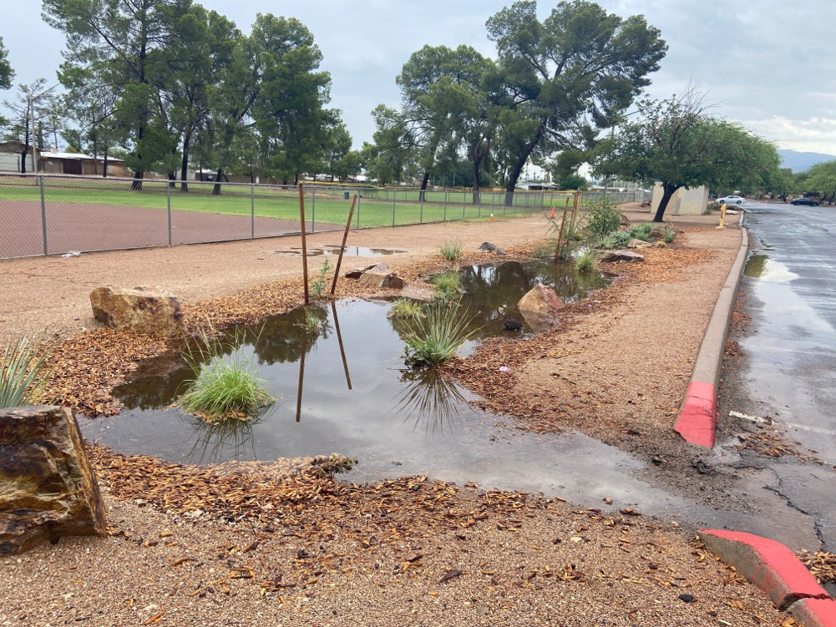
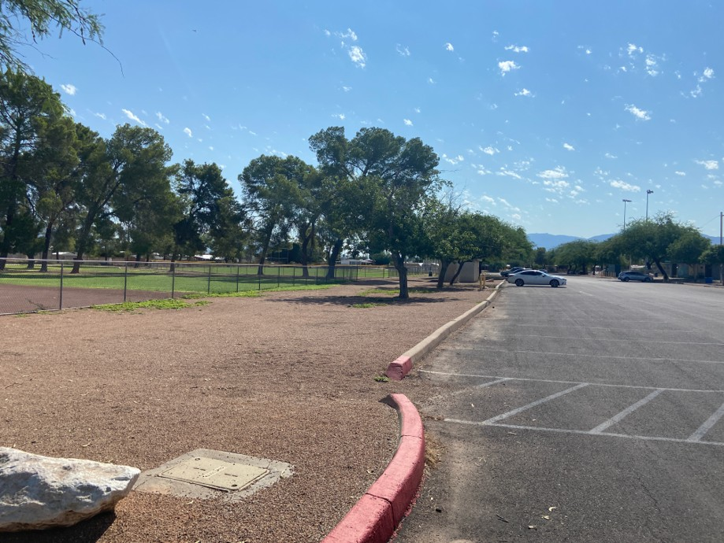
Warm Up: Lesson 2 Part A
Before & After… What do you notice?
Notes:
Where is the water going to run in the first picture, vs. the second pic?

Slide 9
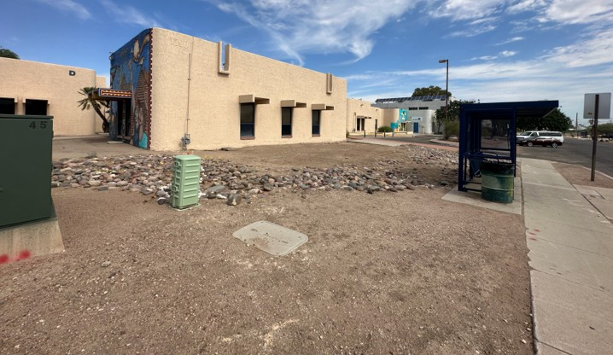
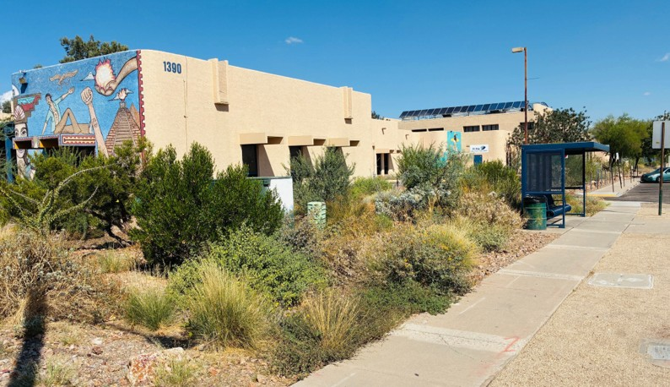
Warm Up: Lesson 2 Part A
Before & After… What do you notice?
Notes:
Which picture has more biodiversity ? Which picture will be cooler?

Slide 10
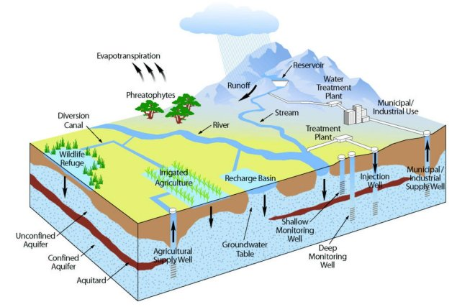
Smart Landscapes: Lesson 2 Part A
The water cycle connects us to our watershed and groundwater systems.
Everything is connected!
Notes:
Review What is a watershed: A land area that drain or flows to a low point.

Slide 11

Smart Landscapes: Human Impacts
Urban Watersheds
Investigative Questions
How does human impact on the land affect water and heat within a watershed?
How can we reduce urban runoff and the flow of contaminants from going into our watersheds and groundwater?
Notes:
So now that we know some of the key things we want to create in our smartscape garden, it is helpful to better understand how human impacts can alter and effect our urban watersheds.

Slide 12
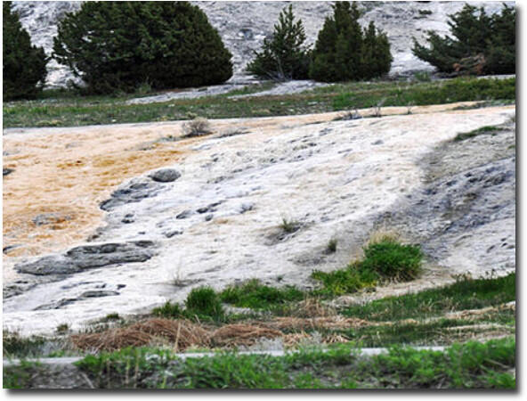
Smart Landscapes: Human Impacts
Following the Flow
When rain falls or when snow melts, does the water just sit there? Or does it move? Why?
We know some of it may percolate down through earth materials into the ground, but most of it flows downhill as what?
Runoff is important as it keeps our rivers, lakes
and groundwater flowing. But…
Notes:
Water flows because of the laws of gravity…
Discuss the three ways that water can move in the natural or built environment:
Soak in
Flow into
Run off

Slide 13
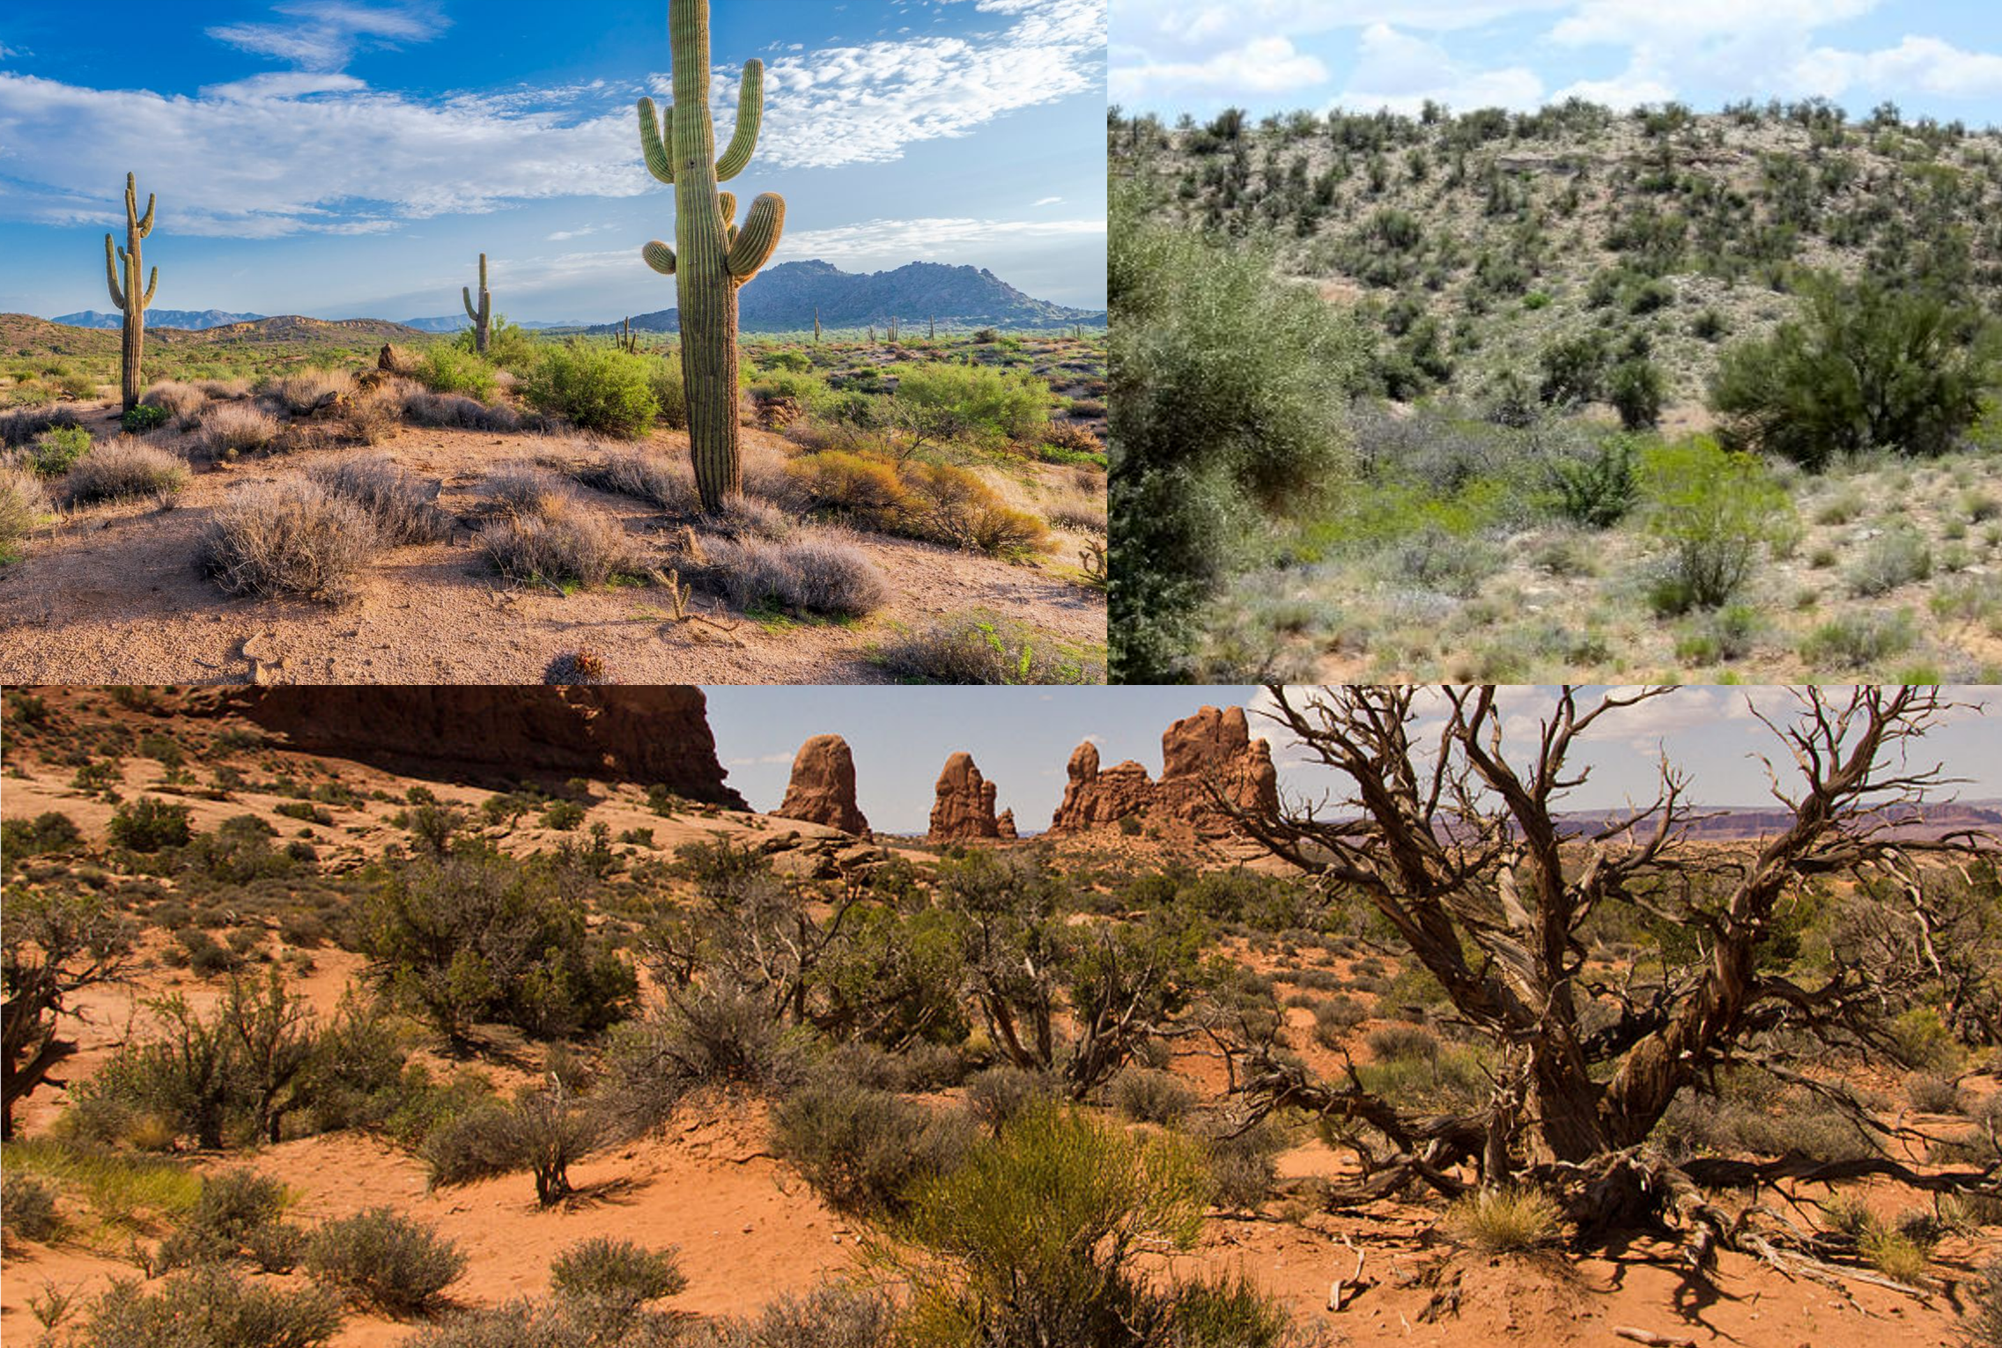
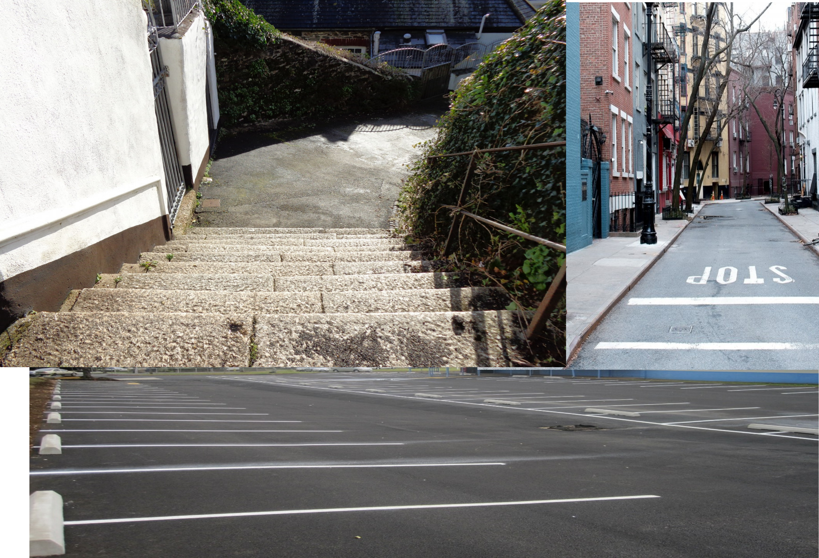

PERMEABLE
Water can sink in or percolate into the earth materials, where plants can use it, or it keeps traveling further down to reach groundwater (infiltration).
IMPERMEABLE
Water cannot penetrate or percolate, but rather pools or runs off the surface. These are also called impervious surfaces.
Notes:
BUT…What is on the surface matters! What would you call the surfaces in the top left corner …? What is going to happen to rain that falls on that land? It is permeable (water can soak into it).
What about the surfaces in the bottom corner… what would the rain do? Runoff, it is impermeable.

Slide 14

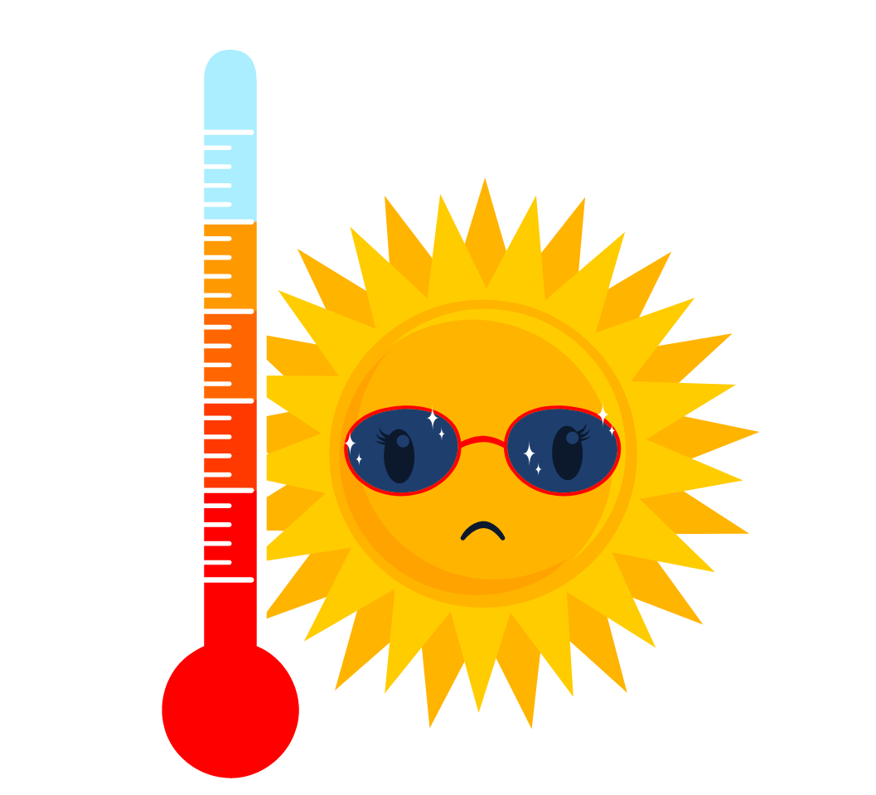
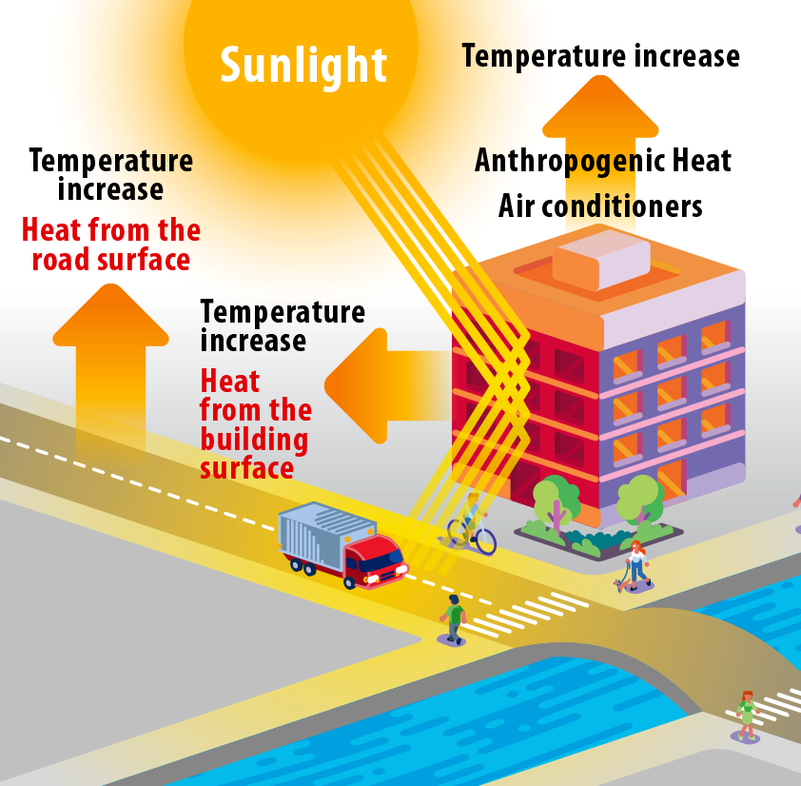
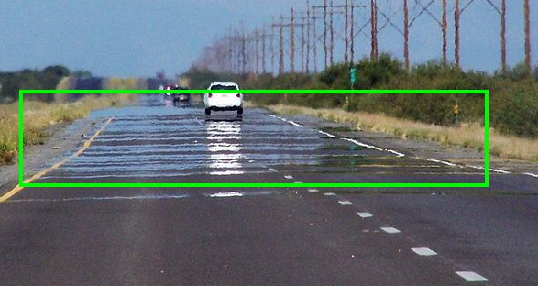
Too Hot to Handle!
What else happens when we have impermeable surfaces?
Notes:
Impermeable surfaces like asphalt, concrete, and cement (like in roads and buildings) store sunlight during the day and release the heat slowly at night. Buildings and roads cool off very slowly at night, which means that air temperatures in the city cool off very slowly at night.

Slide 15
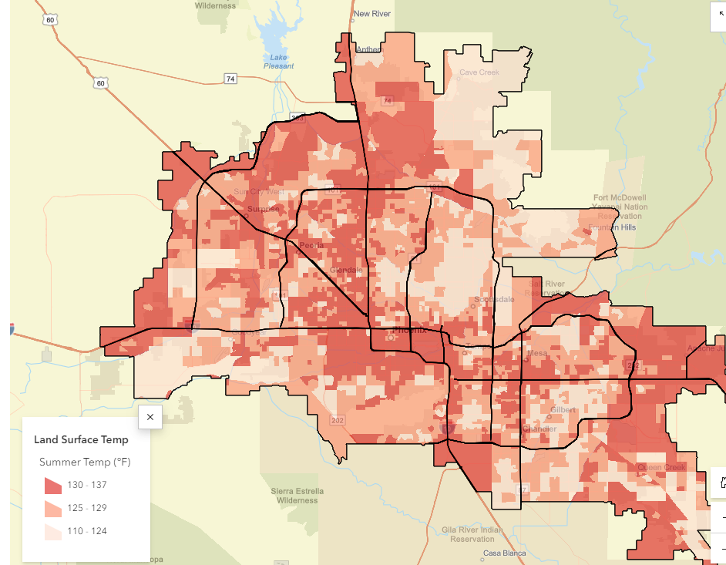
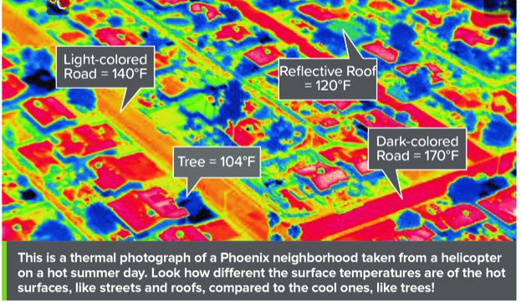
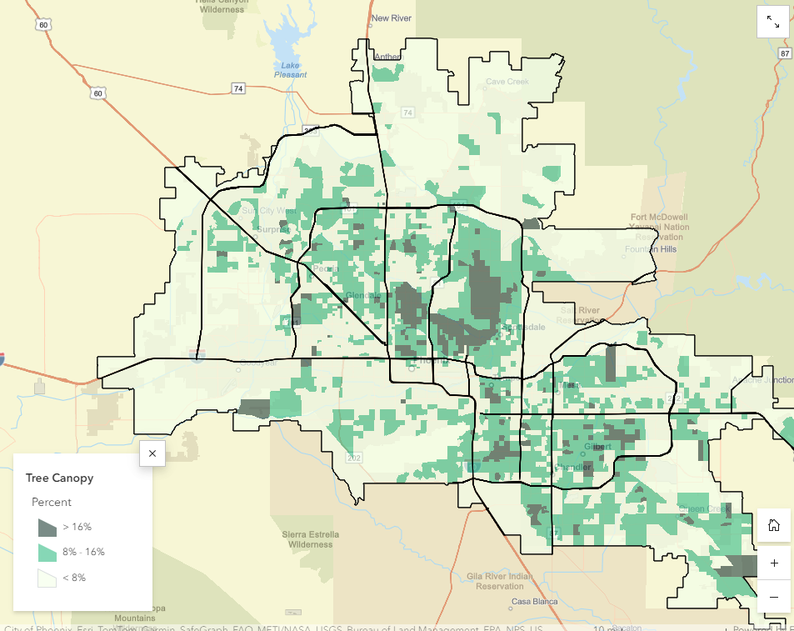
Urban Heat Island Effect
Notes:
Cities have higher concentrations of surfaces like pavement and metal which retain heat during the day and release it at night. This phenomenon, called the Urban Heat Island Effect, causes city temperatures to be higher than surrounding desert and open spaces, especially at night.
Temperatures are typically lower where there are more trees and vegetation. You can see that the areas in dark green around the region have the highest tree canopy and correspond to lower temperature areas in the previous map.

Slide 16
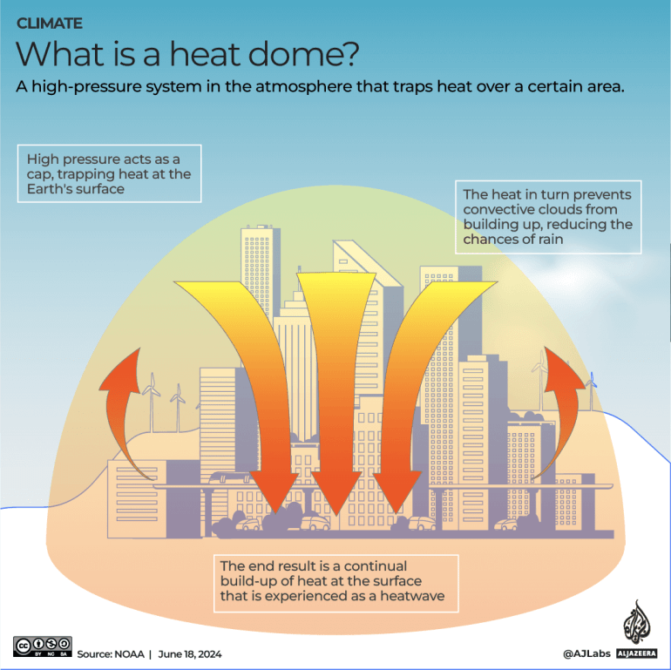
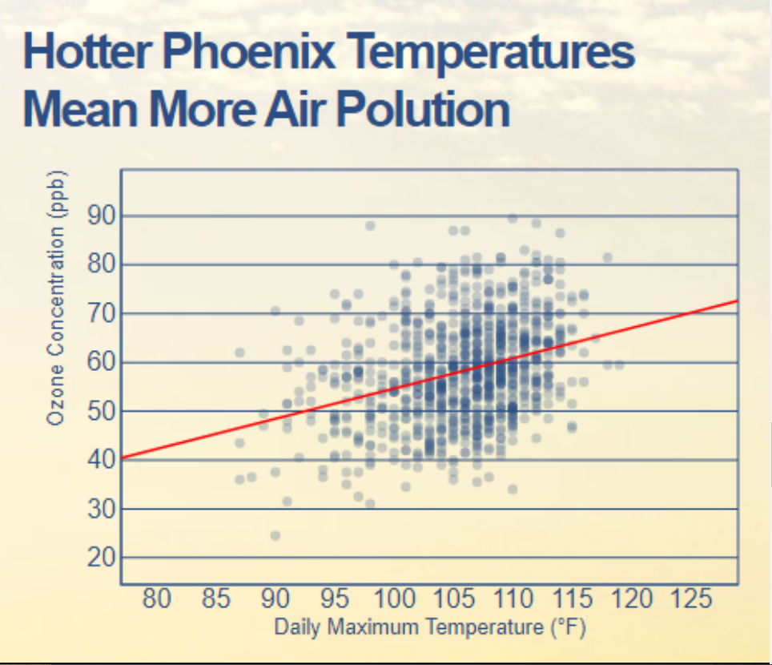
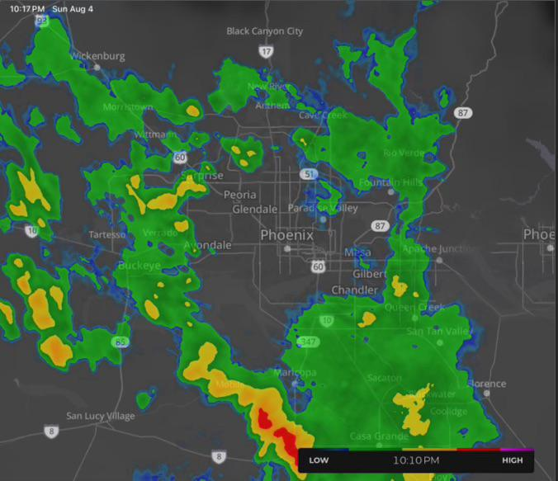
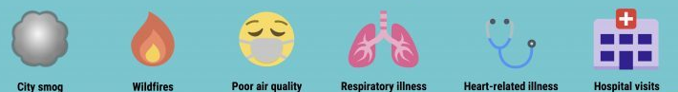
Air Temp, Quality & Rain Changes Too!
What else happens when city temps are warmer?
Notes:
Problems associated with urban heat islands: Increased Energy Consumption. Elevated Emissions of Air Pollutants and Greenhouse Gases. Compromised Human Health and Comfort. Impaired Water Quality. more ground-level ozone (smog) will form as the environment becomes sunnier and hotter.
Energy demand increases with high temperatures which causes larger amounts of air pollutants to be released into the air which also increases the temperature.
The UHI effect is caused by changes in the temperature, moisture, and air quality of the city environment. These changes in the environment create a distinct urban boundary layer, or heat dome. This heat dome extends above the city and in windy conditions, can be shifted downwind.
https://storymaps.arcgis.com/stories/400b68f7aaa143c0bd0d0fd262006087
A heat dome works like a pot with a lid to keep warm air trapped. An area of high pressure will create a lid of stable air in the atmosphere, trapping warm air below that line. The warm air will sink to the surface where it will heat up even more as it becomes compressed from the high pressure. Heat domes happen when strong high pressure atmospheric conditions remain stationary for an unusual amount of time, preventing convection and precipitation and keeping hot air "trapped" within a region.

Slide 17
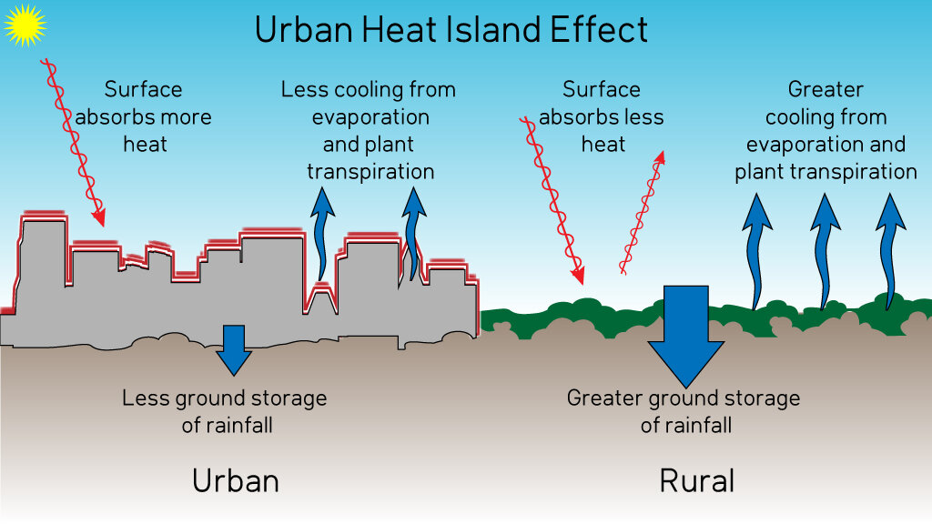
Urban Heat & Water
This Photo by Unknown Author is licensed under CC BY-NC
This Photo by Unknown Author is licensed under CC BY-NC
Notes:
Besides the heat factor, what do we know will happen to the water when we replace natural permeable spaces with impermeable built urban areas? We end up with more water runoff that can’t soak into the ground. Why does this matter?

Slide 18
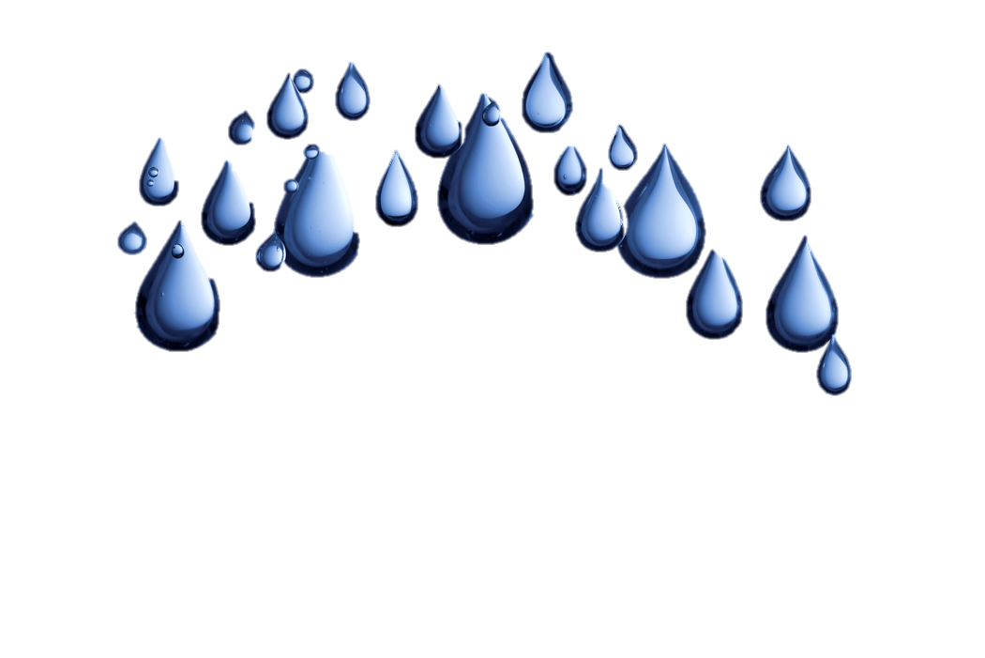
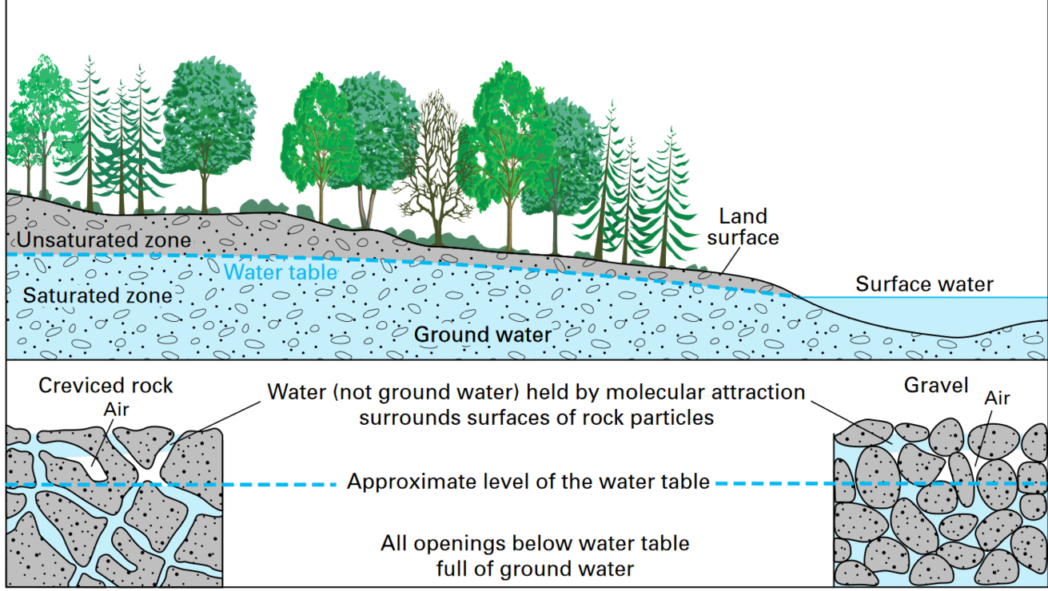
Let’s
Dig In!
Pore Spaces
Groundwater moves between the spaces and pores and is pulled down due to gravity. The bigger the spaces between the materials, the faster or easier the water can move between it.
Aquifer:
An area where significant groundwater is present. Groundwater flows between layers of earth materials.
Notes:
Where does groundwater come from or what does it begin as? Precipitation. Then what happens? If it can it soaks down through materials, or fills up surface water, but if it comes to fast or falls on impermeable surfaces, then it ends up running off the land and going elsewhere.
Groundwater is what it sounds like - water in the ground that fully saturates (or fills up) the pores or cracks in soils, sand and rocks. Then what is an aquifer?
An aquifer is an underground bed of saturated soil or rock that yields significant quantities of water. Aquifers come in all sizes and their origin and composition are varied. They may be small or very large and can run for thousands of square miles underground all while remaining out of sight.
Lesson 1 of Awesome Aquifer - https://groundwater.org/awesome-aquifer/

Slide 19
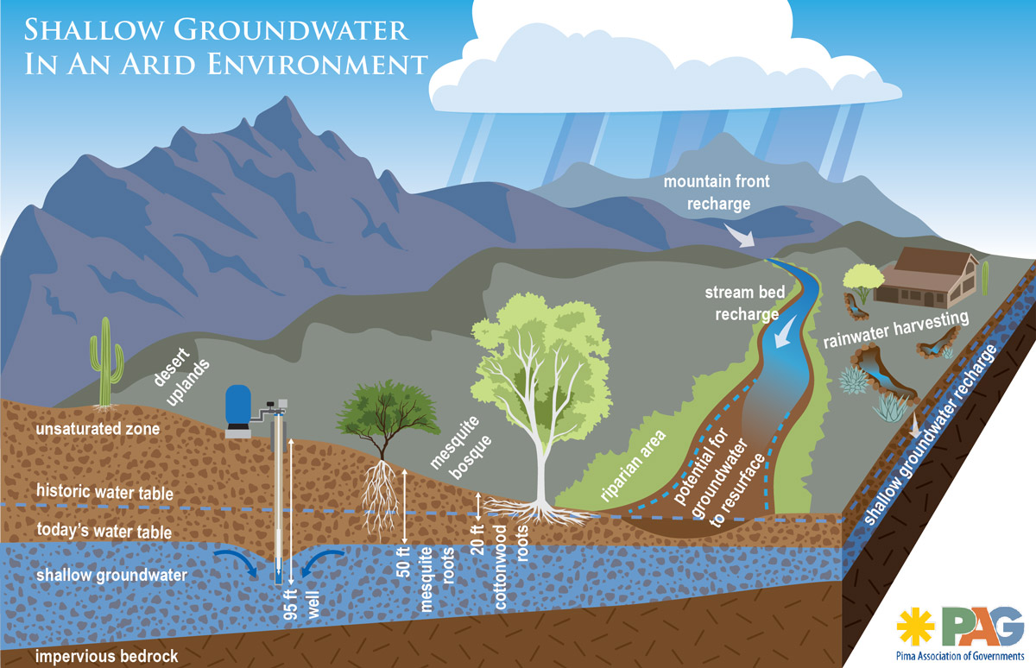
Going, Going, Gone?
Decline & Depletion
Notes:
Why do we care about groundwater? Because we use it (some places only have groundwater). What if we just keep pumping and taking groundwater without putting it back?
The water stored in the ground can be compared to money kept in a bank account. If you withdraw money at a faster rate than you deposit new money you will eventually start having account-supply problems. Pumping water out of the ground faster than it is replenished over the long-term causes similar problems. We call this overdraft
Pumping groundwater at a faster rate than it can be recharged can have some negative effects on the environment and the people who use that water:
LOWERING OF THE WATER TABLE – a severe consequence of excessive groundwater pumping is that the water table, below which the ground is saturated with water, can be lowered.
If groundwater levels decline too far, then shallow wells may dry up causing well owners to drill deeper (this is very expensive and not always possible.
We also know if we take too much groundwater it can reduce the amount of water in our streams, rivers and lakes.
We also call the area that lowers around the well that is pumping water, a cone of depression…

Slide 20
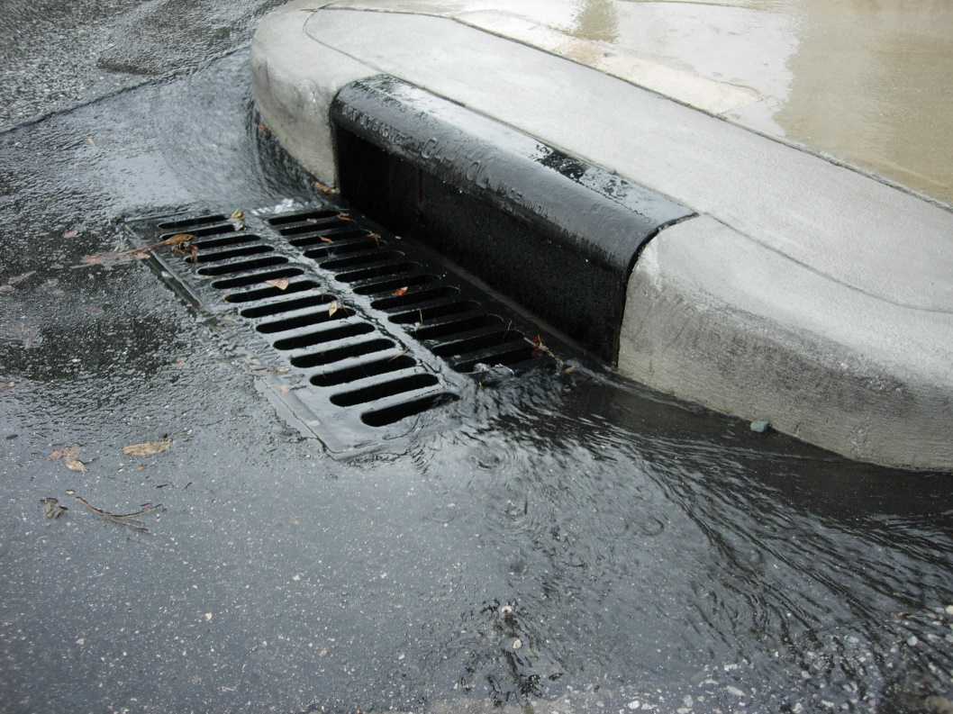
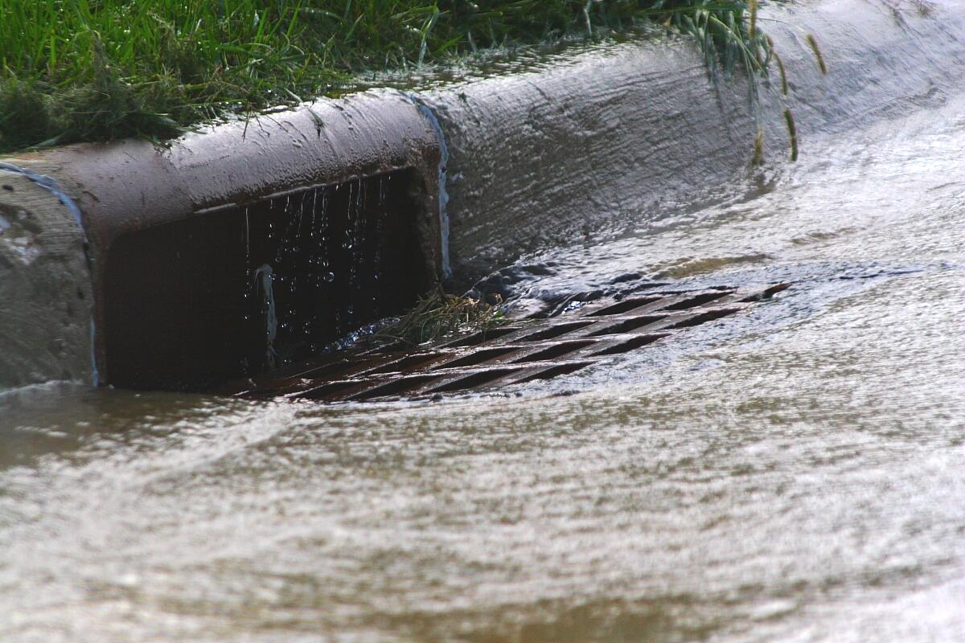
Smart Landscapes: Human Impacts
In our city centers and neighborhoods what happens to that runoff?
Rain
becomes
storm
water!
Notes:
So when there aren’t permeable surfaces and that water can’t get into our groundwater, then what happens to the rain? Where does it go if it can’t soak in? It becomes runoff and if it weren’t for cities creating storm drains, our neighborhoods might flood. So for a long time now with urban development the goal has been to move the water as fast as possible out of our streets and cities and downstream… but do we really want to lose all that water and send elsewhere? Maybe there is a better way?...

Slide 21
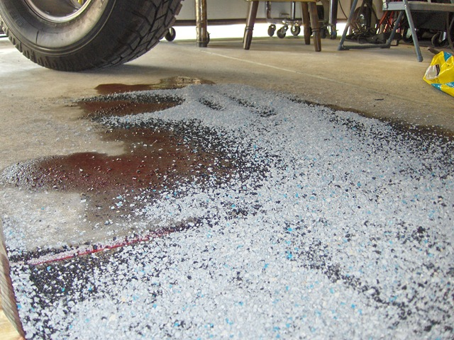
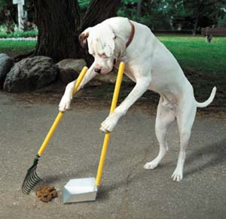
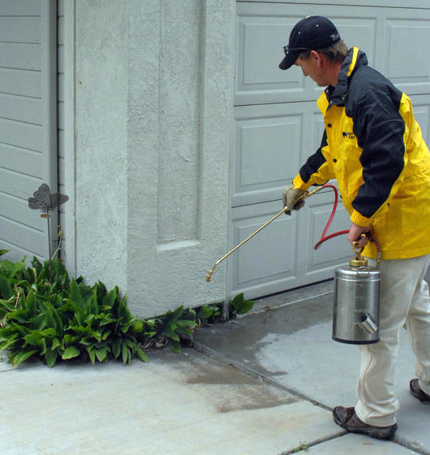
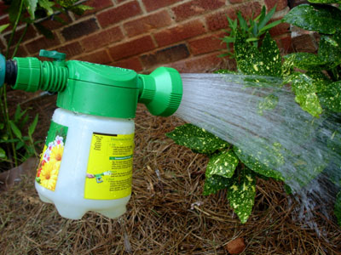
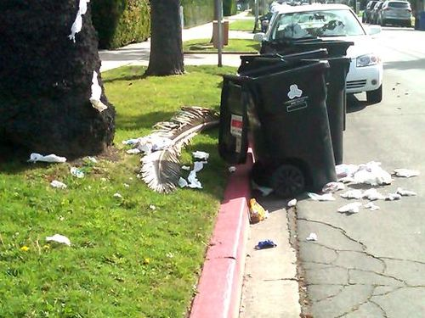
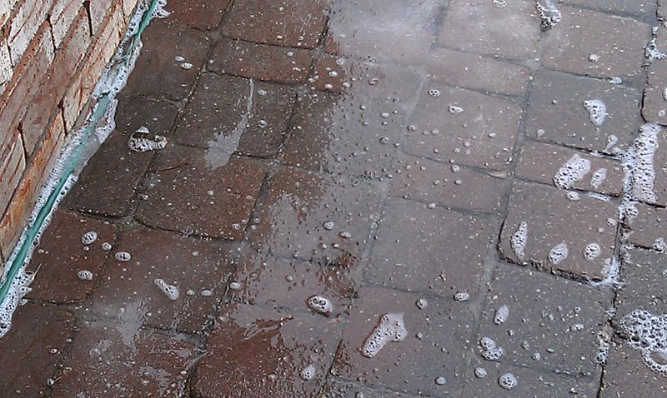
What makes storm water a bad thing?
SOIL – SEDIMENTS – ROAD SALT – VEHICLE SPILLS – FERTILIZERS – PET WASTE
– HEATED WATER – GREASE – TRASH – DETERGENT – SOLVENTS
Notes:
But it’s the journey to these drains that turns a great resource (rainwater) into a source of damage and pollution. Think of all the by products we create that can be picked up by runoff on neighborhood or city streets and sidewalks.
As the “storm water” picks up the particles, it takes it to our storm drains.

Slide 22
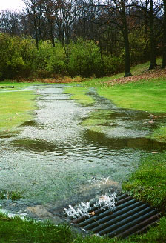
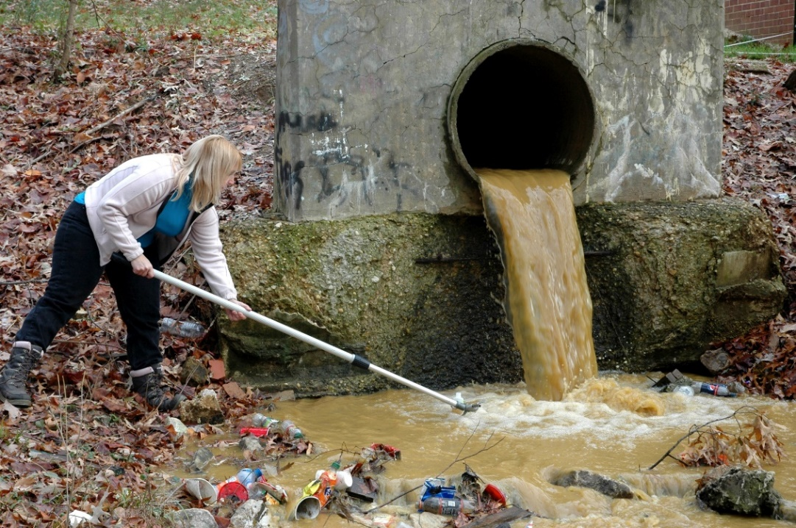
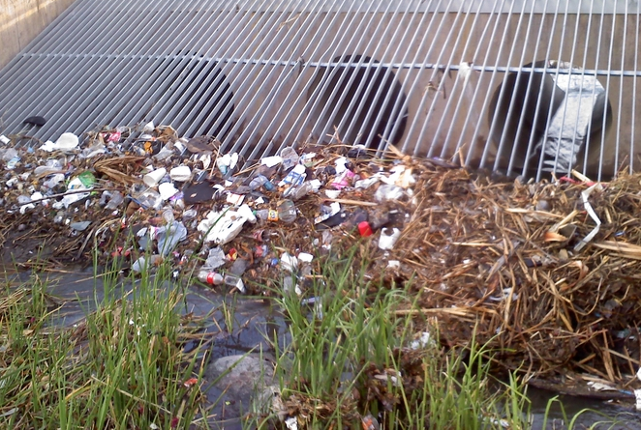
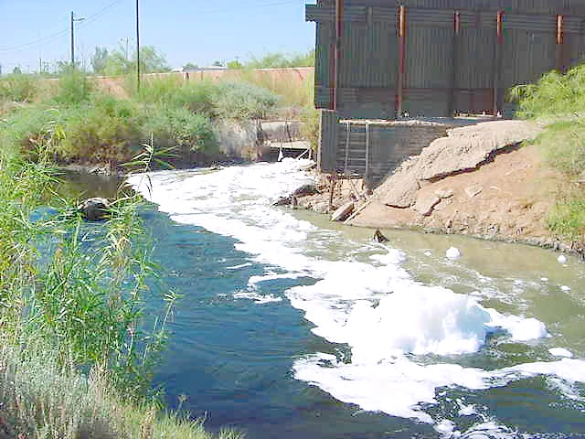
Where does storm water go?
To our rivers, lakes, and natural environment.
Notes:
The water going into the storm drains IS NOT treated and leads straight to rivers, lakes, and our natural environment.
Note: it is important to realize that only stuff that goes down our pipes (in our sinks, tubs and toilets) goes to the sewer system which does get treated. However, storm drains are different, these are openings on the side of the road and around our cities and streets, where runoff water is redirected to retention basins, canals, and rivers (this water is not cleaned or filtered), so any pollutants or chemicals that are picked up, get carried to our land and rivers.
This is a great time to help students understand that their choices make an impact.

Slide 23
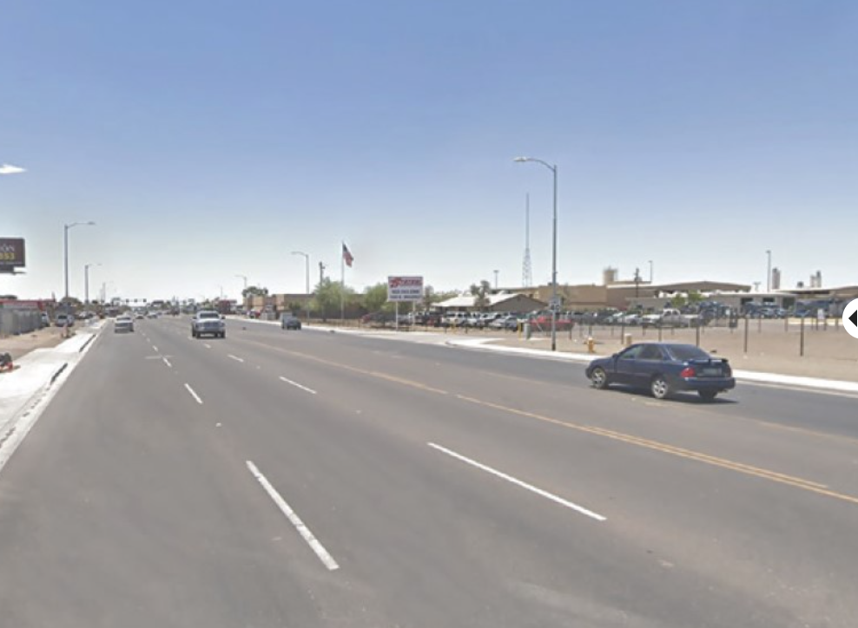
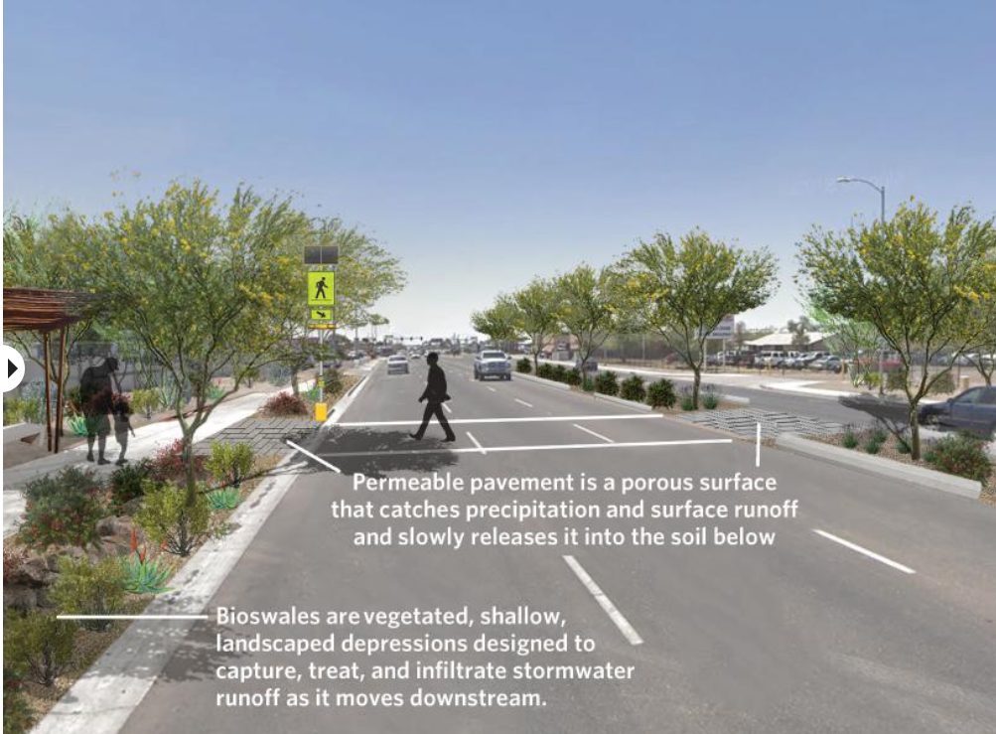
Check out Green Stormwater Infrastructure
Notes:
So as we learn more we might have to reassess our systems. Now that we know better we can do better, which means being smarter about how we can capture that useful rain water and keep it locally, rather than letting it run away. This can make a real difference. Cities call this Green Stormwater Infrastructure…
Click on link - https://storymaps.arcgis.com/stories/b9c35f205ea14015a23b446ff75eeeb4
And at bottom of the page you can click through green stormwater infrastructure examples with your class for solutions we can implement in our community to reduce pollution runoff and mitigate urban heat.
What messages do you think are being sent to the people living in each community…? Which one would you rather live in and why?

Slide 24
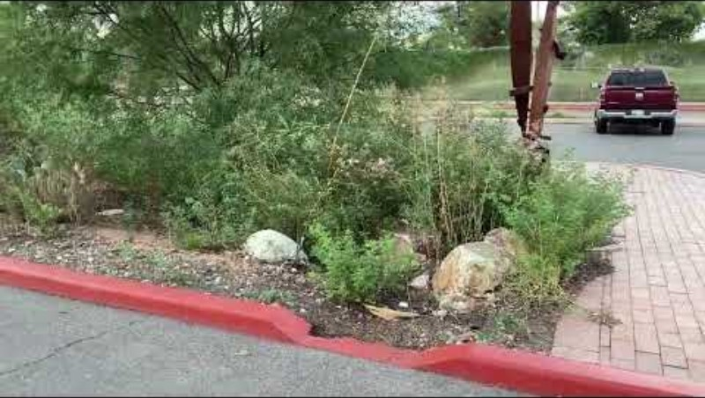
Check out Green Stormwater Infrastructure
Notes:
https://climateaction.tucsonaz.gov/pages/gsi So we want you to think about how you can take these ideas and design a watter-efficient oasis on your school grounds.

Slide 25
Smart Landscapes: Human Impacts
Lesson 2: Part A - Activities:
Activity 1: Soil Pan
Student groups simulate and observe how water runs off a roof and then experiment to see if they can capture the runoff.
Activity 2: “Watershed Tour” of School Grounds
Student groups record observations of where water drains on their school grounds (find high and low areas, impermeable vs. permeable spaces). They brainstorm ways to keep the water on the grounds for landscaping and focus on native plants.
Notes:
Ask students have they ever tried to capture and store rainwater from their roof or water from a stream? Discuss some of the benefits of using rainwater (it is free, saves tap water, it doesn’t contain salts, so plants love it, if it is captured it doesn’t flood streets, it helps replenish groundwater). While students are on their school tours have them think about if they could redesign things what would they do differently?

Slide 26
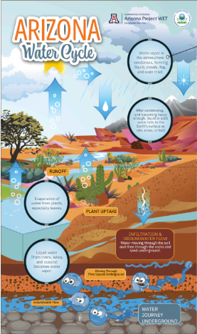
Lesson 2 Part A Wrap-Up
Now we know changes we make to the land affect the water and even the temperature within our watersheds.
So how do those changes interact with the water in the water cycle and groundwater?
Can we reduce the flow of runoff and contaminants within our watershed ?
What can we design instead?
Systems and System Models
& Cause and Effect
Notes:
Have a class discussion about the changes. When we change how the water flows and where it can go
Human land use affects where water is stored and how water moves. We redirect rivers, sometimes build dams, we drain water from wetlands for development. We cover the surface of the land with impermeable materials which changes the flow and speed of water. It also changes where the water ends up in the water cycle. Within an urban environment we often in crease the runoff within a watershed which often also increases the pollutants in the water, which decreases our water quality. In Part B students design solutions to this.

