Slide 1



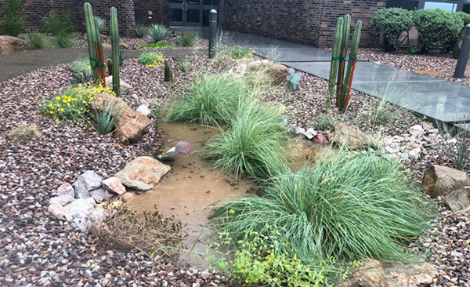


Planting for a Rainy Day
2025-2026

Slide 2

Lesson 2: Part B Smart Landscapes
Investigative Questions
How can you harvest rainwater to transform an impermeable plot of land on your school grounds into a water-efficient oasis?
Notes:
Xeriscape: Derived from xeros, Greek for “dry” plus scape, a scene (Prounced Zeer-a-scape) = Dry Landscapes

Slide 3
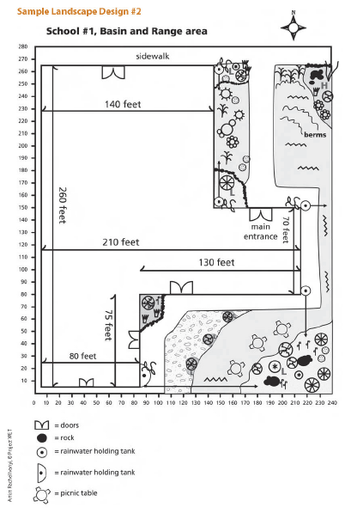
Smart Landscape Design: Lesson 2 Part B
Lesson 2: Part B - Activities:
Have students work in groups to complete the rainwater harvesting calculations page
Go over rubric again and review sample landscape designs 1 & 2
Hand out Steps for Designing Your Water Efficient Landscape

Slide 4
Steps for Designing Your
Water Efficient Landscape
Envision an area of land on your school grounds and design your rainwater harvesting landscape garden.
You can use one of the sample schools provided or draw your own layout.
Make sure you label high and low points accordingly
Draw roof drains, holding tanks, berms and other features of your rainwater system (use symbols and a key)
Finally add plants from the native list and color code them.
Notes:
Keep referencing the rubric so that your group can win during the class vote!

Slide 5
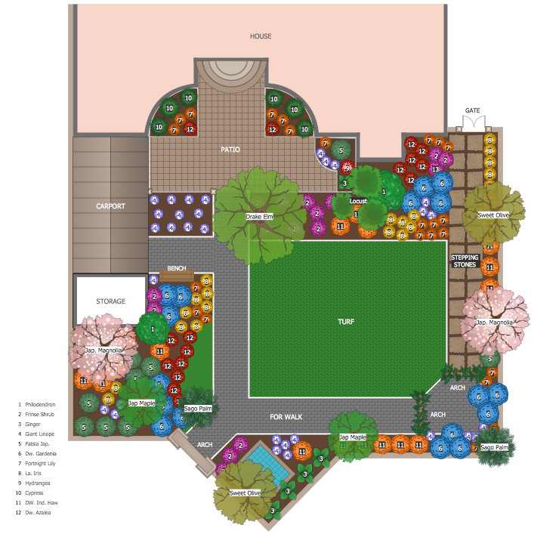
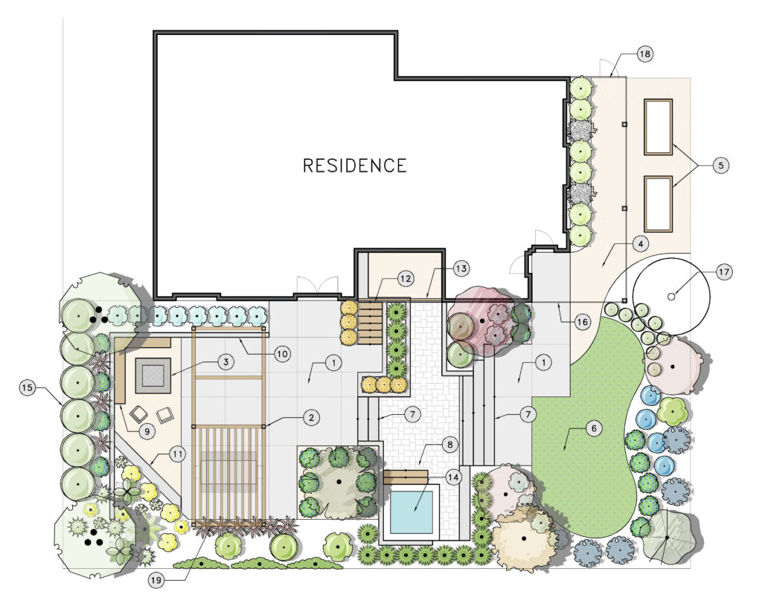
Smart Landscape Design: Lesson 2 Part B
Notes:
Remind students they are not doing the whole school, but picking a spot where they can improve upon what is there…

Slide 6
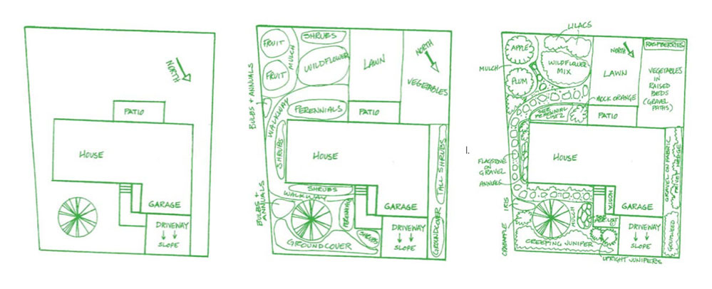
Smart Landscape Design: Lesson 2 Part B
Notes:
It may take several steps and planning to think about all of it

Slide 7
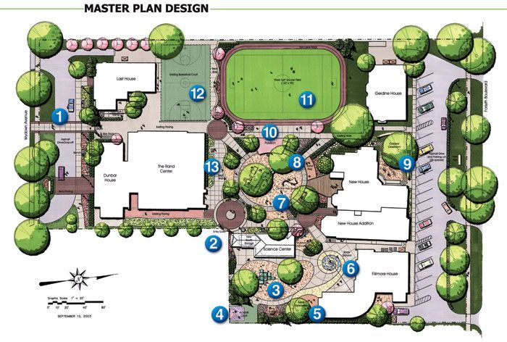
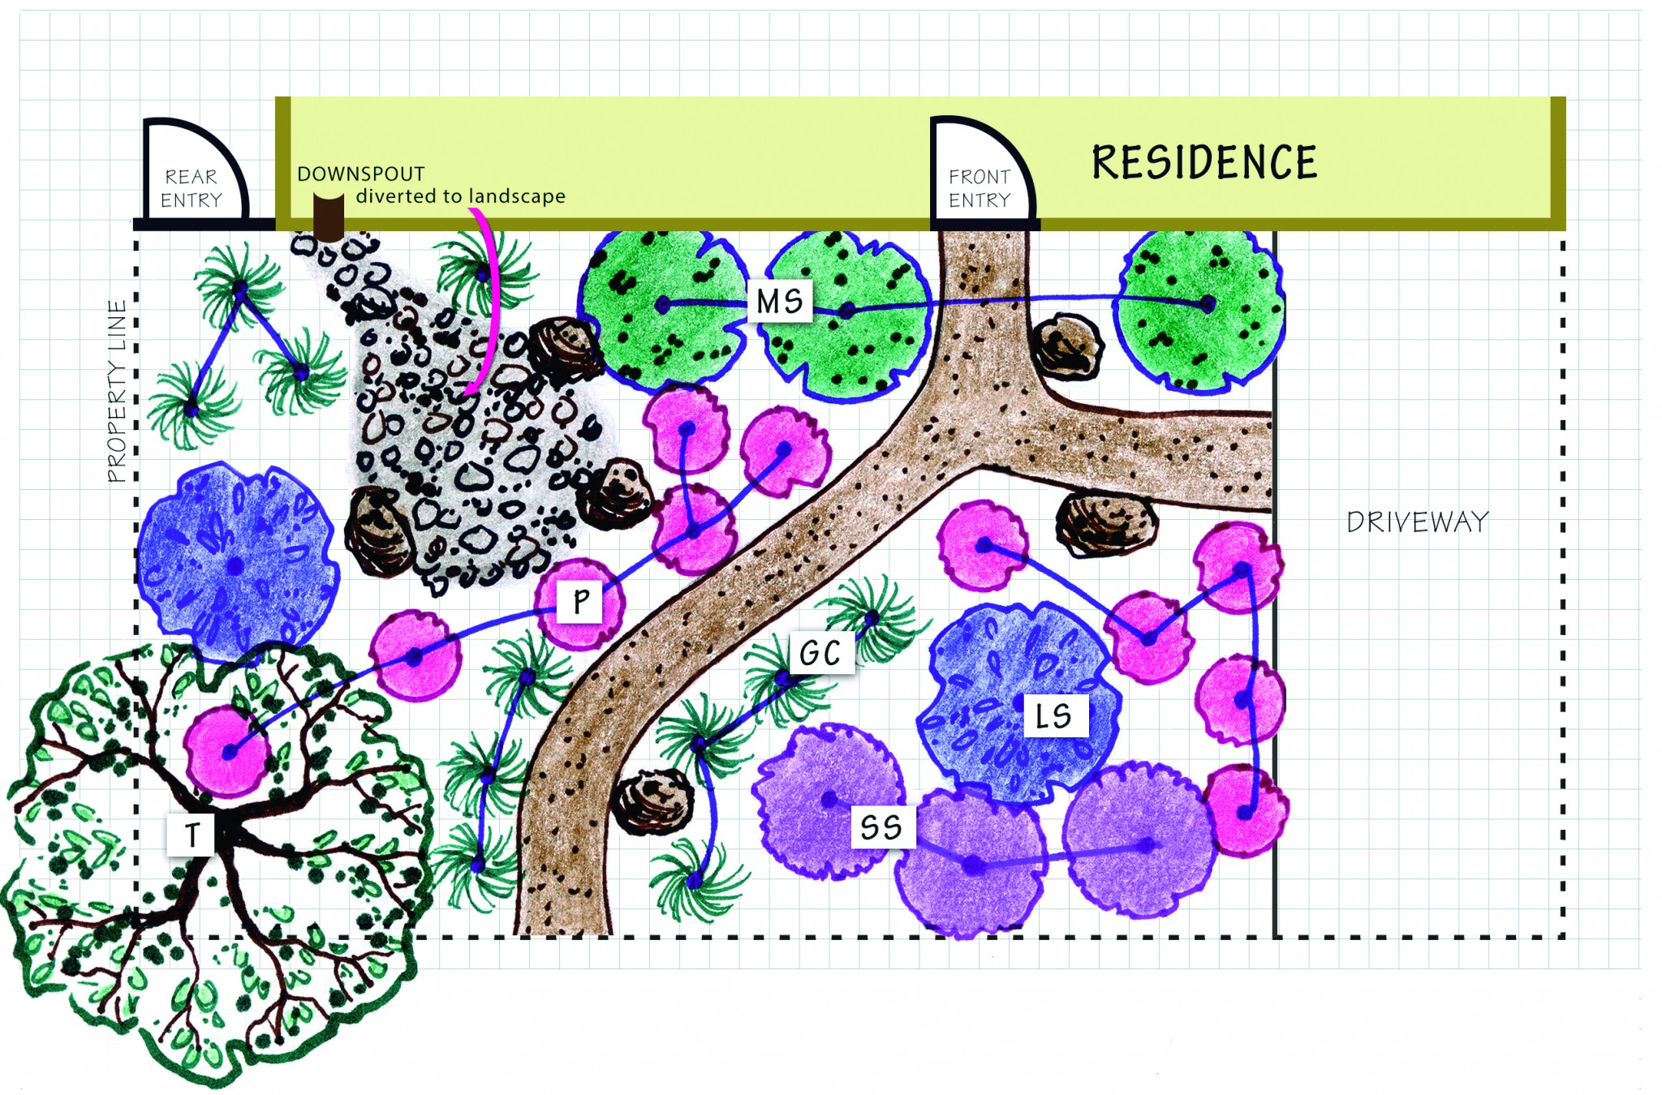

Smart Landscape Design: Lesson 2 Part B
Notes:
Here are some more examples, but again they should be focusing on one area on the campus and then be zooming in on that area around that one building and focusing on how the water is going to runoff and flow and what they are going to do about it.
This should take one to two classes depending on how much time you give them. And then the third class should be for the class to vote on which one is best according to the rubric.

