Slide 1
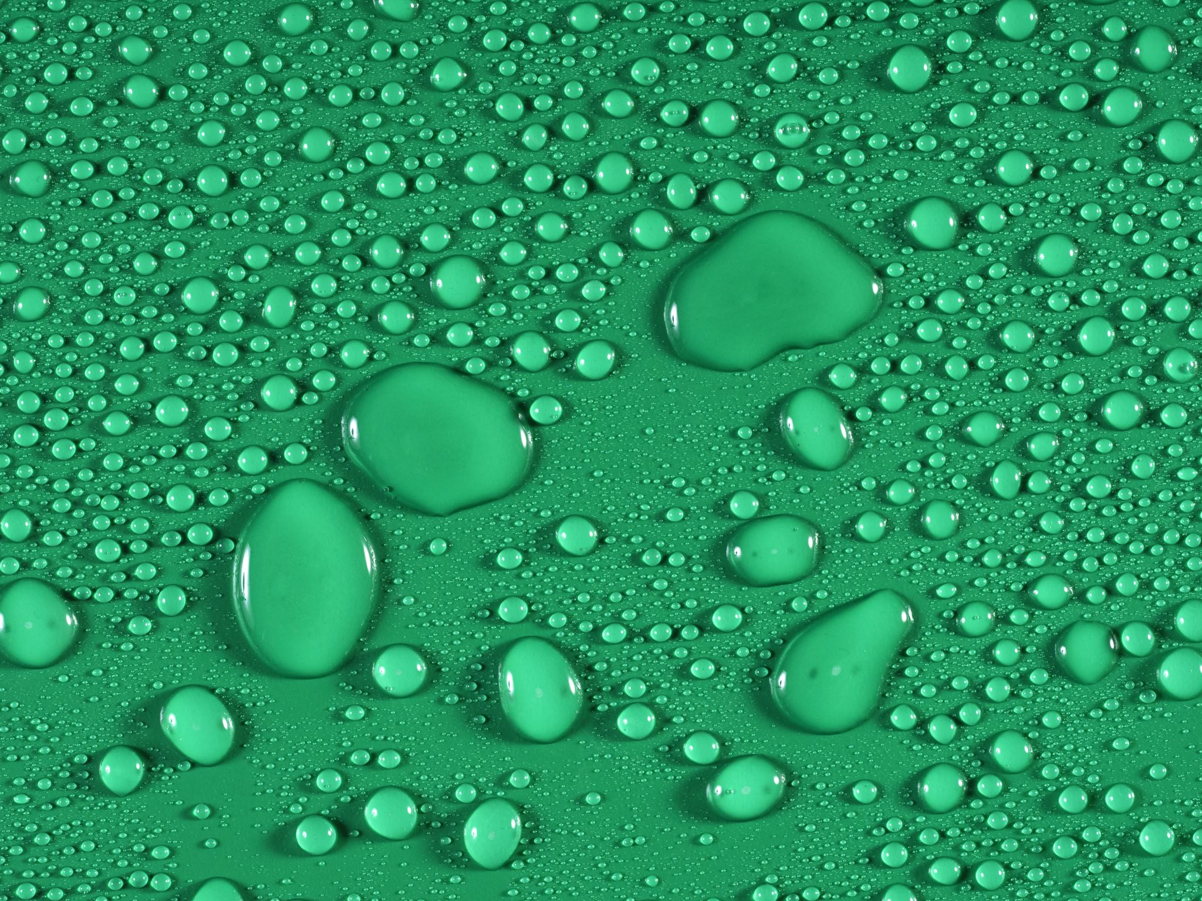


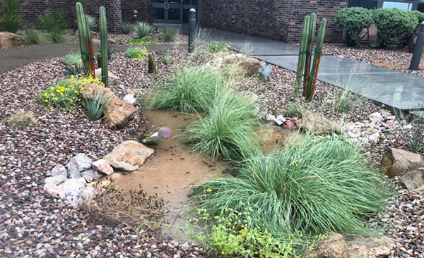


Planting for a Rainy Day
2025-2026

Slide 2

Lesson 2: Wrap Up
Smart Landscapes
Investigative Questions
How can you harvest rainwater to transform an impermeable plot of land on your school grounds into a water-efficient oasis?

Slide 3
Smart Landscape Design: Lesson 2 Wrap Up
Lesson 2: Wrap Up:
After each group has finished their design discuss answers to calculations of Rainwater Harvesting worksheet
Have each group share their design and have the class vote according to rubric
Discuss what were some of the challenges presented by different areas the groups chose around the school? Are there concepts that they have learned through doing this activity that they can apply at home?
Will you be more likely to notice green infrastructure around your neighborhoods and community now?
Send pictures to APW!

Slide 4

SUSTAINABILITY & STEWARDSHIP:
We all have a role:
The quality of water in a river, lake or in our groundwater is influenced by both natural factors and how people use the land around it.
Everyone is responsible for the health of the watershed and the water systems within it.
Our actions, good or bad, have an impact on our water supply.

Slide 5
SUSTAINABILITY & STEWARDSHIP:
My Water Footprint
Investigative Questions
How much water do I use daily?
Why is water use called a water footprint?
How can I be a better water steward?
Notes:
On average how much water do you think a person in Arizona uses? about 100-120 gallons a day. In general, most of this water is used for watering our outdoor areas but now we know how we can improve upon this. But that 120 gallons a day would be our water footprint…

Slide 6
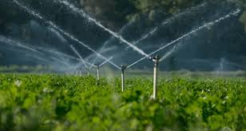

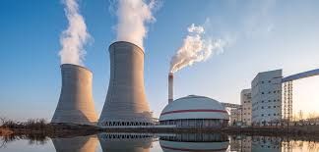
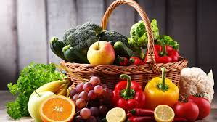
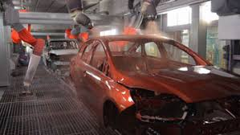
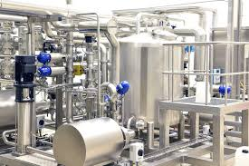
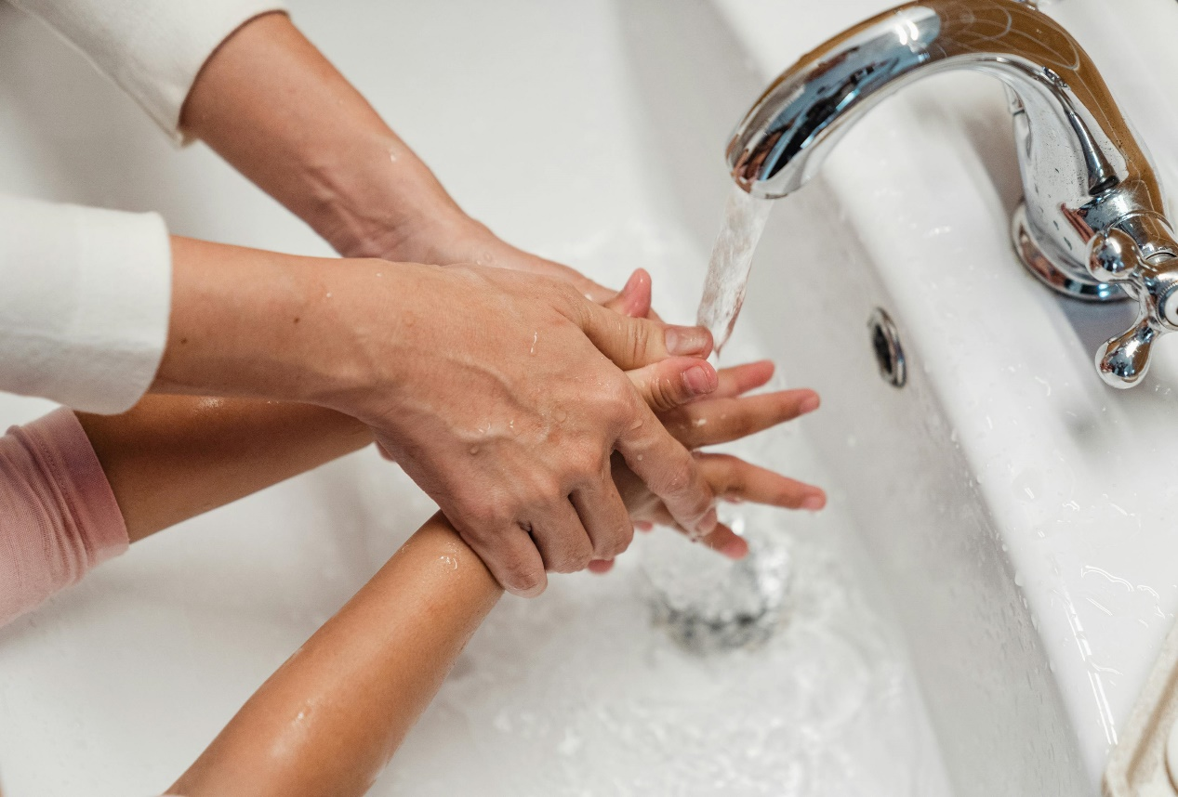
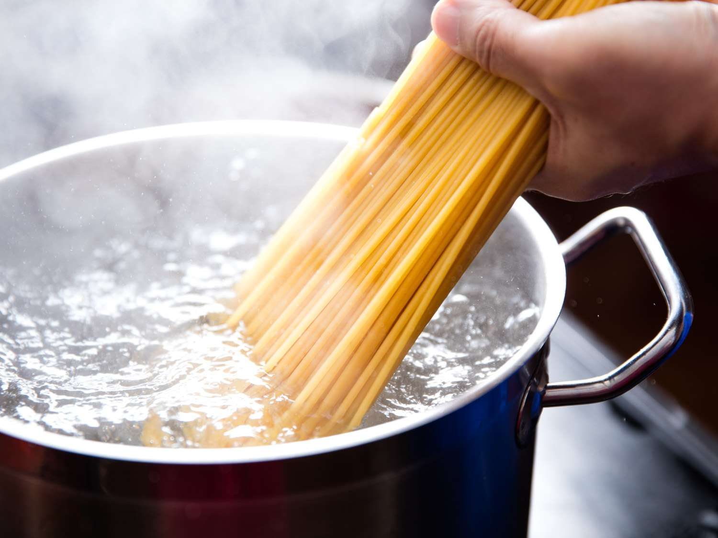
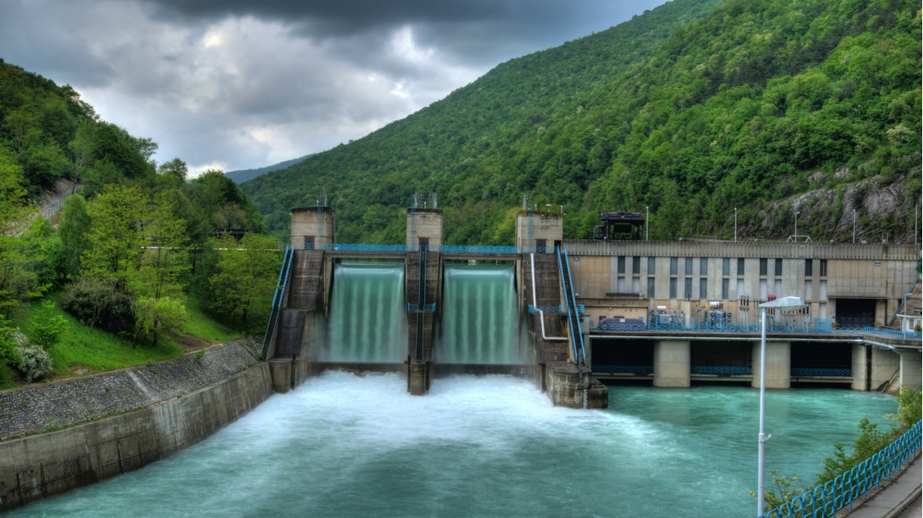
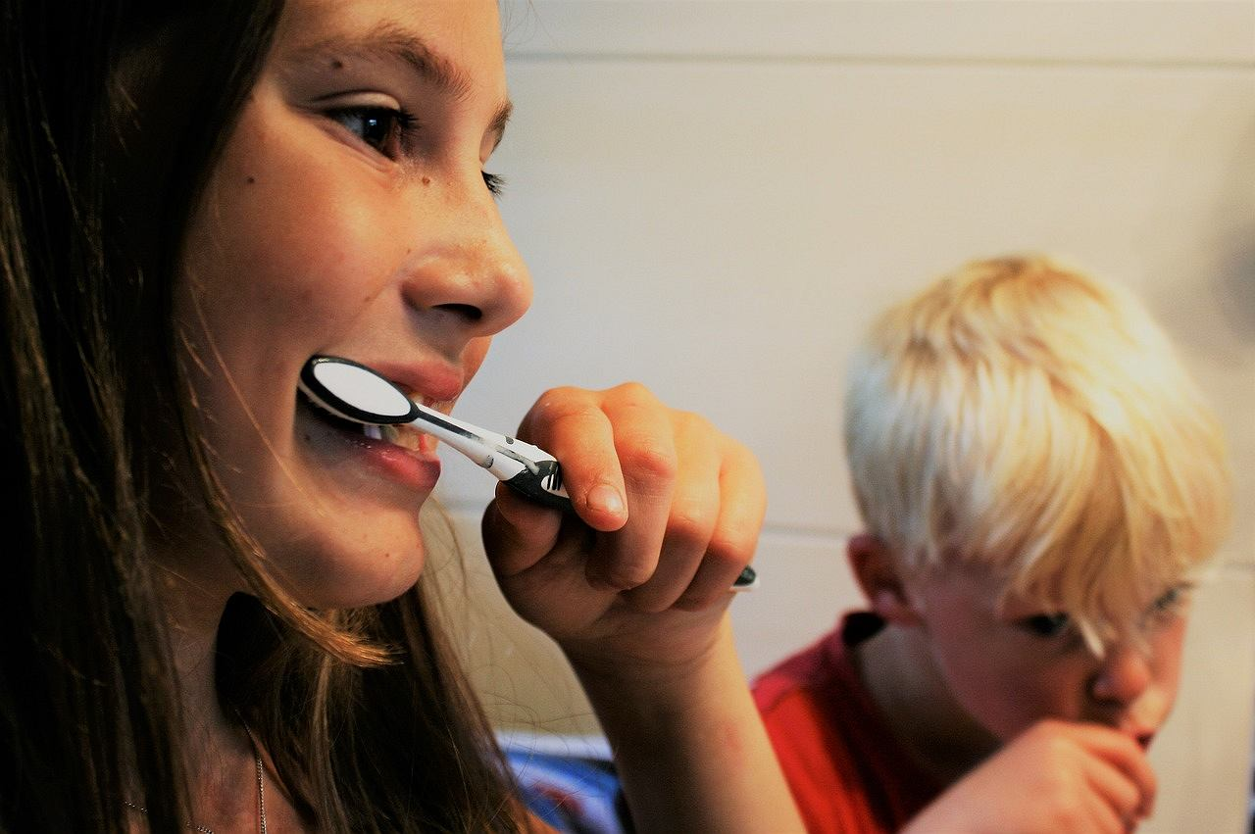
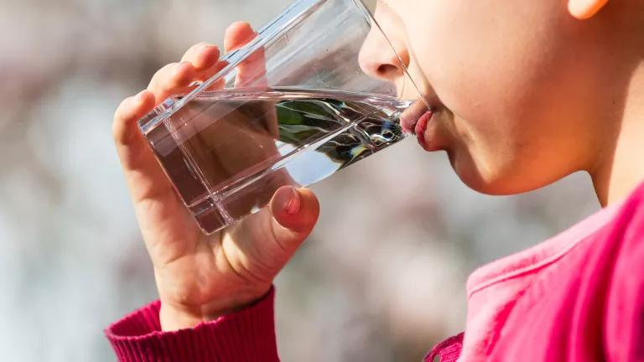
Indirect Water Use
The water used to produce the goods and services we all enjoy. It is the water hidden or not seen by the end-user during the process or manufacturing of a good or service.
Direct Water Use
Water you use directly to do something immediately. Water that is seen, felt and used at that given time, when you turn on your faucet or hose for water.
Notes:
What is Direct Water Use – that will show first, then indirect
Direct Water use: Drinking water, bathing, flushing a toilet, brushing your teeth. To make a bowl of pasta, water is required to boil the dry pasta in the pot – this is direct water use for the person eating that pasta at home.
Indirect Water use: also called hidden or virtual water – because the water use is often unseen by the end-user of a product or service, but the water has been used or consumed throughout the process chain. In order to produce the pasta, water is required at many steps along the way - water to grow the wheat; water to produce the fuel for machines to harvest the wheat and transport the pasta to the store; and water to create the electricity for processing the wheat into flour and pasta.

Slide 7
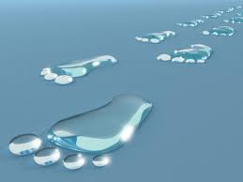
SUSTAINABILITY & STEWARDSHIP:
What is a Water Footprint?
It reveals water use patterns, from the individual level all the way to the national level.
It shines a light on the water used in all the processes involved in manufacturing and producing our goods. It also accounts for water contaminated during manufacturing and production.
A water footprint is measured in terms of the volume of water consumed, evaporated and polluted.
What's Your Water Footprint - Water Calculator
Notes:
It is like an invisible mark that shows how much water you use for all the things you do and things you use (direct water use and what you eat and wear). Everything we do uses water!
Blue Water Footprint: The amount of surface water and groundwater required (evaporated or used directly) to produce an item.
Green Water Footprint: The amount of rainwater required (evaporated or used directly) to make an item.
Grey Water Footprint: The amount of freshwater required to dilute the wastewater generated in manufacturing, in order to maintain water quality , as determined by state and local standards.
https://watercalculator.org/footprint/what-is-a-water-footprint/
There is also a lesson in the book you can do

Slide 8
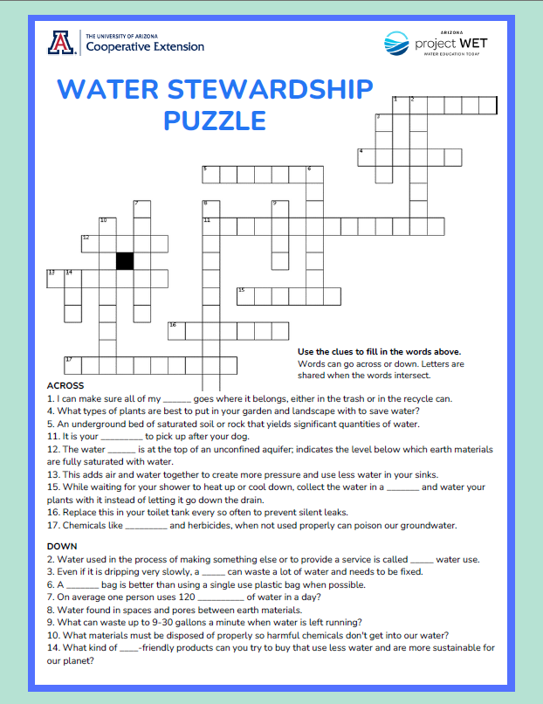
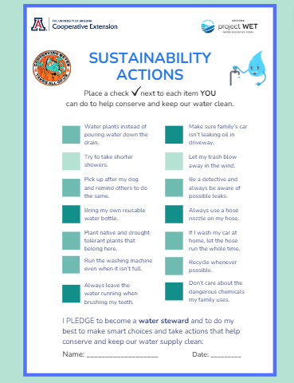
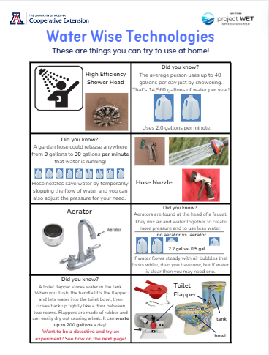
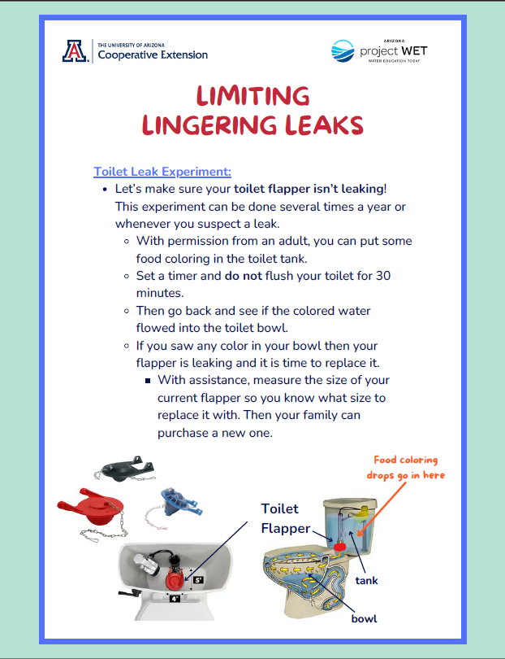
SUSTAINABILITY & STEWARDSHIP:
BE THE TIDAL WAVE OF CHANGE!
Your daily choices and actions can add up to make a positive difference.
Notes:
So it is up to us to improve our water footprint and take actions to conserve water. Now that we know better we can do better. Water Worksheets for your students to check their understanding of sustainability actions. And resources they can share with family and friends

Slide 9
Splashing into Solutions
You Have the Power!
What is Water Conservation?
What is Water Efficiency?
Beneficial reduction in water loss, waste or use by changing behavior to use less water.
Minimize the amount of water used to accomplish a function or task. Doing more with less water. Normally relies on well-engineered products and fixtures or technology.
Notes:
Being a water steward is really about both… making good choices to practice water wise behaviors while also utilizing new technologies to make water use more efficient. This is how we can all help make a positive impact!

Slide 10
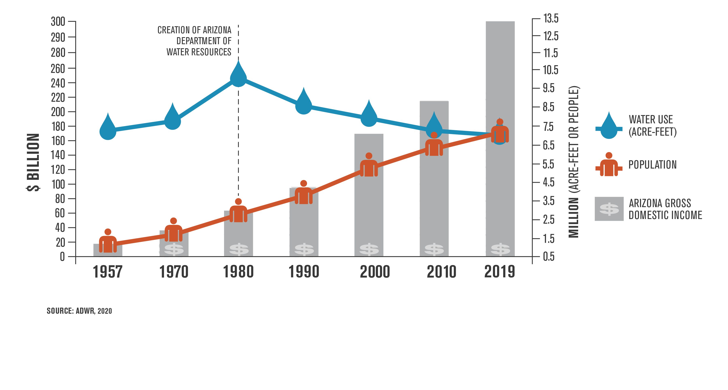
Notes:
There is hope! What do we notice in 1980? Passes the 1980 Groundwater Management Act…
1980 we had 2.7 million people but we were using over 9 million acre-feet of water
2019 we have over 7 million people and we are using under 7 million acre-feet of water – that is pretty incredible
through significant investments in water conservation and infrastructure and the reuse of water, our water use is essentially the same as it was more than half a century ago.
What is an acre foot of water? = enough water to cover an acre of land a foot deep = 326,000 gallons (about the size of a football field a foot deep).
According to the ADWR – The average number of homes served annually by an acre-foot of water actually increases to 3.5 when all of Arizona’s five “Active Management Areas” are taken into account. There are many variables but this is how cities look at development of new homes.

Slide 11
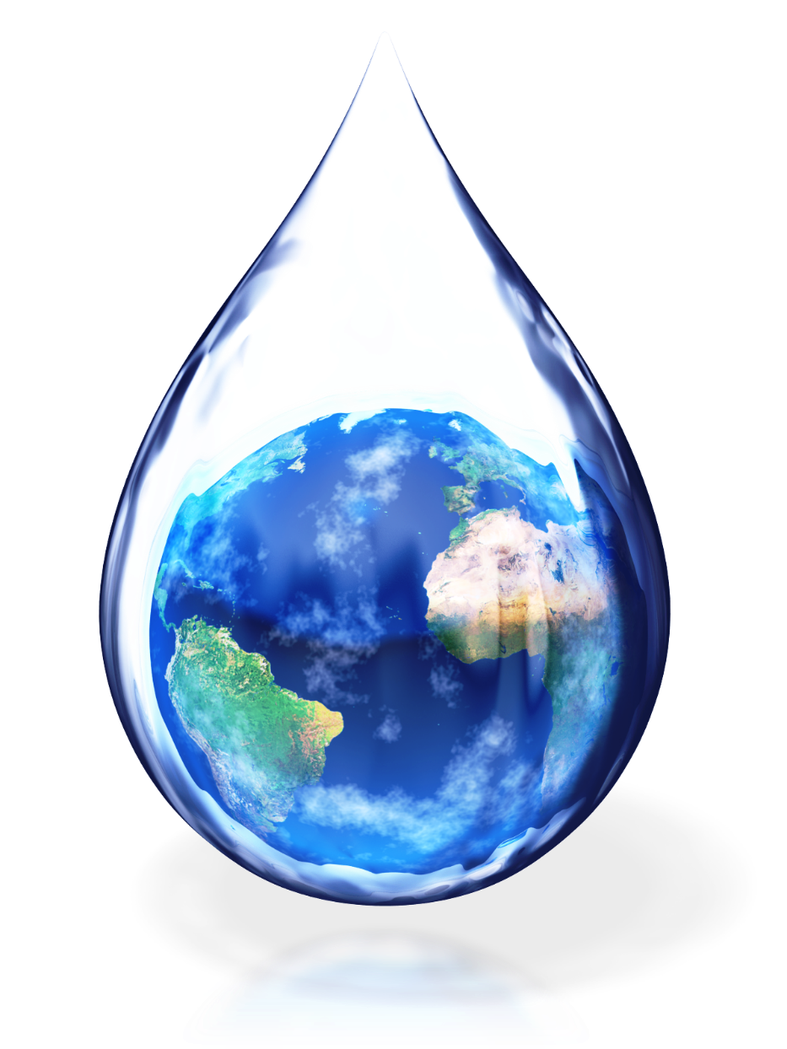
Take the PLEDGE:
I PLEDGE to be a water steward, to do my best to make smart choices and take actions that help conserve and keep our water supply clean.

