Slide 1
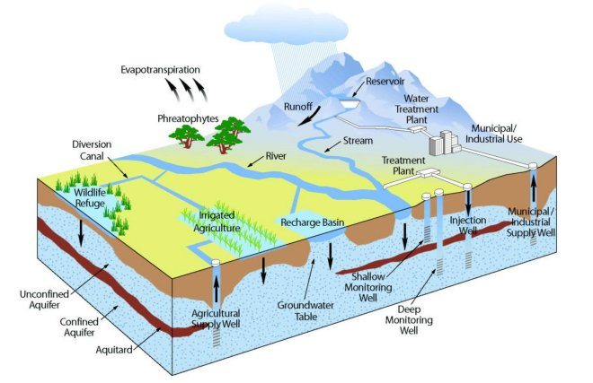
WATER CYCLE & GROUNDWATER: LESSON 2
Water Principles
Water is found in the atmosphere, on the surface of the land, and underground.
The water cycle connects Earth systems, purifying and renewing water on Earth.

Slide 2
WATER CYCLE & GROUNDWATER: LESSON 2
Water Movement Between
Earth Systems
Investigative Questions
How and why does water move between Earth’s systems?
What are some of the consequences of water movement (cause and effect)?
Notes:
Review: Have students take out their desert/forest coloring page. Ask them to think, pair, share about how water moves from one place to another in the picture. Ask them to generate a list of transfers using the Cause and Effect biome page.
Engage: Generate a list of cause-and-effect water transfers on the board/smart board. Ask students if they think water moves from plants into the air. Tell them that they are going to do an experiment to find out and ask them to write down their prediction.

Slide 3
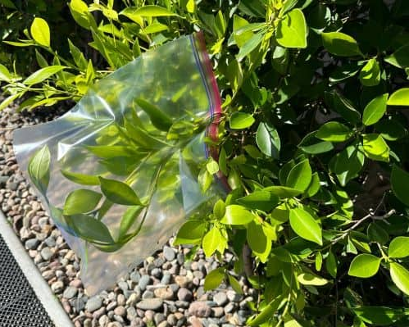
LESSON 2: Thirsty Plants – Set-up
Experiment Time:
Take students outside to an area with several plants (a variety is best).
Have students carefully place the bag over several leaves of their plant, and zip the bag closed.
Record their data on the worksheet.
Make predictions and while you wait to check on your bags (approx. 60 minutes) proceed with earth material fun.
  Tip – sunny days and spots will work best for this experiment!
Notes:
Set up this activity while you do the rest of the lesson, and so it can sit in the sun for at least an hour.

Slide 4
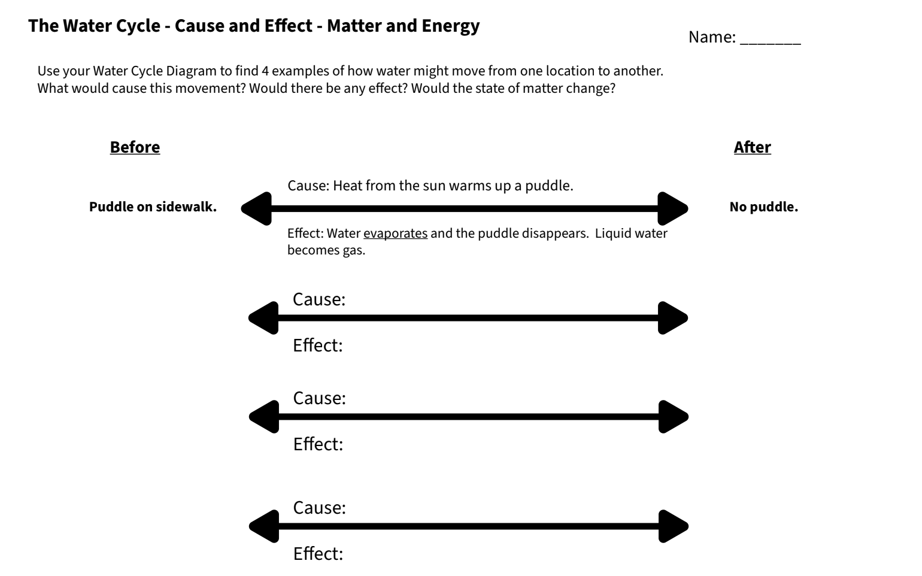

Slide 5
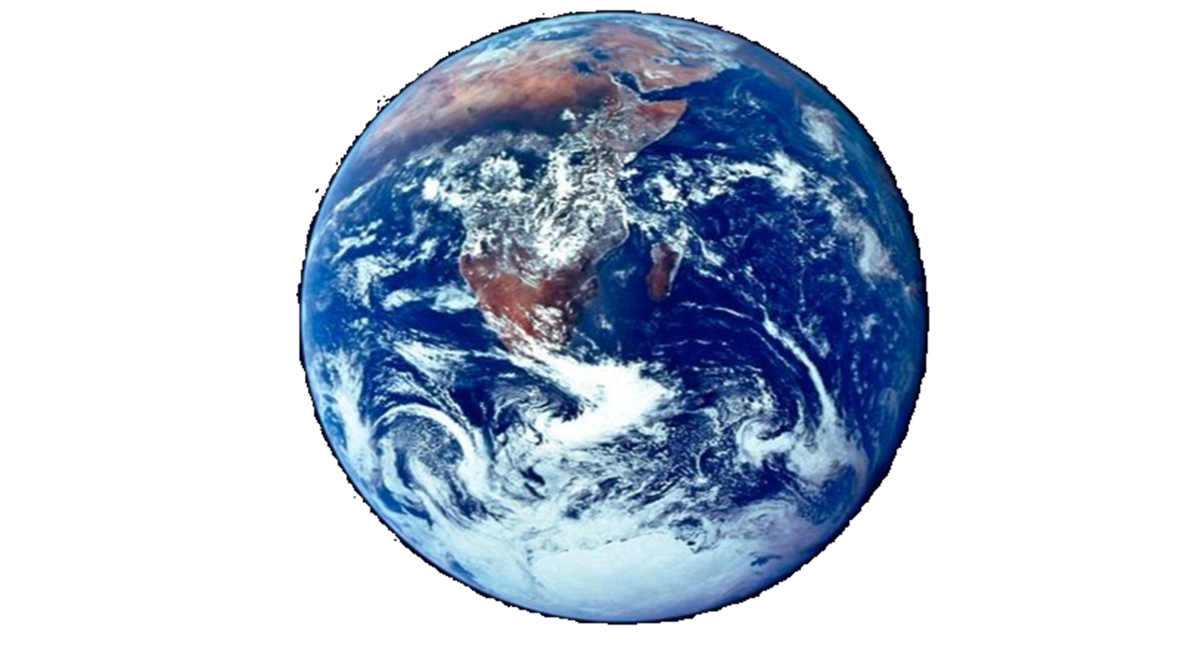
LESSON 2: Water Movement
Warm up:
What are some examples of places water can go in the Earth’s natural system?
Notes:
Put answers in chat!
River, Lake, Ocean, Clouds, Glacier, Soil, Groundwater, Animals, Plants

Slide 6

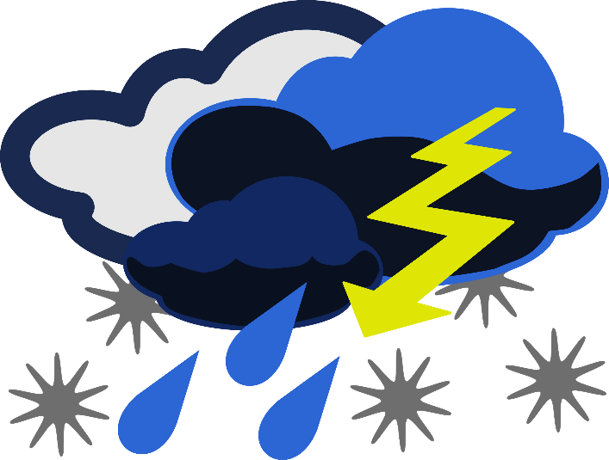
What is climate?
Is climate the same as weather?
Weather: what happens day to day (temp, clouds, precipitation)
Climate: is average measurements over several years
Climate is what you expect, and weather is what you get
Notes:
Because when we live in a desert the climate and weather is a specific way. And this has an effect on the water that we have.
Our climate and weather play an important role in regards to what does happen to the moisture we have here in Arizona…

Slide 7
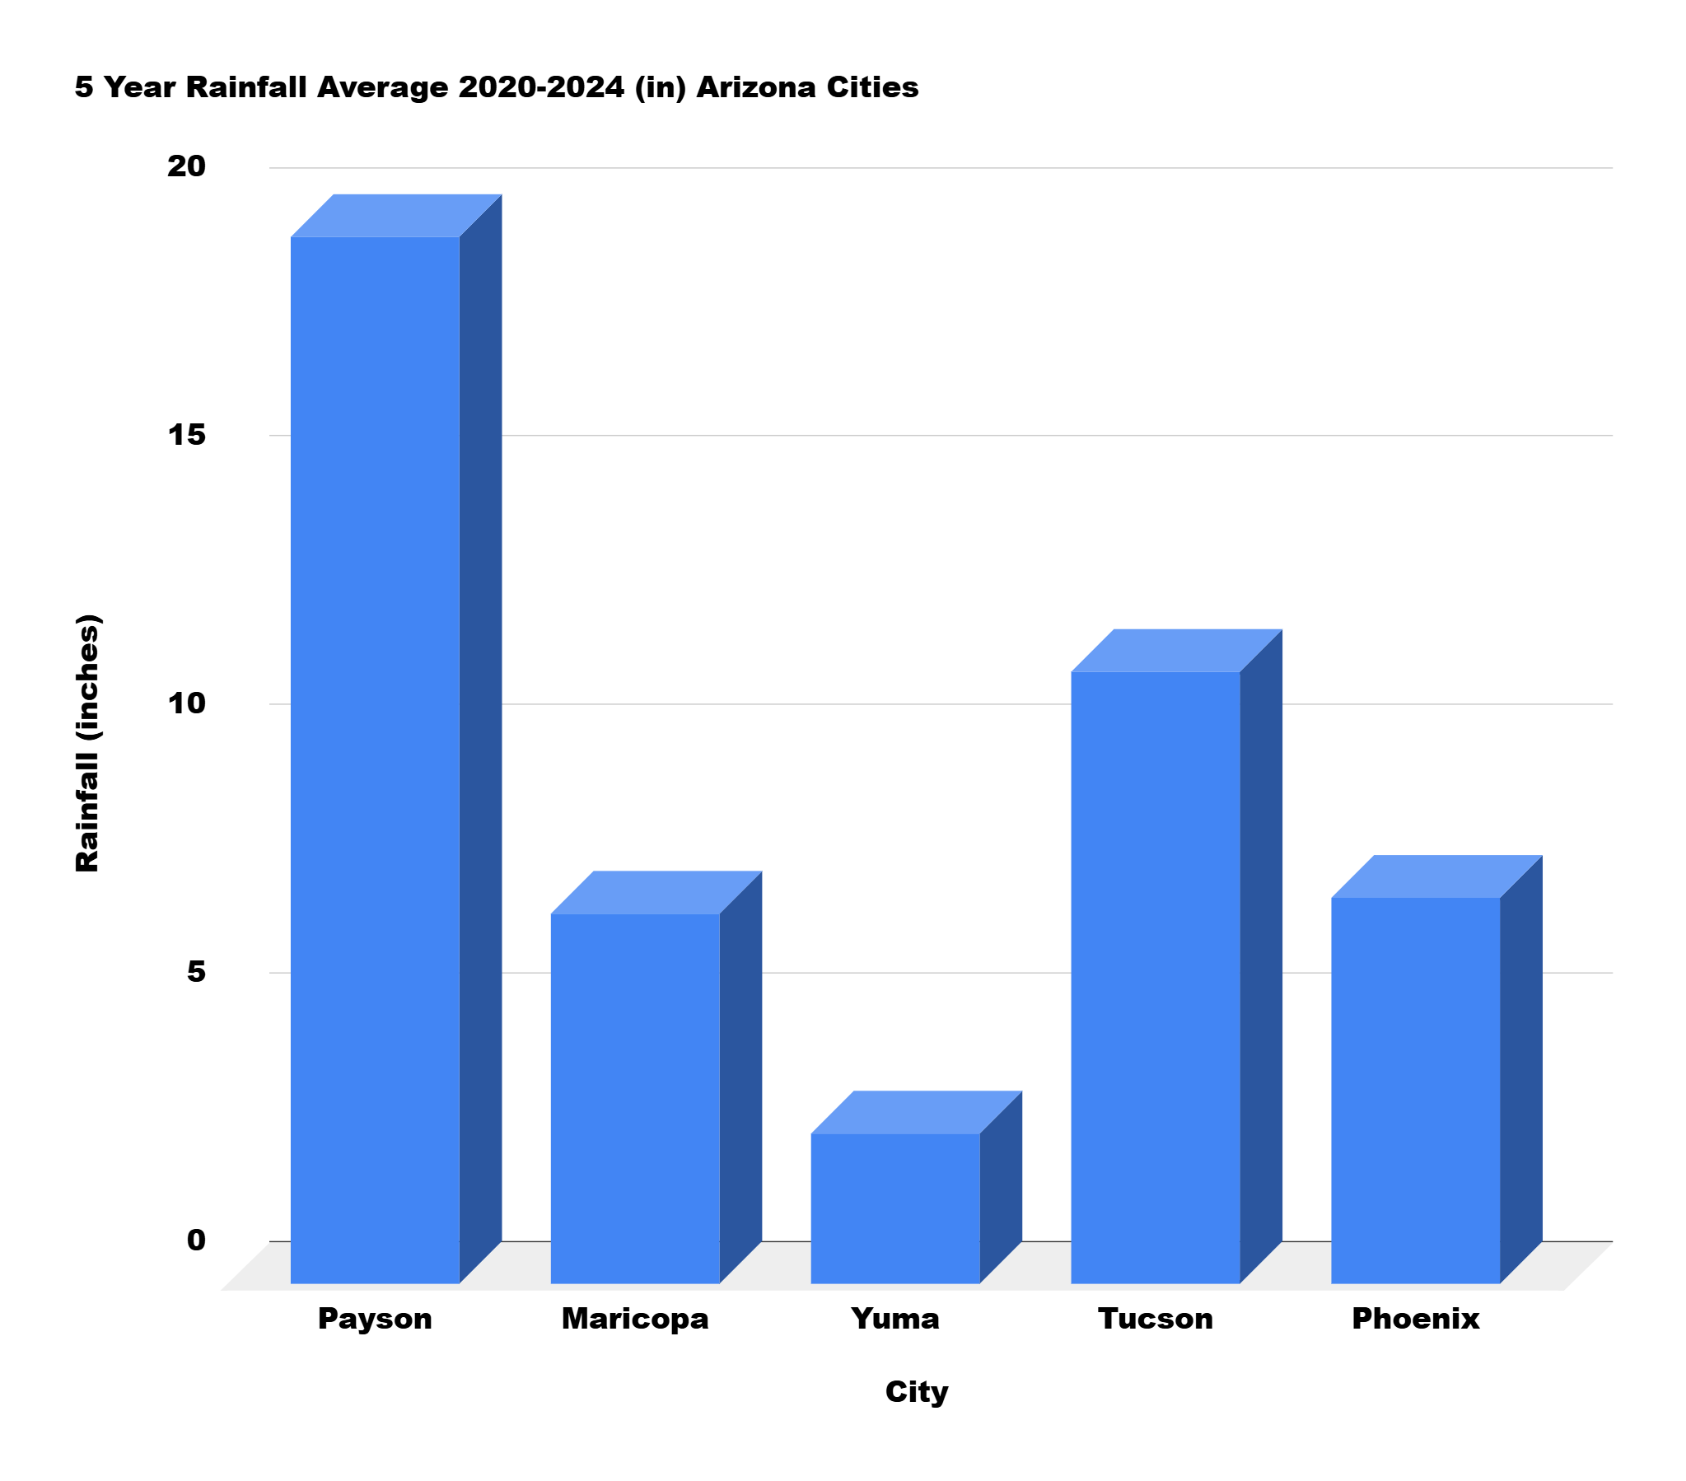
Precipitation (rain, snow, sleet) varies from year to year and in different locations in Arizona.
Which city gets more precipitation, Maricopa or Phoenix?
Which city gets the most? Which city gets the least?
Notes:
Notice inches of rainfall, what is our max?
Note this is over the year

Slide 8
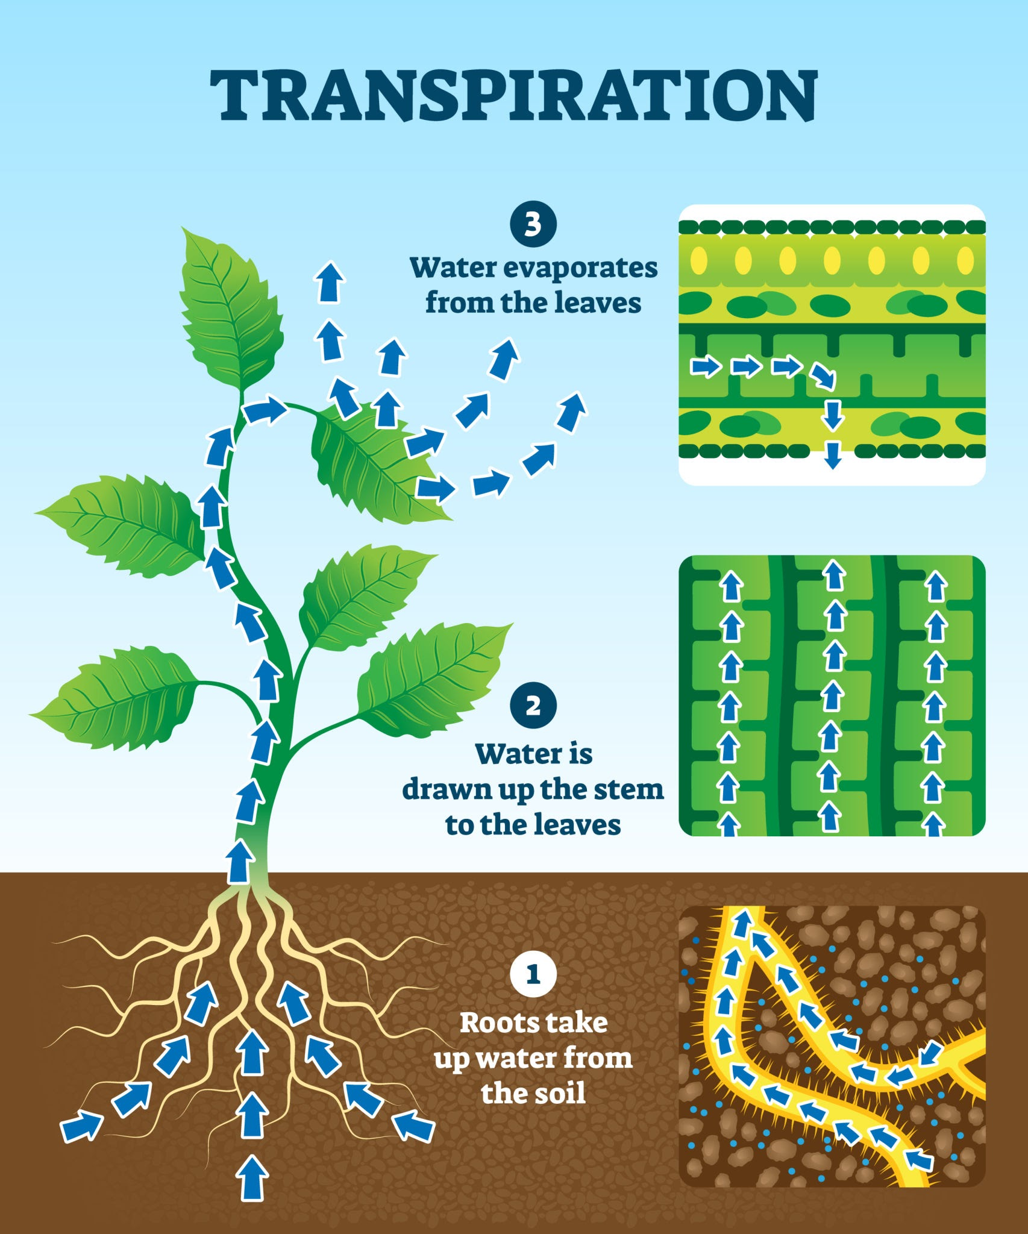
Evapotranspiration (ee-vap-oh-tran-spuh-RAY-shun) is a big word for a simple idea: it's how water goes back up into the air from both the ground and plants.
It is made by combining two separate words:
Evaporation: When the sun heats up a puddle, dirt, or a lake, liquid water turns into invisible steam (water vapor) and floats up into the sky.
Transpiration: Think of this as plant sweat! Plants drink water through their roots, and the extra water travels up to their leaves and evaporates into the air through tiny, invisible holes.
How plants release water into the air. Source: VectorMine / Getty Images

Slide 9
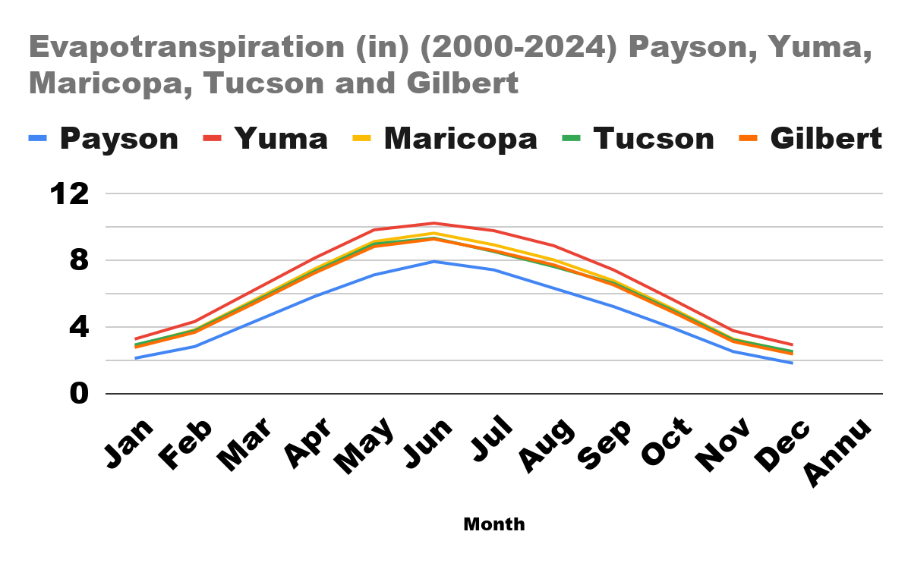
An Easy Way to Remember It: If you spill water on the sidewalk on a hot day, it dries up (evaporation). If a tree drinks water and lets some out through its leaves, that's transpiration. Put them together, and you get evapotranspiration—the total amount of water the air steals back from the earth and plants!
When does the most evapotranspiration happen in Arizona?
Notes:
Potential Evapotranspiration measures the atmospheric demand for water—the amount of water that would evaporate and transpire from a well-watered reference crop (typically cool-season grass).

Slide 10
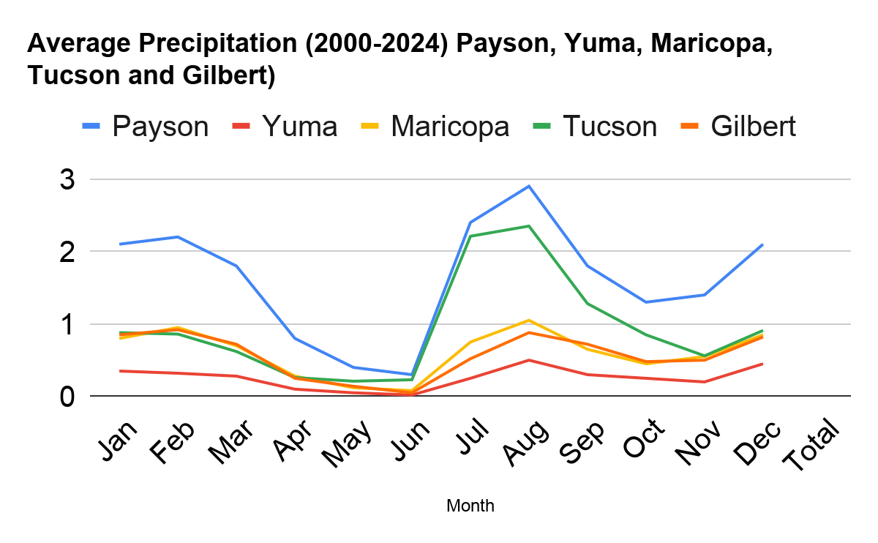
When does most of the rain/snow fall in Arizona?
What do we call the big summer storms that we have in Arizona?
Notes:
This is now looking at the same data but monthly. What do we notice about this graph… there is some consistency among all locations dependent on time of year (winter months, monsoon months), but some places definitely get more rain than others

Slide 11
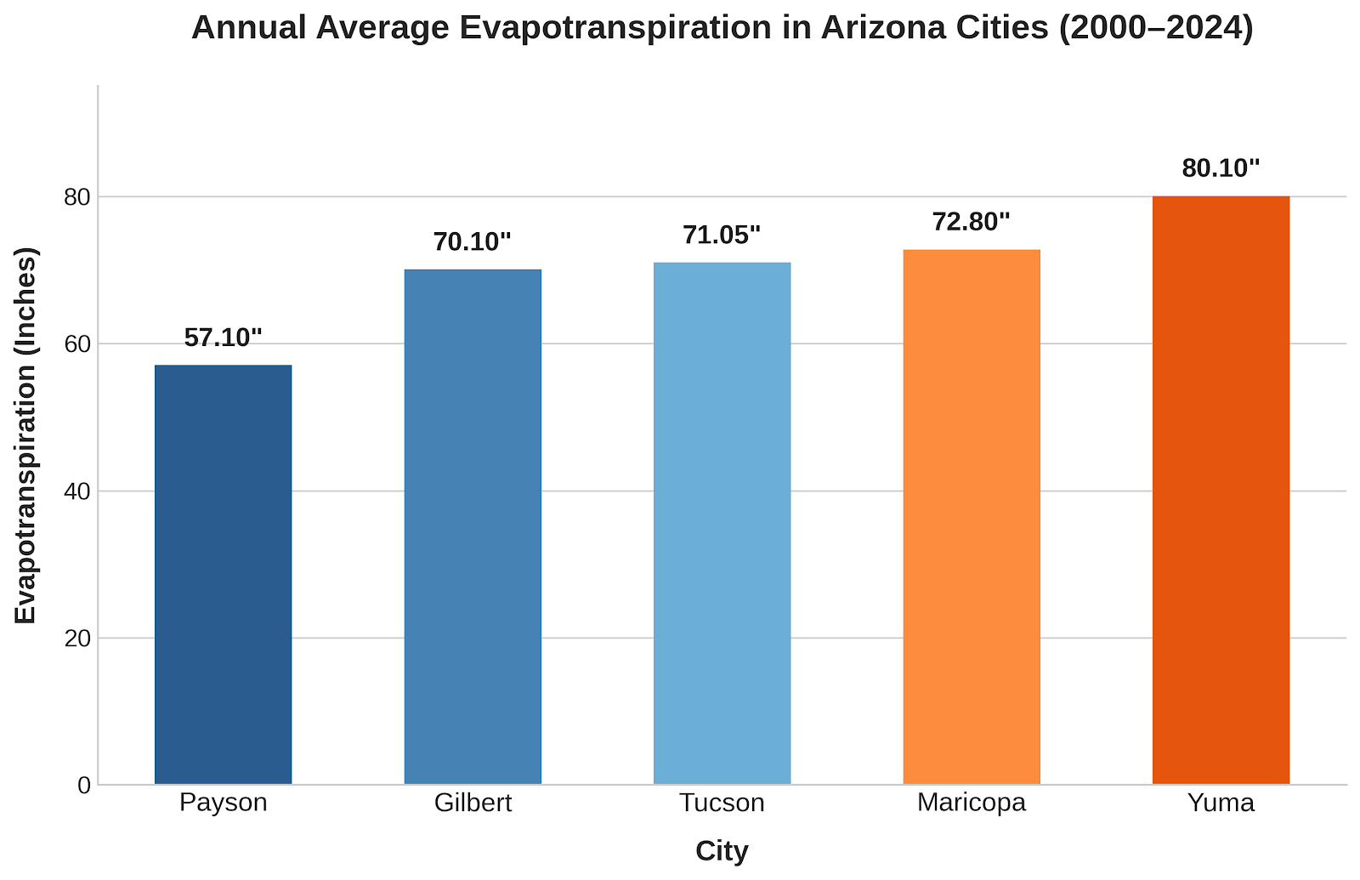
Notes:
Notice max especially when compared to our rainfall max (only 12 inches in Tucson)

Slide 12
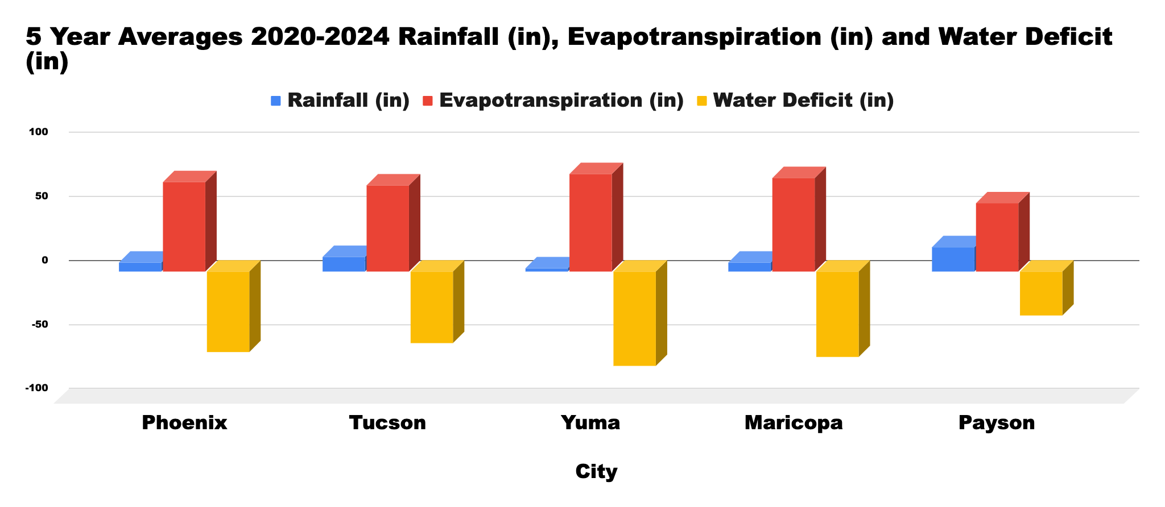
What does the data show us? Make some observations.
Notes:
We get a lot more evapotranspiration then we get precipitation… so what does this say about our climate? If you were an alien and looked at this data, what would you expect the climate to be like in Arizona? What kind of plants would you expect to find? this is going to be a very dry place – a desert, it isn’t that we don’t get rain or precipitation, but that our Evapotranspiration is much higher than our precipitation. About 7 x more …

Slide 13
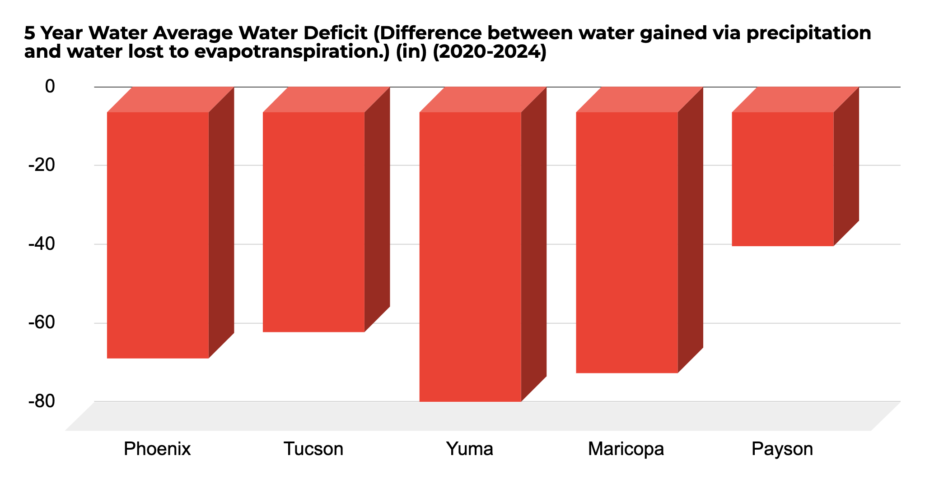
What kind of plants do you think will be able to hold on to more of their water?
What adaptations would help them to survive?

Slide 14
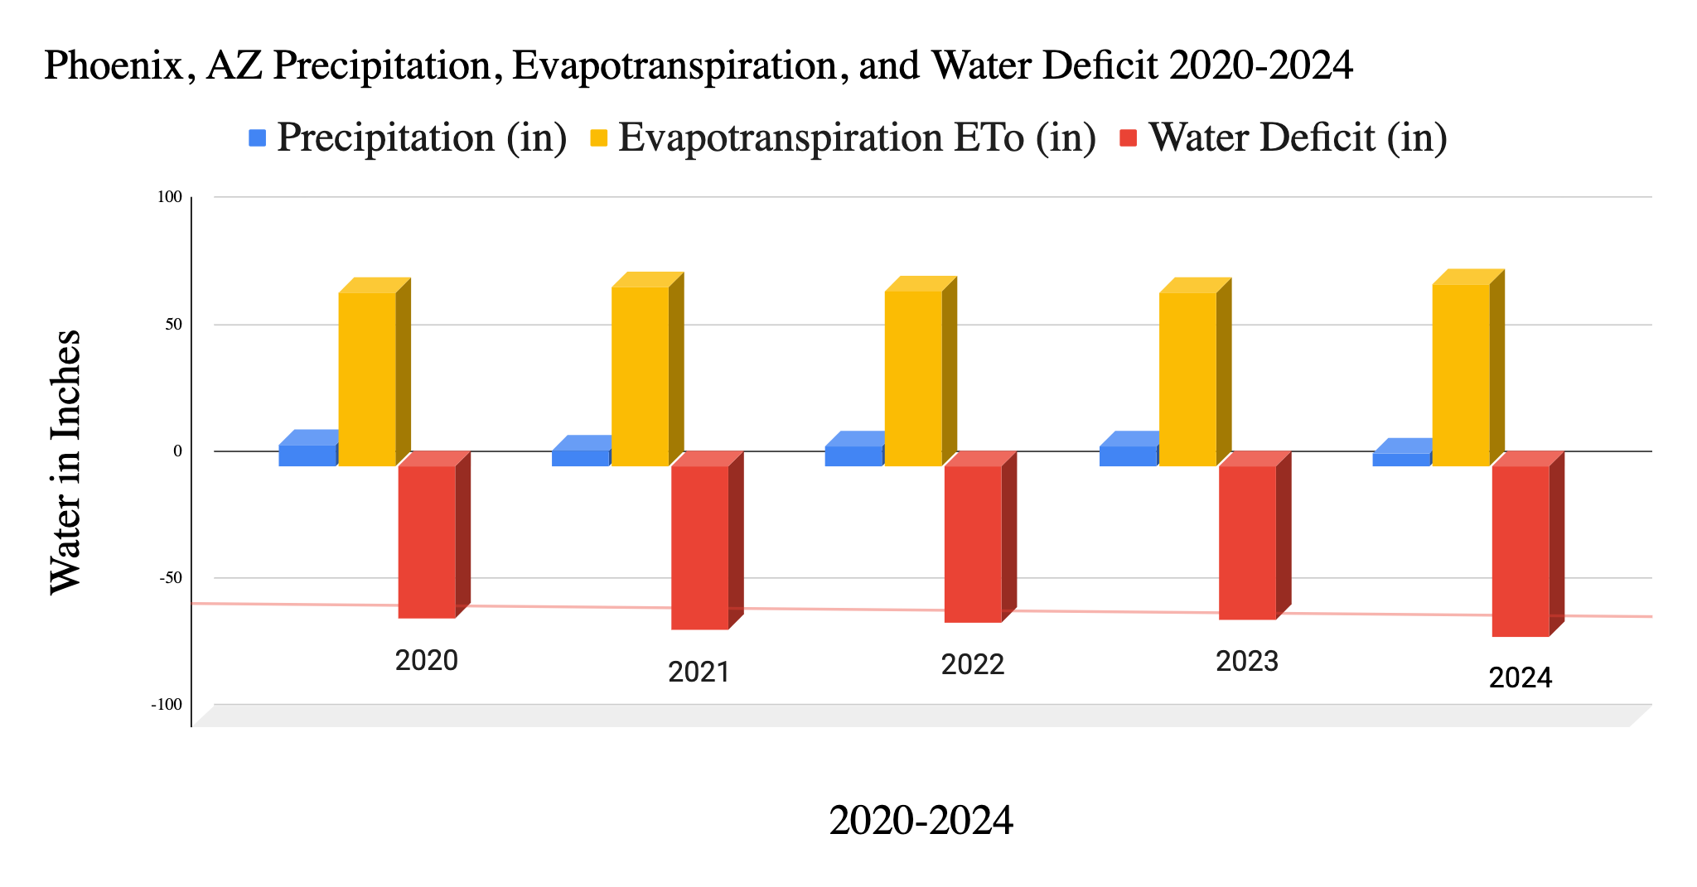
Notes:
What does this mean for your local water cycle and climate? It means we need to be smart about the water we have
Elaborate: Find your county factsheet and discuss what it means in a small group. https://wrrc.arizona.edu/resources/arizona-water-factsheets
Evaluate: Graph analysis questions.

Slide 15
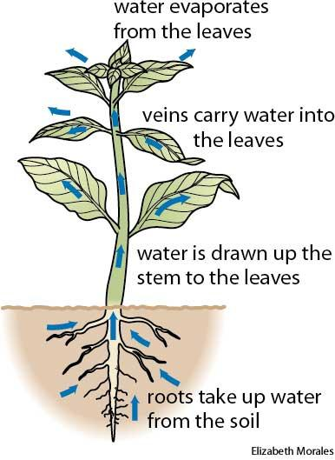
LESSON 2: Thirsty Plants - Discovery
Plant Perspirations!
Take students outside to go collect their bag.
    Carefully remove one leaf from the plant and put in your bag.
    Make observations about how much water is in the bag and share with class.
    How did the water in the bag get there?
Notes:
How does water get into the plant? What form of water goes into the roots? Liquid.
What causes the heat energy? The sun – it is the driver of water moving through the plant.
And then how does it get out? Evaporates out through the leaves…
Do you think that water is potable?
Move to next slide after “Do you know what this process is called?”

Slide 16
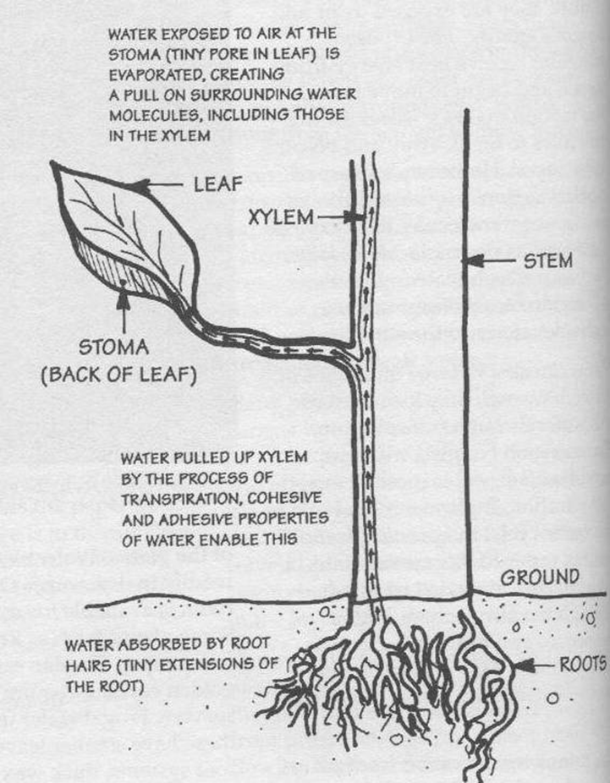
LESSON 2: Thirsty Plants - Discovery
Transpiration
Water molecules change form from a liquid to a gas when the molecules heat up and leave a plant.
Notes:
What form is the water when it leaves the plant? We don’t usually see it because it is a gas. But by collecting it in the bag, we can see the moisture back in the form of a liquid.
Capillary action happens when the sun heats up the water molecules on the plant’s surface and changes it to a gas, it also pulls the next molecules up through the plant due to water sticking to itself and to other things (very important property of water). Water sticks to itself (cohesion) and other things (adhesion – clouds)

Slide 17
Transpiring Thoughts!
Do you think transpiration plays an important role in the water cycle?
How many leaves were in your bag?
How many leaves did you estimate were on your tree?
How much water do you think would come from the entire tree in that same time?
How about all the trees in your neighborhood?
Notes:
This is where you can do some fun math! And this is where you can tie in so many other topics too, like adaptations of plants, and really have the students explore and think about why different types of plants would release more water than others. Why we would want to plant certain plants that can survive in the desert (native and drought tolerant).
Transpiration is invisible, but a very important part of the water cycle.

Slide 18
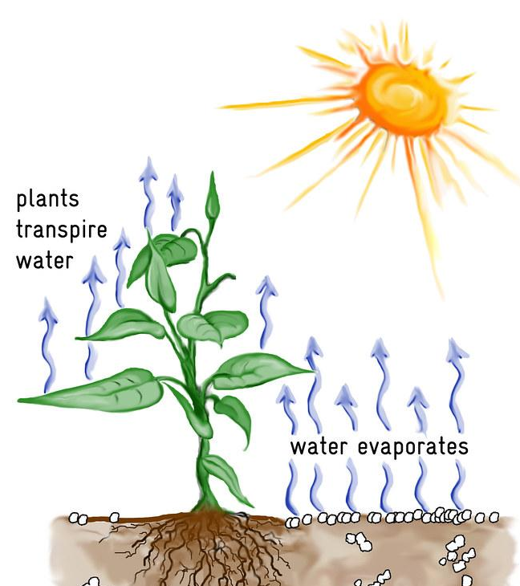
What is
evapotranspiration?
What is evaporation?
What is transpiration?
What form is water changing from and into during each process?
This Photo by Unknown Author is licensed under CC BY
Notes:
Read slide first – water goes from a liquid into a gas – water vapor. then say what do we get when we combine these two processes?
Evapotranspiration – combining evaporation and transpiration together, which means it is all the water that’s coming off the soil. Overall Evapotranspiration is an important process in the water cycle because it is responsible for a substantial amount of the atmosphere's water vapor. Without that input of water vapor, clouds couldn't form and precipitation wouldn’t fall.
So we are going to look at some climate tables.
More info if needed: They measure evapotranspiration in different ways, but one scientific instrument mainly used by farmers is called an atmometer and is usually used with alfalfa crops or grasses, to get the data for different areas. Another measuring device is called a lysimeter.

Slide 19
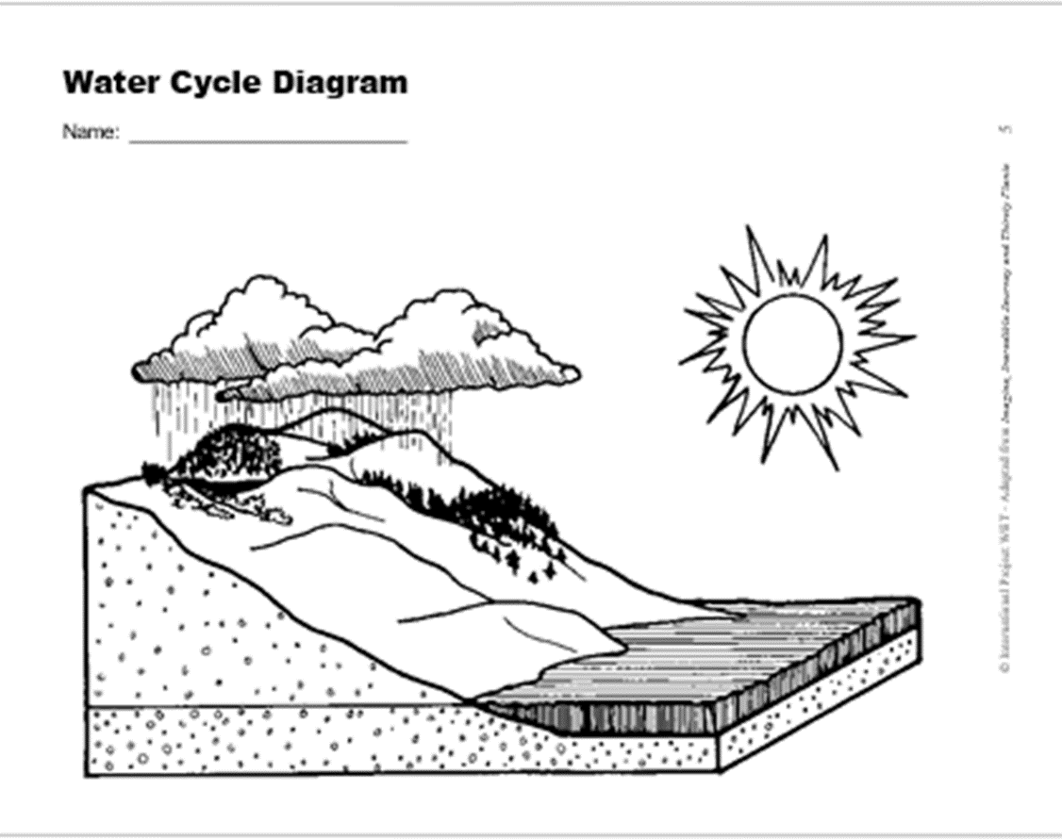
Wrap-Up
LESSON 2
Structure and Function
Add transpiration, evaporation, and precipitation to your water cycle diagram.
Notes:
Have your students make sure to add evaporation/transpiration, precipitation, and percolation to their water cycle diagram and maybe even show how water might flow with arrows?

Slide 20
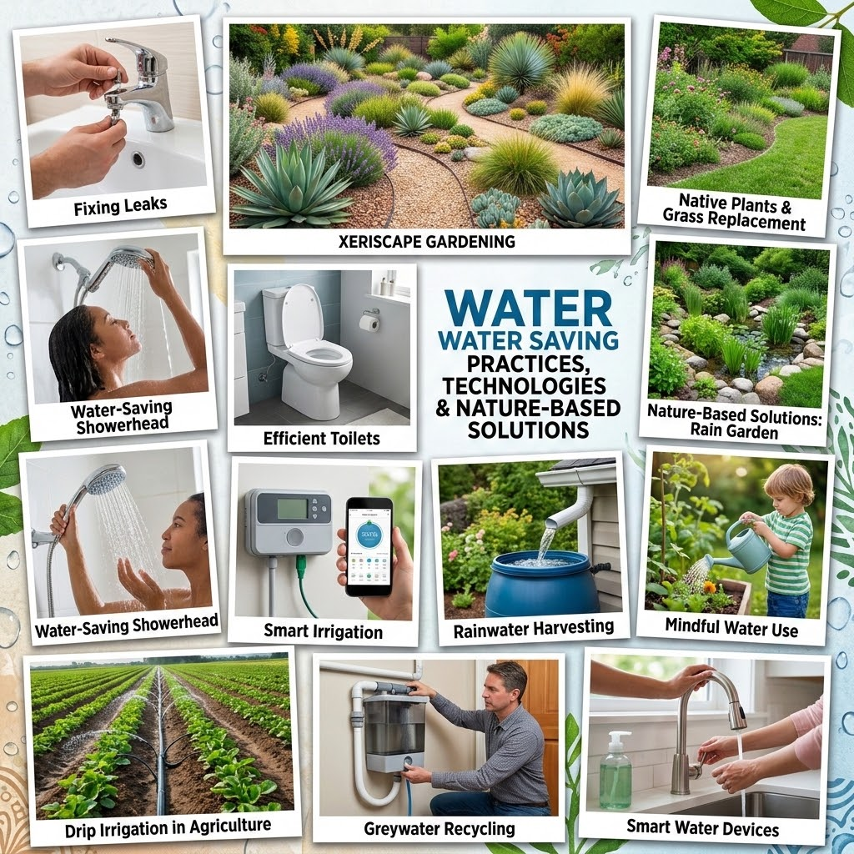
Asking questions, defining problems, generating solutions.
If we are losing more water via evaporation and evapotranspiration than we gain via precipitation, what could we do to save water?
Let’s brainstorm!

Slide 21

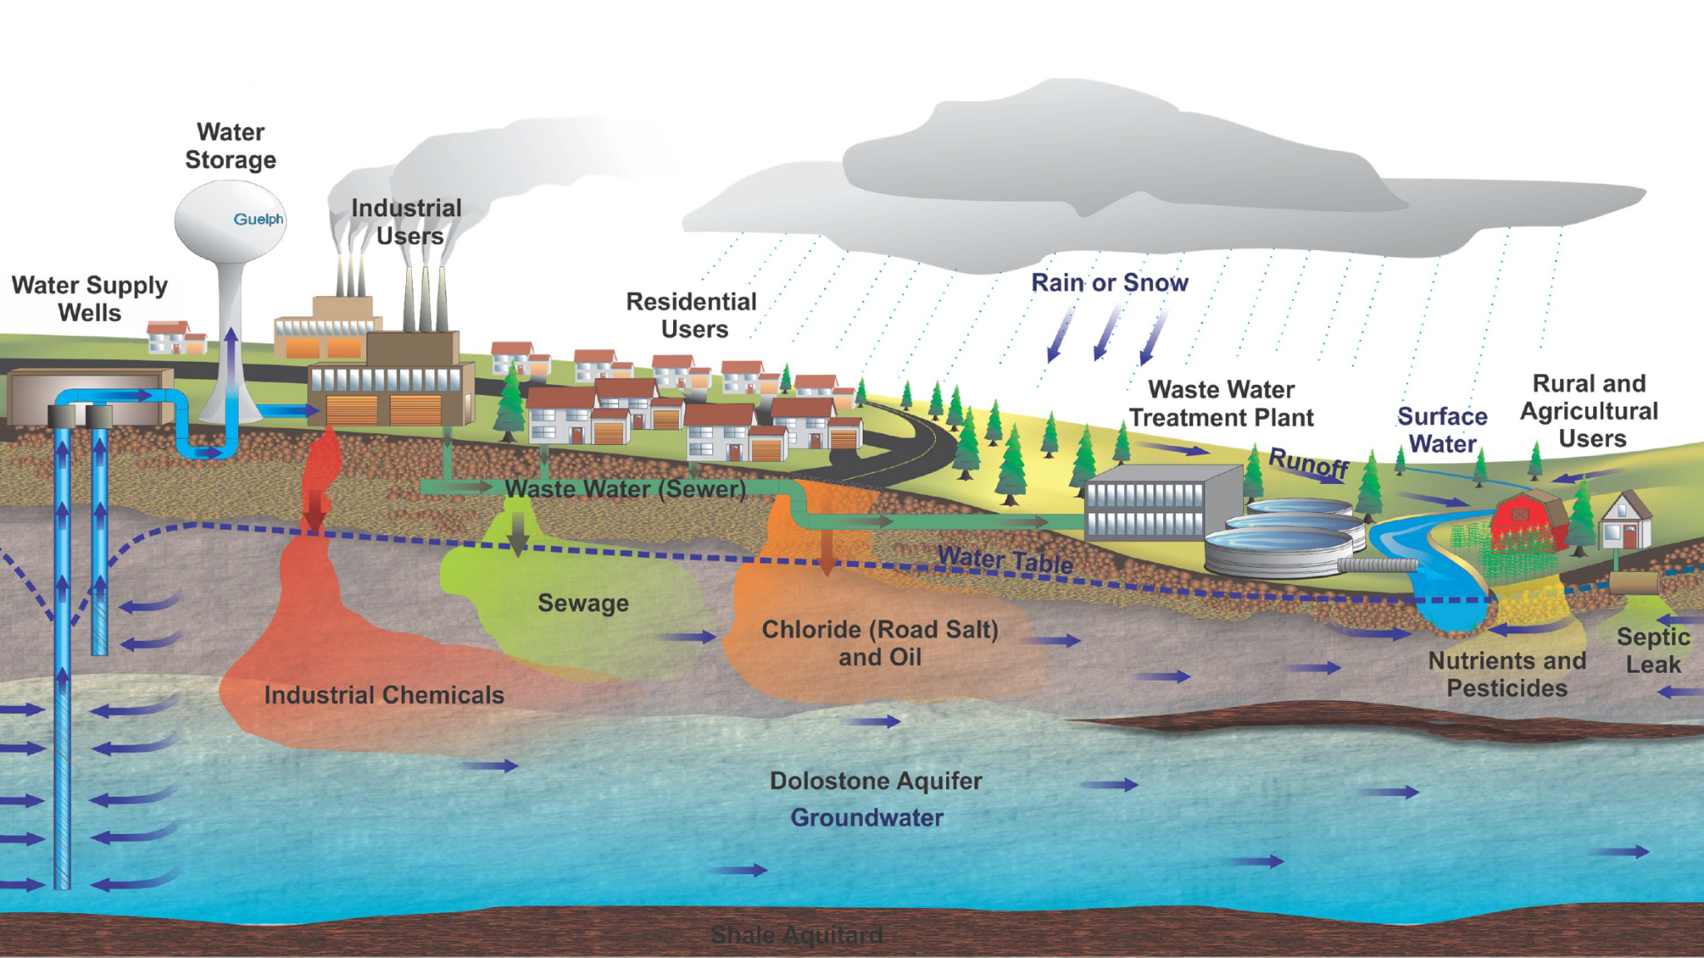

LESSON 2: Water Movement: Groundwater
Is water the only thing that can percolate into the ground?
Infiltration: Precipitation soaks into the soil, passing through the unsaturated zone where both water and air fill the pore spaces. As the water moves deeper underground, we call this PERCOLATION. Please add PERCOLATION to your Water Cycle Diagram
The Water Table: The upper boundary of the saturated zone. Below this line, every crack and space between soil particles is completely filled with water.

Slide 22

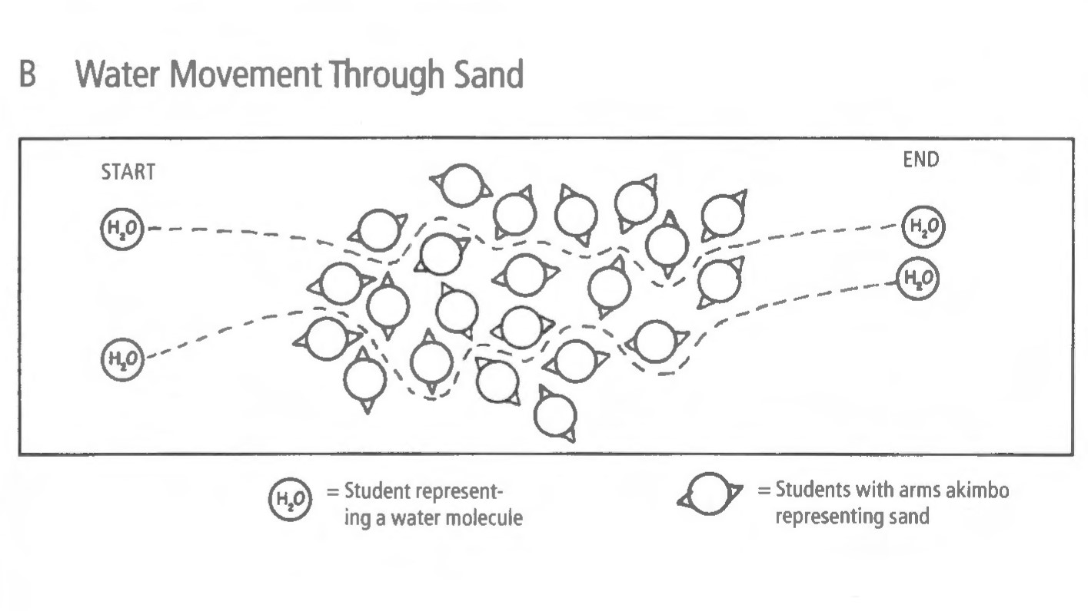
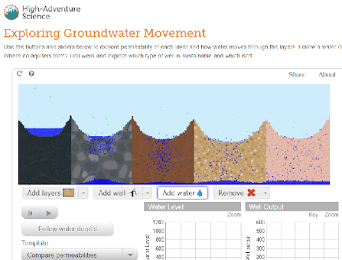
LESSON 2: Water Movement
Digging Deeper -Groundwater Model
Whole Body Simulation
Online Simulation
Notes:
This is a great way to get students to start to think about groundwater and how water is moving beneath our feet!
3 or four students are water molecules, everyone else are different sized earth materials. Water molecule students move through earth material students.
Water movement through gravel – hands outstretched
Water movement through sand – elbows out w/ hands on hips
Water movement through clay – arms pressed to side
Online model – choose compare permeabilities template but fun to play with all the options. Groundwater Movement - High-Adventure Science Interactive

Slide 23
LESSON 2: Water Movement
Earth Material Experiment
Have each student find a cup that will allow for holes to be poked on the bottom. A clear plastic cup is preferable, but this can be as simple as a reused paper to go cup or any container from the recycling bin.
Students should make holes in the bottom of their cup, about a dozen of them.
Students should identify and fill the cup with any earth material from an outdoor area or some they have around the house (examples – gravel, sand, dirt, mulch, etc.).
Notes:
You can also set it up as a classroom observation, if not all students are able to do it, or it can also be done in pairs or table groups (depends on your resources).
Demonstrate earth material tubes or something like it!

Slide 24
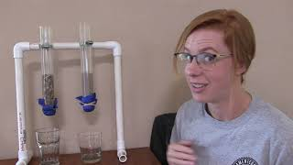
LESSON 2: Water Movement
Notes:
Students will get to do this experiment at the Water Festival, so it is ok not to watch this video ahead of time. If you do, make predictions before you start this part of the activity…
https://youtu.be/_KEjB-u4dQo?si=4nkWYz2L0aCx6Htx

Slide 25
Ground shattering outcomes!
How does water move and why?
Does the water get soaked up or did it move around the pieces of gravel/sand?
Which earth materials did water move through the fastest? Why?
What do we call ground surfaces that allow water to penetrate rather than run off?
When water is underground what do you think it is called?
Notes:
Have teachers put answers in chat or unmute and share!
No, water is moving through the pores or spaces between the materials, not the actual materials themselves.
Even though when we observed the sand getting wet, it looked like it was soaking up the water, but do rocks soak up water? No! What is sand – just tiny rocks. So the water is moving through the spaces and pores, and if the spaces between the materials are smaller, than the water moves slower.
- Why did the water move down in the first place? GRAVITY
Permeable – water can freely move between and through the spaces/pores of a material
GROUNDWATER – it is the largest source of fresh water on Earth – it’s kind of a big deal. We will learn more about it at the festival and in later lessons.

