Slide 1
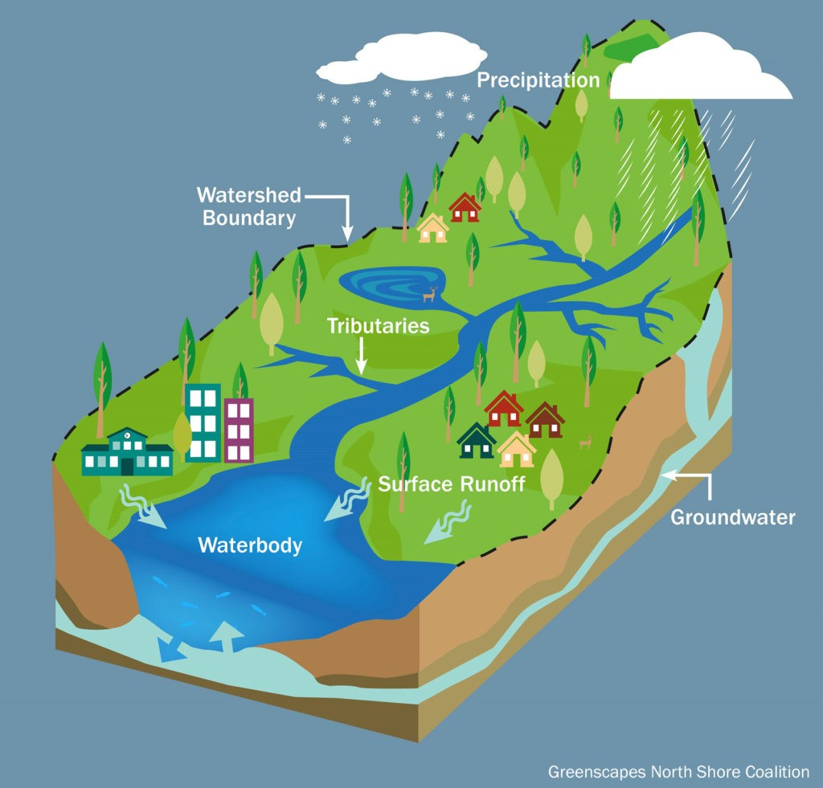
WATERSHED: LESSON 3
Watershed Wonders:
Did you know that with every step that you take, you are always in a watershed?
You probably know what state and city you live in, but do you know which watershed you live in?
What exactly is a watershed, and why should you care about it?

Slide 2
WATERSHED: LESSON 3.1
WATERSHEDS
Review:
Take out your water cycle diagrams. Think, pair, share about how water moves from one place to another in the diagram.
Generate a list of transfers using the Cause-and-Effect water cycle page.

Slide 3
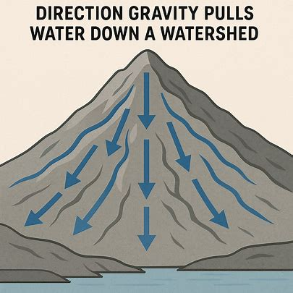
WATERSHED: Watersheds Work
What is a Watershed?
A watershed is a land area where rainfall and snowmelt flow downwards from the high points to the low points.
Notes:
Discuss: “What is a watershed?”
Break the word down:
Water
Shed – both a noun (building that stores something) and verb (to cast off or let fall, like a dog sheds)
Do the definition and motion “A watershed is….a land area…where water FLOWS from high points to low points.”
Ask: “If the definition is true, then what are the edges or boundaries of a watershed?”
Mountains
High points

Slide 4
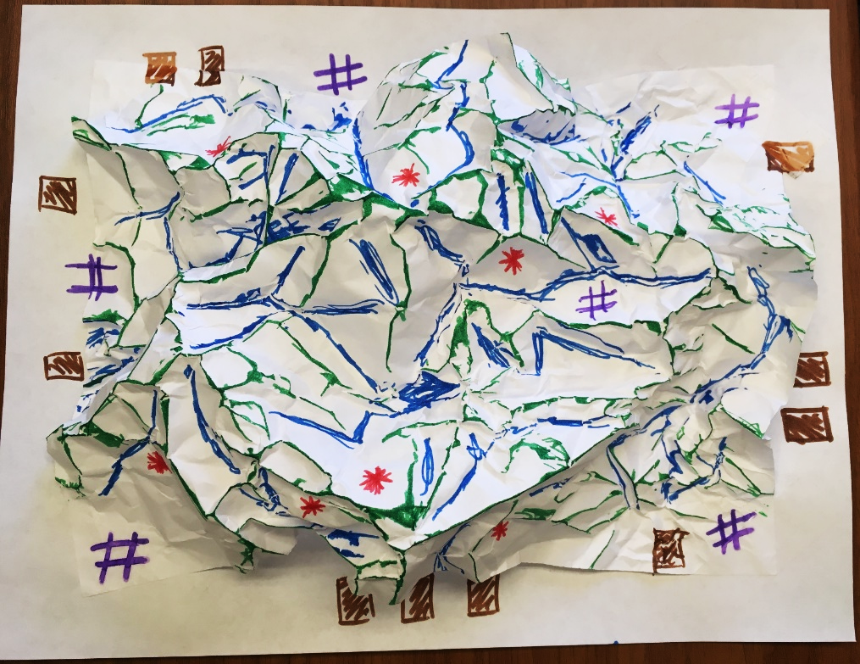
WATERSHED: Watersheds Work
The Activity:
Key/Legend:
  Ridges (along upfold) = Green
  Valleys (along downfold) = Blue
Optional:
  Farms (colored area) = Brown
  Old Mines (*) = Red
  Cities (#) = Purple
Notes:
Engage: Lesson 3.1 is having your students create a watershed model with paper and markers.
Tip, use waterbased markers to get a better effect and don’t let students flatten out the paper too much!
What are the boundaries of a watershed? High points and low points are what? Helping them to understand that they are in a watershed. If you can’t do the watershed in class, there is a nice video.
Explore: Students do a gallery walk of each unique model and make claims based on evidence about what each demonstrated in relation to watersheds.

Slide 5
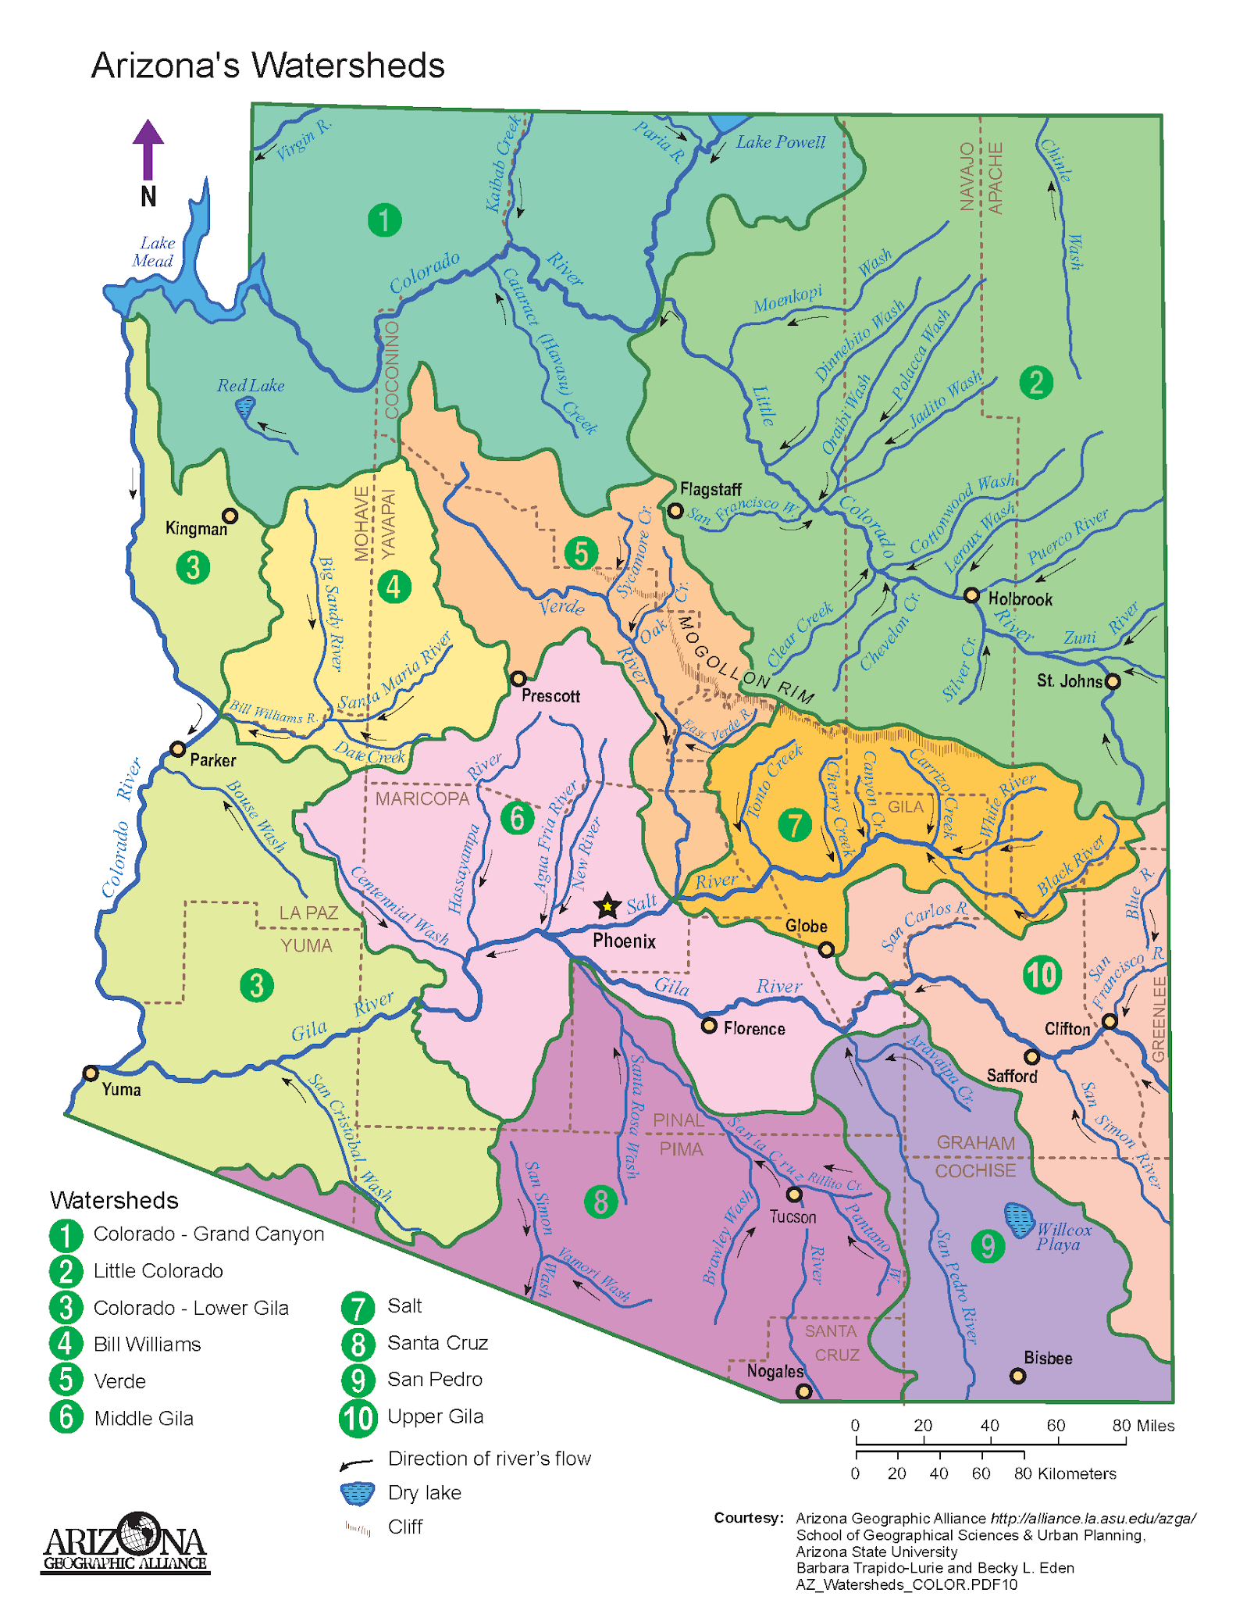
WATERSHED: Watershed Works
What are we managing when we talk about watershed management?
The land and water in that area.
Notes:
We don’t only have to think of and protect the water that is in a watershed, but we also have to manage all of the land in that area… all the way from the high points or mountains, down to the low points of the rivers and valleys.
Because what happens to the land affects the water and what happens to the water affects the land

Slide 6
Wrap-Up
Lesson 3.1
Writing Activity:
Where is the water in our watershed?
Notes:
Evaluate: Write a one paragraph summary in response to the following prompt: Where is the water in our watershed?

Slide 7

WATERSHED: LESSON 3.2
Understanding Urban Watersheds
Investigative Questions
How does human impact on the land affect water and heat within a watershed?
How do the parts of an urban watershed interact with the water cycle?
How do we manage a watershed to make sure our water is clean and sustainable?
How do the parts of a watershed interact with
the water cycle?

Slide 8
WATERSHED: LESSON 3.2
Revisit watershed models:
Where will water be absorbed?
Where will water remain on the surface?
Make predictions about which areas will be warmer and which will be colder:
Buildings
Parking lots
Farms
Parks
Notes:
Engage: Revisit watershed models and ask students to consider, share, and list where they think water will be absorbed (permeable surfaces) and where they think it will remain on the surface (Impermeable surfaces). Ask them to make a prediction about where the surface will be warmer or colder using place locations – buildings, parking lots, farms, parks etc.

Slide 9
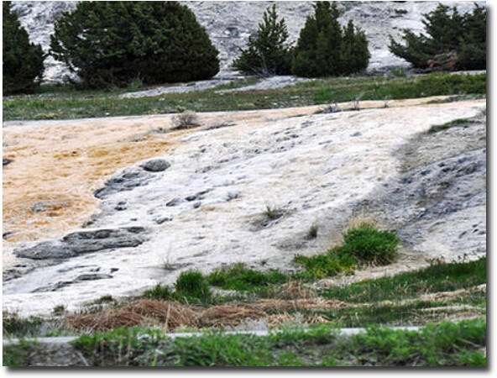
WATERSHED: Understanding Urban Watersheds
Following the Flow
When rain falls or when snow melts, does the water just sit there? Or does it move? Why?
We know some of it may percolate down through earth materials into the ground, but most of it flows downhill as what?
Runoff is important as it keeps our rivers, lakes
and groundwater flowing. But…?
Notes:
Water flows because of the laws of gravity…
Discuss the three ways that water can move in the natural or built environment:
Soak in
Flow into
Run off

Slide 10
Watershed: Understanding Urban Watersheds
What’s on the surface matters
What happens when rain falls on:
    fields, meadows, and pastures?
    a forest or woodland?
    a desert landscape or dunes?
    the city and suburbs?
Notes:
Put answers in chat!

Slide 11
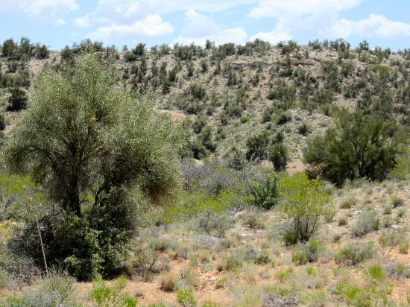
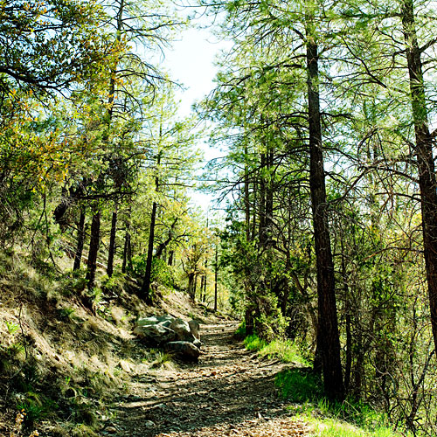
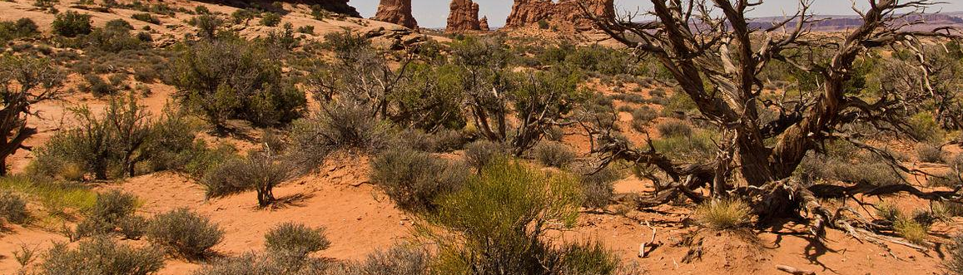
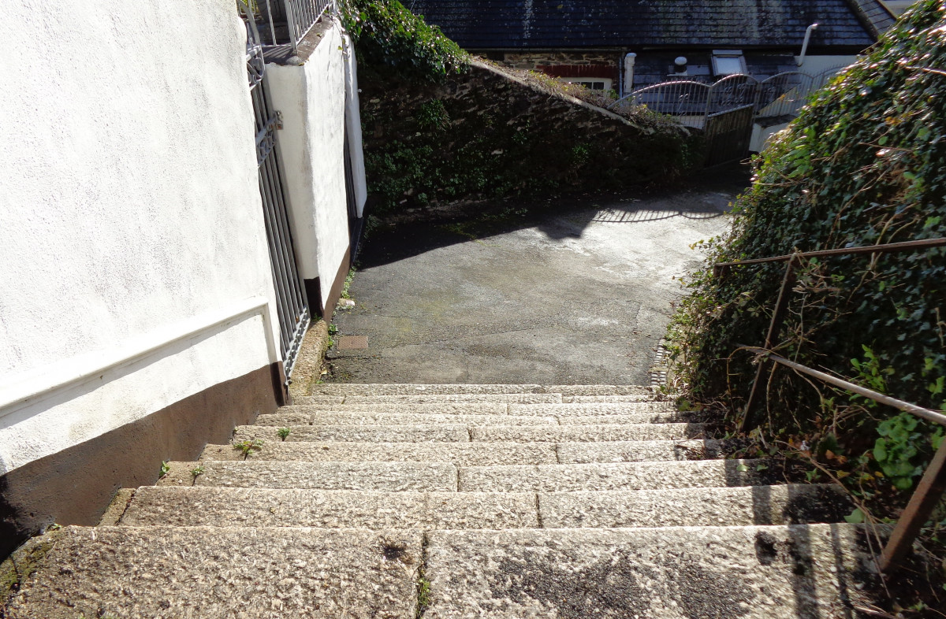
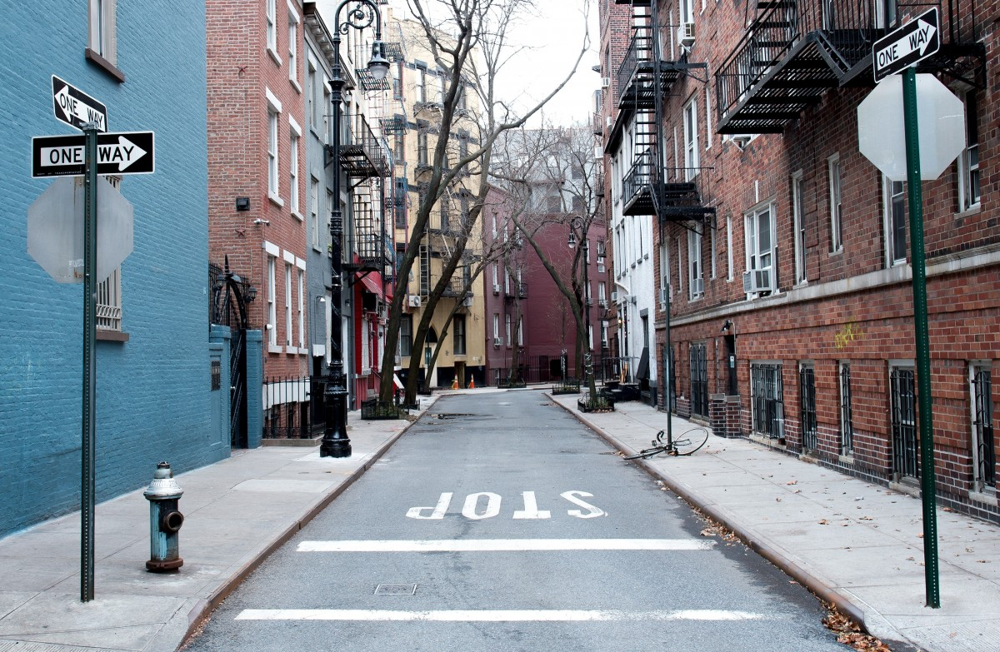
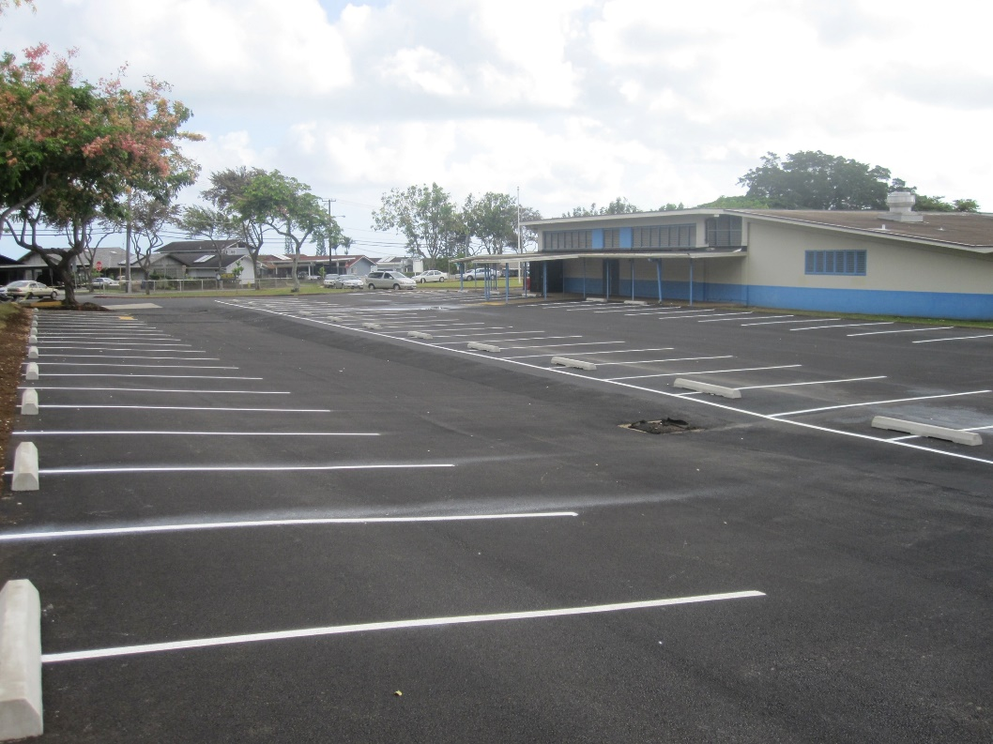

PERMEABLE
Water can sink in or percolate into the earth materials, where plants can use it, or it keeps traveling further down to reach groundwater (infiltration).
IMPERMEABLE
Water cannot penetrate or percolate but rather pools or runs off the surface. These are also called impervious surfaces.
Notes:
What would you call the surfaces in the top left corner …?
What about the surfaces in the bottom corner

Slide 12

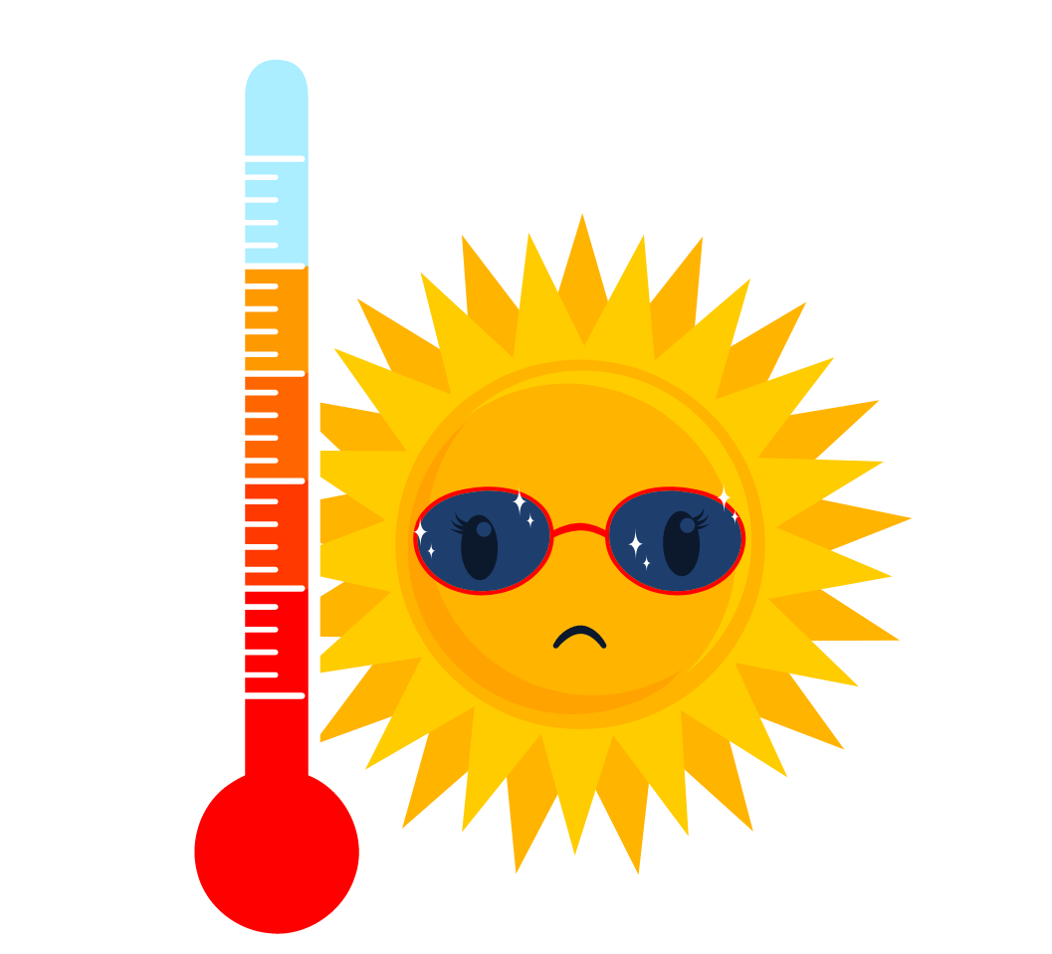
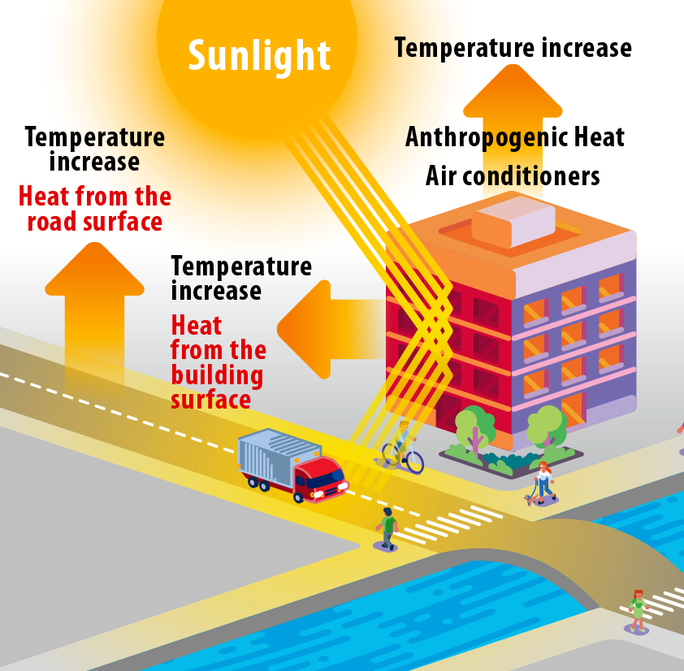
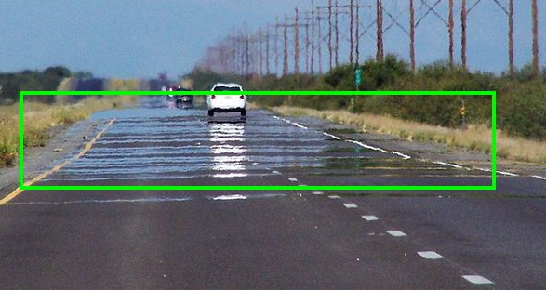
Too Hot to Handle!
What else happens when we have impermeable surfaces?
Notes:
Impermeable surfaces like asphalt, concrete, and cement (like in roads and buildings) store sunlight during the day and release the heat slowly at night. Buildings and roads cool off very slowly at night, which means that air temperatures in the city cool off very slowly at night.

Slide 13
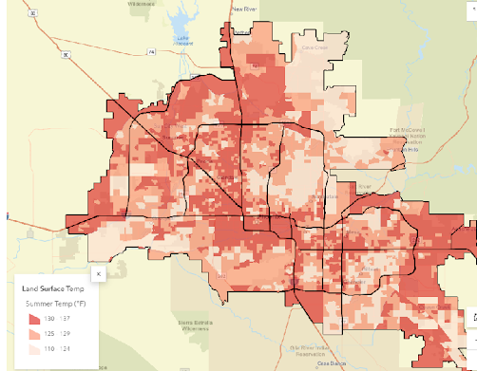
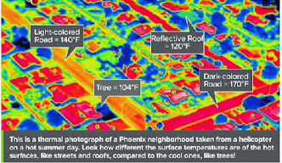
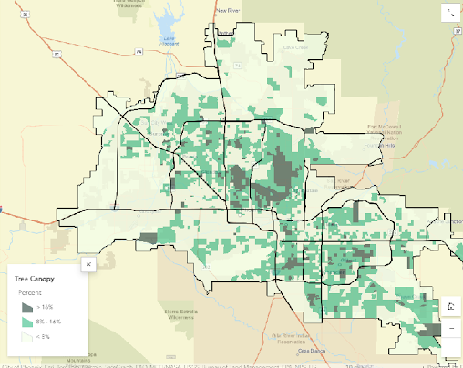
Urban Heat Island Effect
Notes:
Cities have higher concentrations of surfaces like pavement and metal which retain heat during the day and release it at night. This phenomenon, called the Urban Heat Island Effect, causes city temperatures to be higher than surrounding desert and open spaces, especially at night.
Temperatures are typically lower where there are more trees and vegetation. You can see that the areas in dark green around the region have the highest tree canopy and correspond to lower temperature areas in the previous map.

Slide 14
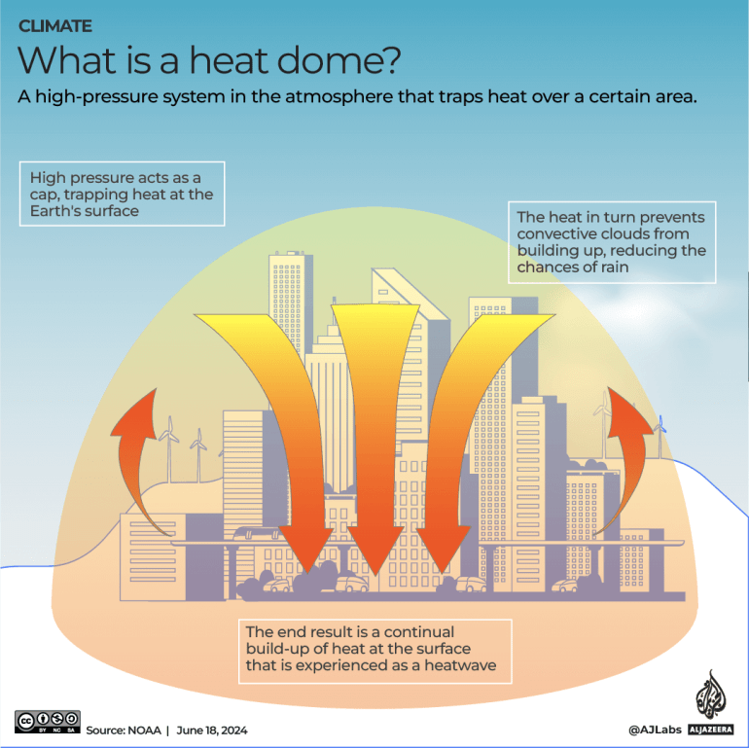
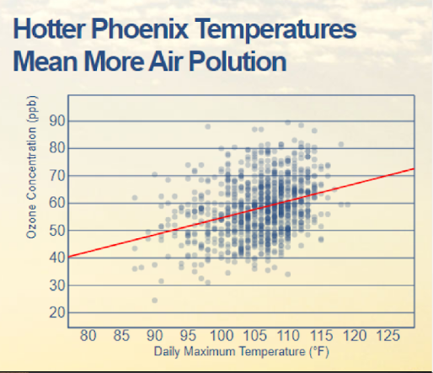
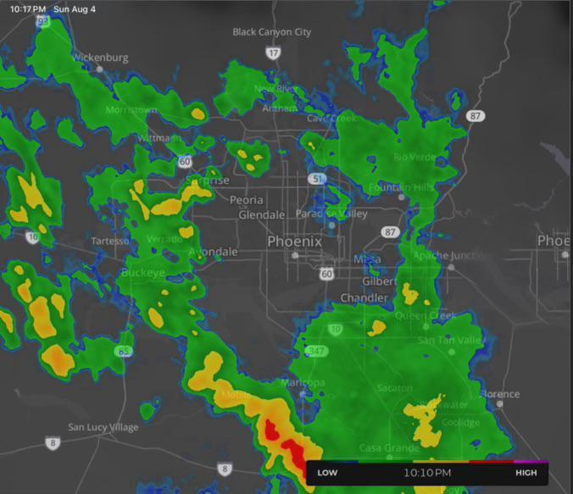
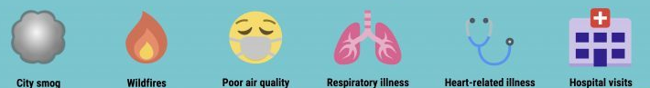
Air Temp, Quality & Rain Changes Too!
What else happens when city temps are warmer?
Notes:
Problems associated with urban heat islands: Increased Energy Consumption. Elevated Emissions of Air Pollutants and Greenhouse Gases. Compromised Human Health and Comfort. Impaired Water Quality. more ground-level ozone (smog) will form as the environment becomes sunnier and hotter.
Energy demand increases with high temperatures which causes larger amounts of air pollutants to be released into the air which also increases the temperature.
The UHI effect is caused by changes in the temperature, moisture, and air quality of the city environment. These changes in the environment create a distinct urban boundary layer, or heat dome. This heat dome extends above the city and in windy conditions, can be shifted downwind.
https://storymaps.arcgis.com/stories/400b68f7aaa143c0bd0d0fd262006087
A heat dome works like a pot with a lid to keep warm air trapped. An area of high pressure will create a lid of stable air in the atmosphere, trapping warm air below that line. The warm air will sink to the surface where it will heat up even more as it becomes compressed from the high pressure. Heat domes happen when strong high pressure atmospheric conditions remain stationary for an unusual amount of time, preventing convection and precipitation and keeping hot air "trapped" within a region.

Slide 15
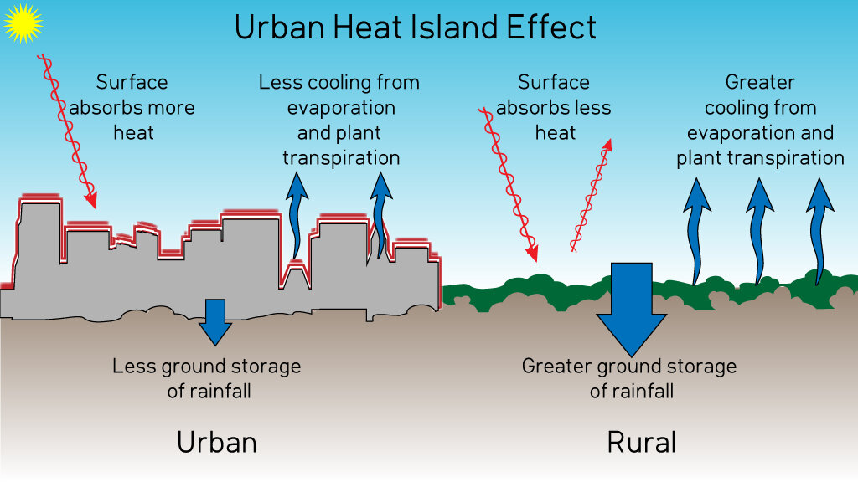
Urban Heat & Water
Notes:
Besides the heat factor, what do we know will happen to the water when we replace permeable surface areas with impermeable? We end up with more runoff that can’t soak into the ground.

Slide 16
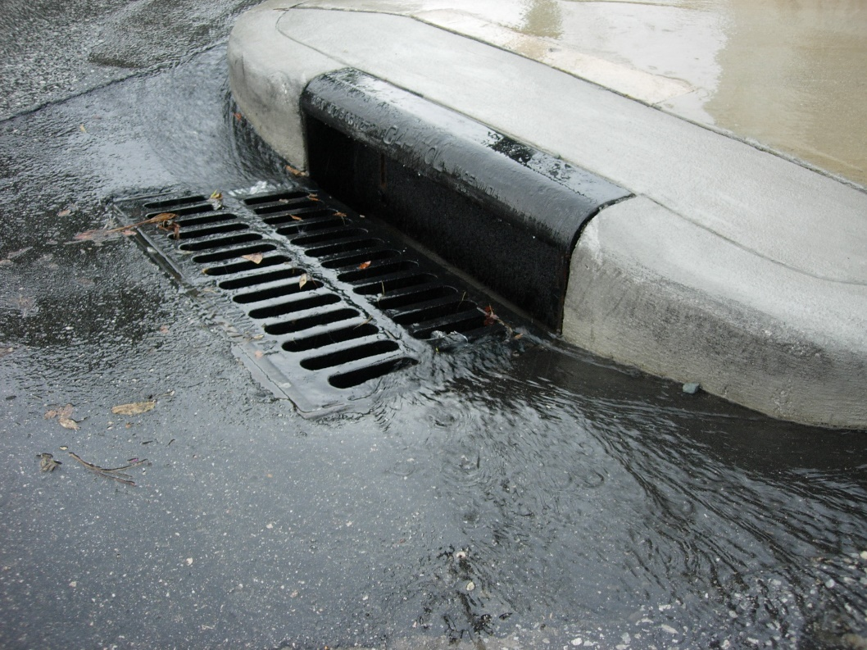
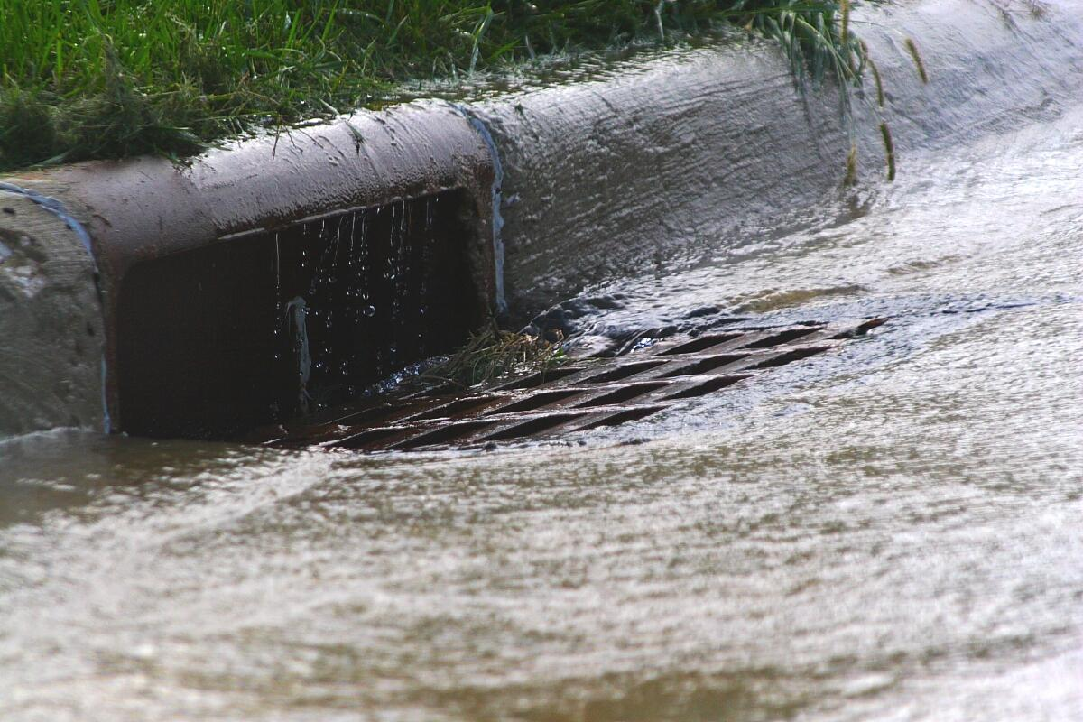
Watershed: Understanding Urban Watersheds
In our city centers and neighborhoods what happens to that runoff?
Rain
becomes storm water!
Notes:
When the rain has no where to go, and it can’t soak in, it becomes runoff and if it weren’t for cities creating storm drains, our neighborhoods might flood.

Slide 17
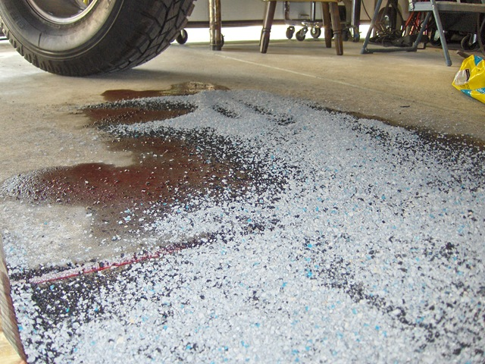
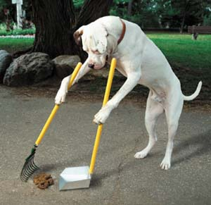
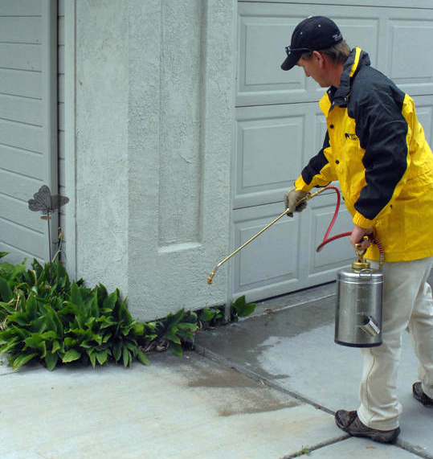
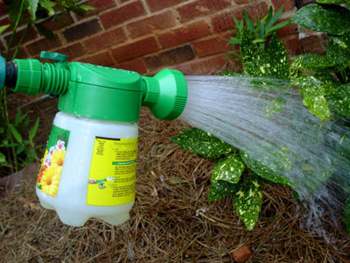
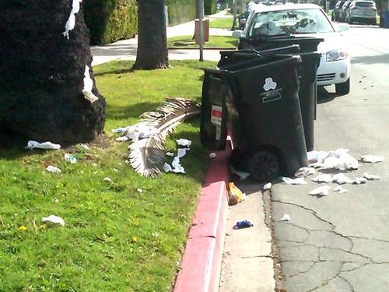
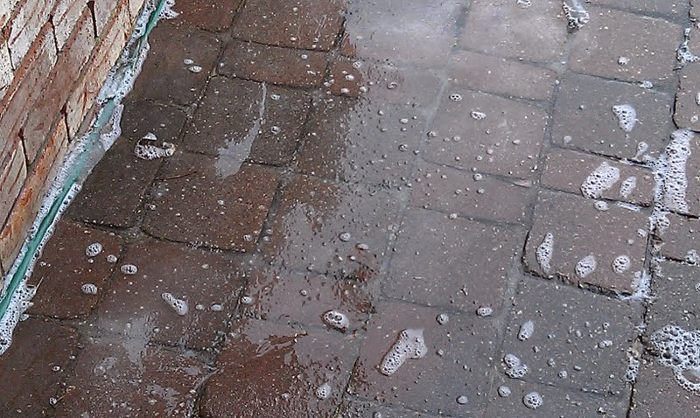
What makes storm water a bad thing?
SOIL – SEDIMENTS – ROAD SALT – VEHICLE SPILLS – FERTILIZERS – PET WASTE
– HEATED WATER – GREASE – TRASH – DETERGENT – SOLVENTS
Notes:
But it’s the journey to these drains that turns a great resource (rainwater) into a source of damage and pollution. Think of all the by products we create that can be picked up by runoff on neighborhood or city streets and sidewalks.
As the “storm water” picks up the particles, it takes it to our storm drains.

Slide 18
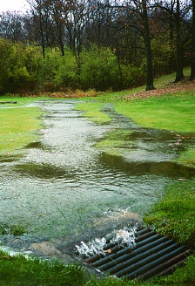
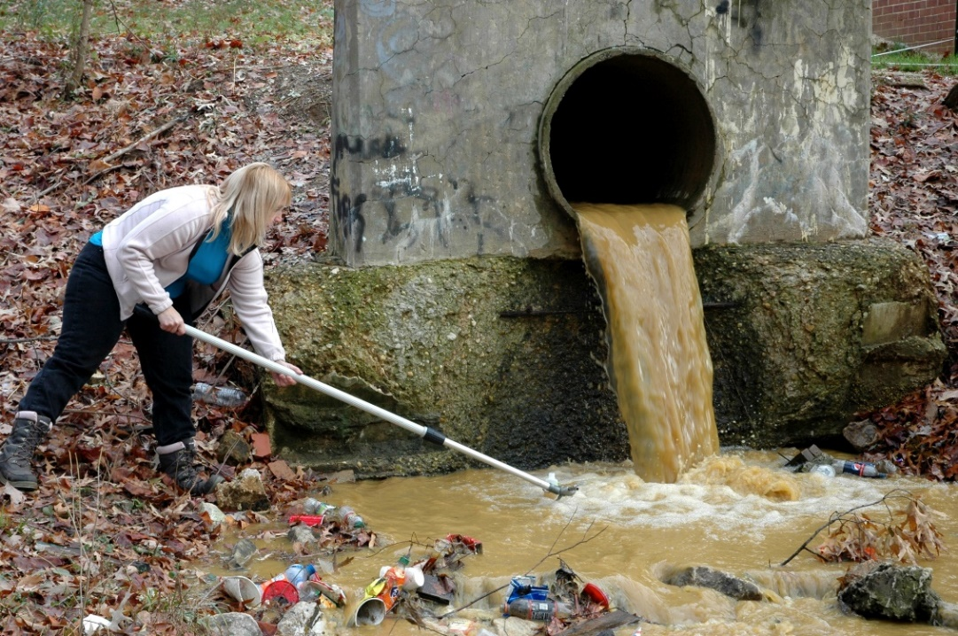
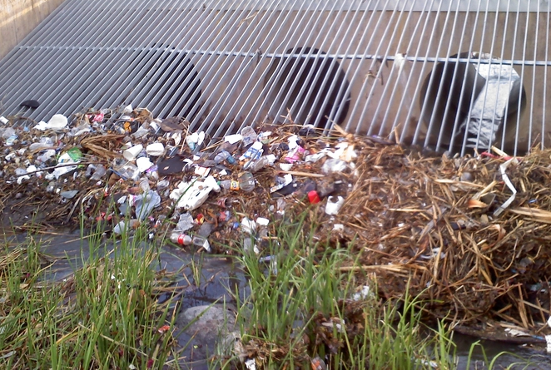
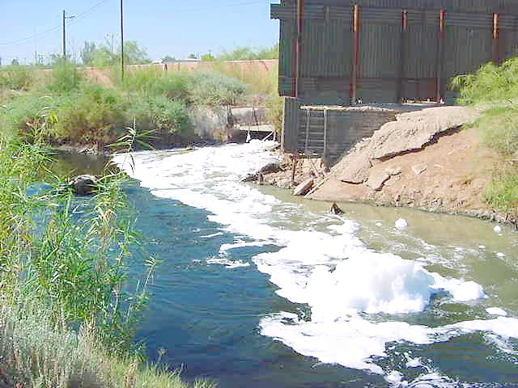
Where does storm water go?
To our rivers, lakes, and natural environment.
Notes:
The water going into the storm drains IS NOT treated and leads straight to rivers, lakes, and our natural environment.
Note: it is important to realize that only stuff that goes down our pipes (in our sinks, tubs and toilets) goes to the sewer system which does get treated. However, storm drains are different, these are openings on the side of the road and around our cities and streets, where runoff water is redirected to retention basins, canals, and rivers (this water is not cleaned or filtered), so any pollutants or chemicals that are picked up, get carried to our land and rivers.
This is a great time to help students understand that their choices make an impact. Another lesson will discuss solutions and actions that can be taken.

Slide 19
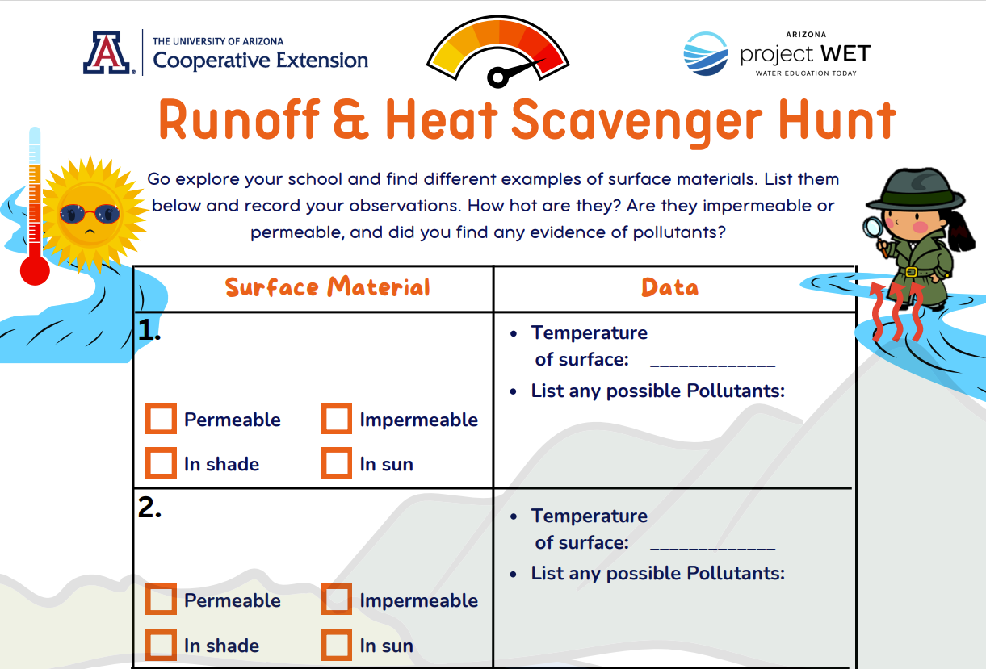
WATERSHED: Understanding Urban Watersheds
Activities:
Activity 1:
Small student groups can do a Runoff & Heat Scavenger Hunt.
Activity 2:
Simulate a whole-body activity of urban runoff in a storm drain system
Notes:
Explore:
Students explore the topics of permeable and impermeable surfaces, the urban heat island effect and pollutants from runoff to better understand how humans can impact the flow of water and the temperature within an urban watershed. Students investigate their school grounds during a scavenger hunt identifying different surfaces, possible pollutants and recording temperature of surfaces with a heat gun (or by touch).
Students participate in a whole-body simulation of urban runoff in a storm drain system and discuss what happens to the quality of water in an urban environment.
Explain: Have students share their findings with the class and generate a list of observations. Ask students to make a claim based on the evidence they have gathered to support or refute the claim: Human choices can affect the amount of heat and pollution in a watershed.

Slide 20
Wrap-Up
LESSONS 3.1 – 3.2
Now we know changes we make to the land affect the water and even the temperature within our watersheds.
    So how do those changes interact with the water in the water cycle?
    Can this impact the amount and quality of water we have available?
Systems and System Models
&
Cause and Effect
Notes:
Have a class discussion about the changes. When we change how the water flows and where it can go
human land use affects where water is stored and how water moves. We redirect rivers, sometimes build dams, we drain water from wetlands for development. We cover the surface of the land with impermeable materials which changes the flow and speed of water. It also changes where the water ends up in the water cycle. Within an urban environment we often increase the runoff within a watershed which often also increases the pollutants in the water, which decreases our water quality. We will focus on how to become better watershed managers in future lessons.
Evaluate: Evidence-based arguments for and against the claim: Human choices can affect the amount of heat and pollution in a watershed.
And/Or
Play vocabulary Gimkit or give vocabulary quiz.
LINK TO VOCABULARY

Slide 21
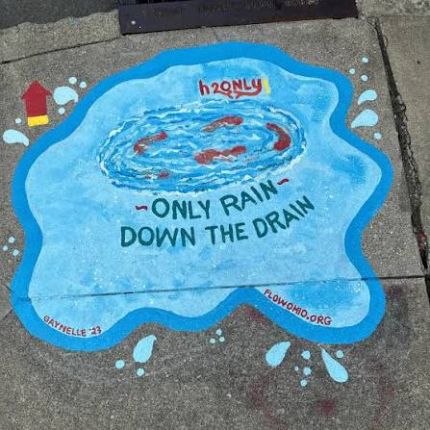
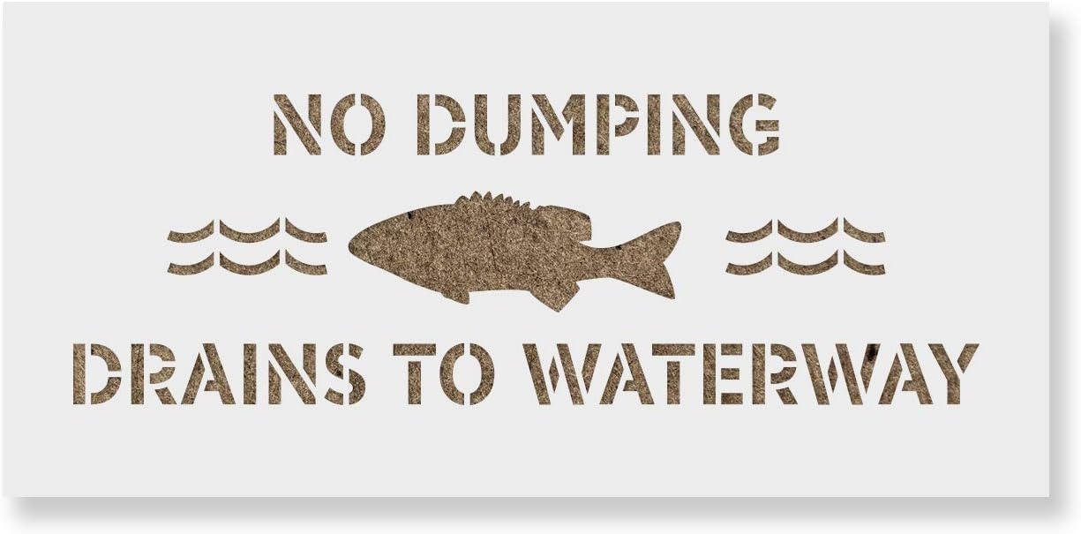
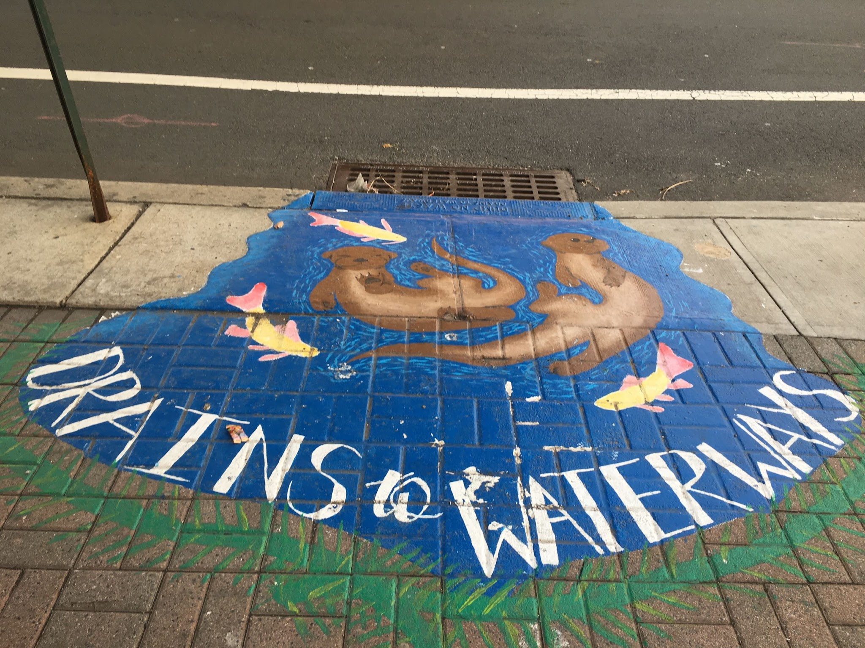
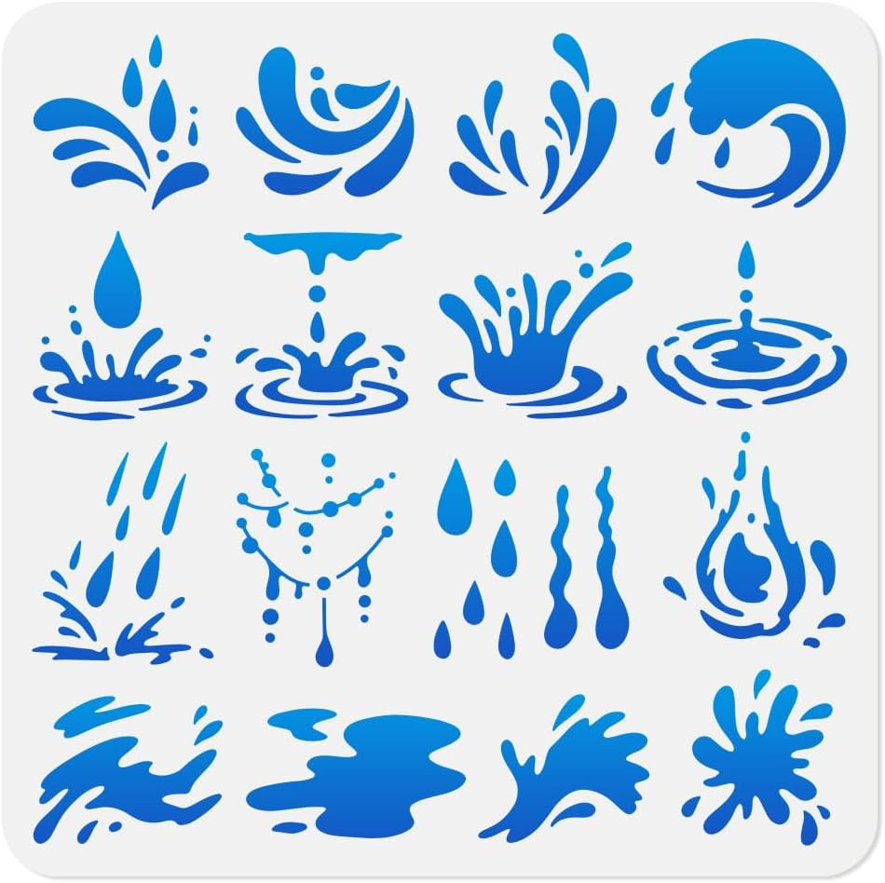
Storm Drain Stencils
Notes:
Arizona Project WET will have storm drain stencil kits and sidewalk chalk available for schools to check out on a first-come, first-served basis. These kits are designed to encourage your class to create a summative, place-based art project at the end of the Water Festival Unit—helping students share what they have learned about where rainwater goes and what happens to water that enters our storm drain systems.
We encourage you to take photos of your students’ artwork and share them with us! We would love to showcase your class’s creativity on our social media platforms and share your projects with local water municipalities and city representatives.

Slide 22
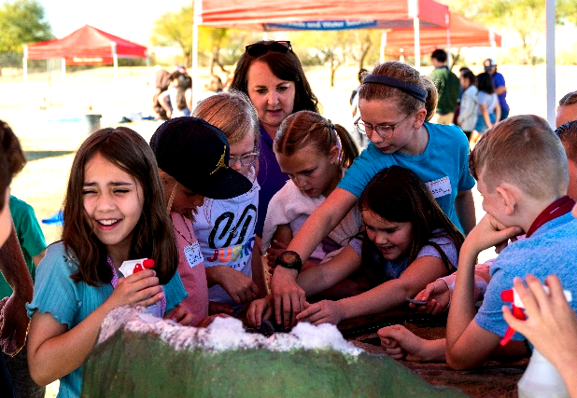
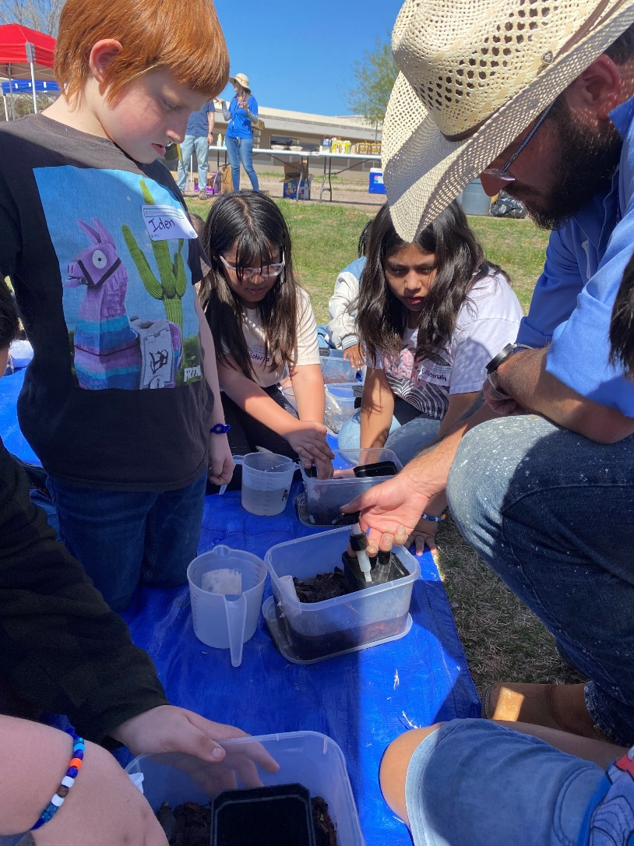
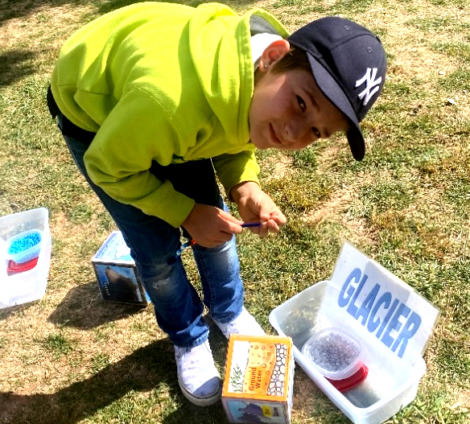
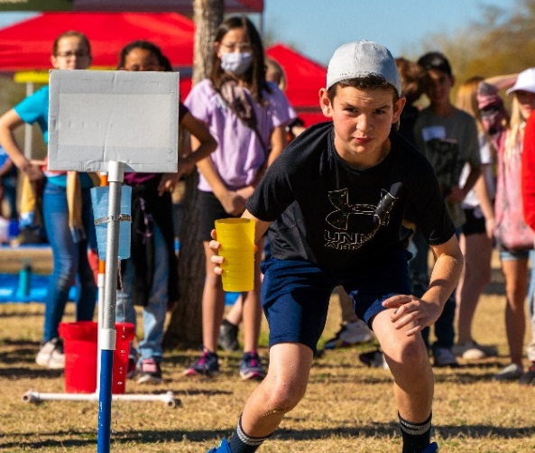
Water Festival Day!
Groundwater
Watershed
Water Cycle
Sustainability
Notes:
You will bring your class during your time session – usually 9:30a-11:30a and 11:45a-1:45pm and your class gets to rotate through each activity for 30 minutes for a total of 2 hours of fun. Please have students wear appropriate clothing and shoes, dress in layers and no it will not be a water balloon fight ;)

