Slide 1
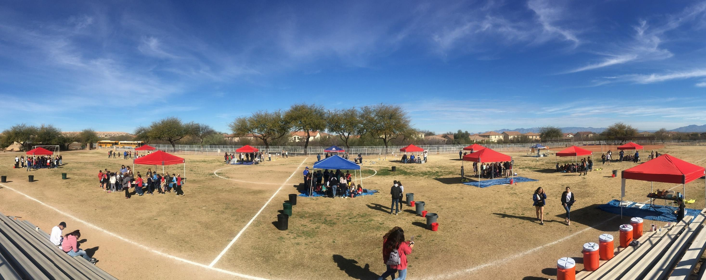



Arizona Project WET Water Festival Teacher Workshop
2026-2027

Slide 2

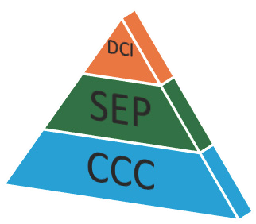
AFTER THE WATER FESTIVAL...
Please debrief with your students!
What stood out for them?
What was their favorite activity?
What did they learn that they didn't know before?
What questions do they have?
Arizona Science Standards have 3 Parts:
Disciplinary Core Idea – Life, Physical, Earth and Space
Science and Engineering Practices
Crosscutting Concepts – CCC's

Slide 3

SUSTAINABILITY & STEWARDSHIP
Project-Based Learning and Assessment Opportunity:
ARIZONA SCIENCE STANDARD 4.E1U2.10
Define problem(s) and design solution(s) to minimize the effects of natural hazards (in the context of droughts and water scarcity).
Anchoring Phenomena: Sustainability and Stewardship
PBL Opportunity - If you have time to do a solutions project, choose the phenomena you think best suits your project. You could talk about droughts, floods, changes in the Colorado or local rivers, groundwater overuse or pollution, desalination, water reclamation, or water purification.

Slide 4
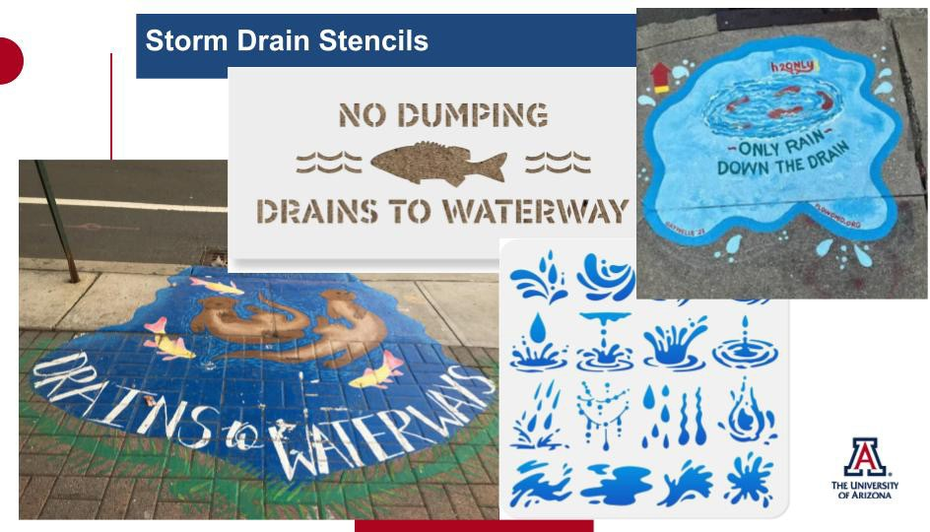


Slide 5

WATERSHEDS & SUSTAINABILITY: LESSON 4
We all have a role:
The quality of water in a river or lake is influenced by both natural factors and how people use the land around it.
Everyone is responsible for the health of the watershed and the water systems within it.
Our actions, good or bad, have an impact on our water supply.

Slide 6
It All Adds Up
WATERSHEDS & SUSTAINABILITY: LESSON 4
Investigative Questions
How do contaminants/pollutants travel downstream?
What are the ways that pollution in a watershed is reduced or prevented?
Notes:
Review: Give students an opportunity to debrief after the water festival. What stood out to them? What do they know now that they didn’t understand before the water festival? What do they still want to know? Generate a list of questions.

Slide 7

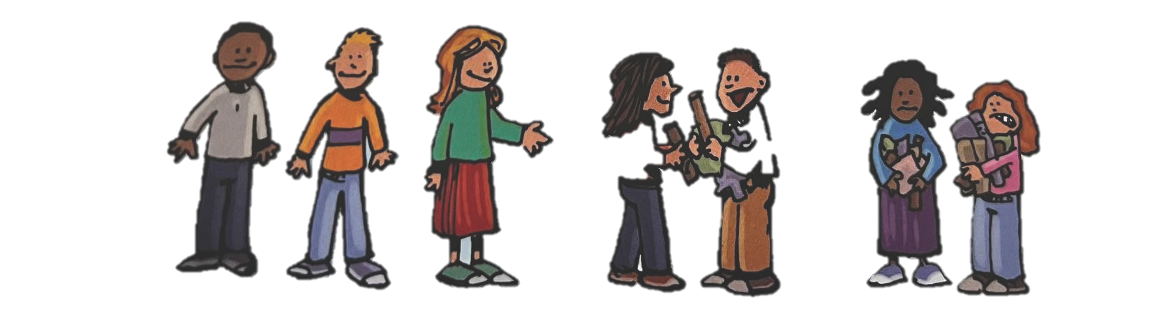
WATERSHEDS & SUSTAINABILITY: Impacting Water
The Activity:
Students develop a plot of waterfront property then learn how everyone can prevent pollution entering a river by identifying the pollution emitted from their property.
Then students get Best Management Practices and discuss how to reduce and prevent pollution from entering waterways.
Notes:
Explain activity from book
Best Management Practices are techniques that everyone can use to help keep as much storm water as possible out of our storm drains and sewers. Some of these Practices can be implemented by City Water Managers, and many of these are “low-impact” and can be done by everyday people living on the land.
Explore: Students differentiate between point and nonpoint source pollution and identify Best Management Practices to reduce pollution and explore ways communities can reduce urban heat.

Slide 8

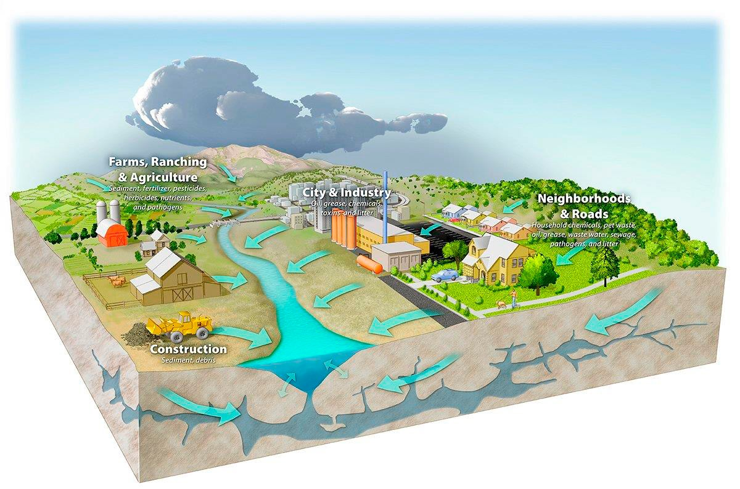
WATERSHEDS & SUSTAINABILITY: Impacting Water
Someone is always downstream
The choices people make and the pollution they create upstream can affect communities and ecosystems downstream.
When tracking water quality we focus on two main categories of
pollution.
Notes:
Now that we understand how watershed work, we know that water connects us all.
Do you know what those two types of pollution are?
Do you think the most influential neighborhoods are upstream or downstream.

Slide 9
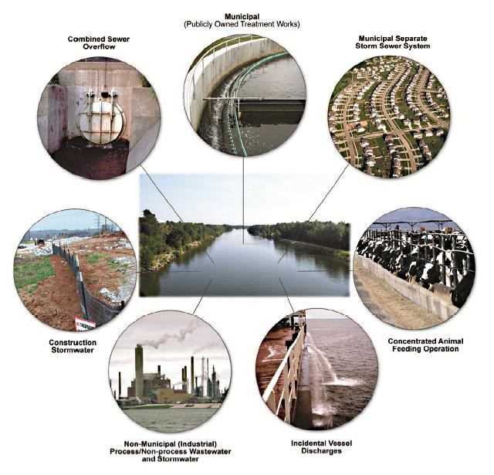
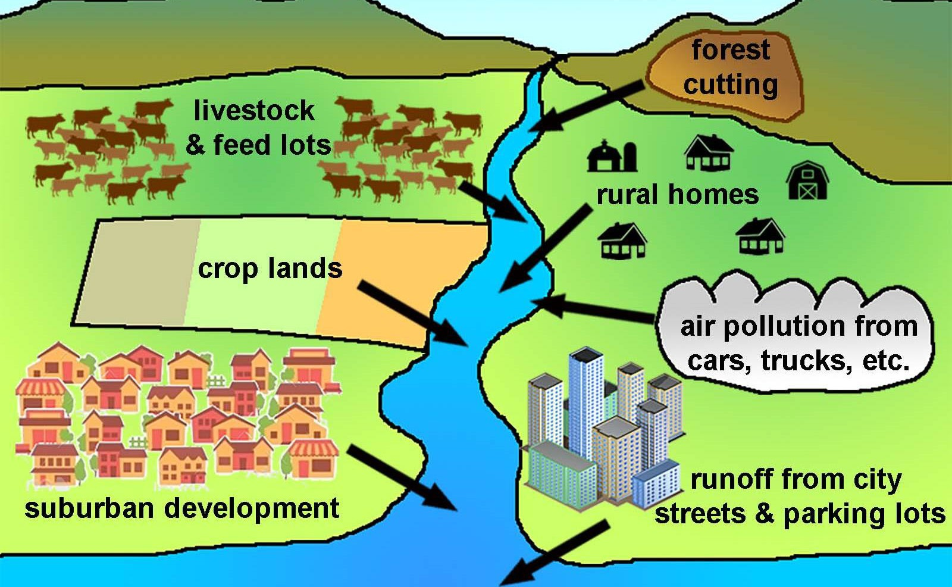

Nonpoint Source
Nonpoint pollution is harder to track as it can come from different places. These pollutants could result from agriculture, transportation, industry, or runoff.
Point Source
Point pollution comes from a specific place, like a factory’s pipe or a sewage drain. It is easier to monitor and we have laws to protect against it.
Notes:
Both types of pollution can be carried by surface runoff and groundwater, which makes it harder to know the source. It is also harder to protect water from nonpoint source pollution because it comes from many different places, and is often hard to hold one person/party responsible.

Slide 10
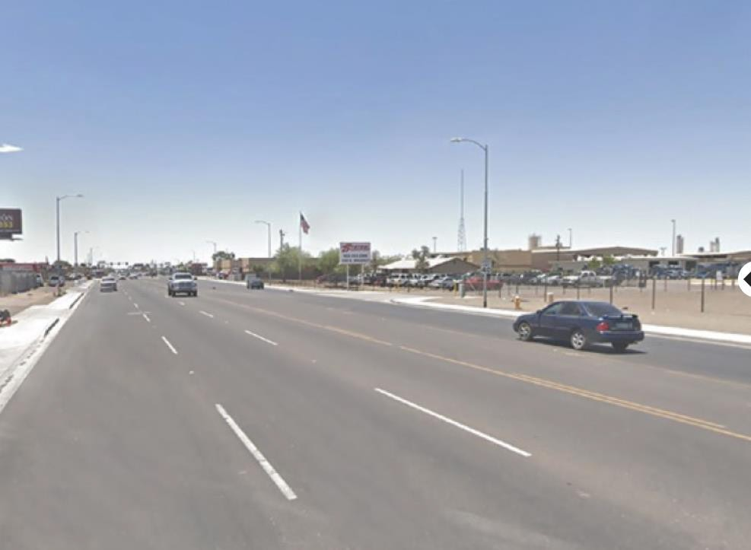
Check out Green Stormwater Infrastructure
Notes:
Click on link - https://storymaps.arcgis.com/stories/b9c35f205ea14015a23b446ff75eeeb4
And at bottom of the page you can click through green stormwater infrastructure examples with your class for solutions we can implement in our community to reduce pollution runoff and mitigate urban heat.
What messages do you think are being sent to the people living in each community…? Which one would you rather live in and why?

Slide 11
Wrap-Up
Lesson 4
How do our choices and human impacts affect the flow and quality of water in Earth's Systems?
How can we apply what we know to design solutions that work with natural systems and improve the sustainability of our water supply?
Cause and Effect Asking Questions Defining Problems Designing Solutions
Notes:
Evaluate: Ask students to share their best solutions with a partner. Listen as you move around the class and then ask some students to share their solutions with the class.
Human water use affects where water is stored and how water moves. We redirect rivers, sometimes build dams, we drain water from wetlands for development. We cover the surface of the land with impermeable materials which changes the flow and speed of water. It also changes where the water ends up in the water cycle. Within an urban environment we often in crease the runoff within a watershed which often also increases the pollutants in the water, which decreases our water quality. We will focus on how to become better watershed managers in future lessons.

