Slide 1
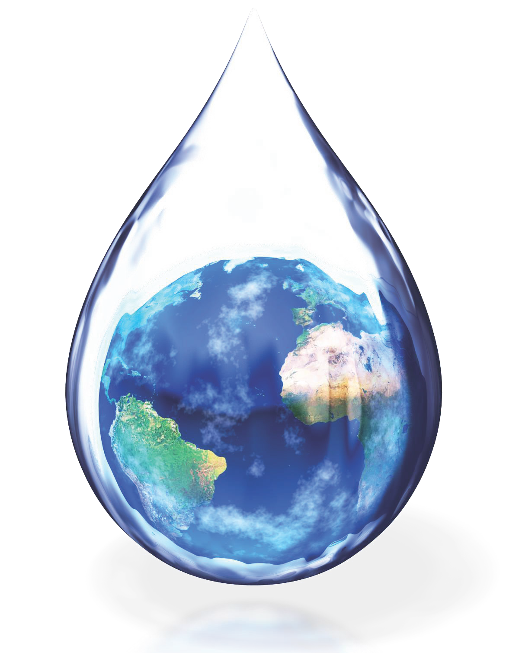

SUSTAINABILITY & STEWARDSHIP: LESSON 6
What do you, a plant in your house, a squirrel in the park, and your classmate all have in common?
What do a loaf of bread, a sheet of paper, and an
automobile have in common?
Notes:
We all use and need water to survive.
Water is used to make all of them.

Slide 2
A Drop in the Bucket
SUSTAINABILITY & STEWARDSHIP: LESSON 6.1
Investigative Questions
How much water on Earth is available for our use?
  What is potable water?
  Does everyone have access to potable water?

Slide 3
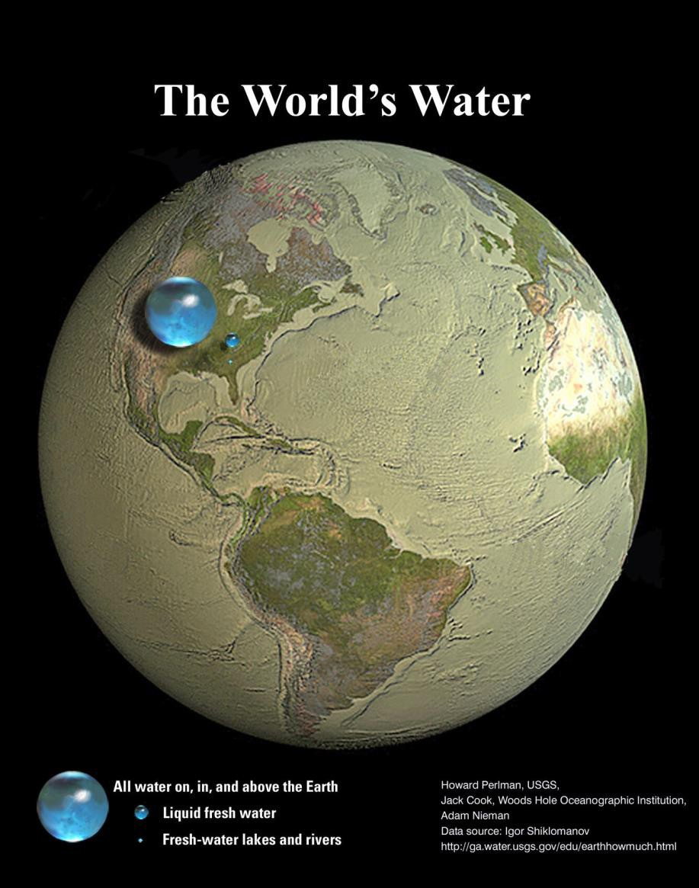
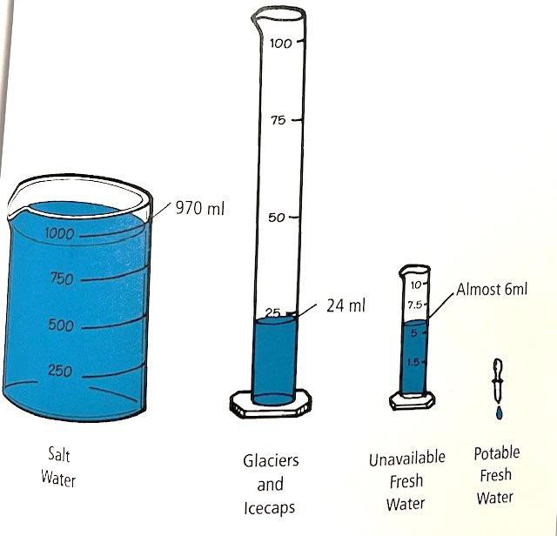
A Drop in the Bucket
The Activity:
Potable water – freshwater that is safe to drink.
Ocean – 97% percent of water on planet
Freshwater – 3%
  80% of that is frozen – polar ice caps
  If not frozen, where is it found?
  Surface water – 25% Under ground – 75%
  1 drop!
Notes:
Engage: In small groups students take 1000ml of water and get to measure out how that water is represented on earth (ocean, frozen, fresh, potable, etc.). Through this activity students calculate the percentage of freshwater available for human use.
You can do this activity as a class demonstration or in groups and let the students actually measure out the water. The picture will also take you to a great graphic and more information.
Helping students make that connection as to just how precious a resource our fresh clean water is, helps make water conservation relevant.

Slide 4
Water Web
SUSTAINABILITY & STEWARDSHIP: LESSON 6.2
Investigative Questions
How do I use water both directly and indirectly?
What are the water sources and who are the water users in my community?

Slide 5
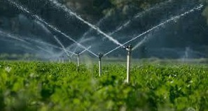
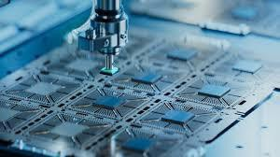
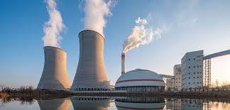
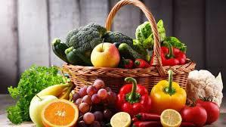
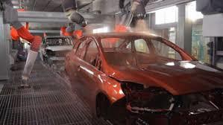
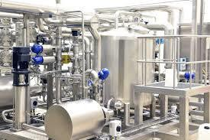
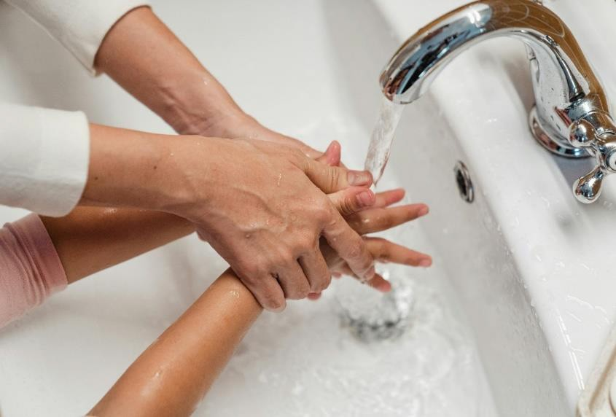
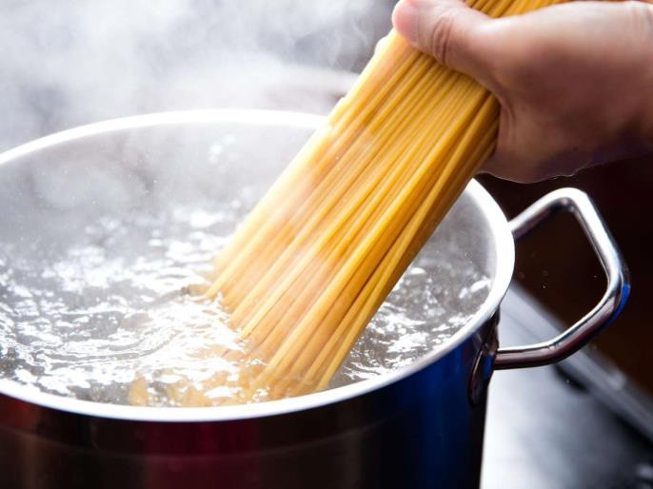
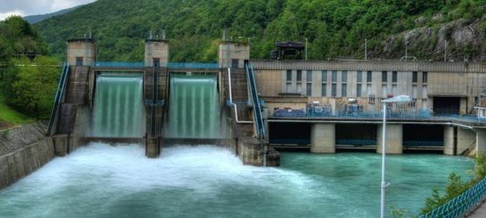
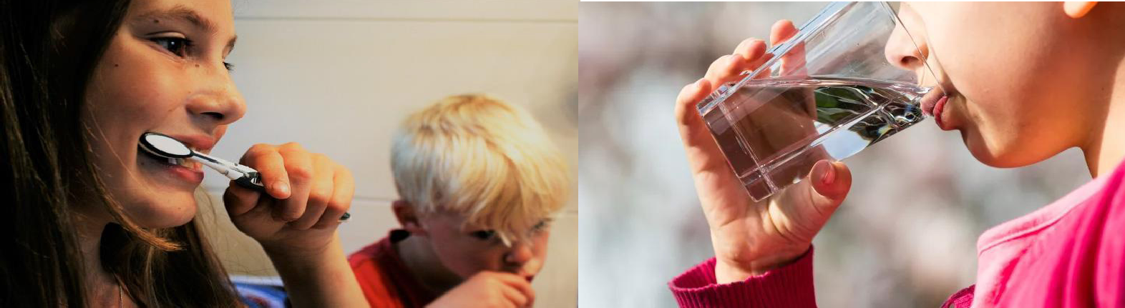

Indirect Water Use
The water used to produce the goods and services we all enjoy. It is the water hidden or not seen by the end-user during the process or manufacturing of a good or service.
Direct Water Use
Water you use directly to do something immediately. Water that is seen, felt and used at that given time. When you turn on your faucet or hose for water.
Notes:
Engage: Students discuss and identify the difference between direct and indirect water use. In groups students examine local industries in Arizona to see how they use water.
Put some ideas about Direct Water Use – that will show first, then indirect
Direct Water use: Drinking water, bathing, flushing a toilet, brushing your teeth. To make a bowl of pasta, water is required to boil the dry pasta in the pot – this is direct water use for the person eating that pasta at home.
Indirect Water use: also called hidden or virtual water – because the water use is often unseen by the end-user of a product or service, but the water has been used or consumed throughout the process chain. In order to produce the pasta, water is required at many steps along the way - water to grow the wheat; water to produce the fuel for machines to harvest the wheat and transport the pasta to the store; and water to create the electricity for processing the wheat into flour and pasta.

Slide 6
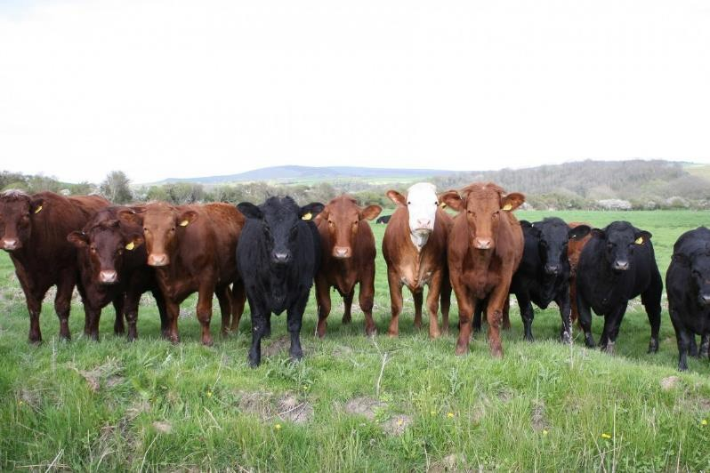

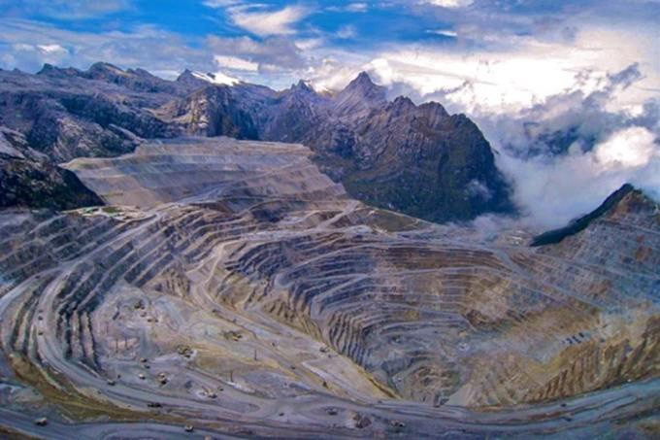
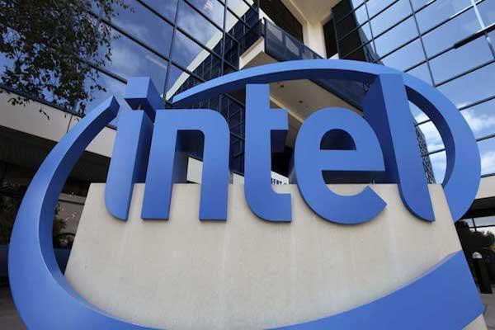
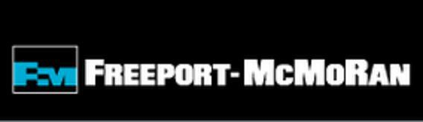
SUSTAINABILITY & STEWARDSHIP: LESSON 6.2
The Activity:
Have students read about some industries in Arizona and complete worksheet.
Have students model a “water
web” to simulate their dependence on water and the interdependence among water users, producers and people in the community.
Notes:
In warmup have students discuss direct and indirect water usage.
Explore: Participating in a full-body activity, students model a “water web” to simulate their dependence on water and the interdependence among water users, producers, and people in the community.
Explain: Give students a chance to ask questions about everything they have seen so far and do your best to answer their questions. If you don’t know the answer to a good question, tell them you will find out and share what you learn.
https://www.watereducation.org/post/food-facts-how-much-water-does-it-take-produce
Evaluate: Students have a group discussion about what they witnessed during the activity demonstrating they can see the connection between multiple water users. Students brainstorm and share ways communities and different users can use less water.

Slide 7
My Water Footprint
SUSTAINABILITY & STEWARDSHIP: LESSON 6.3
Investigative Questions
How much water do I use daily?
Why is water use called a water footprint?
How can I be a better water steward?
Notes:
Engage: Students define the term water footprint and begin to create and describe their personal water footprint. Students interpret a population growth graph and water usage over time graph, and brainstorm solutions (both behaviors and technologies) that can help to conserve and protect water.
Remember at the water festival we told you that on average a person in Arizona uses about 100-120 gallons a day. This would be our water footprint but let’s explore where this comes from…

Slide 8

SUSTAINABILITY & STEWARDSHIP: LESSON 6.3
What is a Water Footprint?
It reveals water use patterns, from the individual level all the way to the national level.
It shines a light on the water used in all the processes involved in manufacturing and producing our goods. It also accounts for water contaminated during manufacturing and
production.
A water footprint is measured in terms of the volume of water consumed, evaporated and polluted.
Notes:
It is like an invisible mark that shows how much water you use for all the things you do and things you use (direct water use and what you eat and wear).
Blue Water Footprint: The amount of surface water and groundwater required (evaporated or used directly) to produce an item.
Green Water Footprint: The amount of rainwater required (evaporated or used directly) to make an item.
Grey Water Footprint: The amount of freshwater required to dilute the wastewater generated in manufacturing, in order to maintain water quality , as determined by state and local standards.
https://watercalculator.org/footprint/what-is-a-water-footprint/

Slide 9
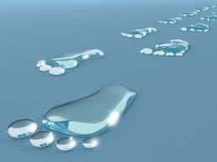
SUSTAINABILITY & STEWARDSHIP: Lesson 6.3
The Activity:
Students trace right and left footprints Write down direct ways they use water in left footprint
Students then write ideas of how to save water on their right footprints.
Play full-body game as students role-play
different water use scenarios.
Notes:
Explore: Participating in a full-body game students role-play out different water use scenarios.

Slide 10
Splashing into Solutions
You Have the Power!
What is Water Conservation?
Beneficial reduction in water loss, waste or use by
changing behavior to use less water.
What is Water Efficiency?
Minimize the amount of water used to accomplish a function or task. Doing more with less water. Normally relies on well-engineered products and fixtures or technology
Notes:
Being a water steward is really about both… making good choices to practice water wise behaviors while also utilizing new technologies to make water use more efficient. This is how we can all help make a positive impact!

Slide 11
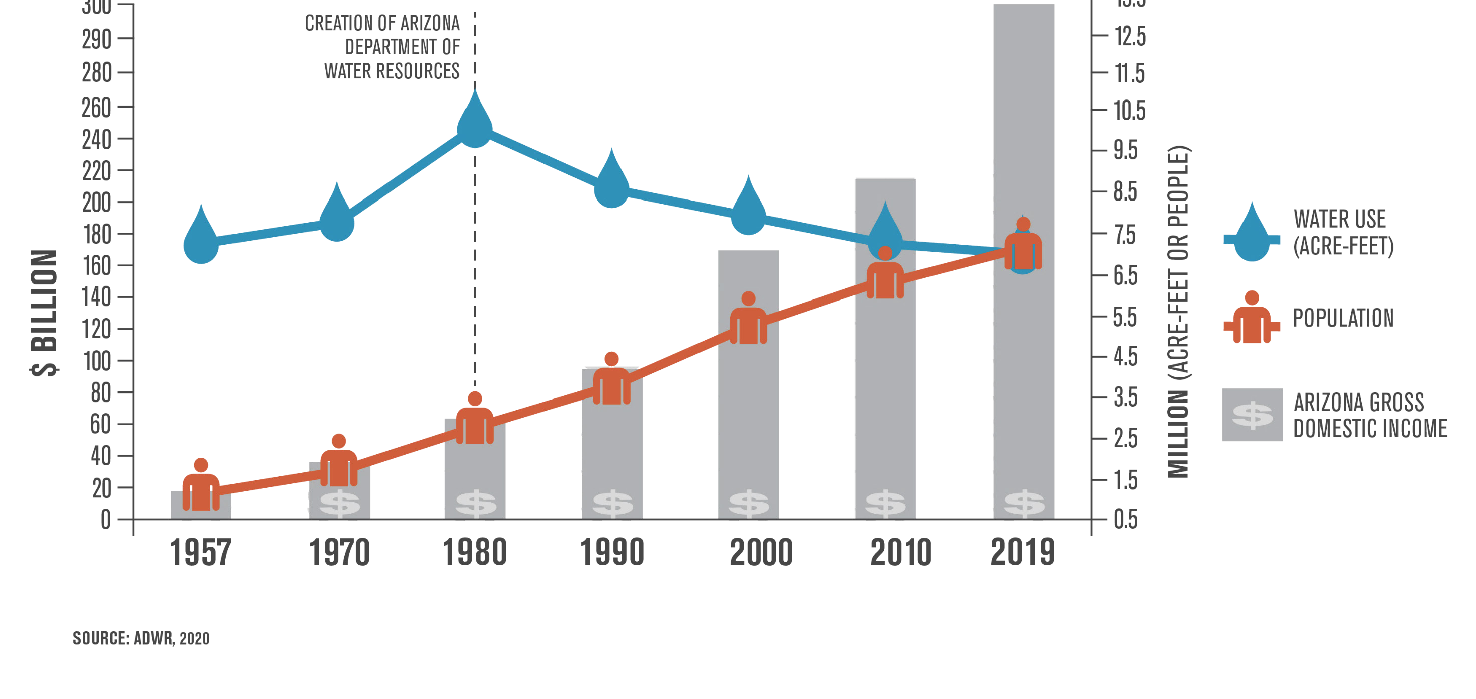
Notes:
Explain: Students interpret a population growth graph and water usage over time graph and share conclusions about what the graph means.
There is hope! What do we notice in 1980? Passes the 1980 Groundwater Management Act…
1980 we had 2.7 million people but we were using over 9 million acre-feet of water
2019 we have over 7 million people and we are using under 7 million acre-feet of water – that is pretty incredible
through significant investments in water conservation and infrastructure and the reuse of water, our water use is essentially the same as it was more than half a century ago.
What is an acre foot of water? = enough water to cover an acre of land a foot deep = 326,000 gallons (about the size of a football field a foot deep).
According to the ADWR – The average number of homes served annually by an acre-foot of water actually increases to 3.5 when all of Arizona’s five “Active Management Areas” are taken into account. There are many variables but this is how cities look at development of new homes.

Slide 12
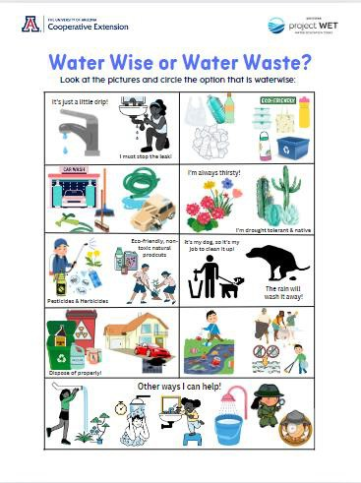
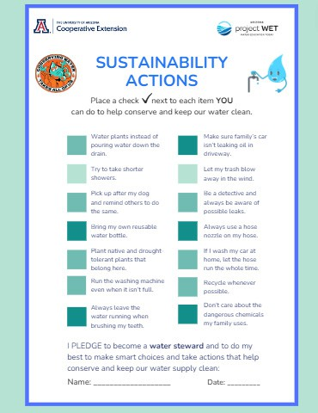
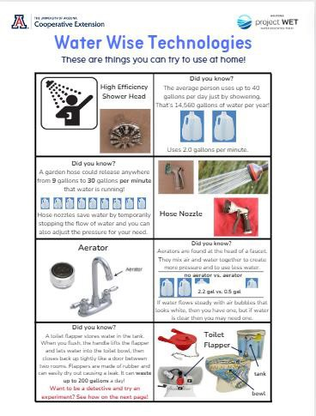
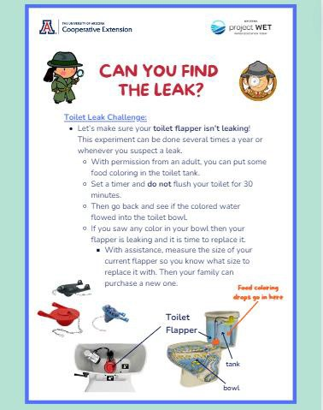
BE THE TIDAL WAVE OF CHANGE! Your
daily choices and actions can add up to make a positive difference.
SUSTAINABILITY & STEWARDSHIP: LESSON 6.3
Notes:
Water Worksheets for your students to check their understanding of sustainability actions. And resources they can share with family and friends

Slide 13

Wrap-Up
Lesson 6
Exploring the ways we use water and the diverse water users in our community helps us understand how we all play a role in our Arizona water cycle.
We are all connected through water and hopefully you feel more empowered than ever to continue being a water steward.
Stability and Change & Cause and Effect
Notes:
Evaluate: Students brainstorm solutions (both behaviors and technologies) that can help to conserve and protect water. Standards-based assessment: 4.E1U2.10 Define problem(s) and design solution(s) to minimize the effects of natural hazards (in the context of droughts and water scarcity).

Slide 14
Where is Arizona’s water? What are the connections between people, water, and life in our environment?
WATER FESTIVAL UNIT GUIDING QUESTIONS:
Notes:
Hopefully now you have a much better understanding of where water is in Arizona and how you can help conserve and protect it. And you can understand and appreciate the connections between people, water and heat in the environment.
You can wrap up the whole unit by asking students to write a paragraph about or make a collage/poster to show:
Where is Arizona’s water
connections they have discovered between people, water and heat in the environment (using evidence to support their argument/explanation).
Does anyone want to share a connection they have found or discovered during this unit? Did you learn anything that surprised you?

Slide 15

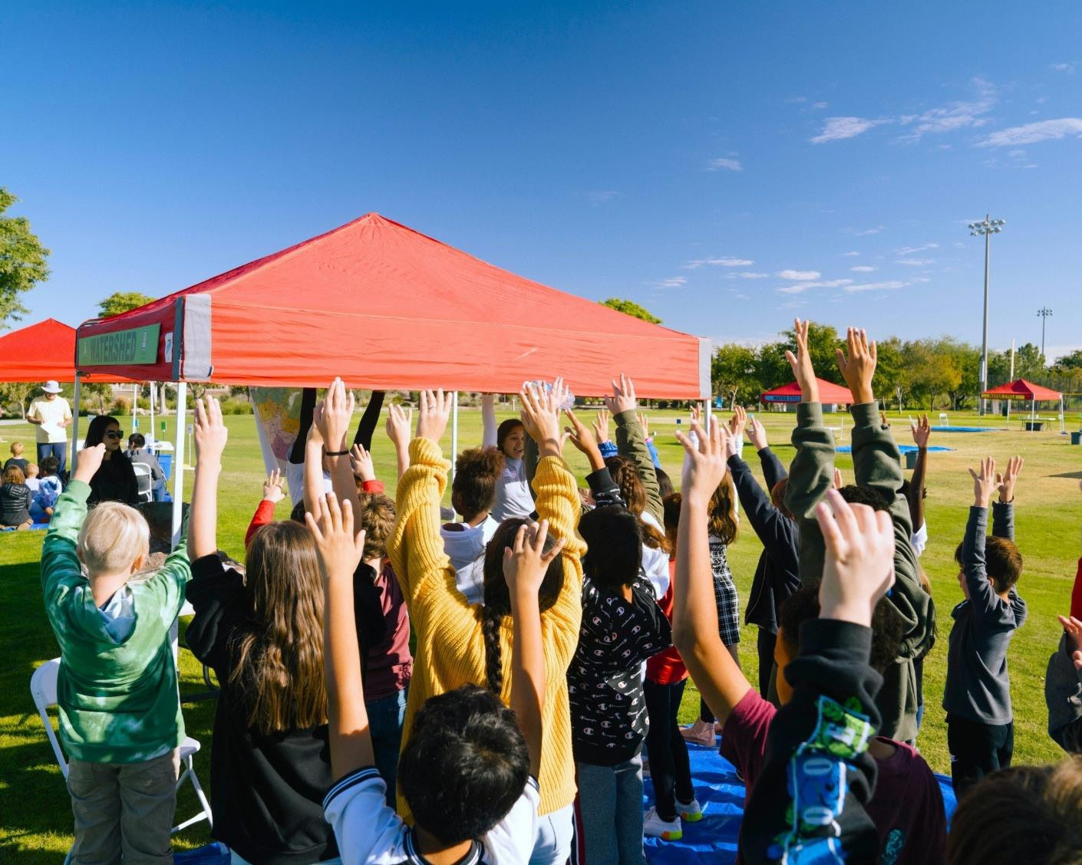

Thank you!
Kirstyn Kay – kkay@arizona.edu
Program Supervisor
Tamara Wells - tamarawells@arizona.edu
Phoenix/Northern AZ Water Festival Coordinator
Michael Keoki Spaeth - mkspaeth@arizona.edu
Tucson/Southern AZ Water Festival Coordinator
https://projectwet.arizona.edu/arizona-water-festival/teacher-
resources
Notes:
STUDENT POST-ASSESSMENT – https://projectwet.arizona.edu/arizona-water-festival/teacher-resources/student-survey
After: Please administer the same survey again after completing the unit. Ideally no more than four weeks after the water festival event. Thank you very much!

