Slide 1
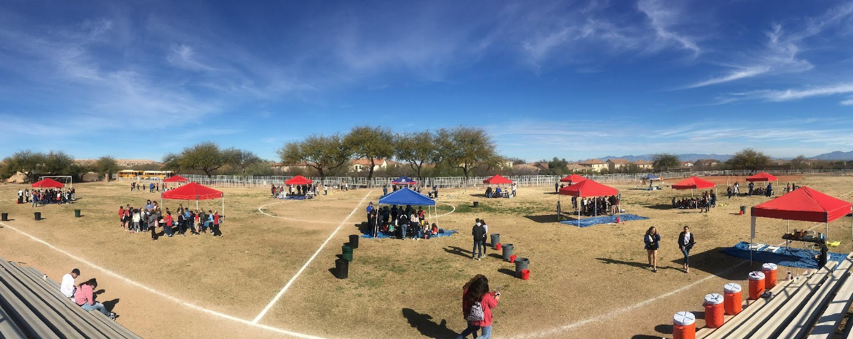


Arizona Project WET
Water Festival Unit Lessons
2026-2027

Slide 2
Student Pre and Post Survey
V
https://projectwet.arizona.edu/
arizona-water-festival/
teacher-resources/student-survey
BEFORE
AFTER
Please administer the "pre-water festival" survey before students start any of the lessons. This is not a test. Please facilitate reading the questions as a class.
Please administer the "post-water festival" survey after completing the unit, ideally no more than four weeks after the water festival event.

Slide 3
AWF Unit of Study
V
Summary:
4th grade students explore the Arizona water cycle, map our regional watersheds, unearth the connection between groundwater and surface water, and learn how their behaviors impact water availability in Arizona. Students use this knowledge to develop accessible, community-focused solutions that simultaneously conserve water and promote sustainable decision-making.

Slide 4
WATER FESTIVAL
UNIT
GUIDING QUESTIONS:
Where is Arizona’s water?
What are the connections between people, water, and heat in the Earth's systems?

Slide 5
GROUNDWATER
WATER CYCLE
Model the movement of water molecules through the Arizona water cycle. Find evidence to support the argument that energy and matter interact in Earth's systems to create the water cycle.
Model aquifer recharge and extraction connecting water availability to human behavior.
WATERSHED
SUSTAINABILITY
Act as environmental stewards, conserving water through
both behaviors and available technologies, supporting resilient solutions that benefit the (biodiverse) community. Design a solution for water savings and safety.
Use a system's model to learn how water moves through a watershed and demonstrate the human impact of changes to that natural system; city surfaces affect the movement of water, and those changes can be observed/measured. Identify the cause-and-effect interactions between matter and energy in the hydrosphere, biosphere, atmosphere, and geosphere.
Notes:
We focus on 4 overarching topics throughout the unit – and these are the objectives

Slide 6
Begin student slides on Slide 7

Slide 7
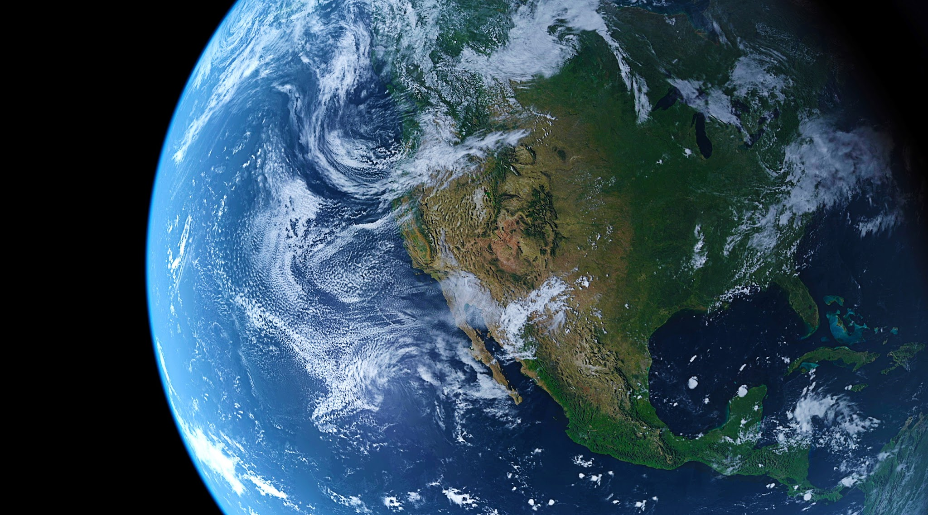
Water Principles
WATER FESTIVAL UNIT:
Water is essential for all life on Earth to exist.
Water connects all Earth systems.
Water has unique and complex physical and chemical characteristics.
Water is a natural resource.
Water resources are managed.

Slide 8
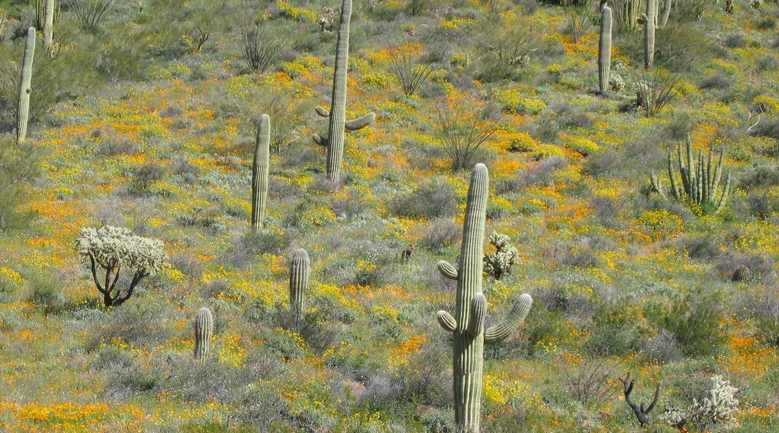
Water Principles
WATER FESTIVAL UNIT:
Water is essential for all life on Earth to exist.
a. All living organisms have water in them.
b. Life processes depend on water—from the cellular to ecosystem levels.
c. Both the quantity and quality of water contribute to sustainability of life on Earth.

Slide 9
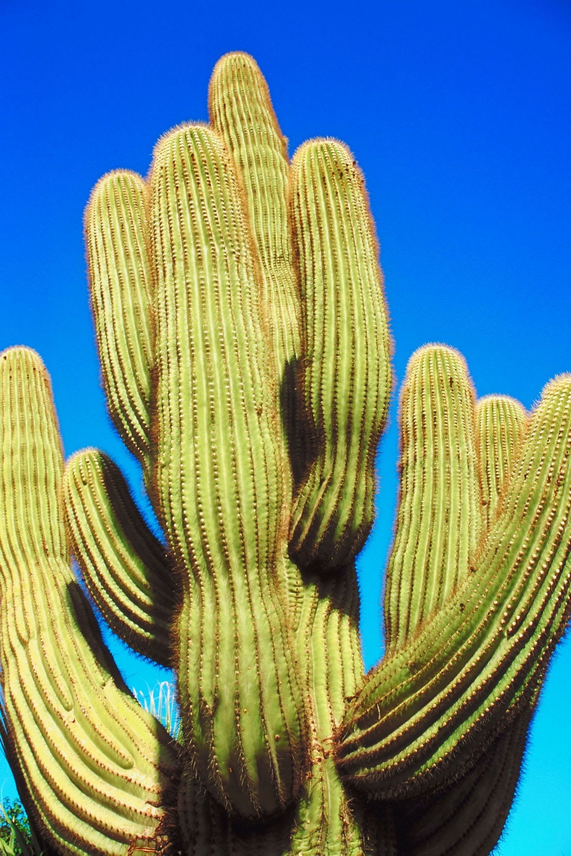
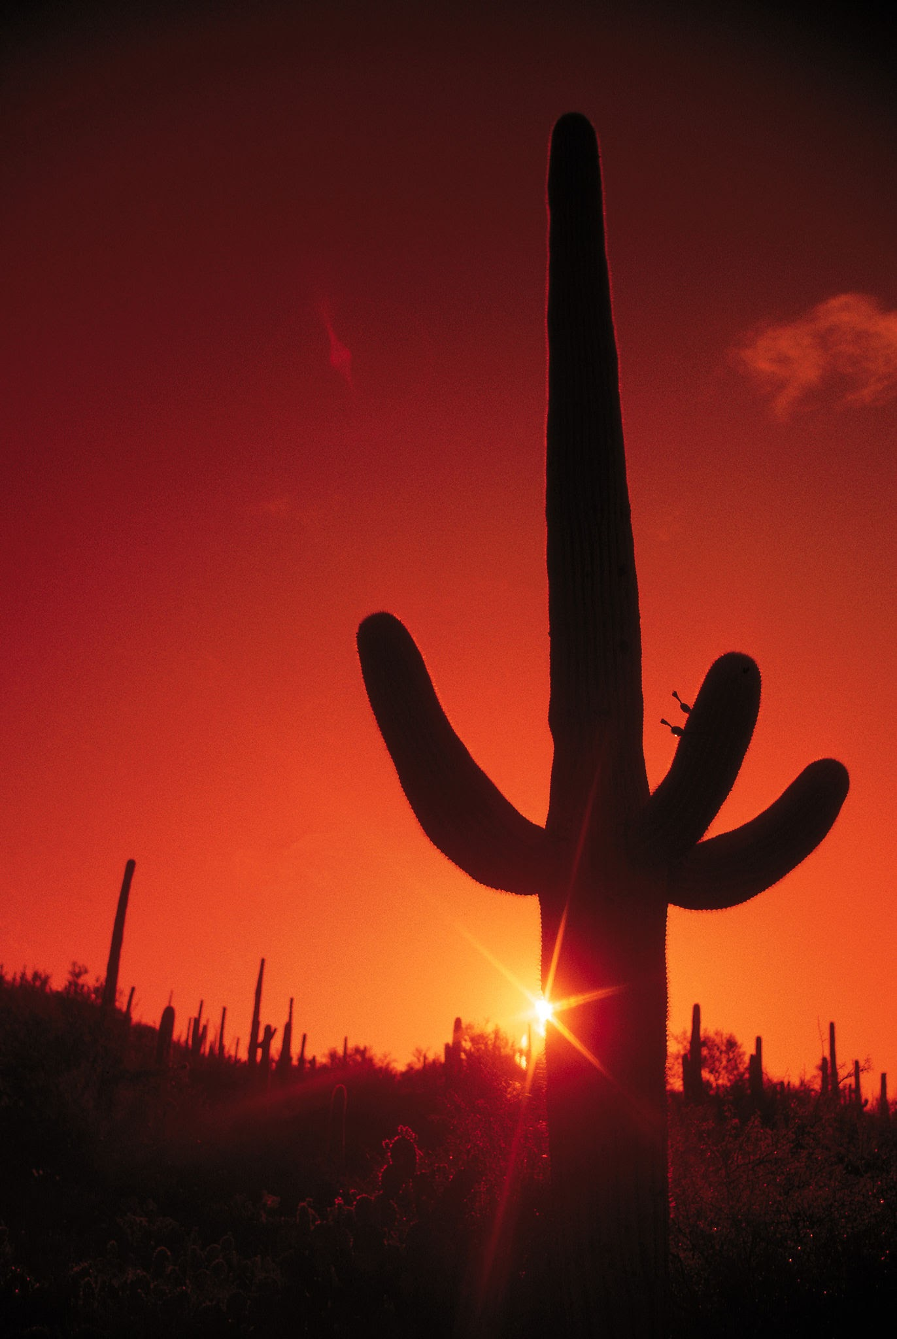
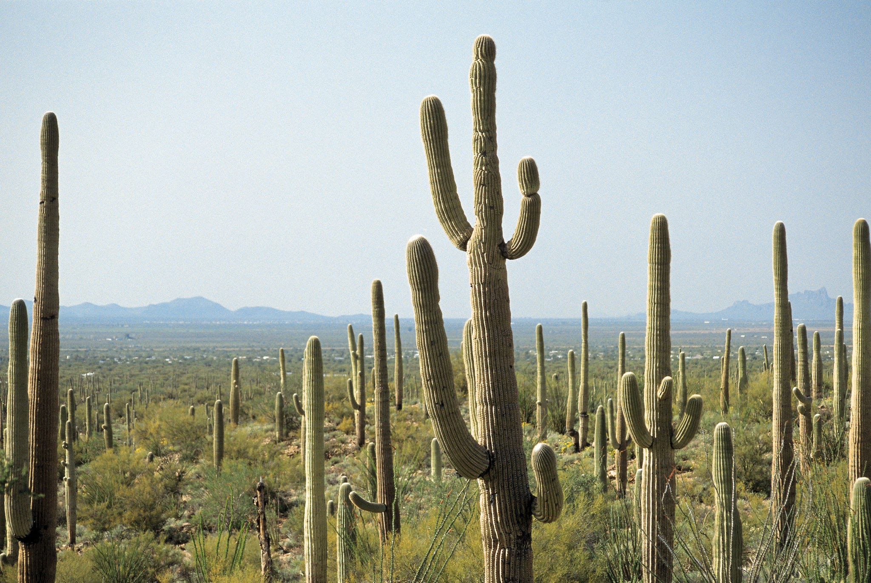
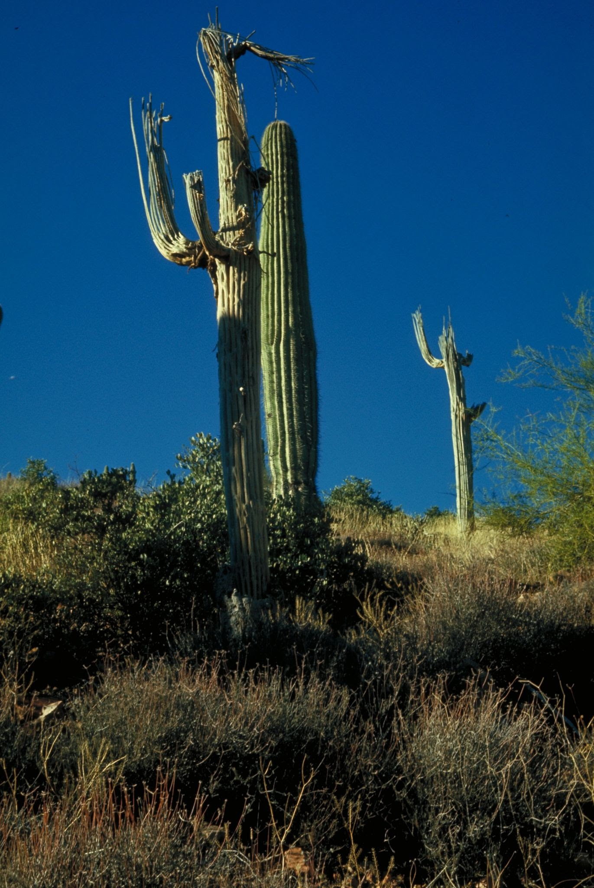
Lesson 1.1 Anchor Phenomena: Desert Adaptations
Can you name this Sonoran Desert superstar species?

Slide 10
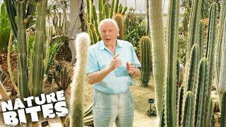
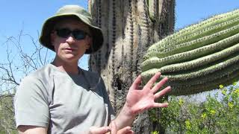
Let’s brainstorm!
How do organisms survive in the desert?
How has the saguaro cactus adapted to survive hot temperatures and low water?

Slide 11
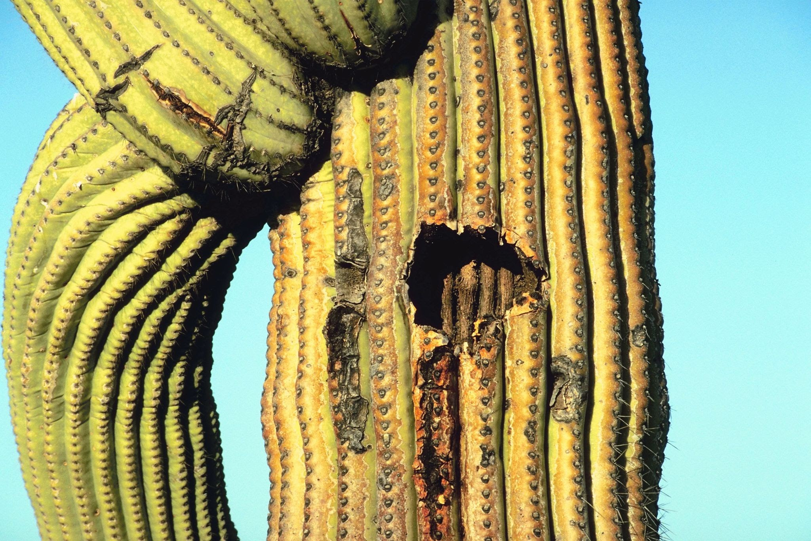
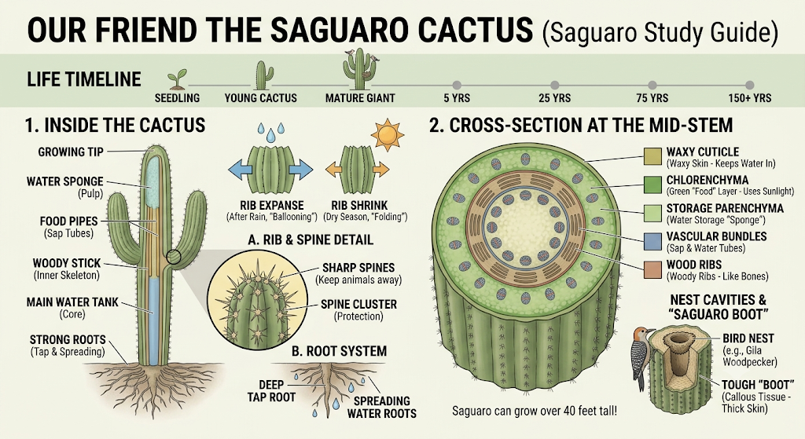
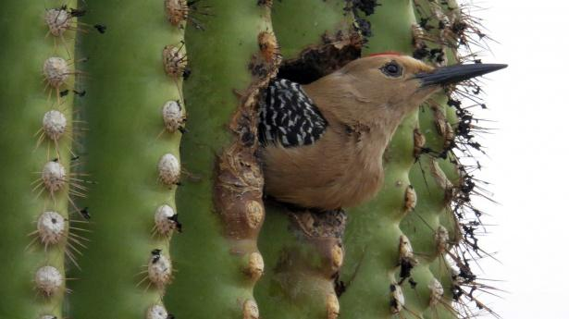
Notes:
If you are using the saguaro cactus reading activity this is a good time to do it with your students.

Slide 12
WATER CYCLE: LESSON 1
LESSON 1.1: Where is the water?
Investigative Questions
Where is the water in each landscape?
How and why does it change form?

Slide 13
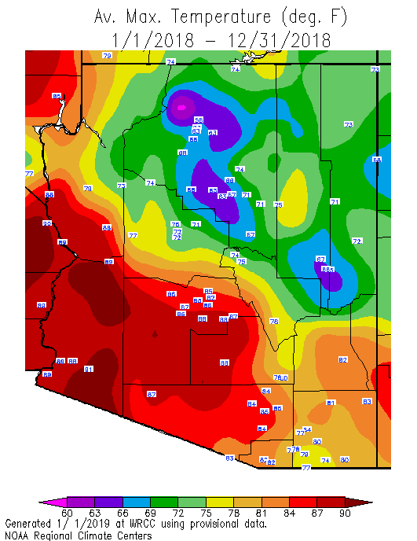
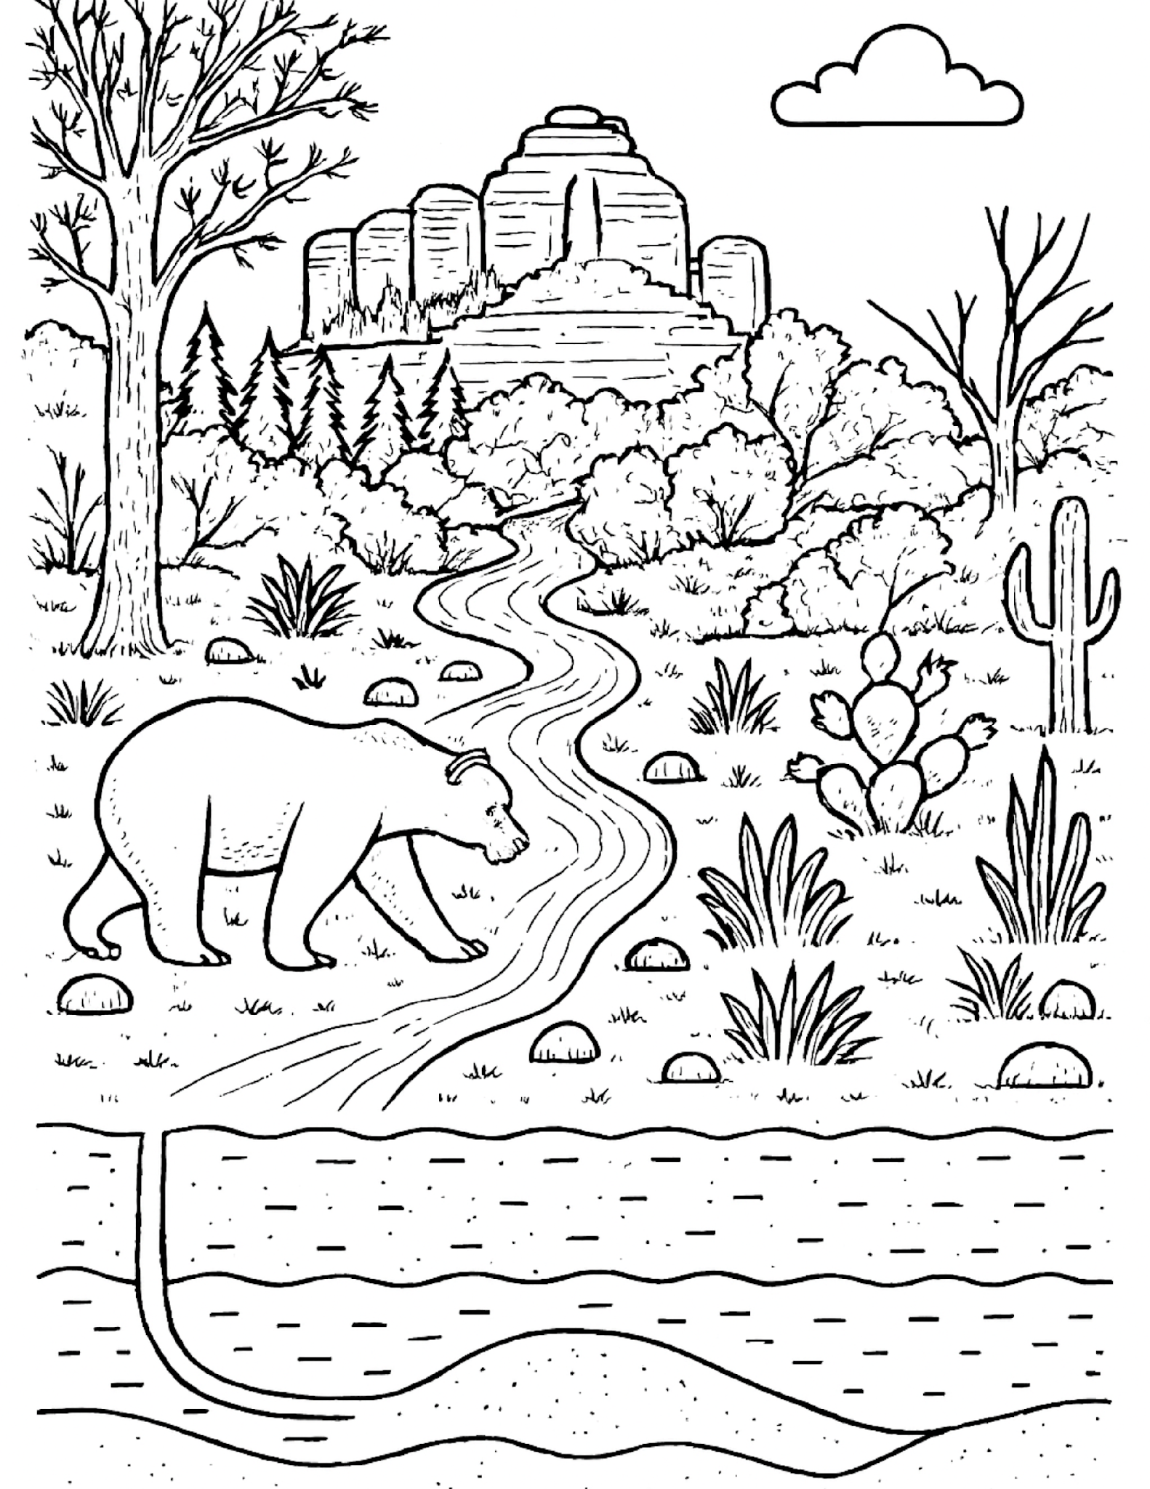
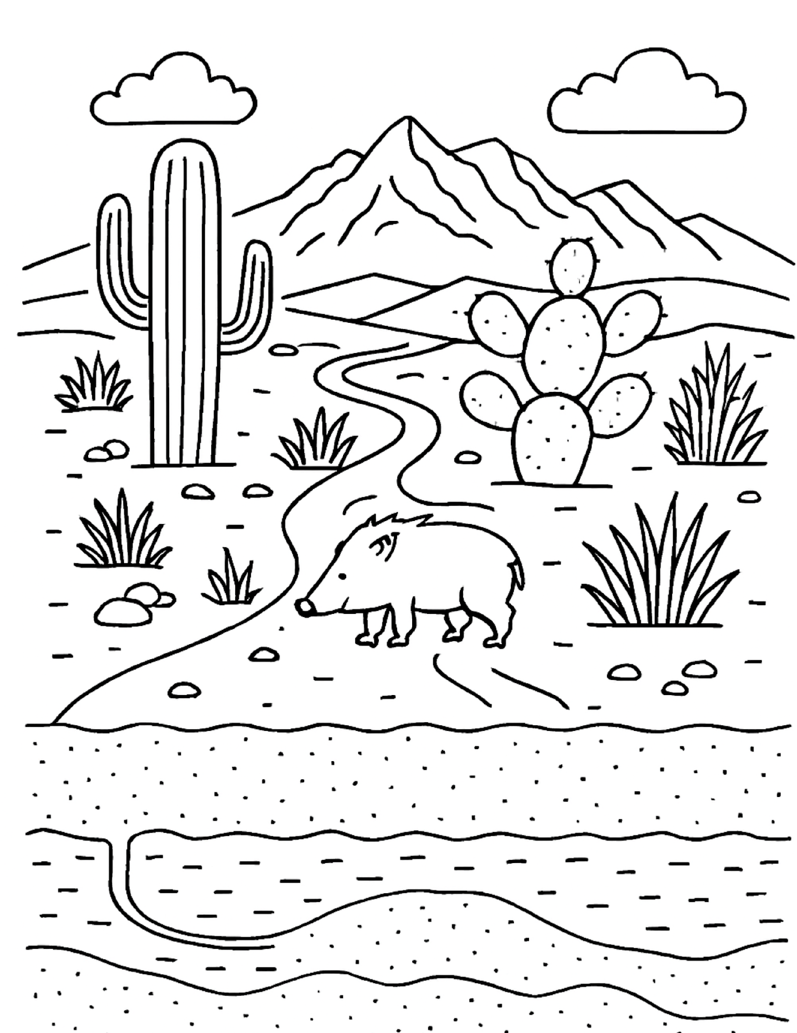
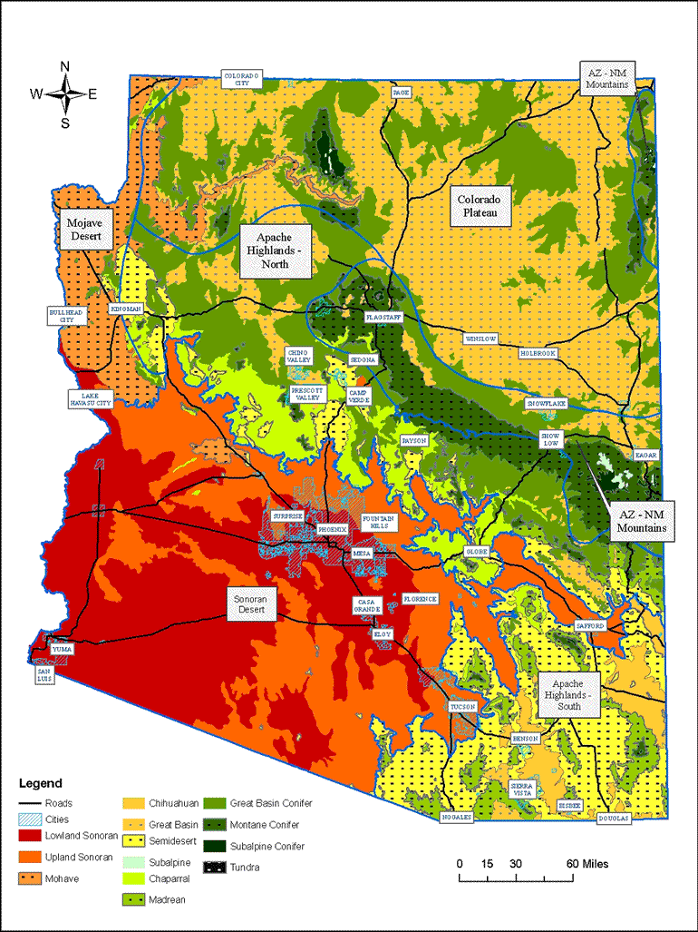
Where is water found in these different landscapes?
Notes:
Engage: Give students the desert/forest coloring sheet and ask them to create a color or symbol code to show where the water is. Prompt students to think about where water can be found outside of lakes, rivers and oceans.
Where is the liquid form of water? Where is the gaseous form of water? Where is the solid form of water? What causes water (matter) to change from a solid to a liquid to a gas? - (Energy from the sun). What causes water vapor to precipitate and fall from the sky and percolate into the ground? (Gravity). Ask students to share their ideas and discuss in small groups. Generate a class list on the board/smartboard/poster board.
Explore: Ask students to commit to a position on the following questions: Is there more water in the desert or in the forest? Why? Ask students to generate a list of evidence to support their answer to the above questions.
Explain: Learn key vocabulary. Play the Gimkit for review.
Elaborate: Ask early finishers to choose an organism in the desert side of the picture and research
and describe how it is able to survive with less water in the desert.

Slide 14
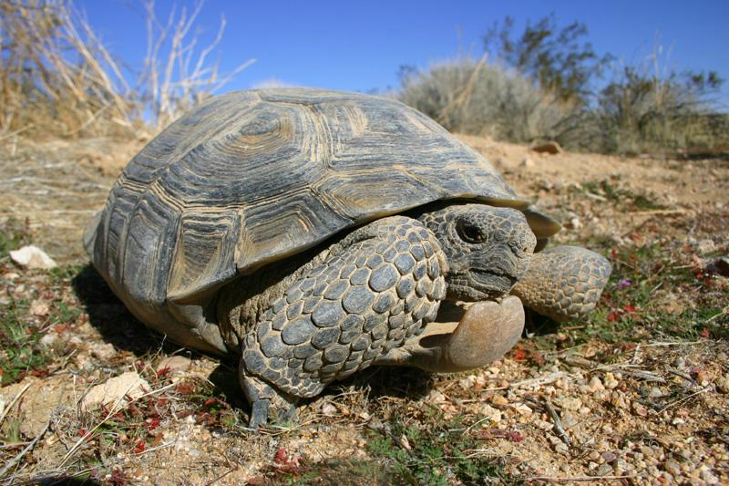
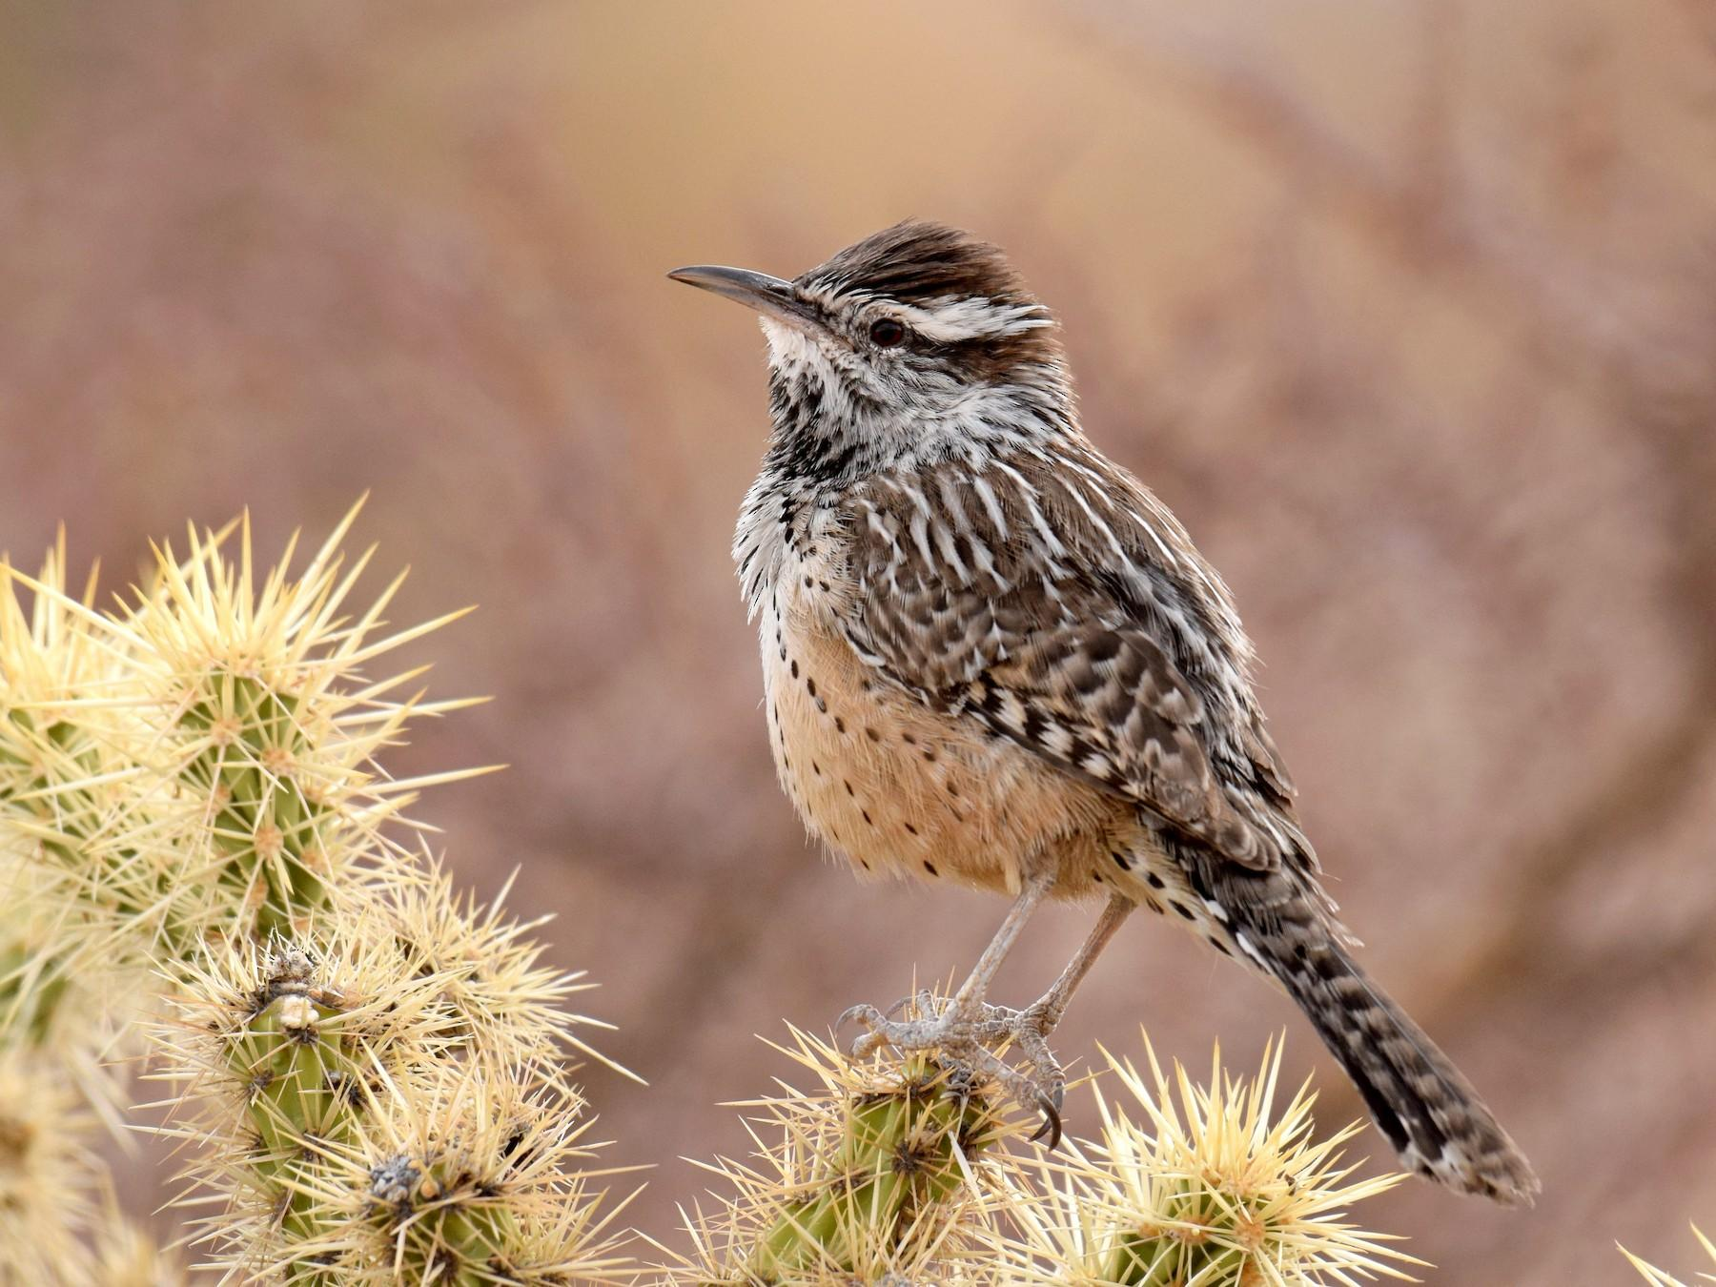
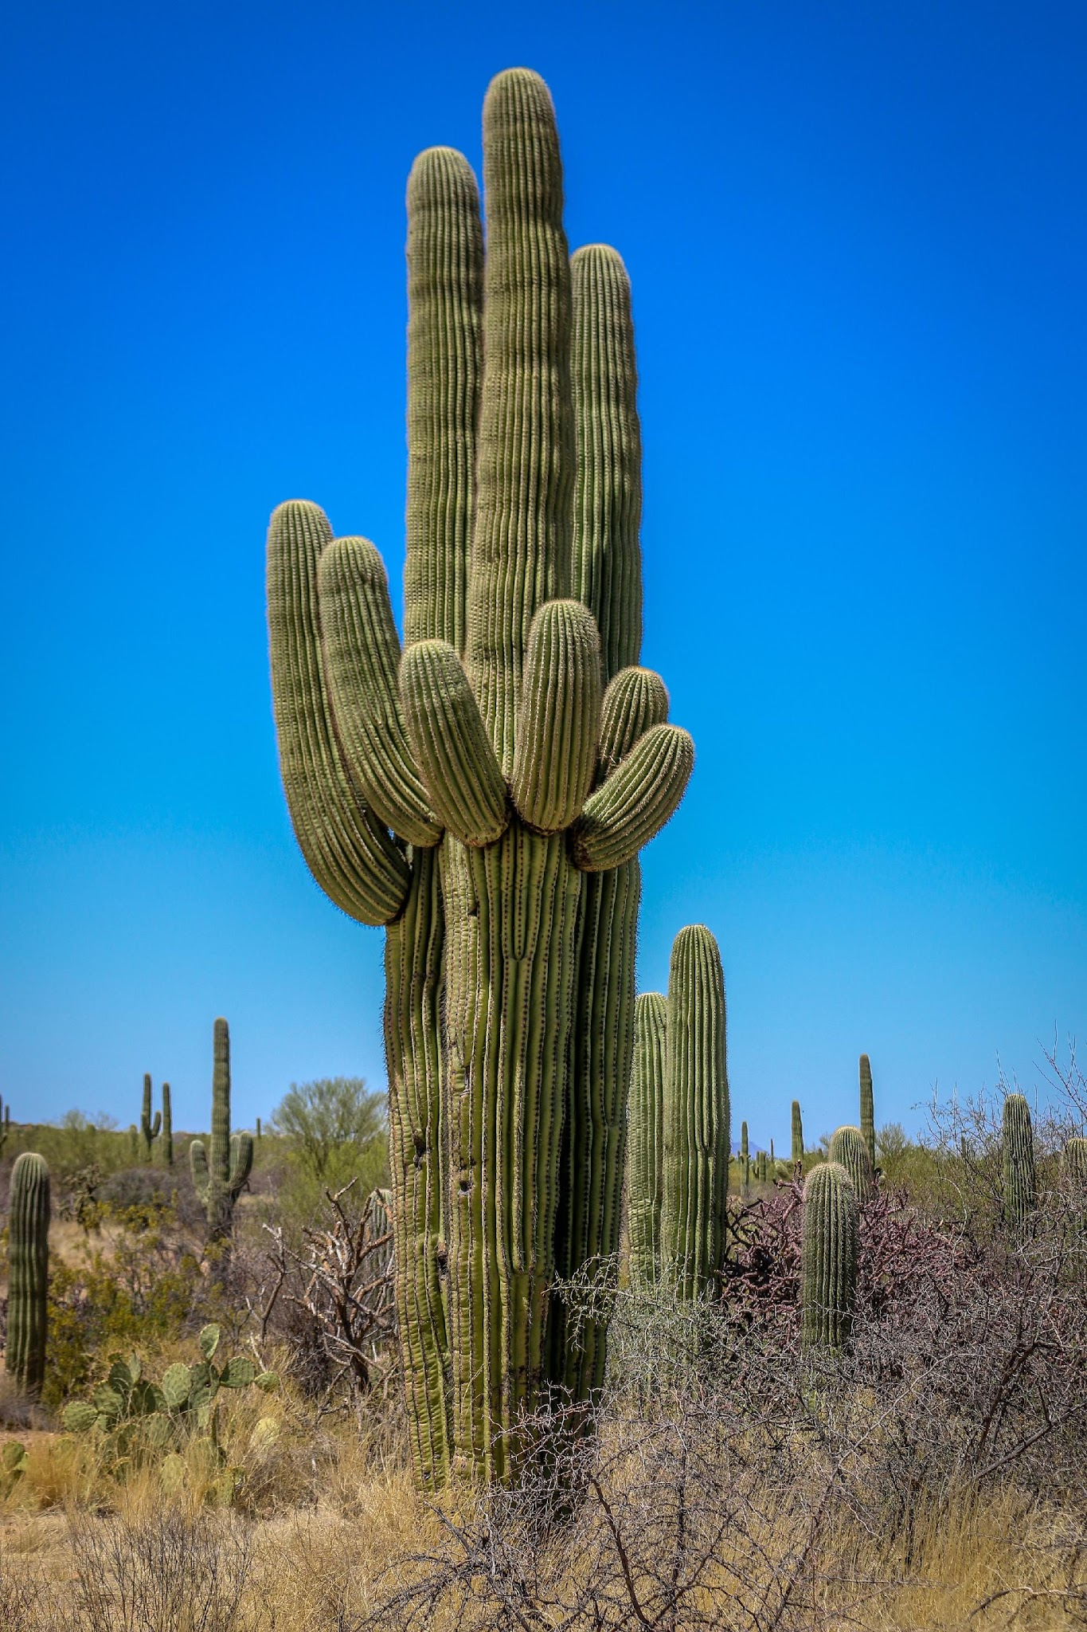
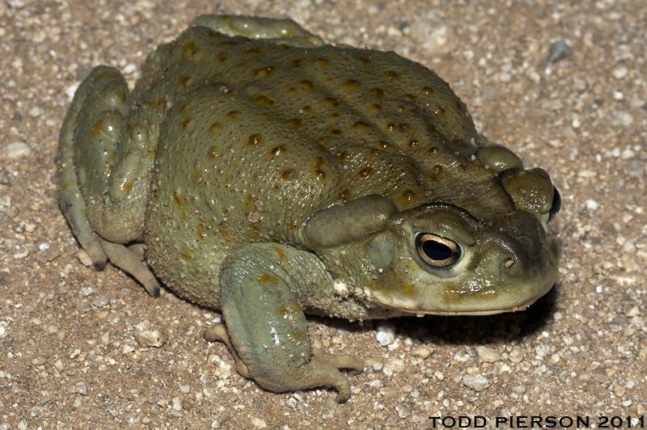
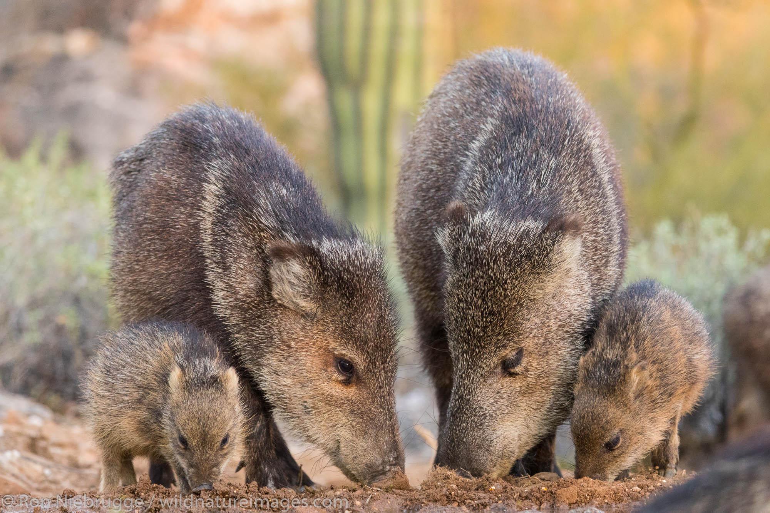
How are desert organisms able to survive with less water in the desert?
Notes:
Elaborate: Ask early finishers to choose an organism in the desert side of the picture and research
and describe how it is able to survive with less water in the desert.
Pictured organisms: Sonoran Desert Tortoise, Cactus Wren, Saguaro, Colorado River Toad, Javelina

Slide 15
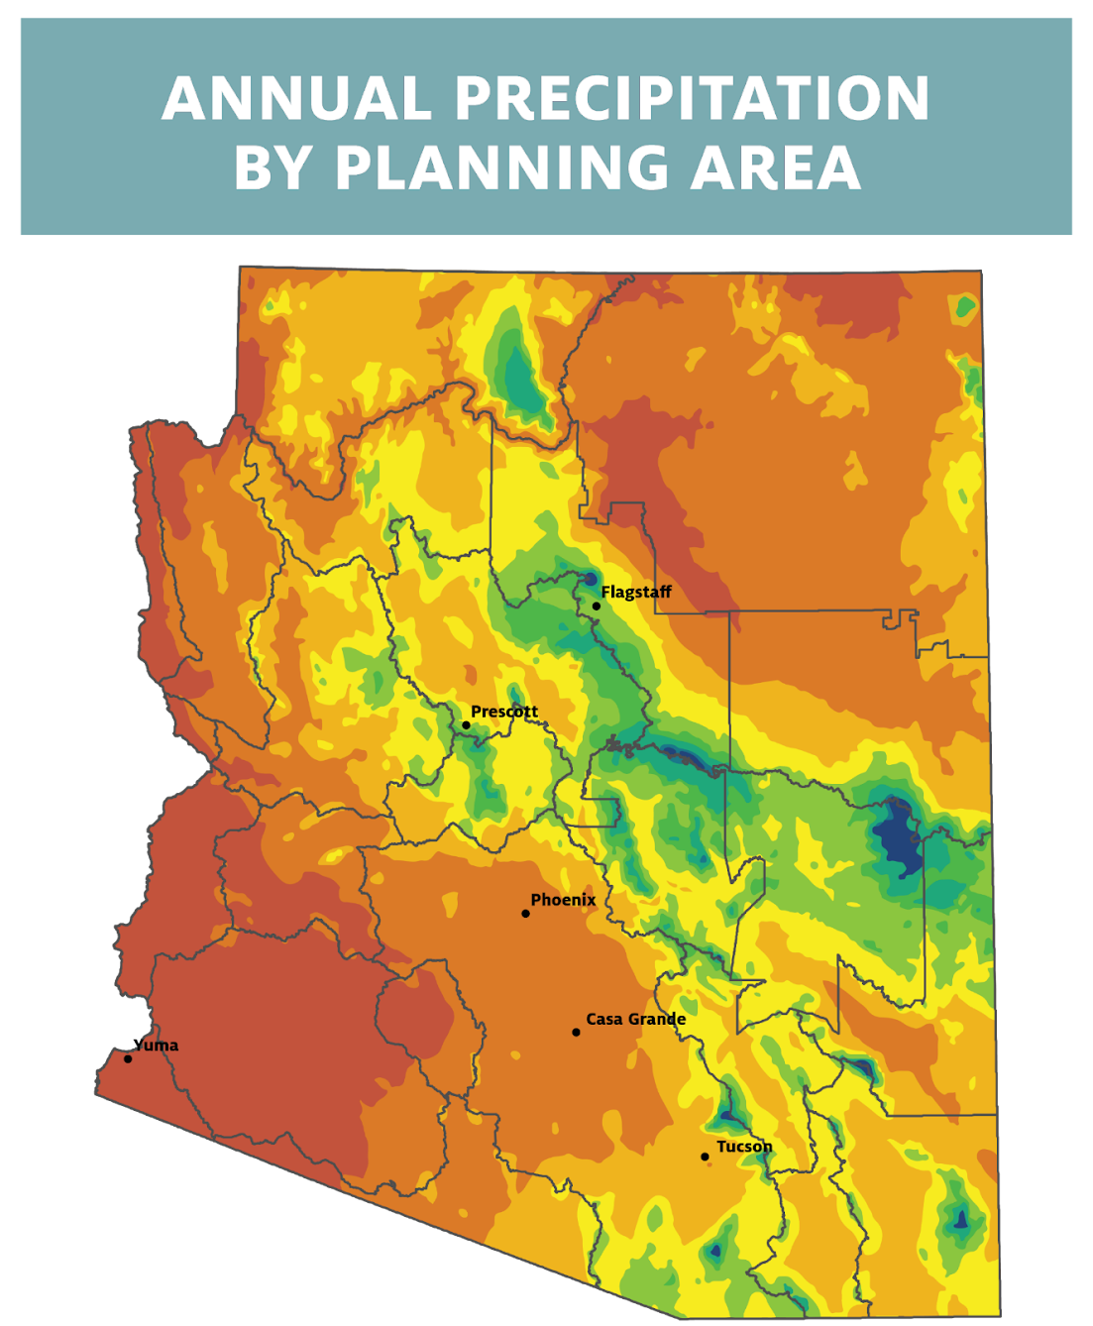
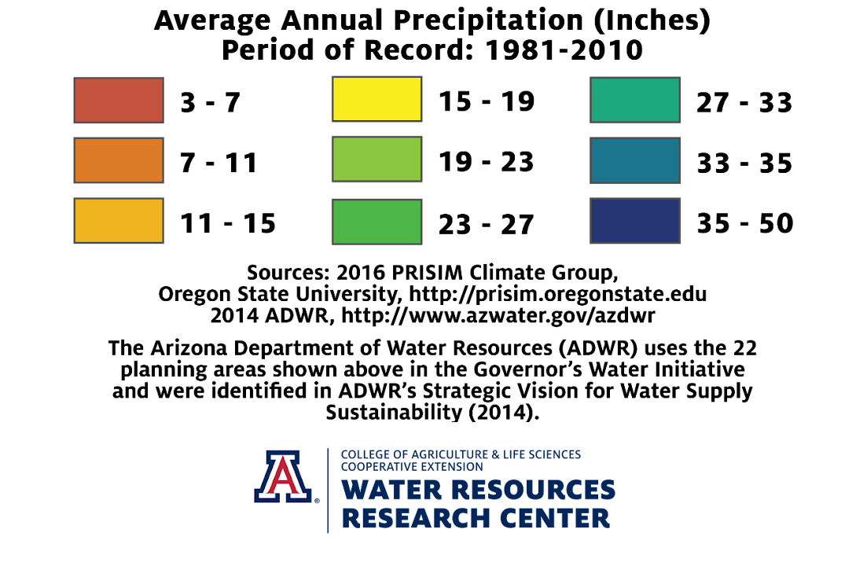
Where can the plants and animals live?
Notes:
Here we cans see that while we do get some rain, most places do not get a lot! Where do we get the most ? The mountains!

Slide 16
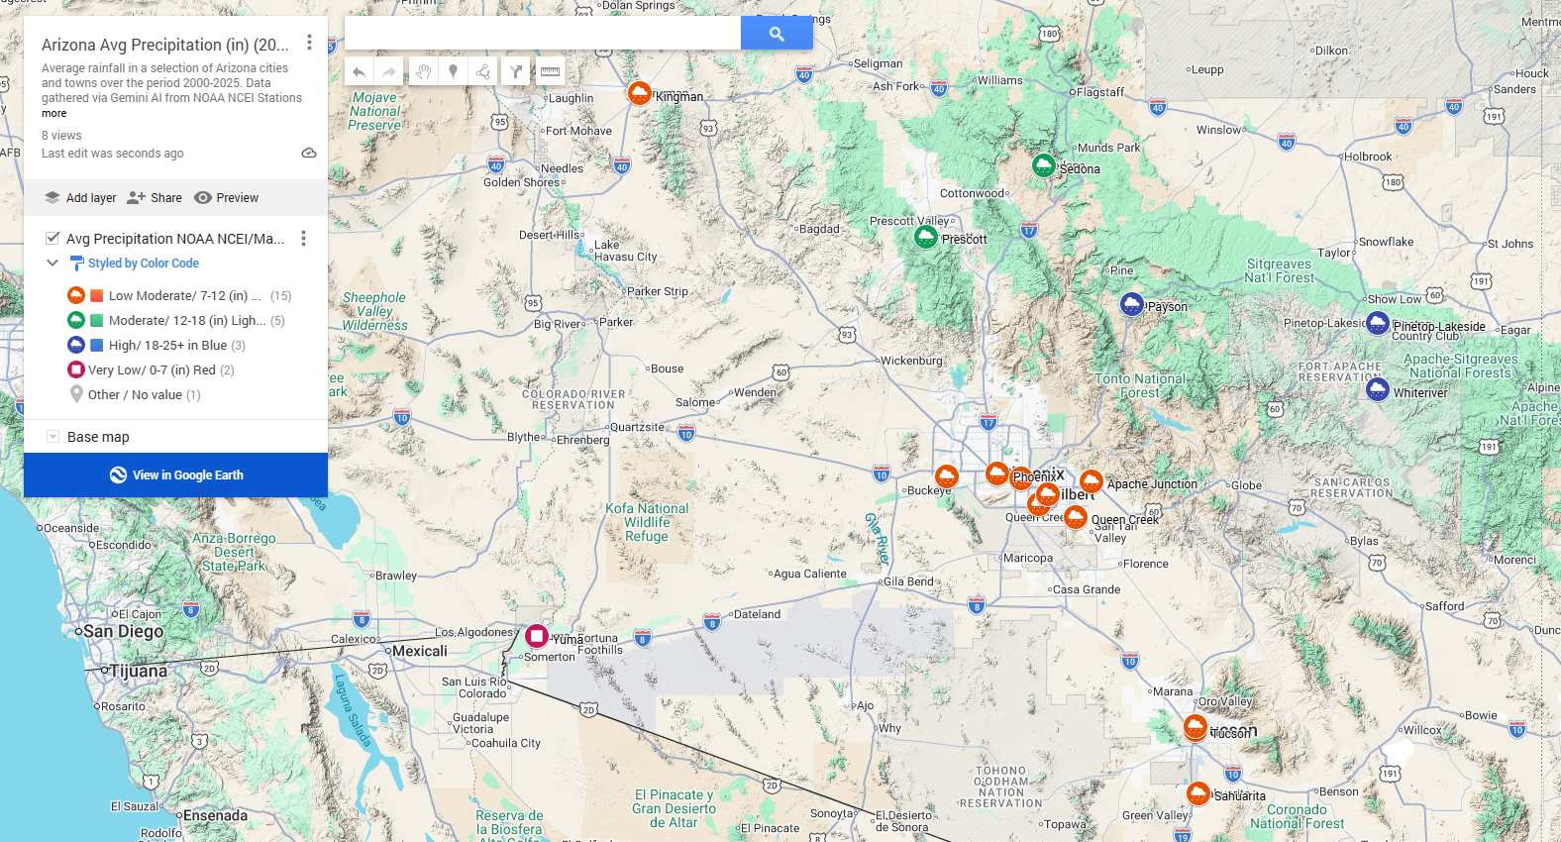
Notes:
https://www.google.com/maps/d/edit?mid=1zipA1PKrRl12k4DMEXg1zPNFkjW7SPQ&usp=sharing Google My Maps live link

Slide 17
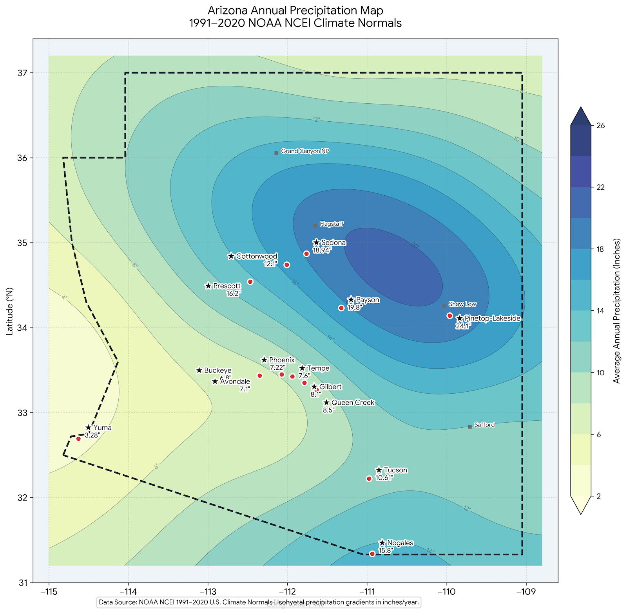
What do you think might be in the area with the most precipitation?
Mountains
Valleys
An ocean
When precipitation falls as snow in the mountains, we call that snowpack. When it melts slowly in the spring and summer, it fills streams and lakes and rivers. Snowpack is like a bank account for water throughout the year.
Notes:
The Orographic Effect
Windward Side (Wet): Prevailing winds push warm, moist air against the mountain slope. As the air rises, it cools and condenses into clouds, producing heavy rain or snow. This side is usually lush and green. [1, 2, 3]
Leeward Side (Dry / Rain Shadow): After crossing the peak, the dry air descends and warms up. Because the air has lost its moisture, it creates an arid region known as a rain shadow. [1, 2]
Key Mountain Impacts
Water Supply: Mountain snowpacks and runoff provide a major share of freshwater for lowland and semi-arid watersheds. [1]

Slide 18


How are desert organisms able to survive with less water?
Average rainfall in a selection of Arizona cities and towns over the period 2000-2025. Data gathered via Gemini AI from NOAA NCEI Stations. Desert organisms have evolved unique mechanisms to thrive in these low-precipitation zones.
Precipitation Zones (in)
Very Low: 0-7" (e.g., Yuma, Buckeye)
Low/Moderate: 7-12" (e.g., Phoenix)
Moderate: 12-18" (e.g., Sedona)
High: 18-25"+ (e.g., Payson)
Key Survival Adaptations
Desert wildlife and plants employ distinct evolutionary strategy groups to manage extreme water scarcity:
Succulence & Storage: Saguaro cacti and desert tortoises store vast water reserves internally to survive prolonged dry spells.
Drought Evasion: Amphibians like the Colorado River Toad estivate underground, emerging only during monsoons.
Behavioral Mitigation: Javelinas and Cactus Wrens utilize microclimates, feeding on water-rich foods during cooler hours.
Notes:
https://www.google.com/maps/d/edit?mid=1zipA1PKrRl12k4DMEXg1zPNFkjW7SPQ&usp=sharing Google My Maps live link

Slide 19
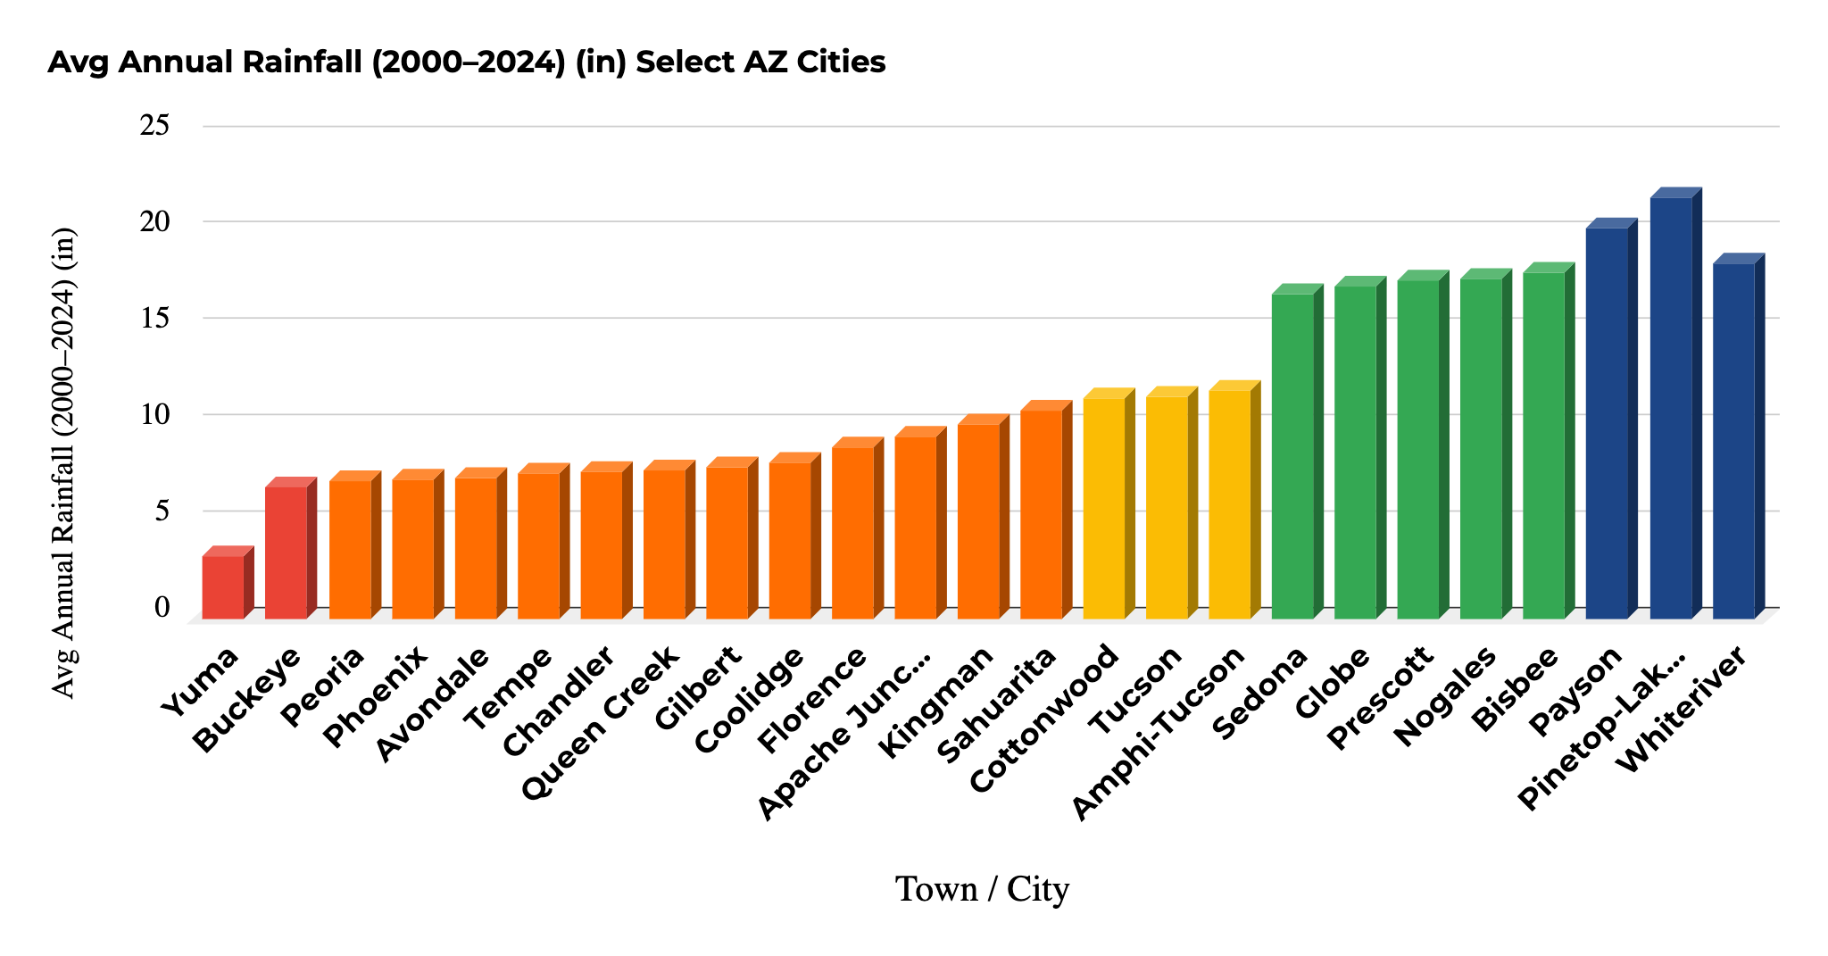
Notes:
Please use the

Slide 20
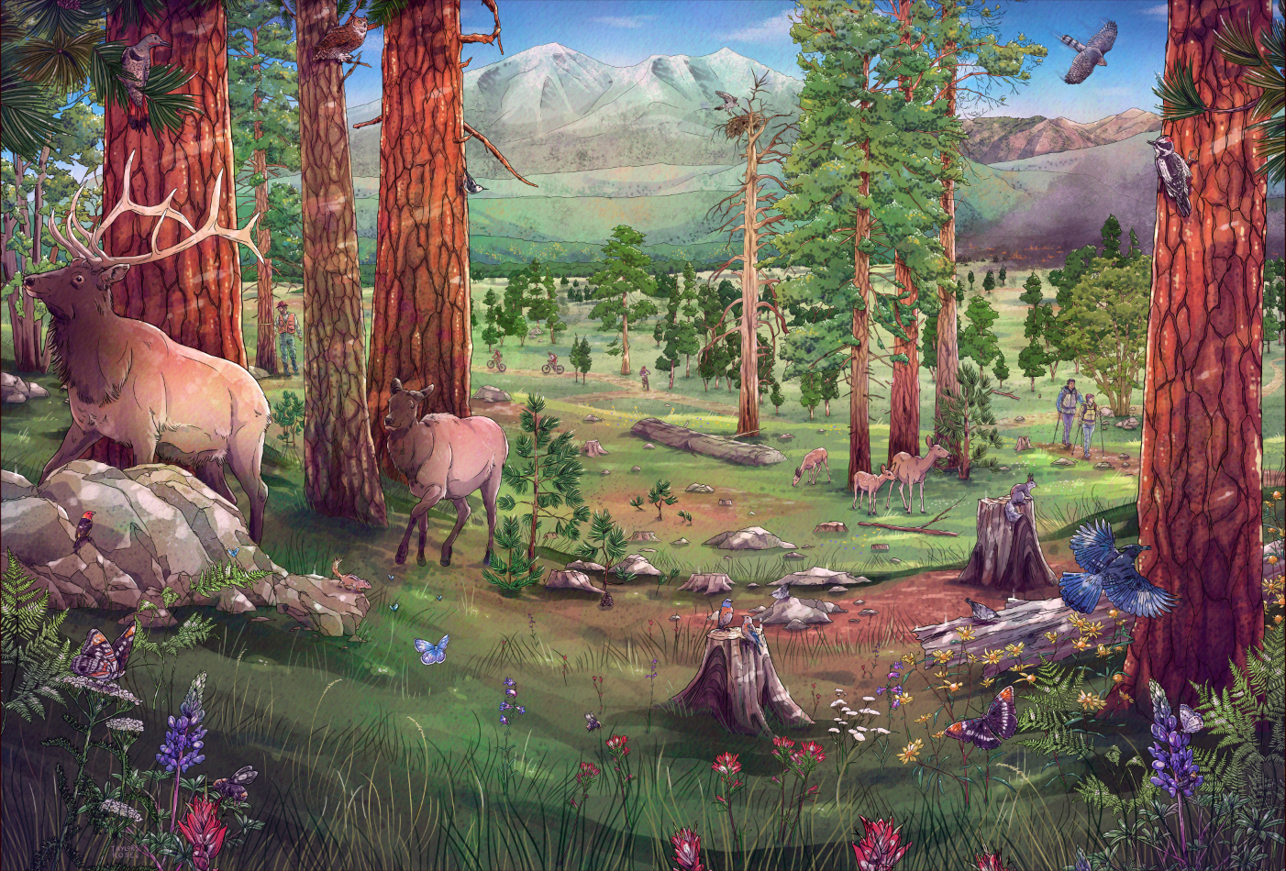
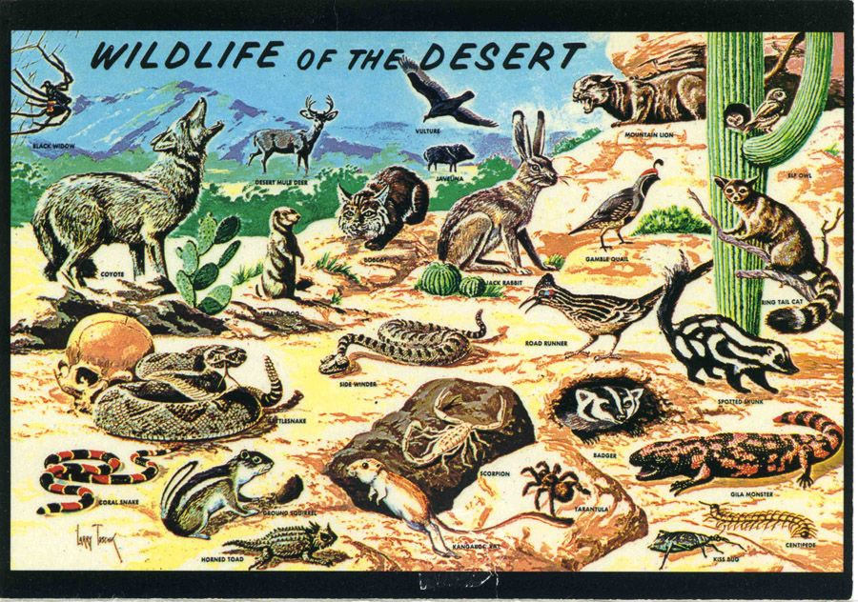
Wrap-Up
LESSON 1.1
    Is there more water available for living organisms in a desert or in a forest?
Notes:
Evaluate: Ask students to write a one-paragraph evidence-based argument responding to the question: Is there more water available for living organisms in a desert or in a forest?

Slide 21
Research and share your evidence!
LESSON 1.1
PRACTICE CURIOSITY! Claim, Evidence, Reasoning
Question:
How does my organism survive in the desert with very little water?
Observations and evidence:
Where does my organism live? How does it find, save, conserve water? What is special about its body that helps it to conserve water?
Evaluate and ask questions.
What do you still want to know?
Can I explain my answers to my classmates? What did I find out that is super interesting? What do I still want to know?
Answers/Explanation:
My organism survives by/with the help of…
Support Explanation With Evidence:
How do these organisms survive in the desert? What adaptations help them to survive with less water available to them?
Notes:
Evaluate: Ask students to write a one-paragraph evidence-based argument responding to the question: Is there more water available for living organisms in a desert or in a forest?

Slide 22
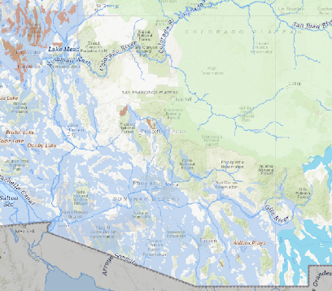
How much water do we have in Arizona? Why?
Total land area of Arizona:
    113,990 square miles
Total water area of Arizona:
    0.3%
Aquifers =
Notes:
https://www.usgs.gov/special-topics/water-science-school/science/how-wet-your-state-water-area-each-state
We don’t have much water compared the size of our state… so what does this mean?
Water is not distributed equally across the Earth-there are arid regions and wet regions.

Slide 23
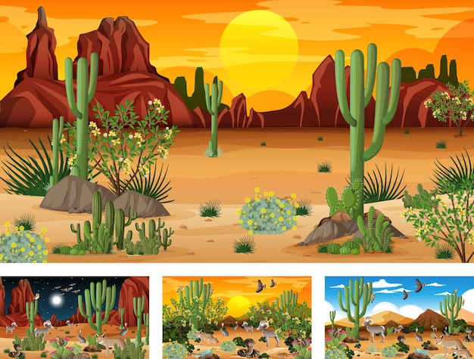
Investigative Questions
How does water move through our local water cycle?
Are you a part of our water cycle?
    Does water move in and out of your body?
We live in a desert!
Notes:
Have your students brainstorm and think about what their local water cycle looks like. What processes are happening? Is it dry or wet most of the time? Are there trees and plants? Animals? People?
People drink, perspire (sweat), breathe –respiration, and urinate – so yes water does move through our body, and we are part of the water cycle

Slide 24

Lesson 1.2 Anchor Phenomena: Clouds
Notes:
https://youtu.be/68A_Azsqqg4?si=N8BCOfBme232YEqE
Engage: Pause the video at 0:55 to have the students try it for themselves. You can end the video at 2:28.
Take some time to discuss what you saw in the video.

Slide 25
Water Principles
Lesson 1.1 Molecules in Motion:
2. Water connects all Earth systems.
a. Water is found in the atmosphere, on the surface, and underground.
b. The water cycle connects Earth systems, purifying and renewing water on Earth.
c. The Sun drives the water cycle through state changes and energy transfer.
d. Climate and water are inseparable—changes in water impact climate, and climate change impacts water resources.

Slide 26
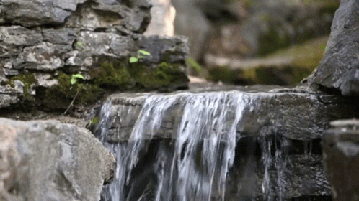
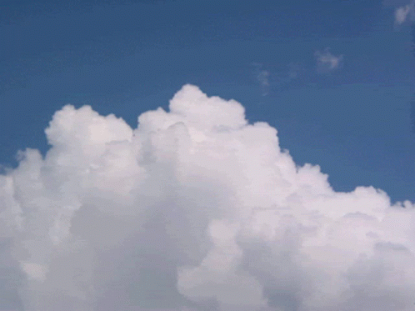
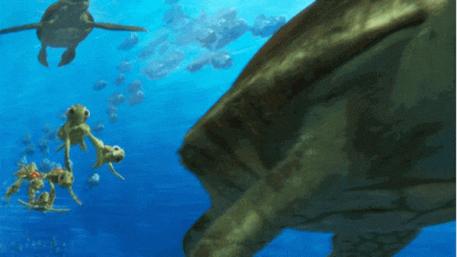
Engage: How does water move?

Slide 27
Water Cycle Vocabulary 1
Term | Definition
Evaporation | When water changes into vapor and goes into the air.
Condensation | When water vapor cools and turns back into liquid.
Runoff | Water that flows over the ground into rivers, lakes, or streams.
Transpiration | When plants let out water through their leaves into the air.
Precipitation | Water that falls from the sky as snow, sleet, or rain.
Infiltration | When water soaks into the ground.
Percolation | When water keeps moving deeper through soil and rocks.

Slide 28
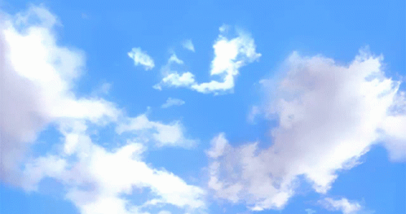
Argue from Evidence: Is a cloud a solid, a liquid or a gas?

Slide 29
Water Cycle Vocabulary 2
Liquid Water | Water that flows and takes the shape of its container.
Solid Water | Water that is frozen and hard.
Gaseous Water (Water as a gas). | Water in the air as vapor.
Water Molecule | The tiniest piece of water, made of hydrogen and oxygen. One hydrogen atom bonded to two oxygen atoms. H20!
Kinetic Energy | Energy of movement.
Heat Energy | Energy from warmth that makes things move faster.
Weather | What the atmosphere is like today (hot, dry, rainy, snowing etc).
Climate | What the weather is usually like over many years.
Gravity | A force that pulls things toward the ground.

Slide 30
Introduction:
How Water Moves In Earth's Systems
Investigative Questions
How does water move and change form in the earth’s natural system?
What are the forces that drive the water cycle?

Slide 31
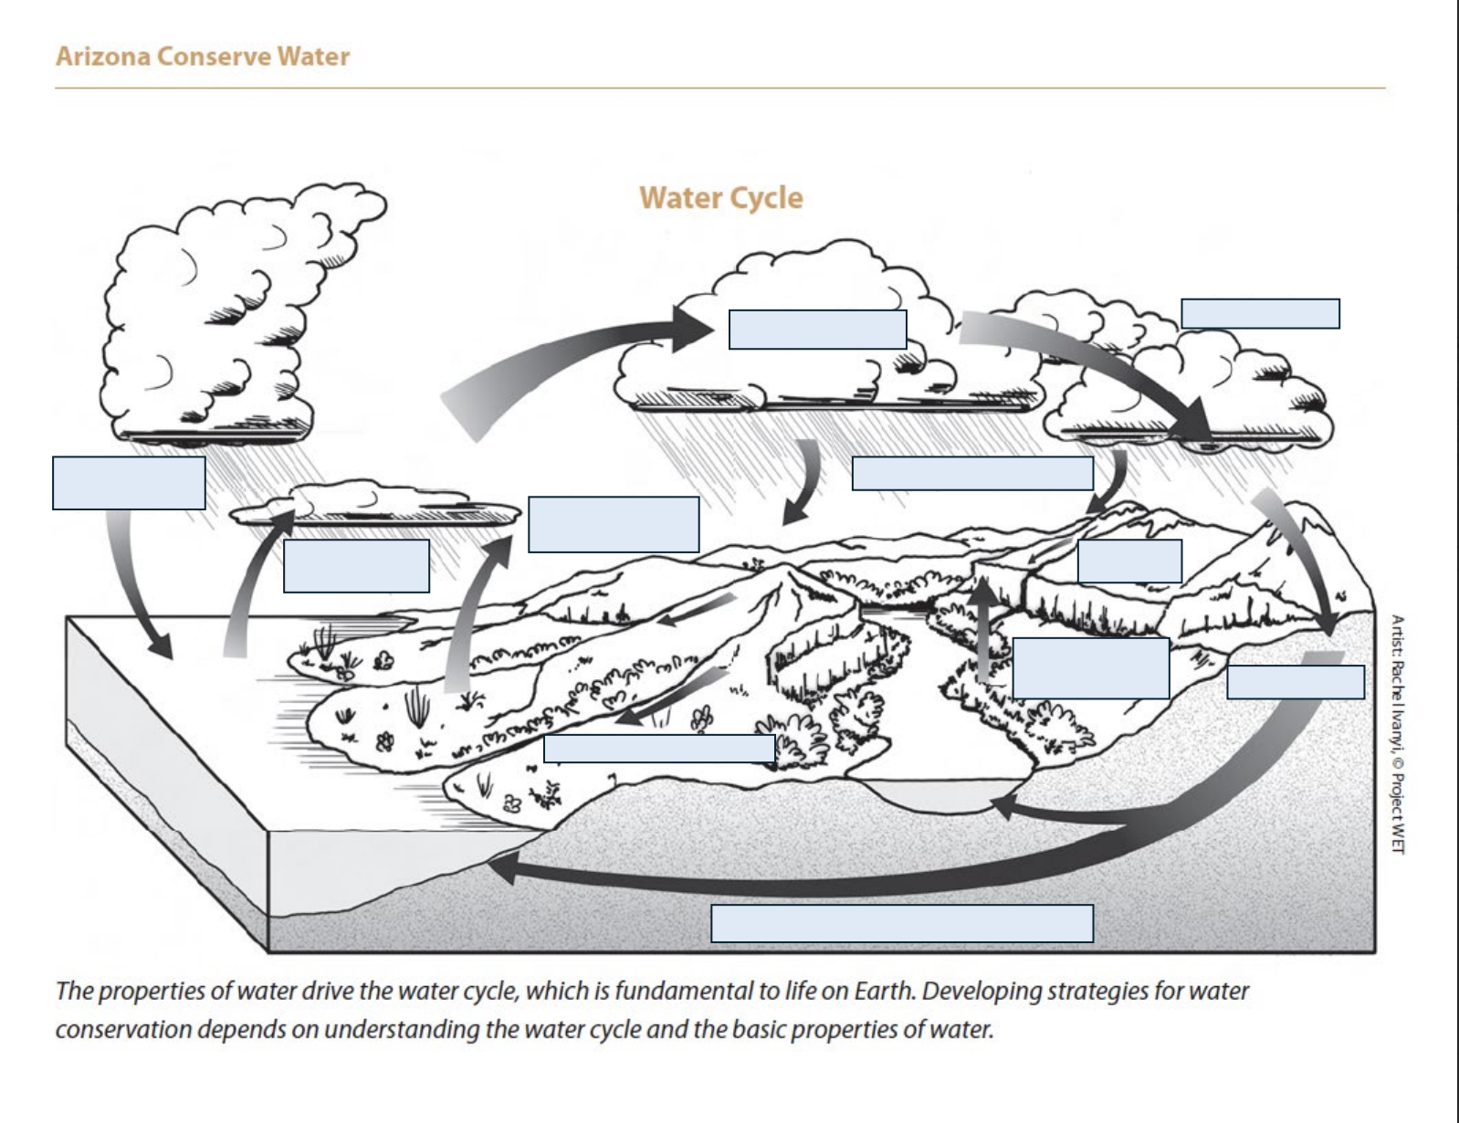
Water Movement & Form Changes
Notes:
Give the students a chance to think about how water moves and changes form. Ask them to write down three questions that they have about the phenomena. If you are able to give the students sticky notes - create a public board of questions to refer back to during the unit.
What are the forces that drive these changes in the water cycle?
Give them the diagram and have them label all of the water cycle parts and processes. (draw arrows, different colors, etc.)
These are the Cross Cutting Concepts demonstrated in this lesson

Slide 32
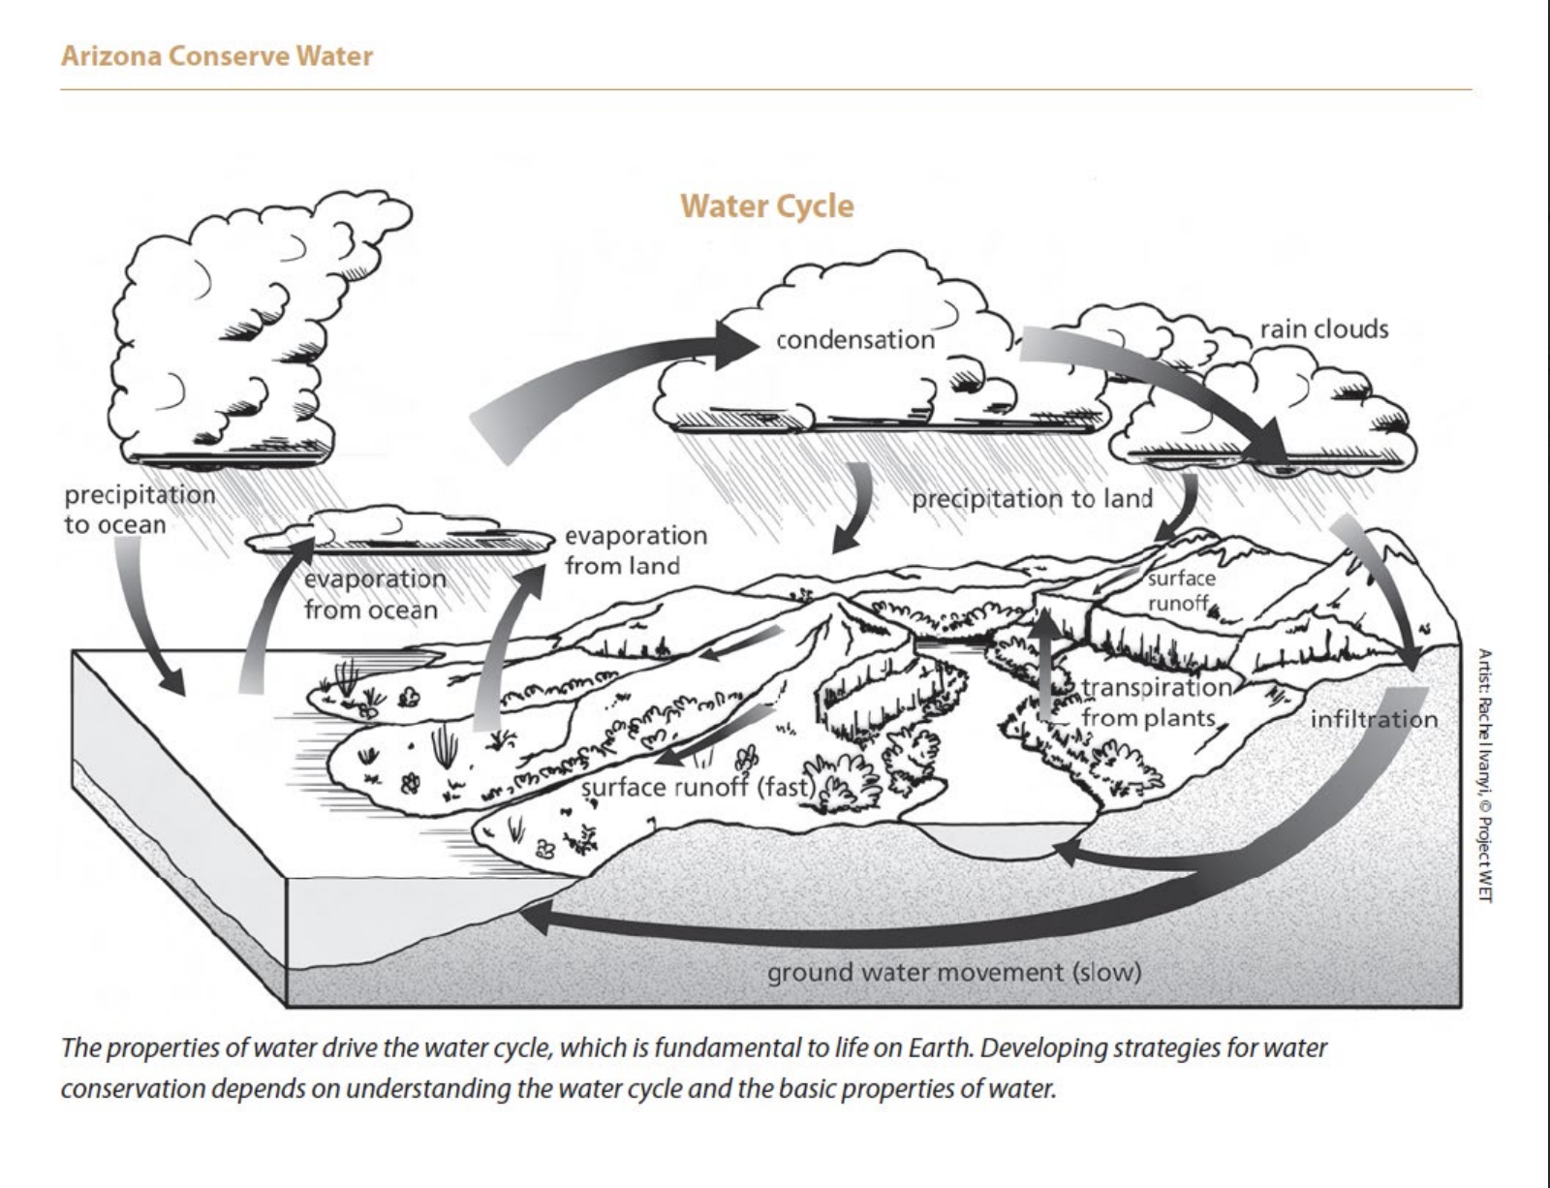
Wrap-Up
Energy and Matter
&
Cause and Effect
Notes:
Challenge students to think about heat as the energy and water as the matter and the relationships they observed.
Give them the diagram and have them label all of the water cycle parts and processes. (draw arrows, different colors, etc.)
These are the Cross Cutting Concepts demonstrated in this lesson

Slide 33
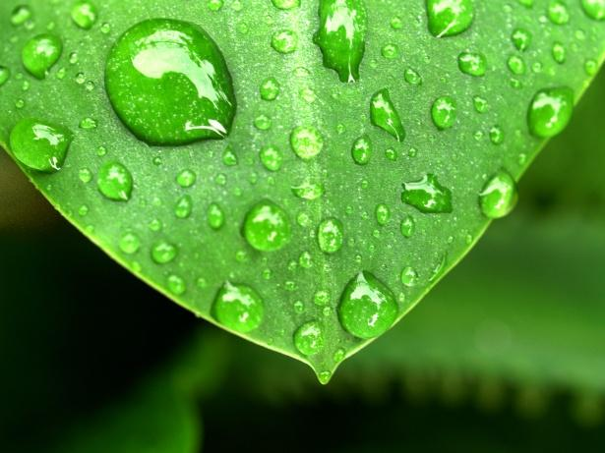
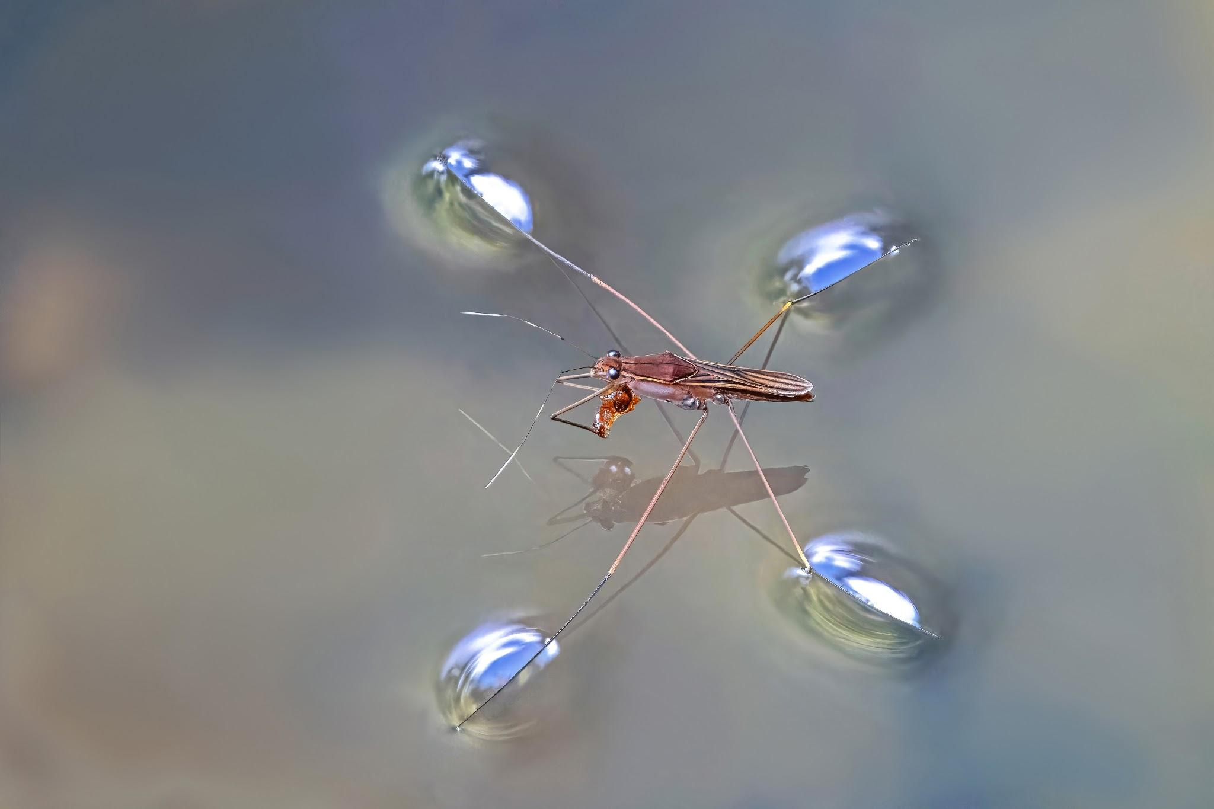
Water Principles
WATER FESTIVAL UNIT:
3. Water has unique and complex physical and chemical characteristics.
a. The nature of the water molecule, as two hydrogens and
one oxygen, determines the physical properties of water and its behavior.
b. Water is the only naturally occurring substance on Earth
that can be found in three physical states: solid, liquid, and gas.
c. The bipolar nature of water molecules results in the properties of cohesion and adhesion.
d. Water is the best solvent out of all liquids—it can dissolve more substances than others.

Slide 34
WATER CYCLE: LESSON 1.2
Molecules in Motion
Investigative Question
      What are the relationships between matter and energy in the movement of water in the water cycle?
Notes:
So we want students to start to think about how water behaves… we are going to think about energy and matter a lot here, that’s one of those cross-cutting concepts that we need to know about.

Slide 35

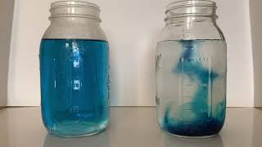
WATERCYCLE: Molecules in Motion
Demonstration
Students will observe the motion of water molecules using food coloring so that those motions are visible and will brainstorm driving questions to explore what is happening.
Notes:
https://youtu.be/NI1h1ZcQ7_E?si=YLxjIPmJLe8q9E3j
We will be watching this video, but I recommend doing this live in the classroom if possible…
I also suggest that you can do the first part of the demonstration as a whole class activity, and then the second part you can do in small collaborative groups.
Please make observation and think about what is happening and why? Stop at 1:56 so that teachers can answer questions.

Slide 36
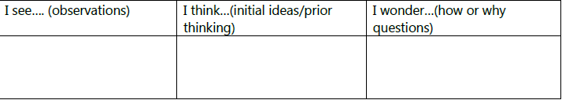
WATER CYCLE: Molecules in Motion
Create a See-Think-Wonder Chart
What did you see/observe in the left jar and the right jar when food coloring was added?
What ideas do you have about why the dye may have behaved the way it did in each jar?
Notes:
When you do this activity with your class make sure to have them create a See-Think-Wonder Chart in their science notebook and fill this in as you do the demonstration and experiment.
Please unmute and share your thoughts or type it into chat:
The jars has the same liquid in them, fresh water, one was just hot water and one was cold water.
Heat is a form of energy, so heat energizes the water molecules. Water molecules will move faster when they are hotter and have more heat energy. Water molecules will move slower when they are colder and have less heat energy.

Slide 37
WATERCYCLE: Molecules in Motion
Notes:
Have students make predictions before you start this part of the activity…
Tips: This is where I would let groups of students do this part of the experiment. Also, we have found that it is helpful to add more food coloring into the jar to make it more intense before ladling it out into room temperature cups. Make a tiny ladle and have students dip ladle into the hot/cold water and then place it into the room temperature cup of water.
In table groups, students will slowly and carefully insert a vial of hot water and vial of cold water (colored so that we can see it) into two separate cup of room temperature water.

Slide 38
WATERCYCLE: Molecules in Motion
Investigation
Why do you think the hot water rose while the cold water stayed in the vial?
What does this experiment tell you about how hot water behaves versus cold water?
Notes:
Either unmute or put answers in CHAT!
Your students might understand that molecules that are warmer move faster, but they may not…
So warmer molecules are moving faster, also heat rises. Hot things go up why? Hot water rises because water molecules are moving faster and are more spread apart than room temp water. Cold water stays below in the vial because the water molecules are moving slower and stay closer together, causing the colder water to stay at the bottom.
Density decreases with a rise in temperature, so what’s actually happening is the molecules are less close together, the molecules are not as tightly packed.
So there are some other models you can use with your students.

Slide 39
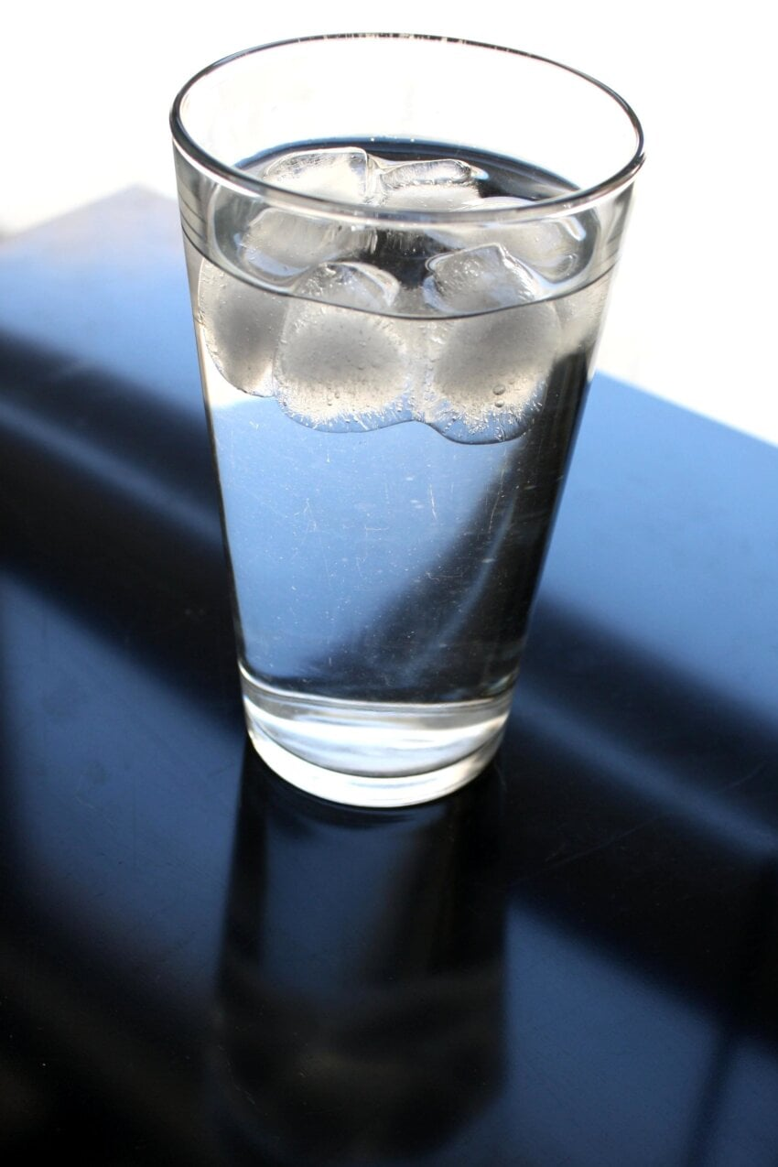
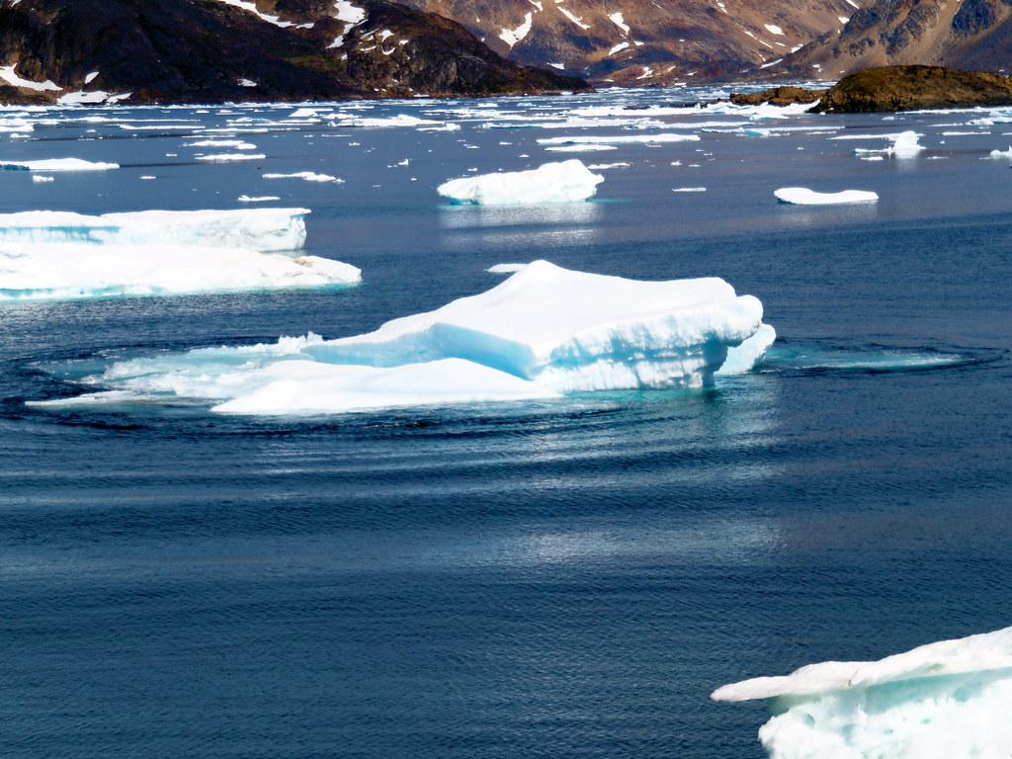
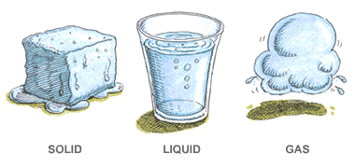
WATER CYCLE: Molecules in Motion
Whole Body Simulation
Students get to become water molecules and participate in a full-body activity to see how heat affects movement of molecules.
Notes:
You can also do this activity in the classroom and have the students change states according to the speed of music – with the music representing heat energy.
In this activity students become water molecules and start as water in a gas form (students move freely and quickly, waving hands and wiggling fingers). Over time some heat energy is lost and they now become liquid. As a liquid they begin bonding with other molecules and letting go (do this by putting a hand on a neighbor’s shoulder and letting go and then moving on to another). More heat is lost and they become slower and slower as the temperature drops and now they get very close together (like we observed the cold water in the vial did). But when water gets cold enough it does an amazing thing… what happens? It freezes and becomes a solid and expands into ice. As ice water molecules stay bonded making crystal hexagonal structure (have students in groups of 6 put a hand on shoulders and stiffen their arms).
Now that you are ice are you closer together or farther apart, then when you were a cold liquid? Farther apart… so what would happen if we put ice in room temperature water? What does the ice do? It floats! Water molecules turn solid in ice form and spread out creating more space making them float… this is very important to the water cycle that ice floats. If the water at the bottom of lake froze first then all the fish would die…

Slide 40

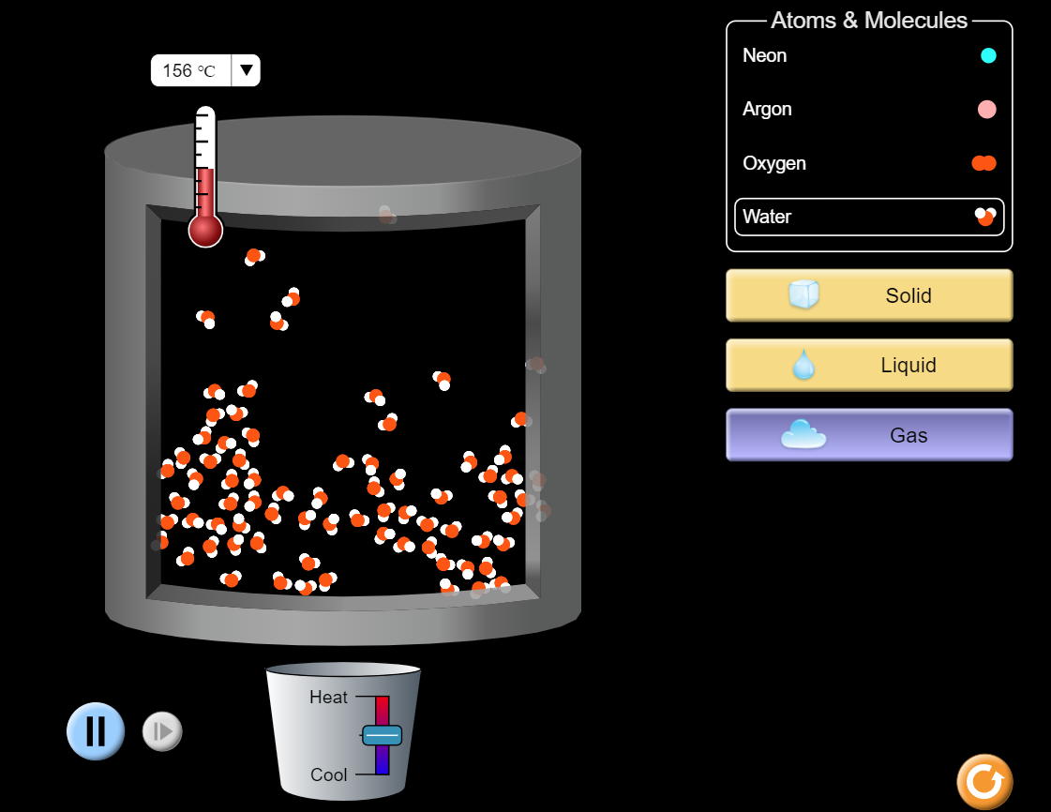
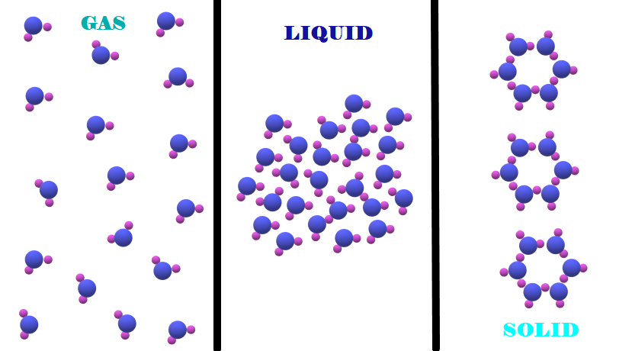
WATERCYCLE: Molecules in Motion
Water Molecule Simulation
https://phet.colorado.edu/sims/html/states-of-matter-basics/latest/states-of-matter-basics_en.html
Notes:
See the hexagon shape of water when it turns to ice and is a solid state.
You can also use this online simulation to so your students can see molecules in motion in another way. So you can play the game outdoors or indoors, and then you can use this model. Select States of Matter, select water, and then you can heat it up and cool it down to see the molecules move accordingly.

Slide 41
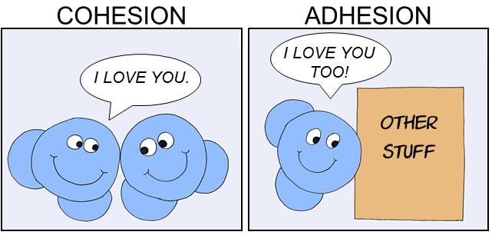
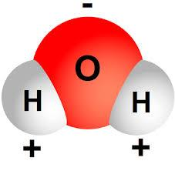
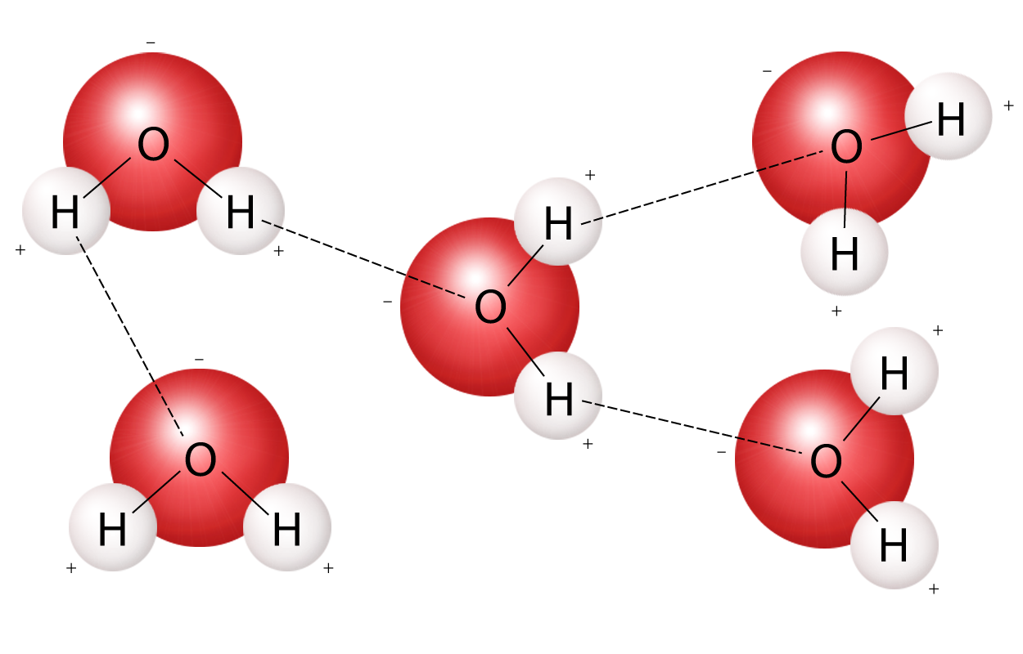
Water has unique and complex physical and chemical characteristics.
Nature of Water:
    Two hydrogens and one oxygen atom
    The polar or "sticky" nature of water allows for cohesion and adhesion.
Notes:
It is these unique characteristics that make water so special and important.
More precisely, the positive and negative charges of the hydrogen and oxygen atoms that make up water molecules makes them attracted to each other. In a water molecule, the two hydrogen atoms align themselves along one side of the oxygen atom, with the result being that the oxygen side has a partial negative charge and the side with the hydrogen atoms has a partial positive charge. Thus when the positive side on one water molecule comes near the negative side of another water molecule, they attract each other and form a bond.
Cohesion is when water molecules stick to other water molecules. This is how water droplets form, and eventual rivers, lakes, streams, and even oceans.
Adhesions is when water molecules stick to other molecules and surfaces. Any easy example of this is water droplets sticking to the side of a glass when enjoying a beverage. Clouds form when water molecules stick to dust and other particles in the air.
Adhesion and cohesion are water properties that affect every water molecule on Earth and also the interaction of water molecules with molecules of other substances. Essentially, cohesion and adhesion are the "stickiness" that water molecules have for each other and for other substances.

Slide 42
Wrap-Up
LESSON 1.2
When we add or subtract heat to water, it changes, and that is important!
    What heat source drives the water cycle again?
Cause and Effect
&
Energy and Matter
Notes:
Make sure you have your students add the sun on water cycle diagram and label as the heat source!

